Slide 1
DEEP LEARNING STUDY PROJECT
SMS Spam Detection using Recurrent Neural Networks
Classifying SMS messages as spam or ham with an Embedding → GRU → Dense → Sigmoid network in TensorFlow/Keras
Name of the Student | 23EG110XXX | CSE(DS)
Under the guidance of Dr P Rajeshwari
Department of CSE (Data Science), Anurag University
Notes:
Title slide. Replace the student name and roll number placeholders before presenting.

Slide 2
Problem Statement
SMS spam (fake prizes, premium-rate numbers, phishing links) is a daily nuisance and a security risk
Keyword filters are easy to bypass when spammers change their wording
Goal: learn spam patterns from real labelled messages with a Recurrent Neural Network
Output: a model that labels any SMS as SPAM or HAM, plus a prediction script
Targets: test accuracy ≥ 95% and spam F1-score ≥ 0.90
SPAM
“Free entry in 2 a wkly comp to win FA Cup final tkts 21st May 2005. Text FA to 87121 to receive entry question…”
HAM
“Ok lar... Joking wif u oni...”
Real examples from the UCI SMS Spam Collection
Notes:
Spam is a binary text-classification problem: every message is either spam or ham.

Slide 3
Dataset Used
5,574
4,827
747
SMS messages – UCI SMS Spam Collection
ham (legitimate) – 86.6%
spam – 13.4% (imbalanced)
Preprocessing
Lowercase; URLs, e-mails, currency and numbers → placeholder words
Remove punctuation, tokenize (5,000-word vocabulary)
Pad / truncate to 50 tokens (covers 98.7% of messages)
Class weights to handle the imbalance
Stratified split (70 / 15 / 15)
Split | Messages | Spam
Training | 3,901 | 523
Validation | 836 | 112
Test | 837 | 112
Tokenizer fitted on the training split only (no leakage)
Notes:
Downloaded automatically from the UCI Machine Learning Repository (Almeida & Gomez Hidalgo, 2011).

Slide 4
Model Architecture
Input
Embedding
GRU
Dense
Output
50 word ids
5,000 × 64
64 units, dropout 0.3
32 ReLU + dropout 0.3
1 unit, Sigmoid
shape (50)
shape (50, 64)
shape (64)
shape (32)
shape (1)
0 params
320,000 params
24,960 params
2,080 params
33 params
Spam probability ≥ 0.5 → SPAM, otherwise HAM
347,073 trainable parameters • the GRU reads the message word by word and its gates decide what to remember
Chosen from 6 attempts (SimpleRNN, LSTM, GRU) by the best validation F1-score
Notes:
Embedding -> recurrent layer -> Dense -> Sigmoid. The GRU is a gated recurrent layer; the best pure SimpleRNN reached 98.57% test accuracy (F1 0.9455).

Slide 5
Hyperparameters
Hyperparameter | Value
Vocabulary size / sequence length | 5,000 words / 50 tokens
Embedding dimension | 64
Recurrent layer | GRU, 64 units
Dense layer | 32 units, ReLU
Dropout | 0.3
Optimizer | Adam, lr 0.001, clipnorm 1.0
Loss | Binary cross-entropy
Batch size | 32
Epochs | max 40 → stopped at 9, best epoch 4
Early stopping | val_loss, patience 5, restore best
Class weights (ham / spam) | 0.577 / 1.865
How it was tuned
Baseline SimpleRNN overfitted (100% train accuracy, rising val loss)
Added dropout and early stopping
Lower learning rate and gradient clipping
Tried LSTM and GRU cells
Softened the spam class weight
Best model picked on validation data, not test
Notes:
Six training runs in total; the full results table is in NOTES.md.

Slide 6
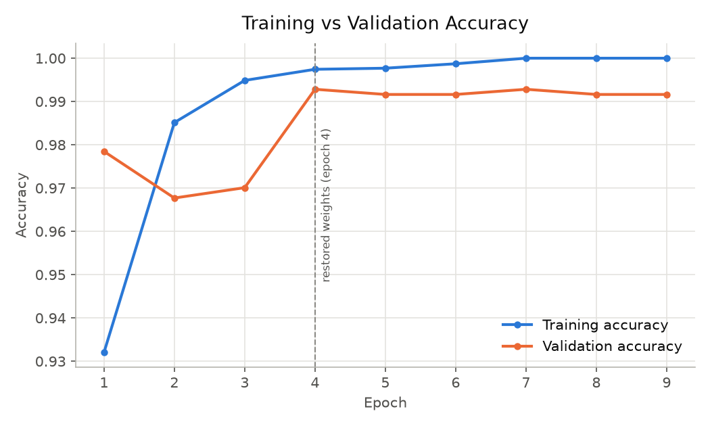
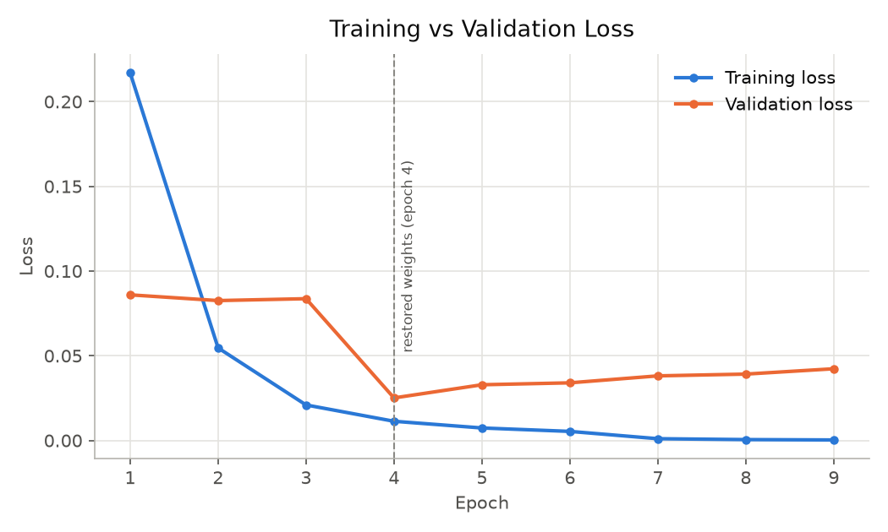
Results: Accuracy and Loss
Dashed line: weights from epoch 4 restored by early stopping
Validation loss rises after epoch 4: early stopping prevents overfitting
99.04%
0.9906
0.9375
0.9633
Test accuracy
Precision (spam)
Recall (spam)
F1-score (spam)
Notes:
Weights from epoch 4 were restored by early stopping (dashed line). After that the training loss keeps falling while the validation loss rises, which is overfitting. Test confusion matrix: TN 724, FP 1, FN 7, TP 105.

Slide 7
Conclusion
The RNN (GRU) model detects SMS spam with 99.04% test accuracy and spam F1 0.9633
Only 1 of 725 legitimate messages was wrongly flagged; 105 of 112 spam caught
Class weights, dropout and early stopping fixed the baseline's overfitting
The prediction script labelled 8 of 8 new test messages correctly
Future work: larger multilingual data, pre-trained embeddings, mobile / web deployment
99.04%
test accuracy (837 messages)
0.9633
spam F1-score (target 0.90)
Notes:
All numbers come from the final run recorded in NOTES.md.

