Slide 1

TEXT SUMMARIZER USING DEEP LEARNING Project Presentation Date: 06/05/2023
Project Lab (IAI-851)
Degree : Bachelor of Technology CSE-AI (I-Nurture)
Project Guide:
Mr. Sudhanshu Kumar
Anshika Gupta (TCA1960003)
Shivansh Sharma (TCA1960001)
FACULTY OF ENGINEERING & COMPUTING SCIENCES
TEERTHANKER MAHAVEER UNIVERSITY, MORADABAD

Slide 2

Team Details
Student Name | Role
ANSHIKA GUPTA | IMPLEMENTATION
SHIVANSH SHARMA | ANALYSIS
2
T011A/ Template Version 5.0

Slide 3
Project Brief
In the modern Internet age, textual data is ever increasing. Need some way to condense this data while preserving the information and meaning. We need to summarize textual data for that.
Text summarization is the process of automatically generating natural language summaries from an input document while retaining the important points.
It would help in easy and fast retrieval of information.
Text summarization can help users quickly grasp the essence and context of the data, and identify the most important or interesting aspects.
3
T011A/ Template Version 5.0

Slide 4
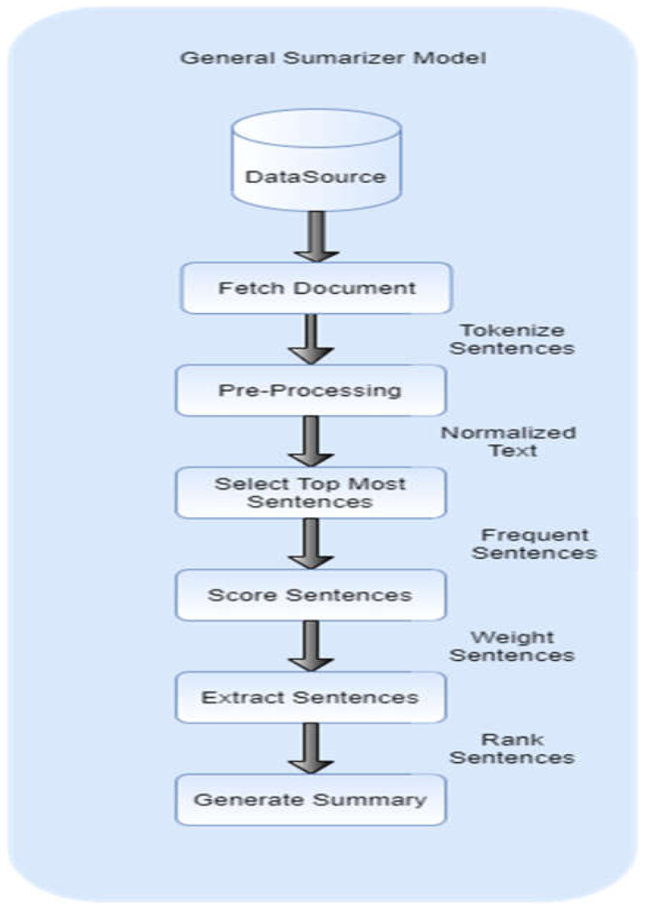
Methodologies/ Technologies/ Tools to be used
4
T011A/ Template Version 5.0

Slide 5
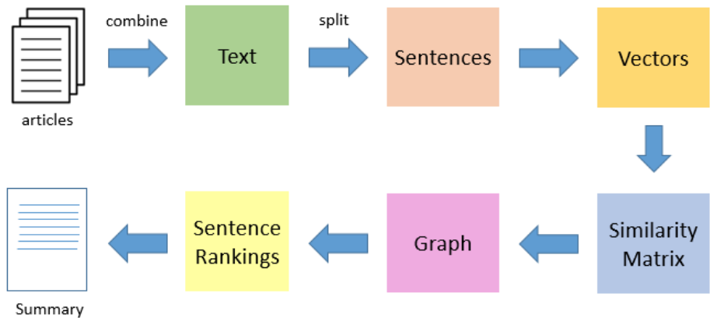
Context Diagram (Overall Project)
5
T011A/ Template Version 5.0

Slide 6
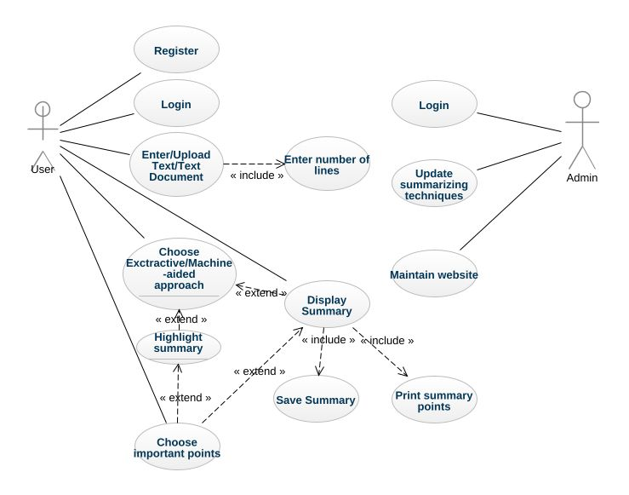
Entity Relationship Diagram (ERD)
6
T011A/ Template Version 5.0

Slide 7
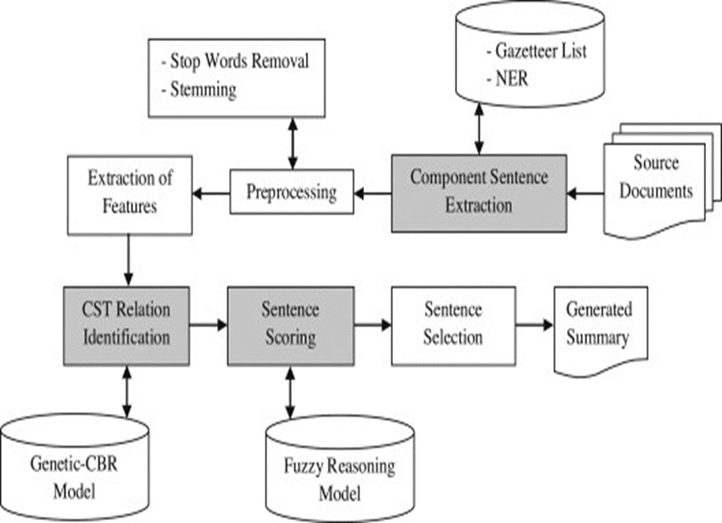
Data Flow Diagram (DFD)
7
T011A/ Template Version 5.0

Slide 8
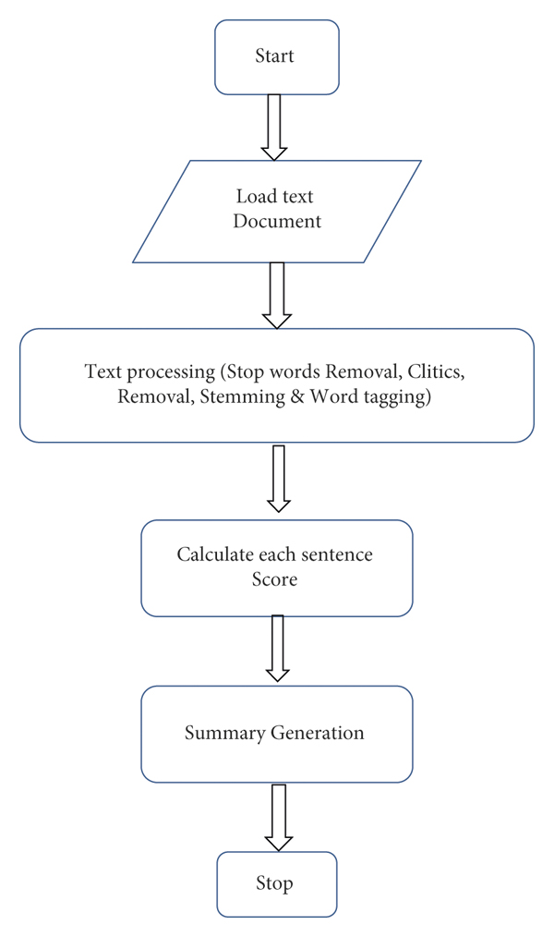
Flow Chart
8
T011A/ Template Version 5.0

Slide 9
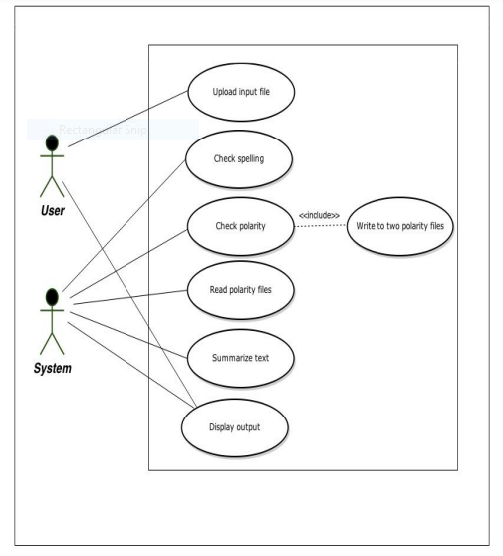
Use Case Diagram
9
T011A/ Template Version 5.0

Slide 10
\
Advantage of The Project
Summarizing reduces perusing time
While investigating reports, outlines make the determination procedure simpler
Summarization improves the adequacy of ordering
Summarization calculations are less one-sided than human summarizers
Personalized summaries are useful in question-answering systems as they provide personalized information
This can improve the efficiency and productivity of data analysis, as well as the communication and presentation of the results.
10
T011A/ Template Version 5.0

Slide 11
References, if any
https://www.kdnuggets.com/2019/01/approaches-text-summarization-overview.html
https://research.ijcaonline.org/volume97/number3/pxc3897087.pdf
https://www.analyticsvidhya.com/blog/2019/06/comprehensive-guide-text-summarization-using-deep-learning-python/
https://data-flair.training/blogs/machine-learning-text-summarization/
11
T011A/ Template Version 5.0

Slide 12
THANKS

