Slide 1
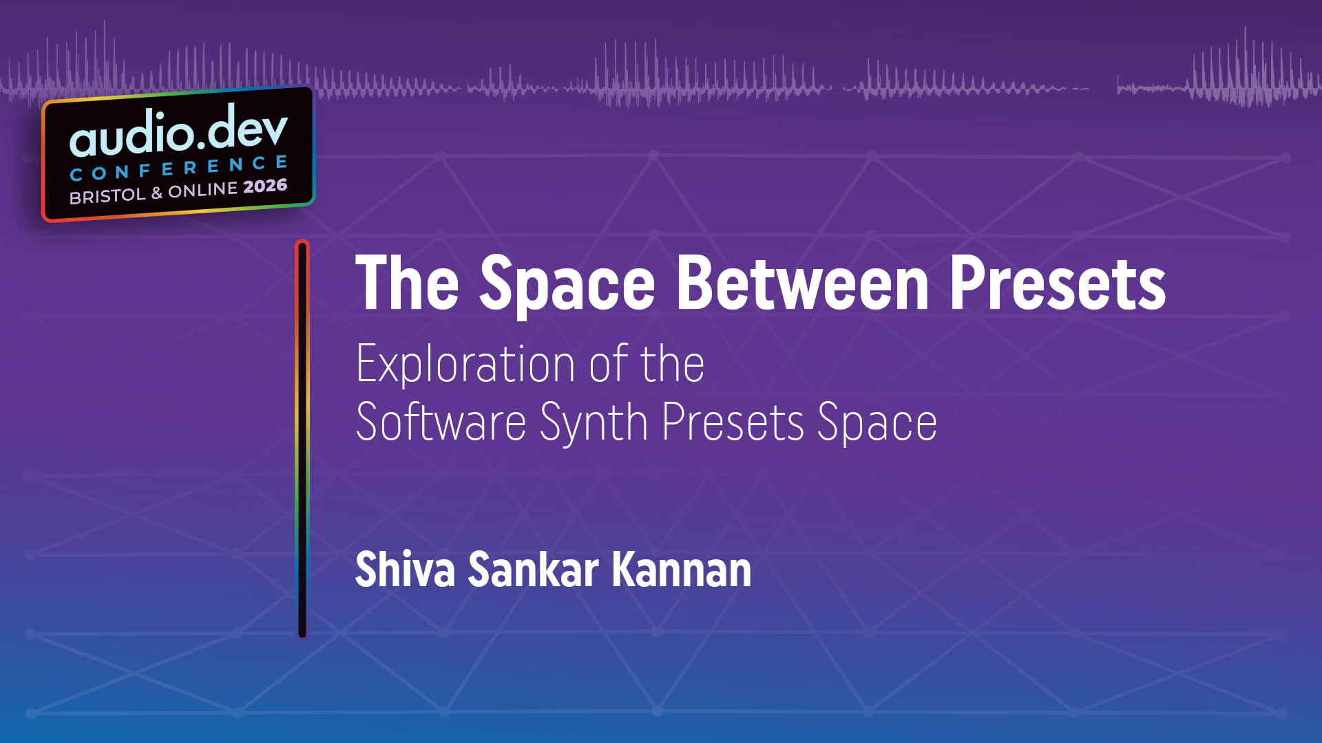

Slide 2
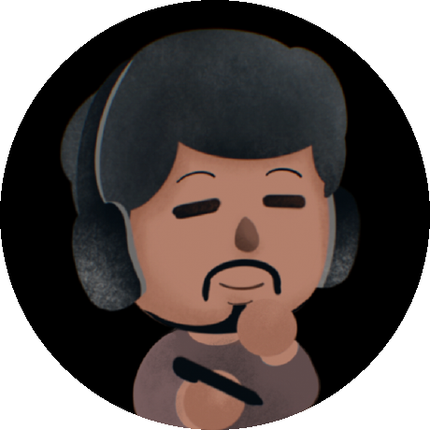

Who I am
2016
2019

Slide 3

Who I am
2016
2019
2021

Slide 4

Who I am
2016
2019
2021
now

Slide 5

Learning synths
Knobs first

Slide 6

Learning synths
Knobs first
Presets first

Slide 7

Learning synths
Knobs first
Presets first
Tutorials first

Slide 8

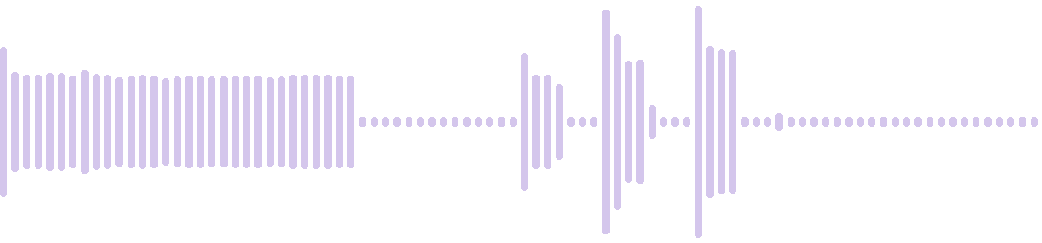
How I learn synths
Mid Key Squeal
Asymptote
Saw Difference Brass
LD Switch LFO Squelch 2
BASS Broken Circuit
Revokoto

Slide 9
How I learn synths
Mid Key Squeal
Asymptote
Saw Difference Brass
LD Switch LFO Squelch 2
BASS Broken Circuit
Revokoto

Slide 10
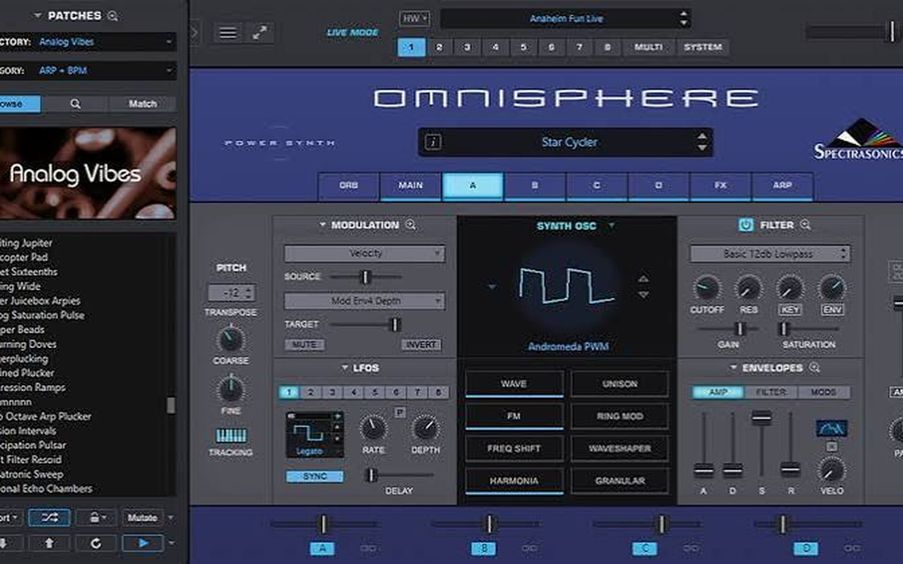
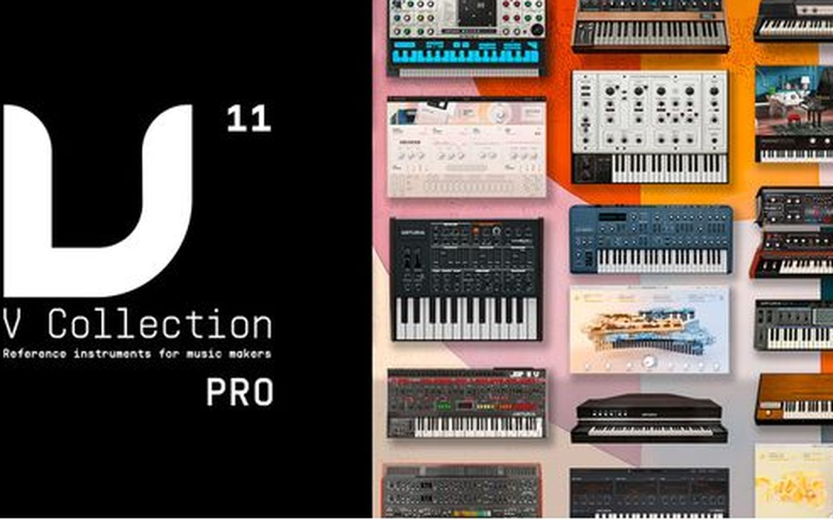
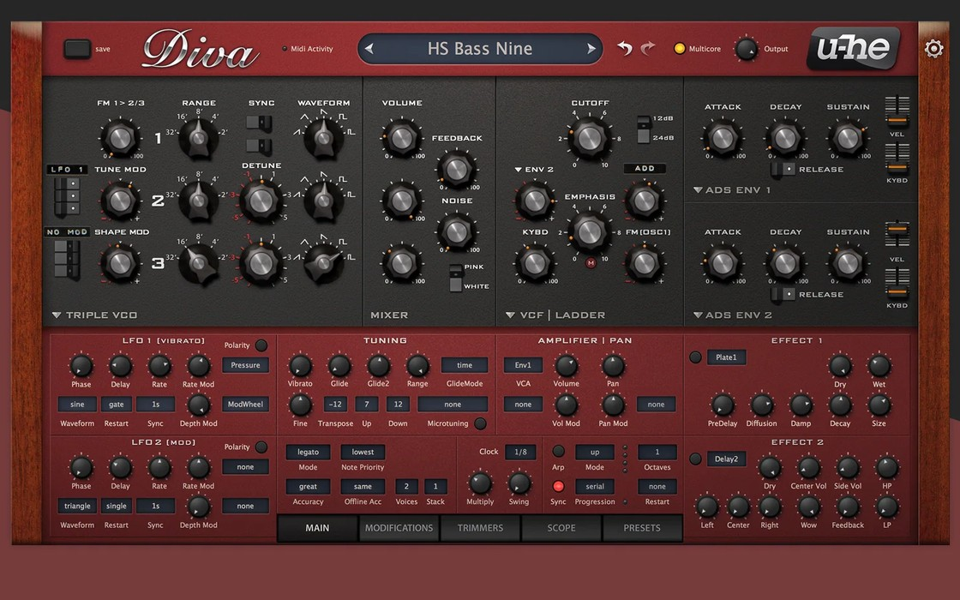
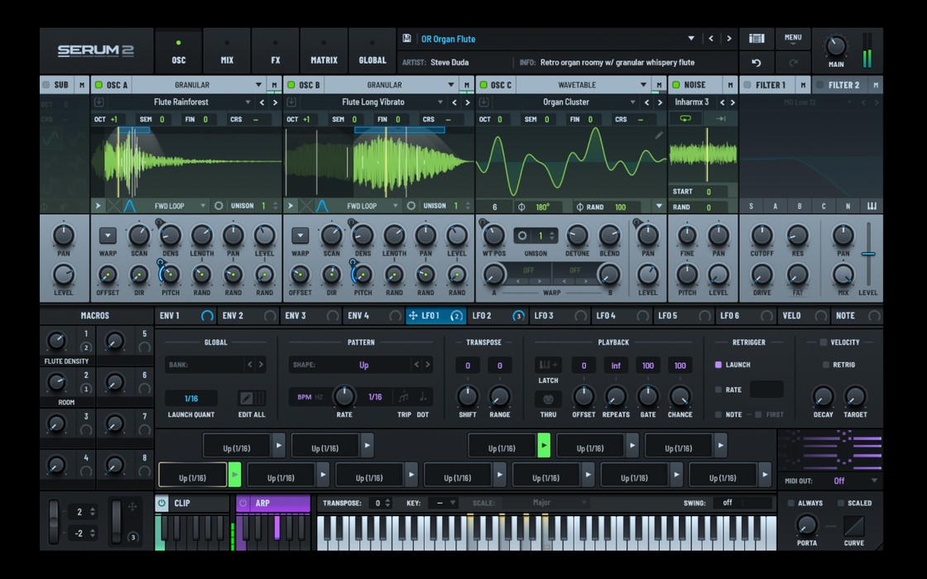
Preset libraries run to thousands of sounds
26,000+
12,000+
1,200
~600
Omnisphere 3
V Collection Pro
Diva
Serum 2

Slide 11
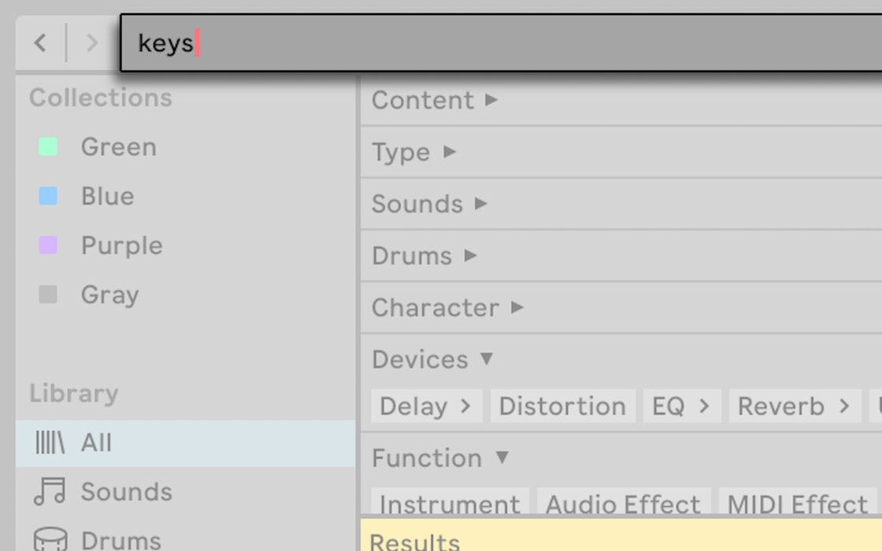
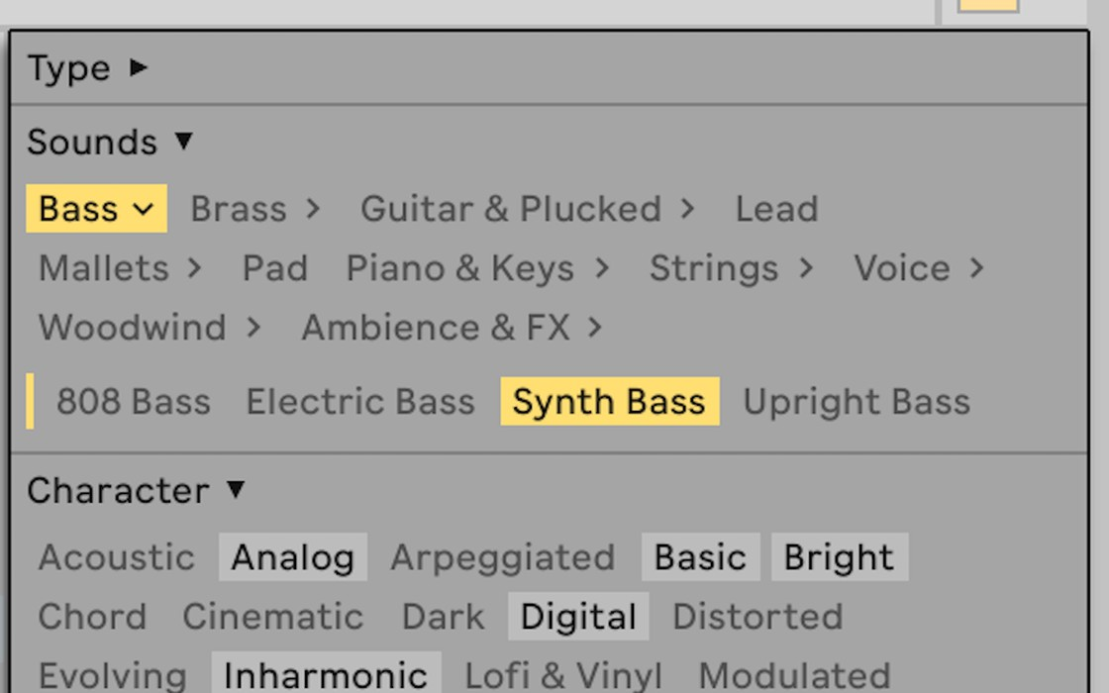
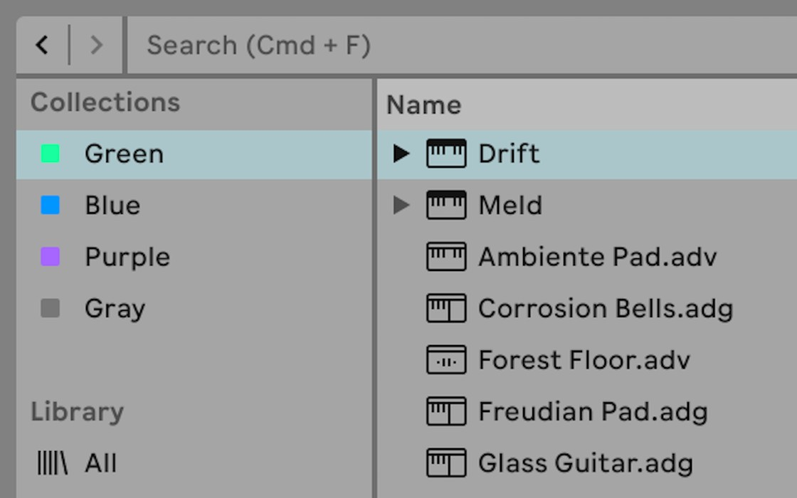
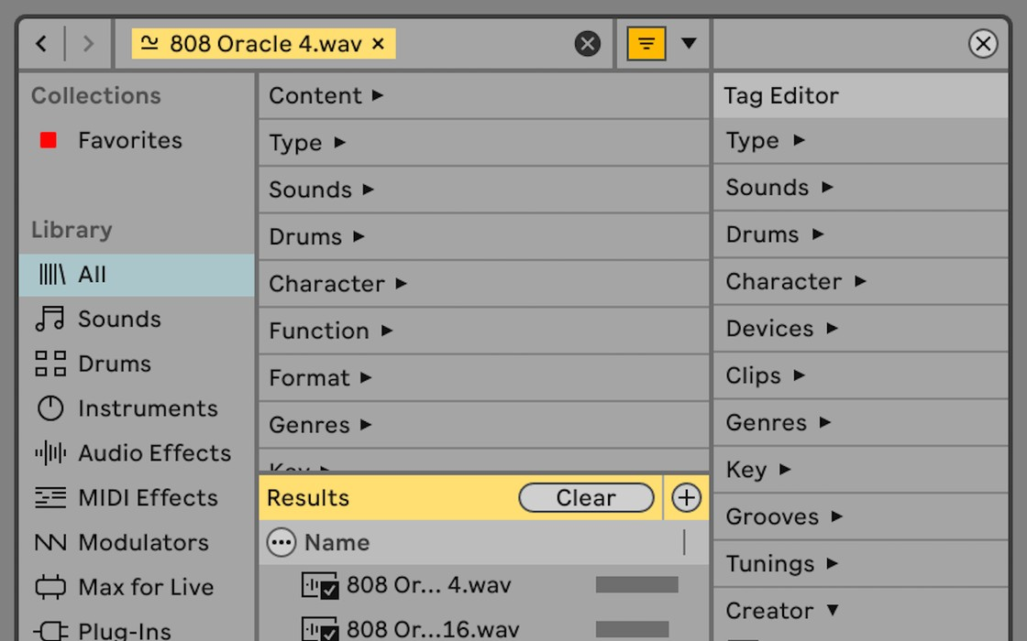
Preset search today
Search by name
Filter by tags
Favourites
Similar sounds
Screenshots: Ableton Live 12 manual

Slide 12
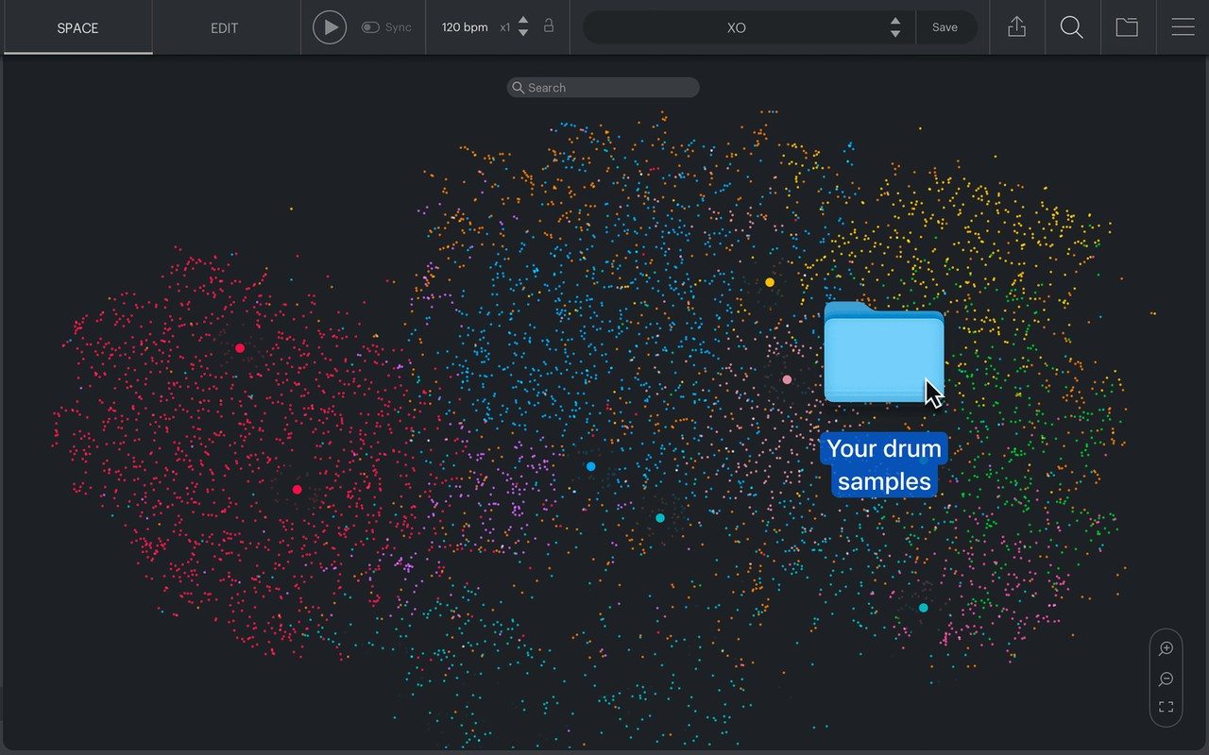
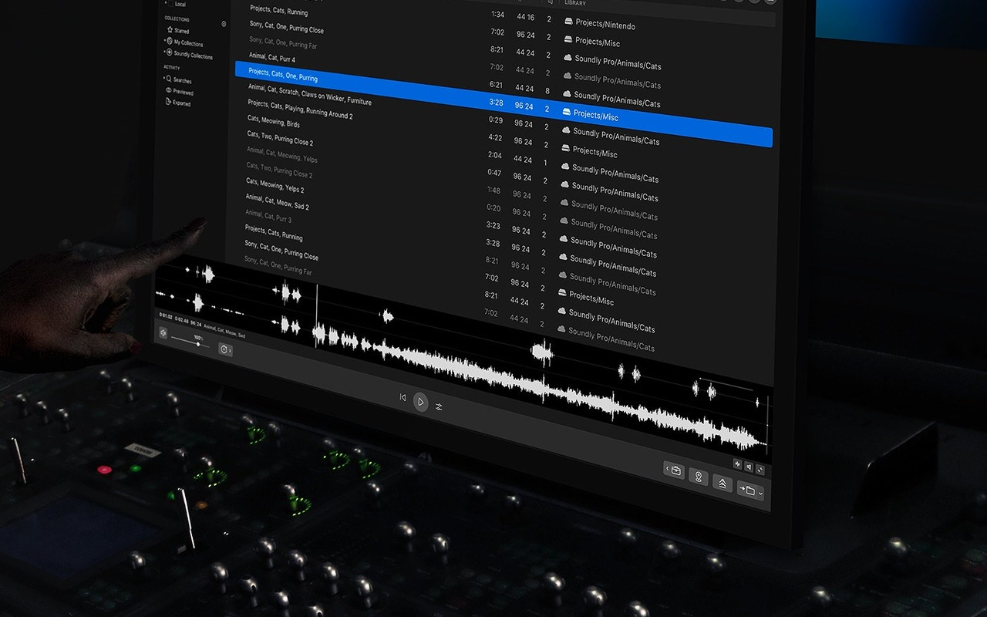
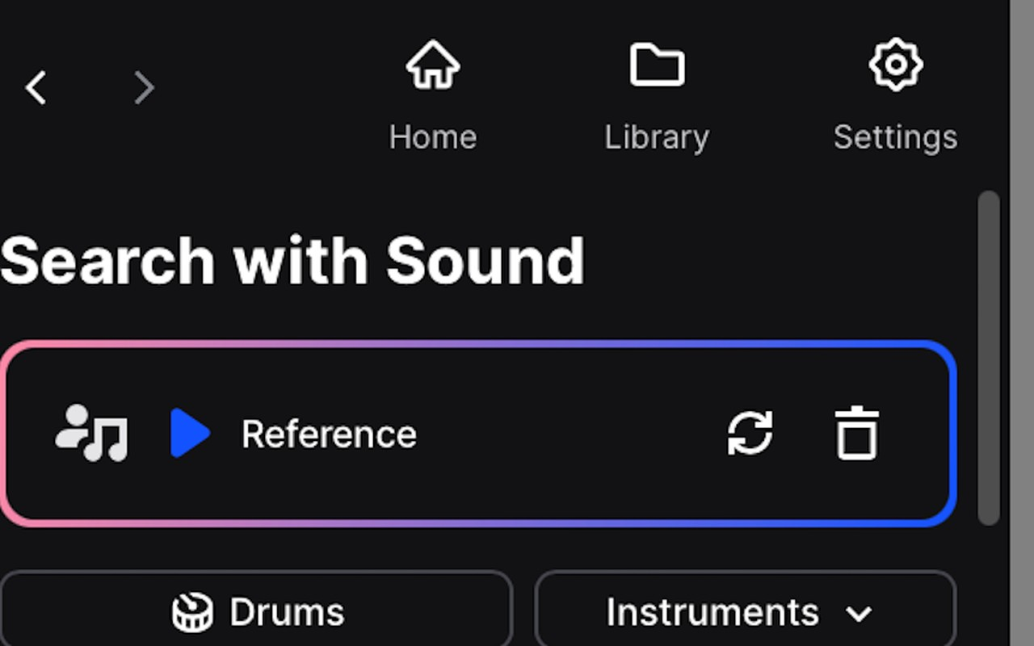
Techniques we could borrow
XLN XO
Soundly
Splice
a map of similar sounds
describe a sound
search with a sound
SynthScribe: Brade et al., IUI 2024
Images: xlnaudio.com, getsoundly.com, Ableton Live 12 manual

Slide 13

Cosine Similarity
Animations: Manim Community Edition

Slide 14
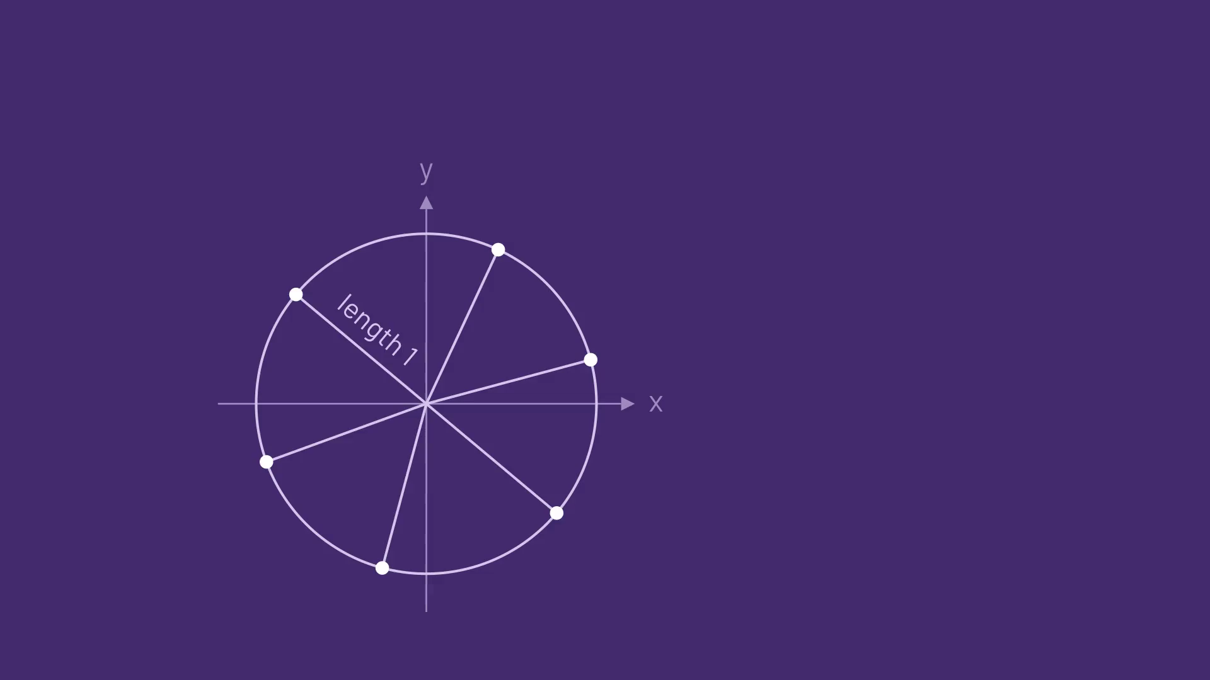
Cosine Similarity
Animations: Manim Community Edition

Slide 15
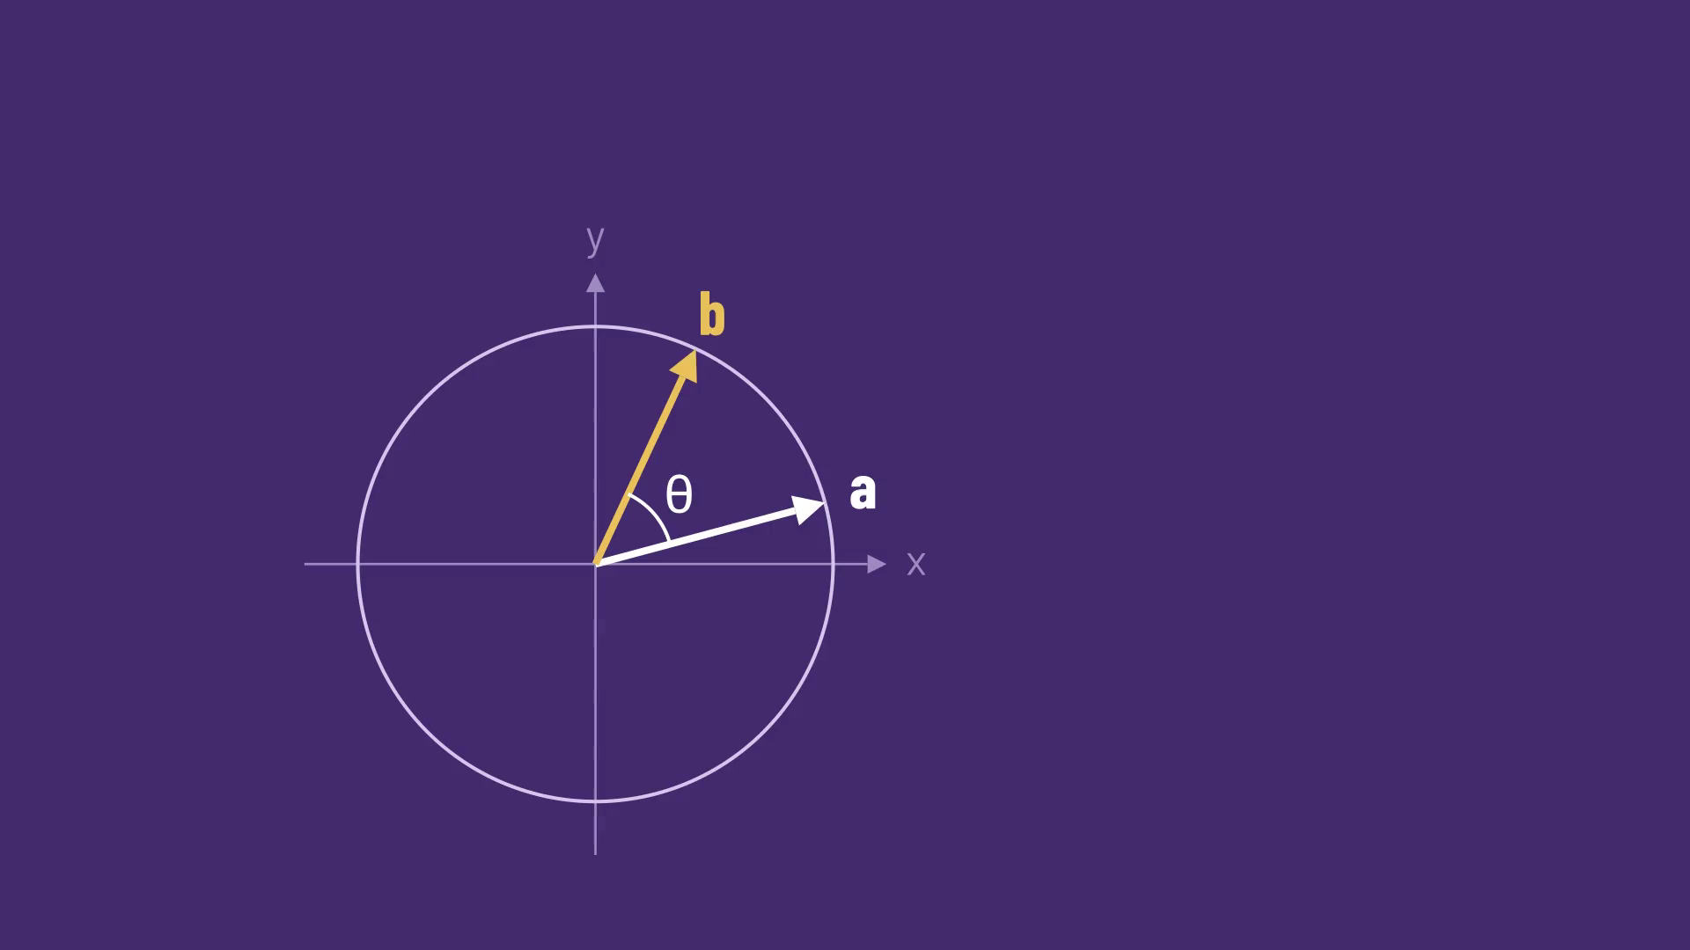
Cosine Similarity
Animations: Manim Community Edition

Slide 16
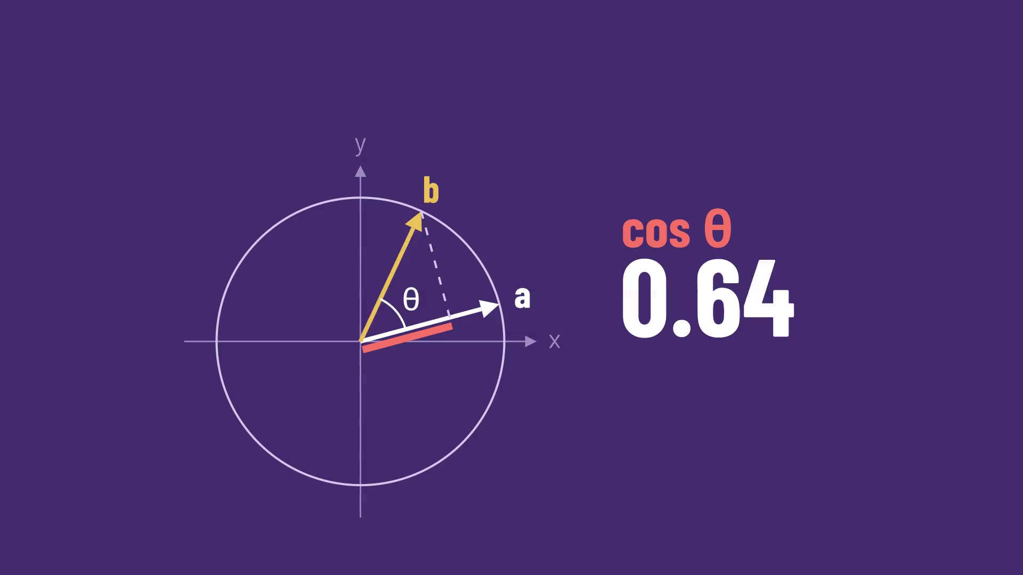
Cosine Similarity
Animations: Manim Community Edition

Slide 17
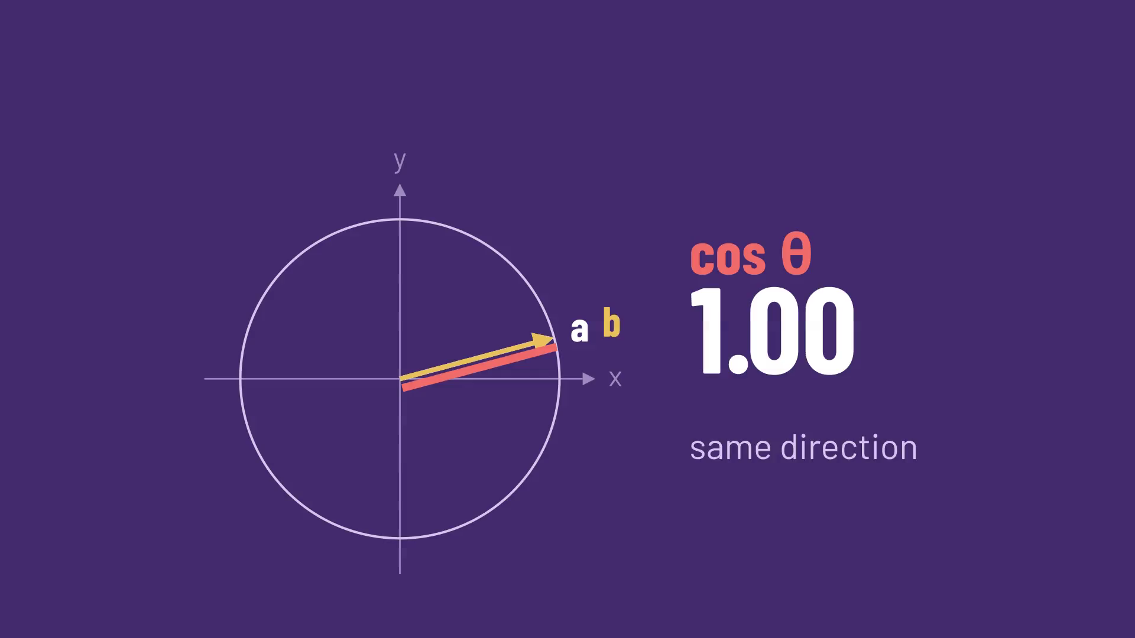
Cosine Similarity
Animations: Manim Community Edition

Slide 18
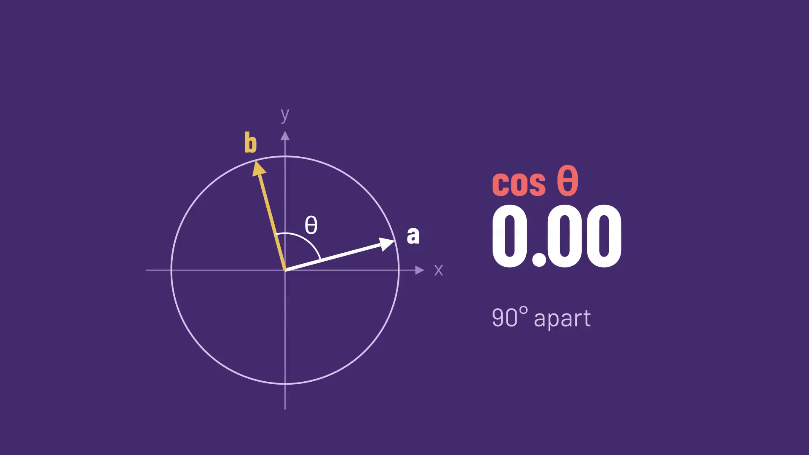
Cosine Similarity
Animations: Manim Community Edition

Slide 19
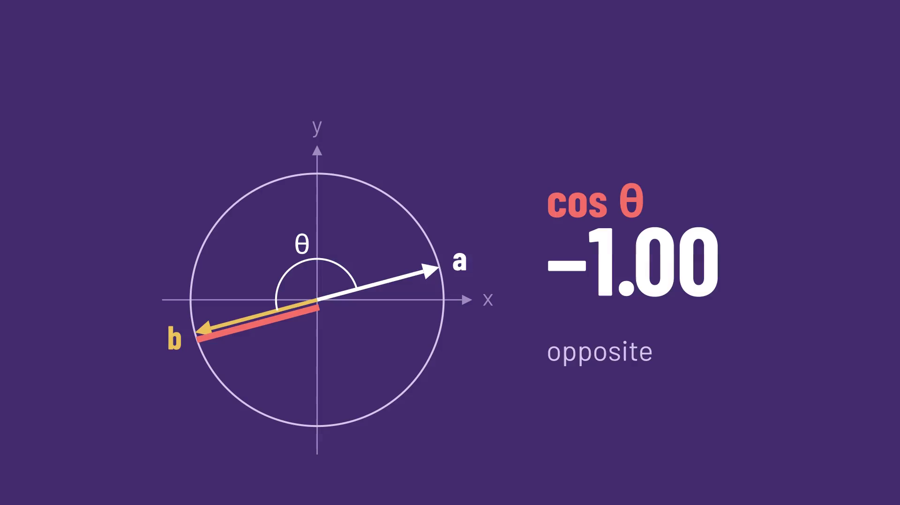
Cosine Similarity
Animations: Manim Community Edition

Slide 20
CLAP puts text and audio in one space
Animations: Manim Community Edition

Slide 21
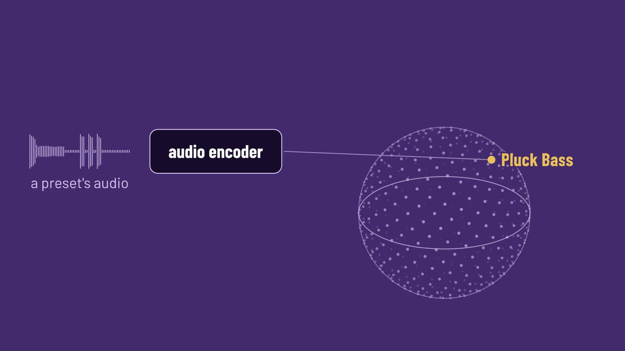
CLAP puts text and audio in one space
Animations: Manim Community Edition

Slide 22
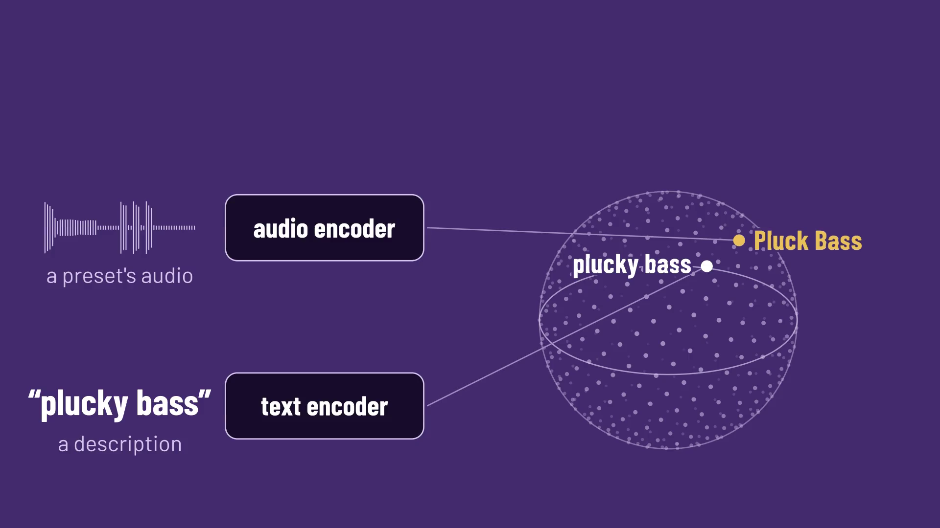
CLAP puts text and audio in one space
Animations: Manim Community Edition

Slide 23
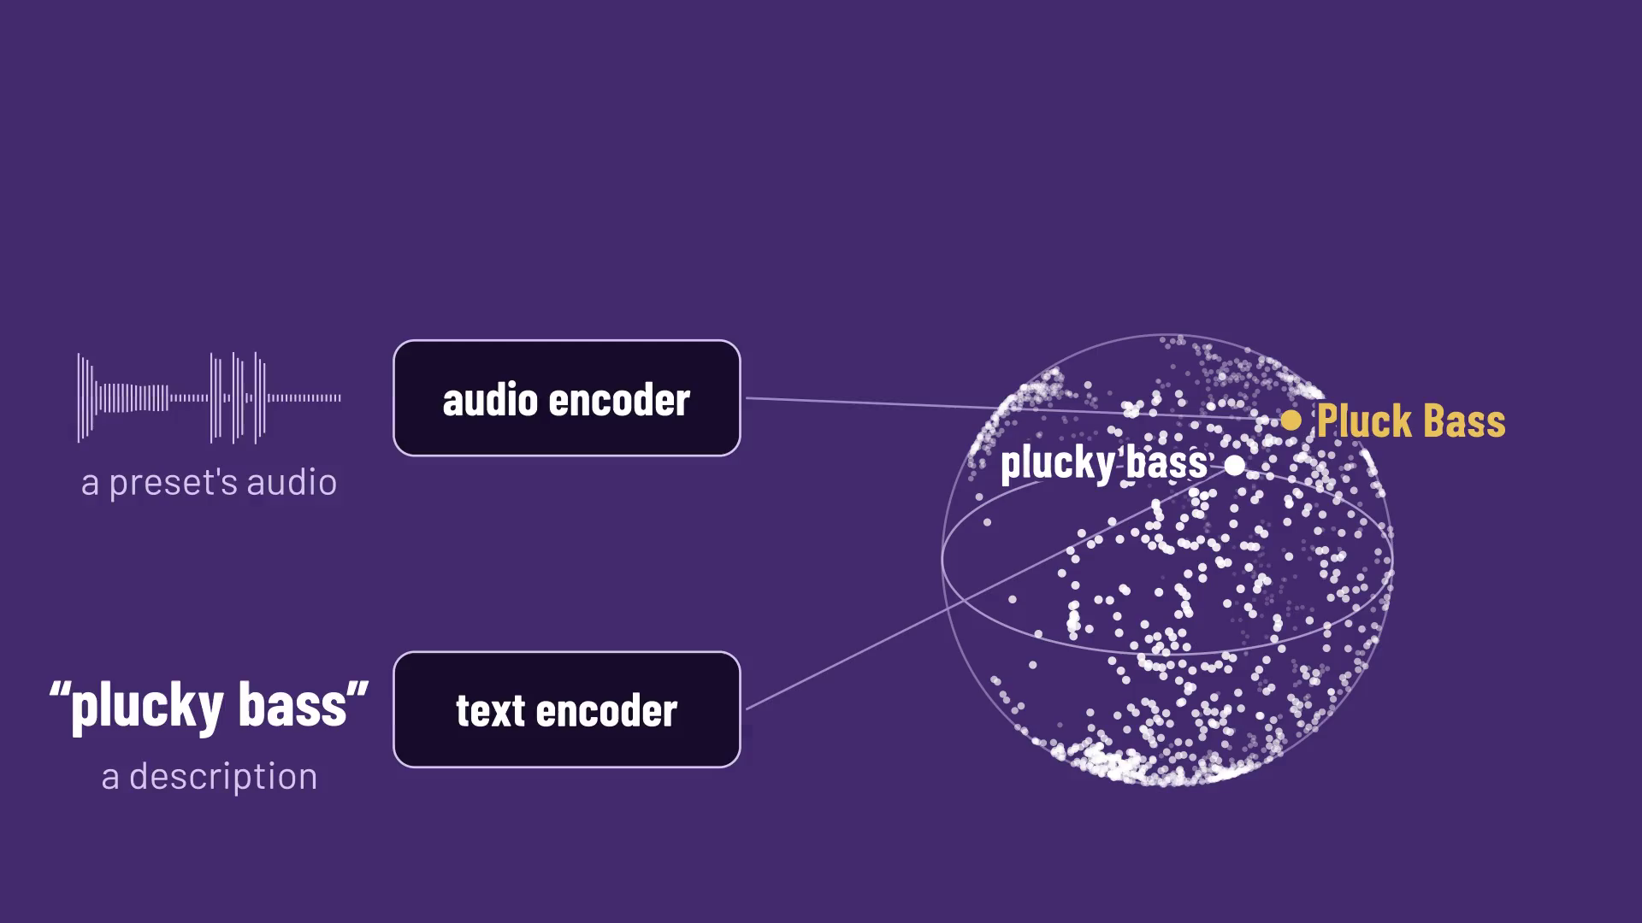
Getting presets out of plugins
Animations: Manim Community Edition

Slide 24
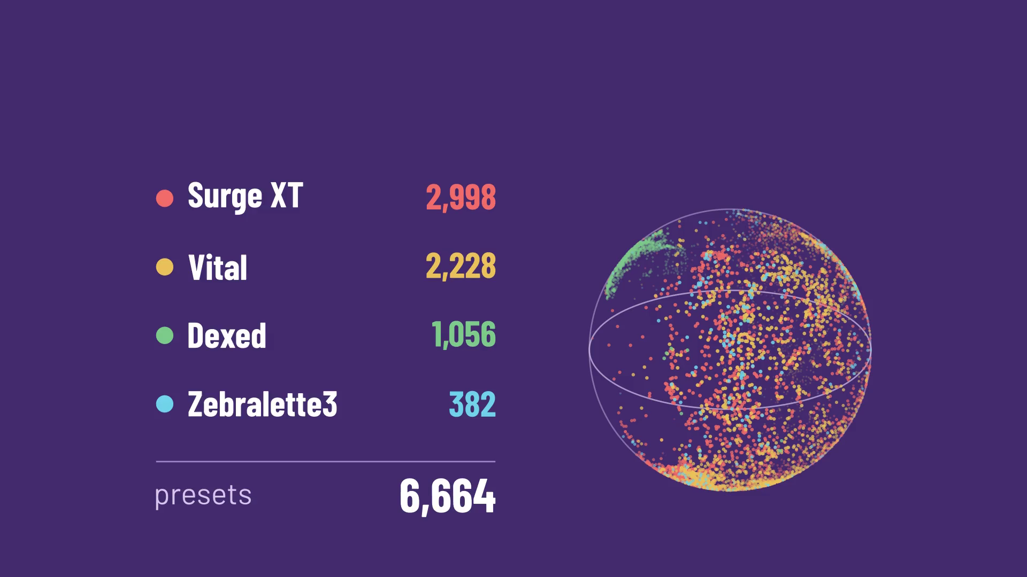
Getting presets out of plugins
Animations: Manim Community Edition

Slide 25
One preset, two renders
Animations: Manim Community Edition

Slide 26
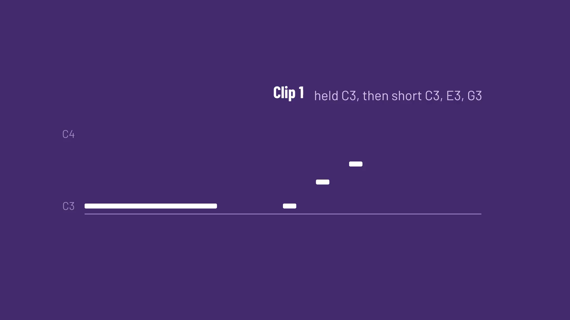
One preset, two renders
Animations: Manim Community Edition

Slide 27
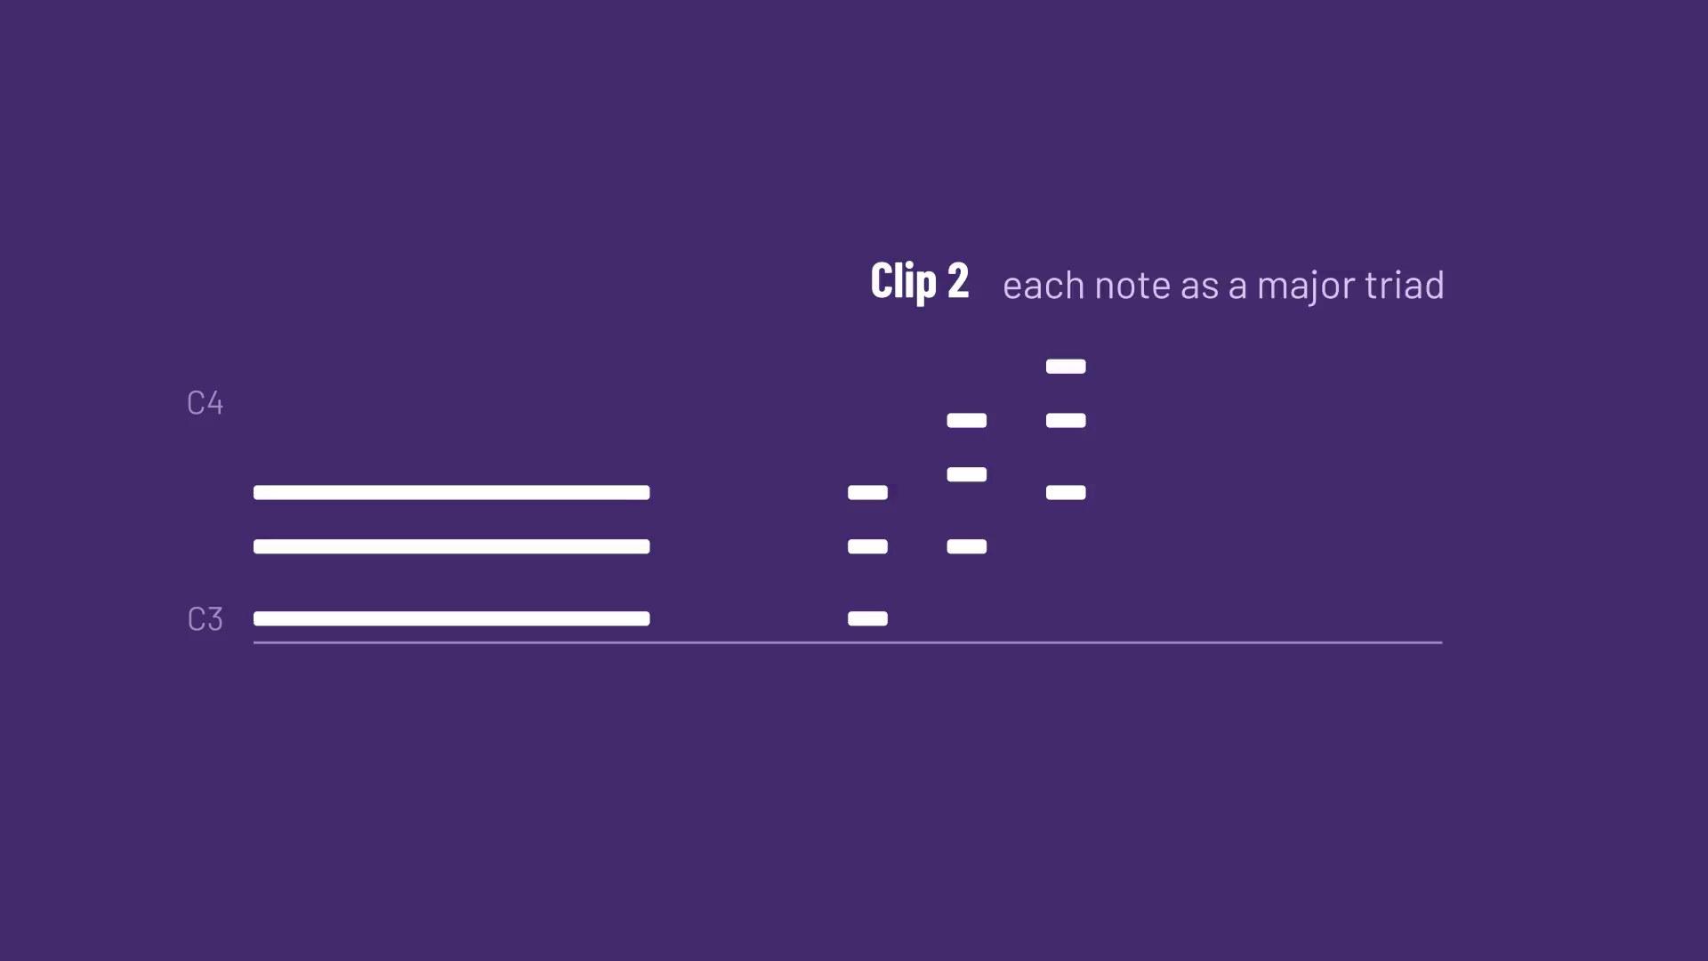
One preset, two renders
Animations: Manim Community Edition

Slide 28
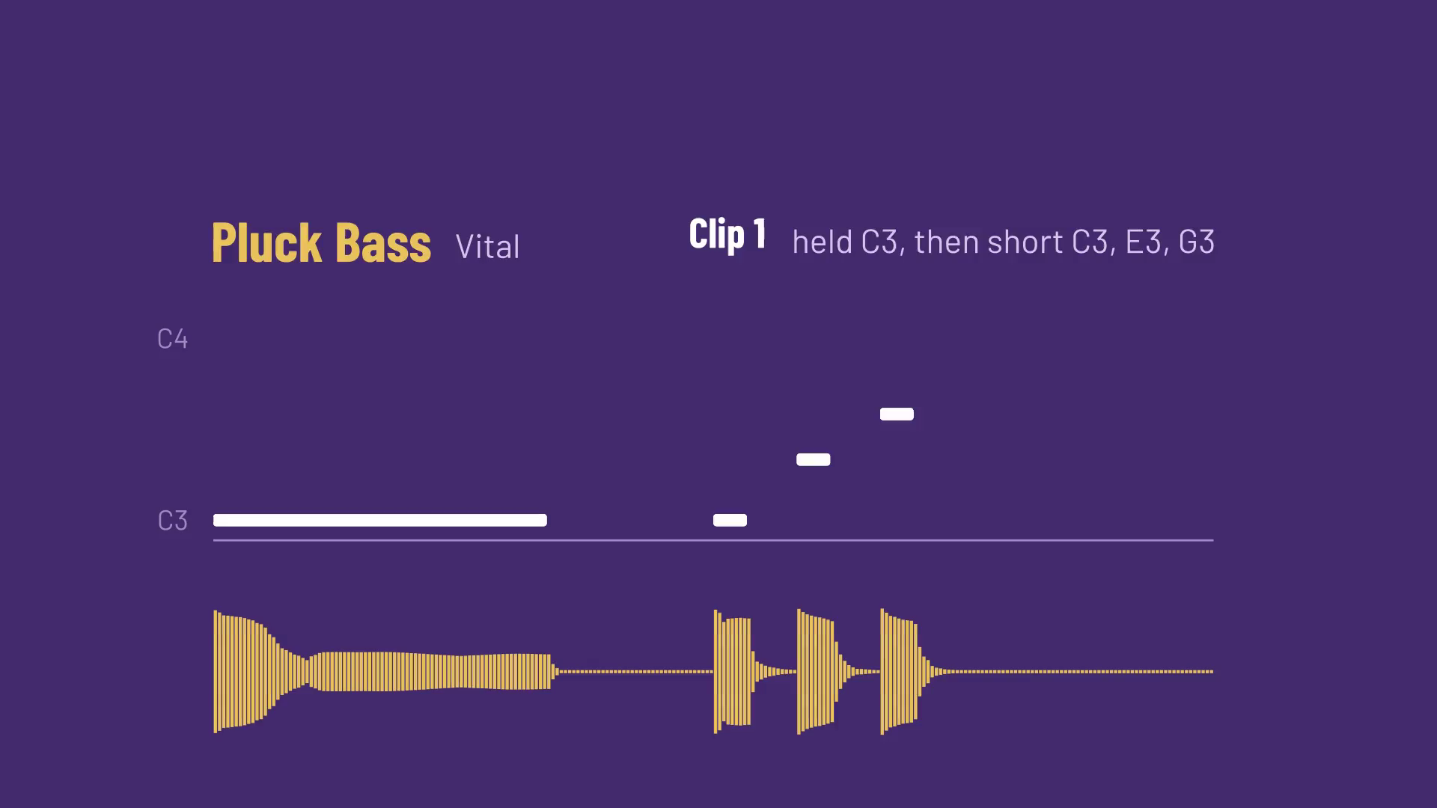
One preset, two renders
Animations: Manim Community Edition

Slide 29
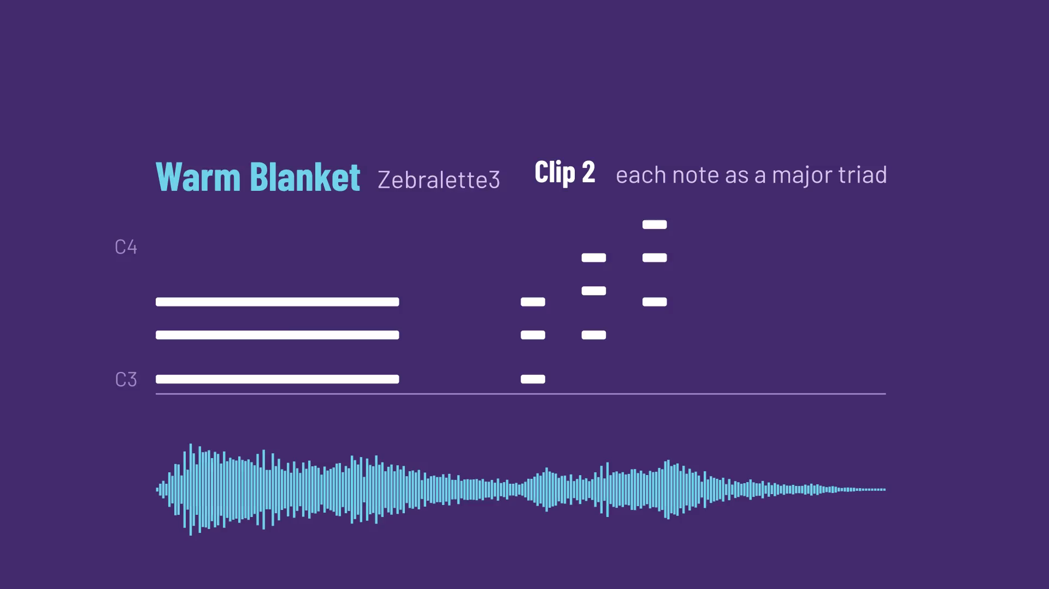
One preset, two renders
Animations: Manim Community Edition

Slide 30
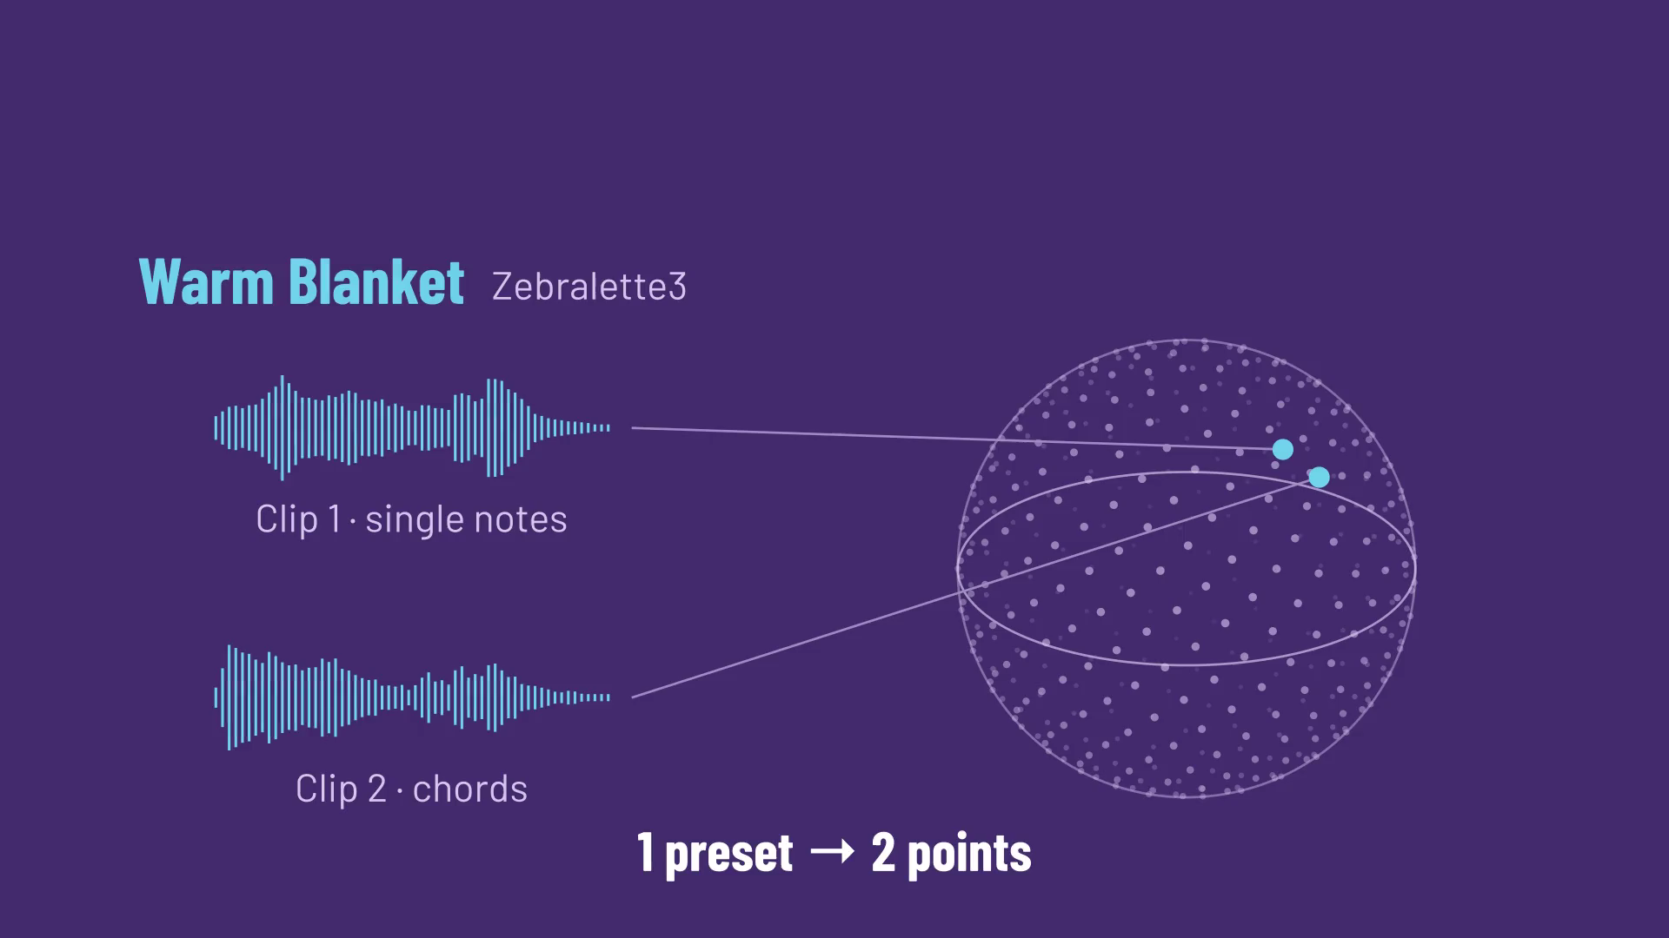
Search by sound or by words
The CLAP checkpoint was trained on LAION-Audio-630K (633,526 audio–text pairs), AudioSet and music. Source: LAION-CLAP README.
Animations: Manim Community Edition

Slide 31
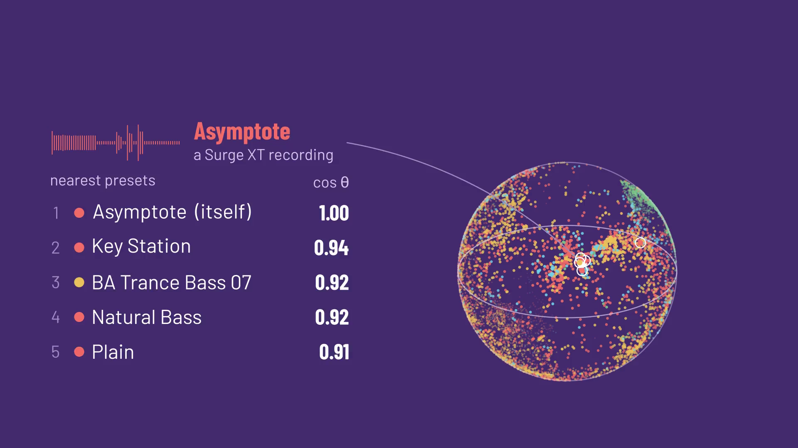
Search by sound or by words
The CLAP checkpoint was trained on LAION-Audio-630K (633,526 audio–text pairs), AudioSet and music. Source: LAION-CLAP README.
Animations: Manim Community Edition

Slide 32
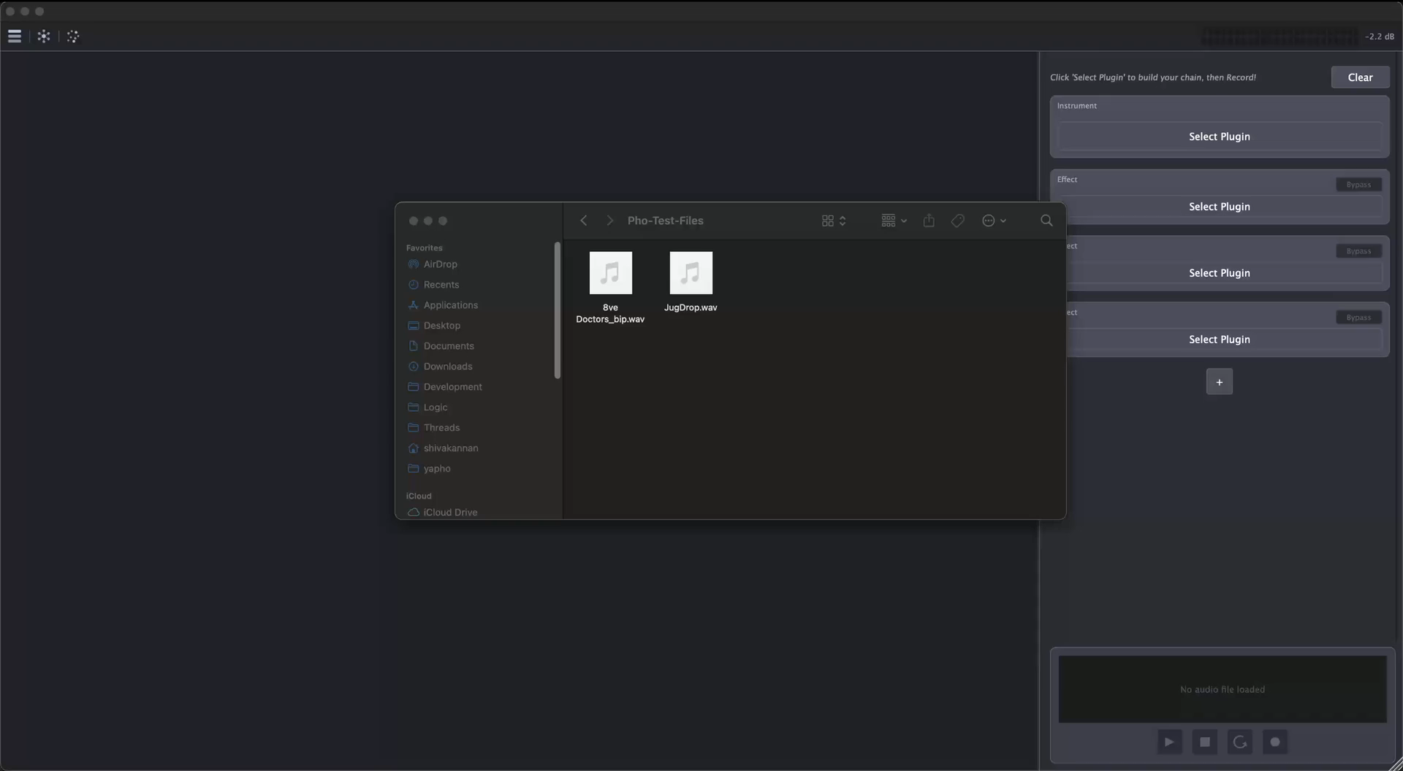
Demo: Sound Match and the Explorer

Slide 33
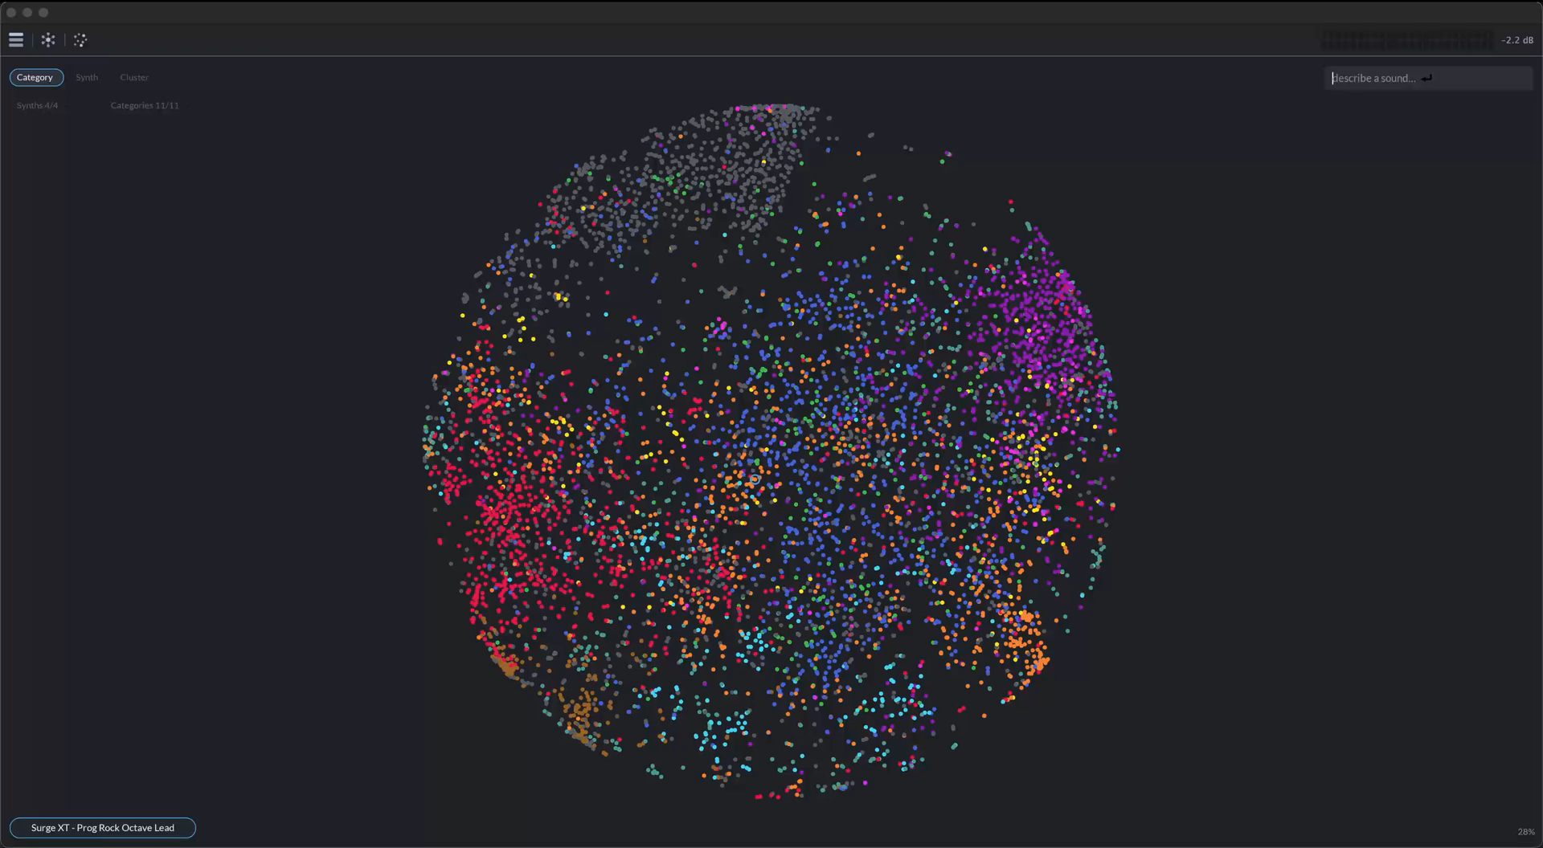
Demo: Explorer

Slide 34
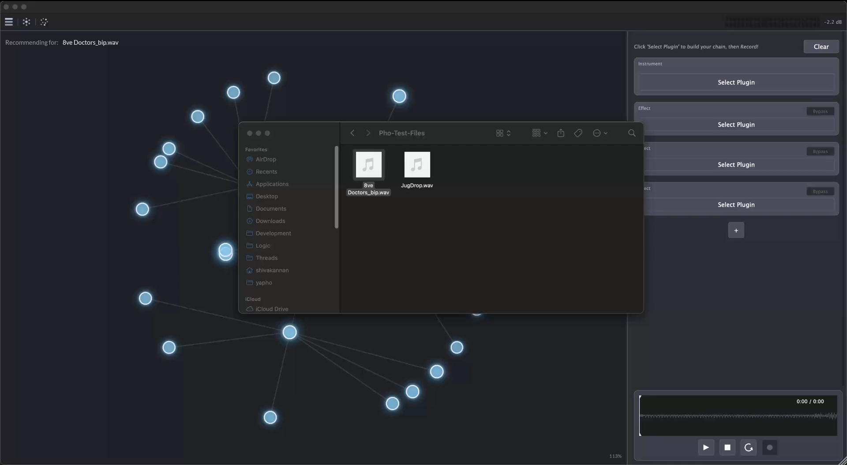
The space between presets

Slide 35
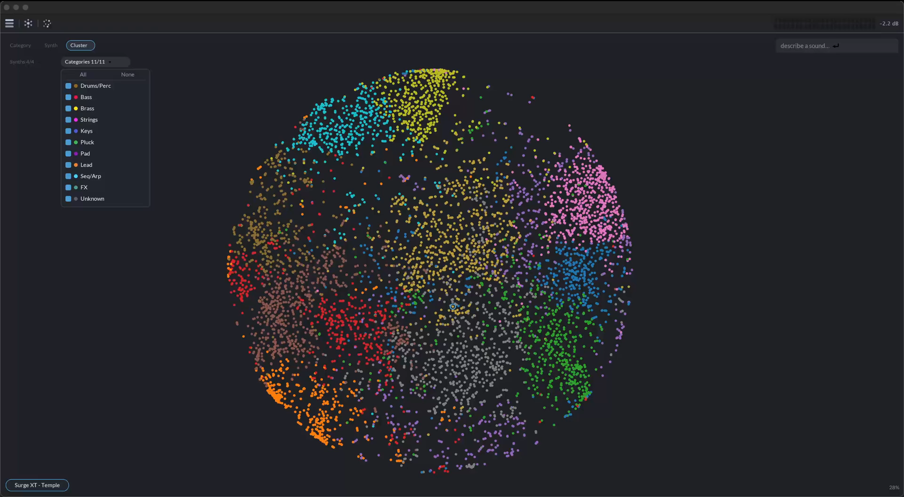
The space between presets

Slide 36
What developers and the community can do
PLUGIN DEVELOPERS
Preset discovery
The CLAP plugin format lets a host list a synth’s presets, with no file parsing.
// preset-discovery.h
begin_preset(name, load_key)
add_creator(creator)
set_description(description)
add_feature(feature)
Code: CLAP SDK, include/clap/factory/preset-discovery.h (free-audio/clap, MIT), abridged

Slide 37
What developers and the community can do
PLUGIN DEVELOPERS
Preset discovery
Mark what can morph
The CLAP plugin format lets a host list a synth’s presets, with no file parsing.
Cutoff
blend
Filter type
switch
// preset-discovery.h
begin_preset(name, load_key)
add_creator(creator)
set_description(description)
add_feature(feature)
Wavetable
out of reach
No plugin format flags this today.
Code: CLAP SDK, include/clap/factory/preset-discovery.h (free-audio/clap, MIT), abridged

Slide 38
What developers and the community can do
PLUGIN DEVELOPERS
MODELS AND DATA
Preset discovery
Mark what can morph
A model that knows synth timbre
The CLAP plugin format lets a host list a synth’s presets, with no file parsing.
Cutoff
blend
LAION-CLAP learned from captions like
“rain on a window”
“a rock song”
Filter type
switch
// preset-discovery.h
begin_preset(name, load_key)
add_creator(creator)
set_description(description)
add_feature(feature)
Wavetable
out of reach
No plugin format flags this today.
Needed: synth sounds described by timbre.
Code: CLAP SDK, include/clap/factory/preset-discovery.h (free-audio/clap, MIT), abridged

Slide 39
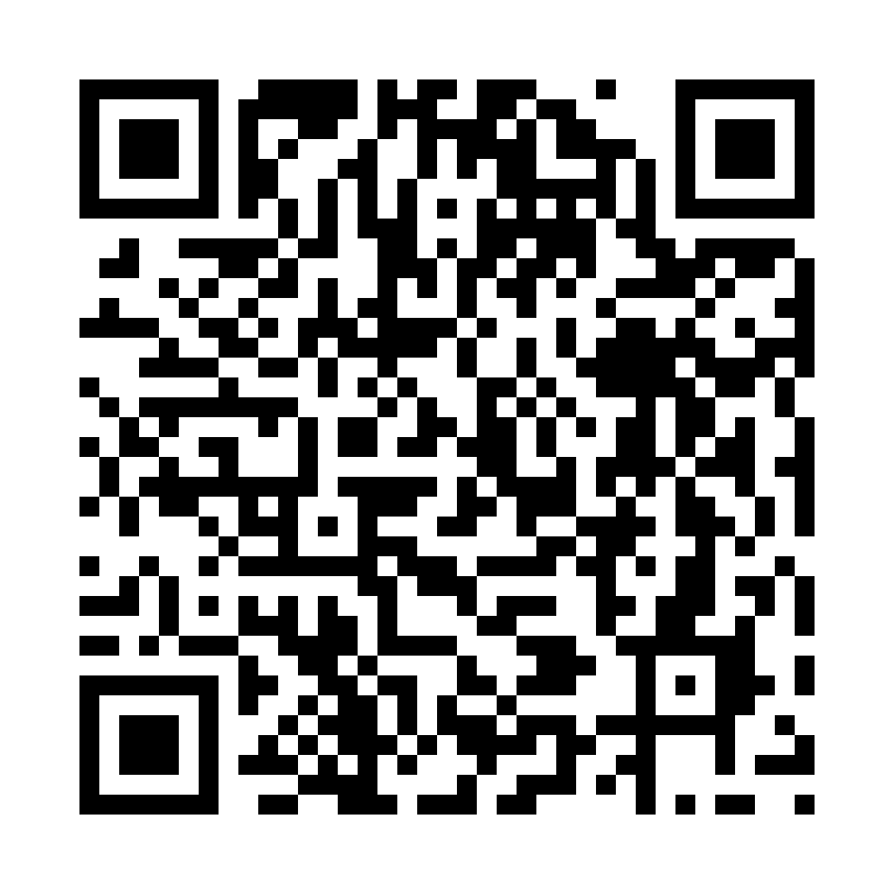
Further reading, and the free Pho beta
LAION-CLAP
Timbre semantics in CLAP
TimbreCLIP
SynthScribe
CTAG
Neural Proxies
FM-SynAPSE
Synth-JEPA
shiva-kannan.github.io/pho-beta
Thanks to: Rishikesh Daoo, Derek Jones, Eric Yeargan, Anirudh Venkatesh, Karran Pandey, Dinesh P

