Slide 1
Lecture 01
HTML

Slide 2
What is HTML?
HTML stands for Hyper Text Markup Language
An HTML file is a text file containing small markup tags
The markup tags tell the Web browser how to display the page
HTML files have .htm or .html file extension
A HTML file can be created using a simple text editor or using a WYSIWYG (What You See If What You Get) editor.

Slide 3
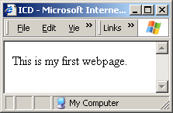
A basic HTML page
First tag in a HTML document
is the <html> tag. The HTML page should also end with the </html> end tag
After the <html> tag usually comes the <head> tag. Inside the <head> tag are other tags such as <title>, <script>, <meta> etc.
<html>
<head>
<title>ICD</title>
</head>
<body>
This is my first webpage.
</body>
</html>
The text between the <title> tags is the title of your document displayed in your browser's caption.
The text between the <body> tags is the text that will be displayed in your browser.

Slide 4

HTML Tags
HTML files consist of HTML elements.
HTML tags are used to mark-up HTML elements
Tags are surrounded by the two angle brackets < and >
E.g. <b> tag is used to define bold text, <u> tag is used to define underlined text.
Tags usually come in pairs
This text is in <b>bold</b>
In HTML, these tags do not really need to come in a pair:
br
p
img
hr
start tag
end tag

Slide 5
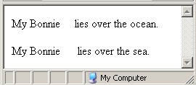
Quiz!
HTML tags are case-sensitive. True or False?
The HTML code on the left will be rendered as the screenshot on the right. True or False?
<p> My Bonnie lies over the ocean. My Bonnie lies over the sea. </p>

Slide 6
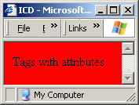
Tag Attributes
Some tags have attributes, which provide additional information about the HTML elements on your page.
E.g. the <body> tag
Attributes always come in name/value pairs like this: name="value".
Attributes are always added to the start tag of an HTML element.
<body bgcolor=“red”>

Slide 7
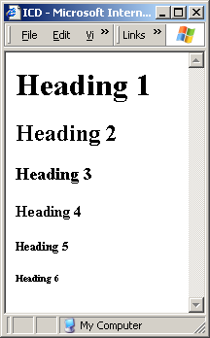
Headings
Headings are defined with the <h1> to <h6> tags.
<h1> defines the largest heading. <h6> defines the smallest heading.
<h1>Heading 1</h1>
<h2>Heading 2</h2>
<h3>Heading 3</h3>
<h4>Heading 4</h4>
<h5>Heading 5</h5>
<h6>Heading 6</h6>

Slide 8

Headings (cont)
You can also customize the alignment of the headings by defining the “align” attribute to:
  left (default)
  right
  center
<h1 align=“center”>Welcome</h1>
<h2 align=“right”>Welcome</h2>

Slide 9
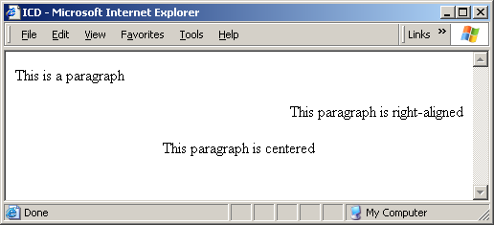
Paragraphs
Paragraphs are defined with the <p> tag.
HTML automatically adds an extra blank line before and after a paragraph.
<p>This is a paragraph</p>
<p align="right">This paragraph is right-aligned</p>
<p align="center">This paragraph is centered</p>

Slide 10
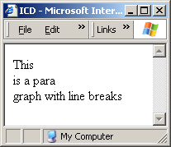
Line Breaks
The <br> tag is used when you want to end a line, but don't want to start a new paragraph. The <br> tag forces a line break wherever you place it.
The <br> tag is an empty tag. It has no closing tag.
<p>This <br> is a para<br>graph with line breaks</p>

Slide 11
Comments
You can insert comments in HTML using the syntax below.
Comments are ignored by the browser. You can use comments to explain your code, which can help you when you edit the source code at a later date.
<!-- This is a comment -->
<!–
This is line 1 of a multi-line comment
This is line 2 of a multi-line comment
This is line 3 of a multi-line comment
-->

Slide 12
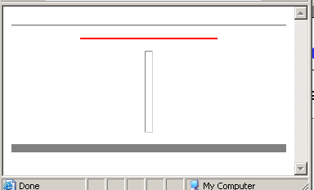
Horizontal Rule
You can insert a horizontal rule using the <hr> tag.
<hr>
<hr color="red" width="50%">
<hr width="10" size="100">
<hr size=“10” noshade>
noshade
If present, specifies that the element should not have shading. Note that this is a deprecated attribute

Slide 13
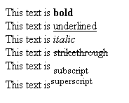
Text Formatting
<b> | Bold
<u> | Underline
<i> | Italics
<s> | Strikethrough
<sub> | Subscript
<sup> | Superscript
This text is <b>bold</b> <br>
This text is <u>underlined</u> <br>
This text is <i>italic</i> <br>
This text is <s>strikethrough</s> <br>
This text is <sub>subscript</sub> <br>
This text is<sup>superscript</sup> <br>

Slide 14
HTML Entities
Some characters like the < character, have a special meaning in HTML, and therefore cannot be used in the text.
To display a less than sign (<) in HTML, we have to use a character entity.
Result | Description | Entity Name | Entity Number
 | non-breaking space | &nbsp; | &#160;
< | less than | &lt; | &#60;
> | greater than | &gt; | &#62;
& | ampersand | &amp; | &#38;
° | degree | &deg; | &#176;

Slide 15
HTML Entities (cont)
Result | Description | Entity Name | Entity Number
© | copyright | &copy; | &#169;
® | registered trademark | &reg | &#174;
™ | trademark | &trade; | &#8482;
¼ | fraction 1/4 | &frac14; | &#188;
½ | fraction 1/2 | &frac12; | &#189;
¾ | fraction 3/4 | &frac34; | &#190;
÷ | division | &divide; | &#247;
http://www.w3schools.com/tags/ref_entities.asp

Slide 16
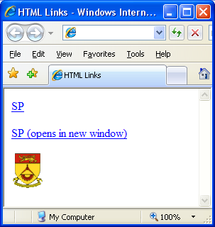
HTML Links (hyperlinks)
The <a> (anchor) tag creates a link to another document.
An anchor can point to any resource on the Web: an HTML page, an image, a sound file, a movie, etc.
Link opens in SAME window
<a href="http://www. sp.edu.sg/">SP</a>
Link an image
<a href="http://www.sp.edu.sg">
<img src="splogo.gif" border="0">
</a>
Link opens in a new window
<a href="http://www. sp.edu.sg/“ target=“_blank”>SP (opens in new window)</a>

Slide 17
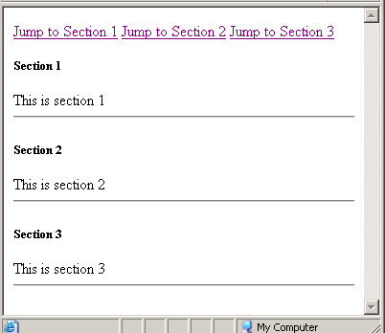
Named Anchors
Besides linking to another website, we can also link to a specific section on the SAME page, known as named anchors.
<a href="#s1">Jump to Section 1</a>
<a href="#s2">Jump to Section 2</a>
<a href="#s3">Jump to Section 3</a>
<h5><a name="s1">Section 1</a></h5>
This is section 1<hr>
<h5><a name="s2">Section 2</a></h5>
This is section 2<hr>
<h5><a name="s3">Section 3</a></h5>
This is section 3 <hr>

Slide 18

Email Links
This example shows how to create an email link.
My email:
<a href="mailto:dora@sp.edu.sg">dora@sp.edu.sg</a>.

Slide 19


Lists
We can create ordered or unordered lists using the <ol> and <ul> tags respectively.
<ol>
<li>Coffee</li>
<li>Milk</li>
</ol>
<ul>
<li>Coffee</li>
<li>Milk</li>
</ul>

Slide 20
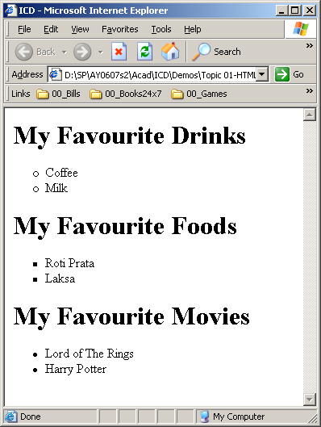
Lists (cont)
You can change the list type:
<h1>My Favourite Drinks</h1>
<ul type=“circle”>
<li>Coffee</li>
<li>Milk</li>
</ul>
<h1>My Favourite Foods</h1>
<ul type=“square”>
<li>Roti Prata</li>
<li>Laksa</li>
</ul>
<h1>My Favourite Movies</h1>
<ul type=“disc”>
<li>Lord of The Rings</li>
<li>Harry Potter</li>
</ul>

Slide 21
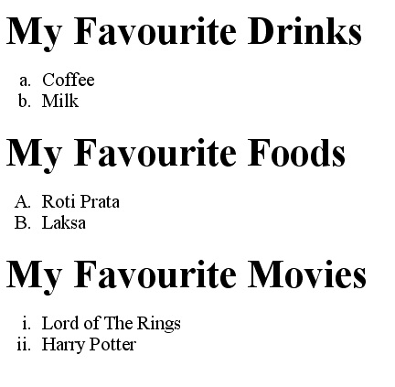
Lists (cont)
Change the list type of an ordered list :
<h1>My Favourite Drinks</h1>
<ol type=“a”>
<li>Coffee</li>
<li>Milk</li>
</ol>
<h1>My Favourite Foods</h1>
<ol type=“A”>
<li>Roti Prata</li>
<li>Laksa</li>
</ol>
<h1>My Favourite Movies</h1>
<ol type=“i”>
<li>Lord of The Rings</li>
<li>Harry Potter</li>
</ol>

Slide 22
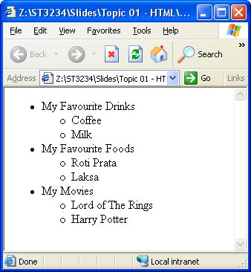
Lists (cont)
Lists can also be nested as the example below shows:
<ul>
<li>My Favourite Drinks</li>
<ul>
<li>Coffee</li>
<li>Milk</li>
</ul>
<li>My Favourite Foods</li>
<ul>
<li>Roti Prata</li>
<li>Laksa</li>
</ul>
<li>My Movies</li>
<ul>
<li>Lord of The Rings</li>
<li>Harry Potter</li>
</ul>
</ul>

Slide 23

Images
We can insert images using the <img> tag.
<html>
<head><title>Image</title></head>
<body>
<img src="pic.jpg">
</body>
</html>
NOTE
if the image resides in a subdirectory called images, you can use this syntax:
<img src="images/pic.jpg">

Slide 24
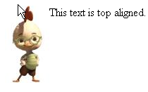
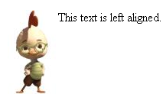



Images (cont)
We can change the way the image wraps around text through the “align” attribute.
<img align=“top” src=“pic.jpg”>
<img align=“left” src=“pic.jpg”>
<img align=“bottom” src=“pic.jpg”>
<img align=“right” src=“pic.jpg”>
<img align=“middle” src=“pic.jpg”>

Slide 25
Images (cont)
We can adjust the horizontal / vertical spacing between an image and the text surrounding it using hspace and vspace attributes
<img align=“middle” src=“pic.jpg”>

Slide 26
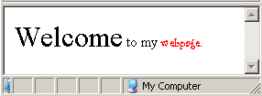
<font> tag
The <font> tag in HTML is deprecated (obsolete)
It is supposed to be removed in a future version of HTML.
Make the font 3 sizes bigger than usual
<font size="+3">Welcome</font> to my
<font face="Curlz MT" color="red" size="-1">webpage</font>.
Change font face to "Curlz MT"
Change color to red
Make the font 1 size smaller than usual

Slide 27
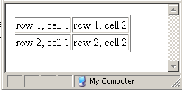
Tables
Tables are defined with the <table>, <tr>, and <td> tags.
Each table starts off with a <table> tag, and each table row is defined with the <tr> tag and each table cell is created with the <td> tag.
<table border=“1”>
<tr>
<td>row 1, cell 1</td>
<td>row 1, cell 2</td>
</tr>
<tr>
<td>row 2, cell 1</td>
<td>row 2, cell 2</td>
</tr>
</table>

Slide 28

Tables (cont)
This example shows how we can merge two columns using the colspan attribute.
<table border="1">
<tr>
<td>row 1, cell 1</td>
<td>row 1, cell 2</td>
<td>row 1, cell 3</td>
</tr>
<tr>
<td>row 2, cell 1</td>
<td colspan="2">row 2, cell 2</td>
</tr>
</table>

Slide 29

Tables (cont)
This example shows how we can merge two rows using the rowspan attribute.
<table border="1">
<tr>
<td>row 1, cell 1</td>
<td>row 1, cell 2</td>
<td rowspan="2">row 1, cell 3</td>
</tr>
<tr>
<td>row 2, cell 2</td>
<td>row 2, cell 2</td>
</tr>
</table>

Slide 30

Tables (cont)
This example shows how we can change the default background colors of table cells, and customise colors of certain cellls.
<table border="1" bgcolor="blue">
<tr>
<td bgcolor=“red”>row 1, cell 1</td>
<td>row 1, cell 2</td>
<td>row 1, cell 3</td>
</tr>
<tr>
<td>row 2, cell 1</td>
<td>row 2, cell 2</td>
<td>row 2, cell 3</td>
</tr>
</table>

Slide 31
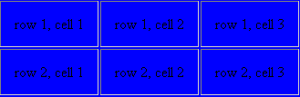
Tables (cont)
This example shows how we can change the cellpadding, that is the space INSIDE of each cell.
<table border="1" bgcolor="blue" cellpadding="15">
<tr>
<td>row 1, cell 1</td>
<td>row 1, cell 2</td>
<td>row 1, cell 3</td>
</tr>
<tr>
<td>row 2, cell 1</td>
<td>row 2, cell 2</td>
<td>row 2, cell 3</td>
</tr>
</table>

Slide 32
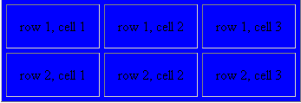
Tables (cont)
This example shows how we can change the cellspacing, that is the space OUTSIDE of each cell.
<table border="1" bgcolor="blue" cellspacing="5">
<tr>
<td>row 1, cell 1</td>
<td>row 1, cell 2</td>
<td>row 1, cell 3</td>
</tr>
<tr>
<td>row 2, cell 1</td>
<td>row 2, cell 2</td>
<td>row 2, cell 3</td>
</tr>
</table>

Slide 33
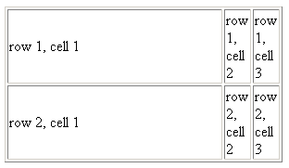
Tables (cont)
This example shows how we can change the width of the whole table or widths of individual <td> cells.
<table border="1" width=“300”>
<tr>
<td width=“80%”>row 1, cell 1</td>
<td>row 1, cell 2</td>
<td>row 1, cell 3</td>
</tr>
<tr>
<td>row 2, cell 1</td>
<td>row 2, cell 2</td>
<td>row 2, cell 3</td>
</tr>
</table>
300 pixels
80% of table

Slide 34
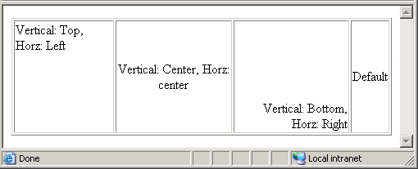
Tables (cont)
This example shows how we can change the vertical and horizontal alignment of individual <td> cells.
<table border="1" width="100%" height="100%">
<tr>
<td valign="top" align="left">Vertical: Top, Horz: Left</td>
<td valign="center" align="center">Vertical: Center, Horz: center</td>
<td valign="bottom" align="right">Vertical: Bottom, Horz: Right</td>
<td>Default</td>
</tr>
</table>

Slide 35
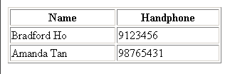
Tables <th> tag
You can also use the <th> tag in place of <td> tags for table cells that contain header data.
<table border="1" width="300">
<tr><th>Name</th><th>Handphone</th></tr>
<tr><td>Bradford Ho</td><td>9123456</td></tr>
<tr><td>Amanda Tan</td><td>98765431</td></tr>
</table>

Slide 36



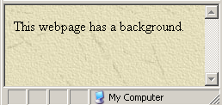
<body> tag
The <body> tag has two attributes where you can specify a background color or a background image.

Slide 37
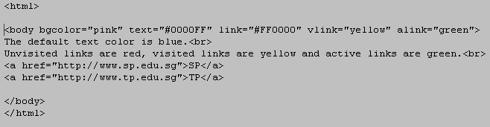
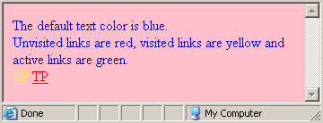
<body> tag
You can also specify the default text colors and default link colors with the <body> tag.
text – for specifying default text / foreground color
bgcolor – specify background color
link – for specifying normal link color
vlink – specify visited link color
alink – specify active link color

Slide 38
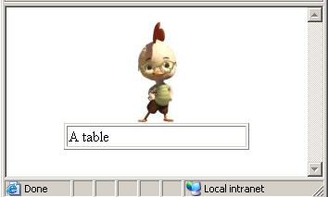
<center> tag
Allows you to position any HTML element in the center of the window.
<center><img src=“pic.jpg”></center>
<center>
<table border=“1” width=“200”>
<tr><td>A table</td></tr>
</table>
</center>

Slide 39
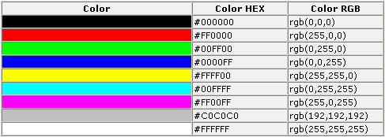
HTML Colors
Colors are displayed combining RED, GREEN, and BLUE light sources.
Colors are defined using a hexadecimal notation for the combination of Red, Green, and Blue color values (RGB).
Each color value ranges from #00 (lowest) to #FF(highest).

Slide 40
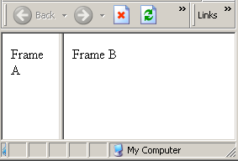
Frames
With frames, you can display more than one HTML document in the same browser window.
Each HTML document is called a frame, and each frame is independent of the others.
The <frameset> and <frame>
tags are used to create
frames.

Slide 41
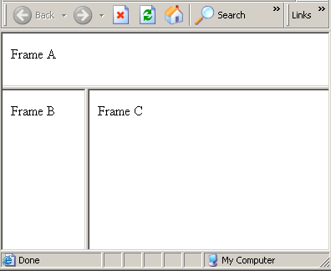
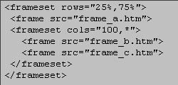
Frames (cont)
The Frameset Tag
The <frameset> tag defines how to divide the window into frames
Each frameset defines a set of rows or columns
The values of the rows/columns indicate the amount of screen area each row/column will occupy
The Frame Tag
The <frame> tag defines what HTML document to put into each frame

Slide 42
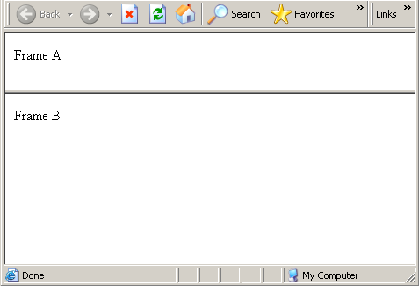
Frames (cont)
<frameset cols="25%,75%">
<frame src="frame_a.htm">
<frame src="frame_b.htm">
</frameset>
<frameset rows="25%,75%">
<frame src="frame_a.htm">
<frame src="frame_b.htm">
</frameset>

Slide 43
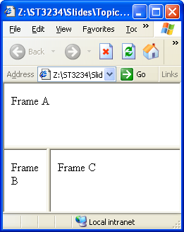
Frames (cont)
This example shows a more
complicated mixed frameset.
A frameset within another
frameset
<html>
<frameset rows="50%,50%">
<frame src="frame_a.htm">
<frameset cols="25%,75%">
<frame src="frame_b.htm">
<frame src="frame_c.htm">
</frameset>
</frameset>
</html>

Slide 44
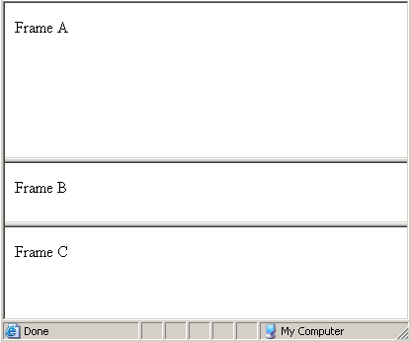
Frames (cont)
By default, frames are
resizable.
This example shows
how you can make
only a certain frame
non-resizable.
<frameset rows="50%,20%,*“>
<frame noresize="noresize" src="frame_a.htm">
<frame src="frame_b.htm">
<frame src="frame_c.htm">
</frameset>
Not resizable

Slide 45
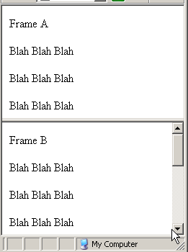
Frames (cont)
By default, scrollbars
automatically appear
when a document is
too long to fit in the
window.
This example shows
how you can make
disable this automatic
scrolling.
Other values:
  scrolling=“yes”
  scrolling=“auto”
<frameset rows="50%,*">
<frame scrolling="no" src="frame_a1.htm">
<frame src="frame_b1.htm">
</frameset>

Slide 46
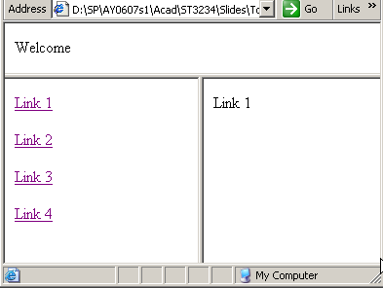
Frames (cont)
<html>
<frameset rows="100,*">
<frame src="top.htm" name="top">
<frameset cols="200,*">
<frame src="nav.htm" name="nav">
<frame src="link1.htm" name="main">
</frameset>
</frameset>
</html>
This example shows how to set the target of the hyperlink to open in a specified frame.
<html>
<body>
<a href="link1.htm">Link 1</a><p>
<a href="link2.htm" target="main">Link 2</a><p>
<a href="link3.htm" target="nav">Link 3</a><p>
<a href="link4.htm" target="top">Link 4</a><p>
</body>
</html>

Slide 47
Frames (cont)
<html>
<frameset cols="25%,50%,25%">
<frame src="frame_a.htm">
<frame src="frame_b.htm">
<frame src="frame_c.htm">
<noframes>
<body>Your browser does not handle frames!</body>
</noframes>
</frameset>
</html>
Though it is not common nowadays, some older browsers may not support frames.
This example shows how to use the <noframes> tag to show a friendly message to users whose browsers cannot display frames.

Slide 48
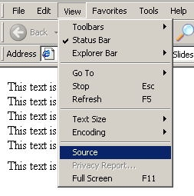
How to View HTML Source
Have you ever seen a Web page and wondered "How do they do that?"
To find out, simply click on the VIEW option in your browsers toolbar and select SOURCE or PAGE SOURCE.
This will open a window that shows you the actual HTML of the page.

Slide 49
Summary of tags learnt so far
<html> | Every HTML file begins with this
<head> | Appears before the <body> tag, may contain other tags such as <title>, <meta>, <style>, <script> etc
<title> | Specifies the caption to appear on browser’s titlebar
<body> | Begins the body of the HTML document. Has attributes to control default background color, text color and link colors.
<p> <br> | Paragraph break, line break
<b> <i> <u> <s> | Text formatting tags for creating bold, italics, underlined, strikethrough etc.
<img> | Insert image
<ol> <ul> <li> | Create ordered / unordered lists

Slide 50
Summary of tags learnt so far
<a> | Create links
<font> | Specify font effects
<table> <tr><td> | Create tables
<frameset> <frame> | Create frames
&nbsp; &lt; &gt; | HTML entities. Special characters.
<hr> | Horizontal rule
<!—Comment --> | Comments
<center> | Generic tag to center any HTML element

Slide 51
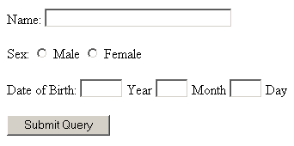
Forms
A form is an area that can contain form elements.
Form elements are elements that allow the user to enter information (like text fields, textarea fields, drop-down menus, radio buttons, checkboxes, etc.) in a form.
A form is defined with the <form> tag.
<form>
<input>
<input>
</form>

Slide 52
Form Elements
<FORM>: marks the form
<INPUT>: tag used to define variables and field types
  TEXT: single-line textbox
  PASSWORD: single-line textbox but in hidden text
  RADIO: radio button single-choice selections
  CHECKBOX: checkbox button multiple-choice selections
  RESET: used to reset variables back to default value
  SUBMIT: used to submit form to the CGI script
  BUTTON: used to submit form to a JavaScript
  HIDDEN: used to submit hidden information
<TEXTAREA>: tag used for multiple-line textbox
<SELECT>: tag used for pull-down menus

Slide 53
<form> tag
<form action=“register.jsp” method=“get” name=“form1”>
</form>
The <form> tag encloses form elements and other HTML elements.
The “action” attribute specifies where the data is sent when the submit button is clicked.
The “method” attribute can have either the “get” (default) or “post” values.
"get“
Form data is sent as a URL with ?form_data info appended to the end
Can be used only if data is all ASCII and not more than 100 characters
"post"
Form data is sent in the body of the URL request
Cannot be bookmarked by most browsers

Slide 54
<input> tags
Form contents consist primarily of INPUT tags, which define the field types and the names of the variables.
These INPUT tags allow the visitor to enter information or to select choices.
Each INPUT tag is given a TYPE and NAME attributes. These attributes determine what kind of information it contains and the name identifer for the field.
This is the syntax for an input tag:
<input type="option" name="text" />

Slide 55
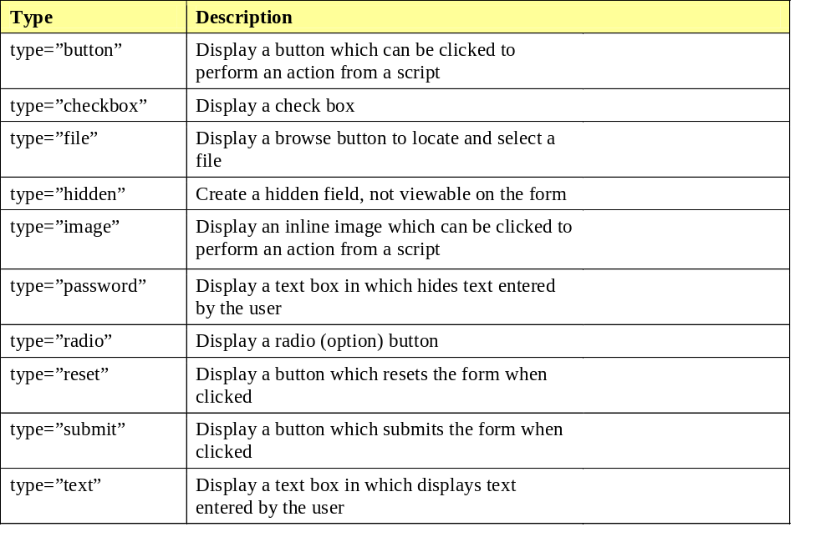
Input Types

Slide 56

<input type=“text”>
<form>
Your name <input type="text" size="10" maxlength="50“ value=“Your name”>
</form>
Length of the field
Maximum characters that can be typed, e.g. restrict the user from typing more than 50 characters

Slide 57

<input type=“radio”>
<form>
Gender<br>
<input type="radio" value="M" name="gender“ checked>Male
<input type="radio" value="F" name="gender">Female
</form>
NOTE
You must name each radio button in order that it can be chosen.
Radio buttons belonging to the same group must have the same name
Use “checked” attribute to pre-select a particular radio button

Slide 58

<input type=“checkbox”>
<form>
Movies you have watched<br>
<input type="checkbox" value="starwars" name="movies">Star Wars
<input type="checkbox" value="lordoftherings" name="movies">Lord of The Rings
<input type="checkbox" value="narnia" name="movies“ checked>Narnia
<input type="checkbox" value="harrypotter" name="movies">Harry Potter
</form>
NOTE
Check boxes belonging to the same group must have the same name
Use “checked” attribute to pre-select a particular check box

Slide 59

<input type=“password” />
<form>
Enter your password:
<input type="password" name="pass" size="10" maxlength="10" />
</form>

Slide 60

<input type=“submit” />
<form action=“search.jsp” method=“post”>
Search: <input type="text" name="search">
<input type="submit" value="Go" />
</form>
NOTE
submit type usually goes with a form action tag

Slide 61

<input type=“reset” />
<form>
Your name: <input type="text">
<input type="submit" value="Register"><input type="reset">
</form>
NOTE
use reset button to clear all fields in the form

Slide 62

<input type=“image”/>
<form action=“submit.jsp” method=“post”>
Your name: <input type="text">
<input type="image" src="submit.gif" border="0">
</form>
NOTE
image type performs same function as a submit button but is more visual.
usually goes with a form action tag as well.

Slide 63
<input type=“button” />
The <input type=“button”> element differs from the <input type=“submit”> element in that it DOES NOT submit the form.
E.g. you might create a Javascript program to calculate the total cost of an order.
<form>
No of books purchased <input type="text" name="qty">
<input type="button" value="Calculate Total Cost" name="calculator" />
</form>

Slide 64
<input type=“hidden” />
Allows submission of default or previously specified text that is hidden from the user.
<form>
No of books purchased:
<input type=“text” name=“qty”>
<input type=“hidden” value=“4.50” name=“cost”>
<input type=“submit”>
</form>

Slide 65

<textarea>
<form>
Your comments:
<textarea name="comments" rows="3" cols="50">Pls type your comments
</textarea>
</form>

Slide 66

<select>
<form>
<select name="Gender">
<option value="M">Male</option>
<option value="F“ selected>Female</option>
</select>
</form>
NOTE
Use “selected” attribute to pre-select a particular option value
Remember to name the select tag as well.

Slide 67
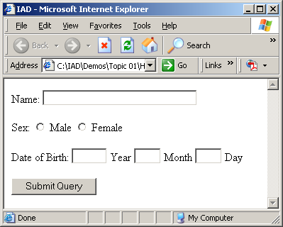
FORM example
<form method=POST action=“SomeProgram">
Name:
<input type=text name=name size=32 maxlength=80>
<p>Sex:
<input type=radio name=sex value="M"> Male
<input type=radio name=sex value="F"> Female
<p>Date of Birth:
<input type=text name=year size=4 maxlength=4>
Year
<input type=text name=month size=2 maxlength=2>
Month
<input type=text name=day size=2 maxlength=2>
Day
<p><input type=submit>
</form>

Slide 68
Summary of form tags
<form> | Begin every form section with this
<input> | Used to create Textfield <input type=“text”> Radiobutton <input type=“radio”> Checkbox <input type=“checkbox”> Password field <input type=“password”> File browsing <input type=“file”>
<textarea> | Multi-line textbox
<select> | Dropdown list

Slide 69
Block elements vs Inline elements
Most HTML elements permitted within the <body> are classified as either
  block-level elements or
  inline elements.

Slide 70
Block elements vs Inline elements
Block-level elements
  usually begin on a new line.
  typically contain inline elements and other block-level elements
Inline elements
  usually do not begin on a new line.
  typically may only contain text and other inline elements.

Slide 71
Block elements vs Inline elements
Block-Level Elements | Inline Elements
<h1>... <h6> <hr> <div> <center> <ol><ul><li> <p> <table>, <tr>, <td> <form> | <b>, <i>, <i>, <sub>, <sup>, <strike> <font> <a> <img> <br> <span>
http://www.w3.org/TR/html401/struct/global.html#h-7.5.3
http://www.webdesignfromscratch.com/css-block-and-inline.cfm

Slide 72
XHTML vs HTML
The Extensible HyperText Markup Language, or XHTML, is a markup language that is just like HTML, but with a stricter syntax.
XHTML is a World Wide Web Consortium (W3C) standard.
XHTML is based on XML (to be covered in Topic 6) and imposes rules such as:
  Every document must start with the <!DOCTYPE> tag
  All tags must be lower-case
  All tags must have both open and close tags.
  All attributes must be quoted

Slide 73
XHTML vs HTML
XHTML | HTML
First line of document must be <!DOCTYPE ....> | First line is usually <html>...
All tags must be in lowercase <body> | Tags can be upper / lowercase. <BoDy>
All tags must be closed <p>This is a paragraph</p> <br/> | Some tags need not be closed <p>This is a paragraph <br>
All attributes must be quoted <img src=“apple.jpg”> | Non-quoted attributes are ok <img src=apple.jpg>

Slide 74
Why write XHTML?
Writing XHTML compliant web pages has many advantages:
XHTML code is guaranteed to be well-formed
Your pages render consistently across browsers with XHTML support
XHTML compliant pages conform more readily to accessibility standards.
XHTML is extensible, allowing the definition of new elements.
XHTML pages are more readable by computer programs / more easily transformable

Slide 75
<!DOCTYPE>
The <!DOCTYPE> declaration is the very first thing in your document, before the <html> tag.
This tag tells the browser which HTML or XHTML specification the document
By using different specifications, you can thus instruct the browser to interpret your HTML / XHTML:
  STRICTLY
  LENIENTLY
http://validator.w3.org/
http://www.w3schools.com/xhtml/xhtml_syntax.asp

Slide 76
HTML / XHTML document types
Used when you need to use HTML's presentational features because your readers don't have browsers that support Cascading Style Sheets
HTML Transitional
<!DOCTYPE HTML PUBLIC "-//W3C//DTD HTML 4.01 Transitional//EN" "http://www.w3.org/TR/html4/loose.dtd">
Used when you want clean markup, free of presentational clutter, together with Cascading Style Sheets (CSS):
XHTML Strict
<!DOCTYPE html PUBLIC "-//W3C//DTD XHTML 1.0 Strict//EN" "http://www.w3.org/TR/xhtml1/DTD/xhtml1-strict.dtd">
Used when you need to use XHTML's presentational features because your readers don't have browsers that support Cascading Style Sheets (CSS):
XHTML Transitional
<!DOCTYPE html PUBLIC "-//W3C//DTD XHTML 1.0 Transitional//EN" "http://www.w3.org/TR/xhtml1/DTD/xhtml1-transitional.dtd">

Slide 77
XHTML Transitional Example
Below is an example of XHTML Transitional Compliant code
<!DOCTYPE html PUBLIC "-//W3C//DTD XHTML 1.0 Transitional//EN" "http://www.w3.org/TR/xhtml1/DTD/xhtml1-transitional.dtd">
<html xmlns="http://www.w3.org/1999/xhtml">
<head>
<meta http-equiv="Content-Type" content="text/html; charset=utf-8" />
<title>XHTML Transistional</title>
</head>
<body>
<h1>XHTML Transistional</h1>
<b>Compliant</b><a href=“http://www.sp.edu.sg”>SP</a>
<br/>
</body>
</html>
<!DOCTYPE>
Mandatory elements present: html, head, body, title
Specify charset, esp for Unicode documents
Attributes are quoted
All elements are closed

Slide 78
Other useful tags

Slide 79
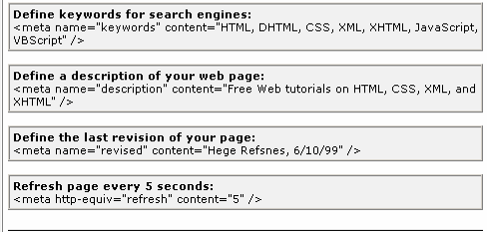
META Element
Records document information, forwards and refreshes pages
  NAME="author"
  NAME="keywords"
  NAME="description"
  HTTP-EQUIV="refresh"
All these are embedded in the <head> tag

Slide 80
META Element, Example
<html>
<head>
<title>Page 01</title>
<META http-equiv="refresh" content="5;URL=page02.htm">
</head>
<body bgcolor="#ffffff">
<h1>Page 01</h1>
You will be redirected to the page 02 automatically in 5 seconds.
</body>
</html>

Slide 81
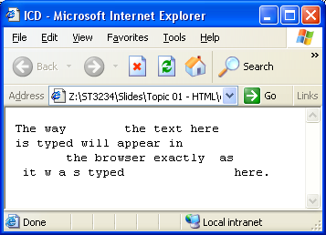
<pre> tag
The <pre> tag preserves the text formatting exactly as it was typed in the HTML document.
<pre>
The way the text here
is typed will appear in
the browser exactly as
it w a s typed here.
</pre>

Slide 82
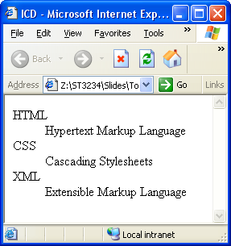
<dl><dt><dd>
The <dl>, <dt> and <dd> tags allow you to define definition terms.
<dl> starts the definition list.
Each new definition term is defined with <dt>
Each definition of each term is defined with <dd>
<dl>
<dt>HTML</dt>
<dd>Hypertext Markup Language</dd>
<dt>CSS</dt>
<dd>Cascading Stylesheets</dd>
<dt>XML</dt>
<dd>Extensible Markup Language</dd>
</dl>

Slide 83
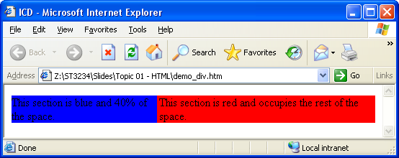
<div>
The <div> tag defines a division/section in a document.
It is often used in conjunction with stylesheets to divide a document into columns as shown below.
<div style="background-color:blue;width:40%;float:left;">
This section is blue and 40% of the space.
</div>
<div style="background-color:red;">
This section is red and occupies the rest of the space.
</div>

Slide 84
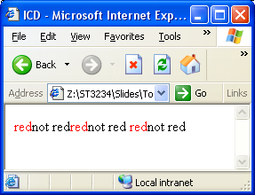
<span>
The <span> tag is often used in conjunction with stylesheets to format small blocks of text, images etc.
<html>
<head>
<title>ICD</title>
<style>
.red {color:red;}
</style>
</head>
<body>
<span class="red">red</span>not red<span class="red">red</span>not red
<span class="red">red</span>not red
</body>
</html>

Slide 85
Questions?

