Slide 1
Topic 02
Cascading Style Sheets
(CSS)

Slide 2
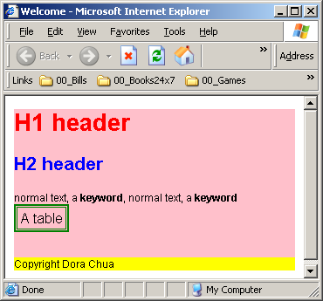
What are Cascading Style Sheets?
Cascading Style Sheets (CSS) are a collection of formatting rules that control the appearance of content in a web page.
body {
font-family: Arial;
font-size: 12 px;
}
h1 {font-size:20pt; color:red;}
h2 {font-size:16pt; color:blue;}
table {border: medium double green}
#main {width:100%;height:95%;background-color:pink;}
#footer {width:100%;height:5%;background-color:yellow;}
.keyword {font-weight:bold;}

Slide 3
What is CSS
Styles define how to display HTML elements
Styles were added to HTML 4.0 to solve a problem
External Style Sheets can save a lot of work
External Style Sheets are stored in CSS files
HTML was intended to define the content of a document, like:
<h1>This is a heading</h1>
<p>This is a paragraph.</p>
When tags like <font>, and color attributes were added to the HTML 3.2 specification, it started a nightmare for web developers. Development of large web sites, where fonts and color information were added to every single page, became a long and expensive process.

Slide 4
Why CSS
CSS gives us more powerful and flexible formatting
  As HTML consists of a limited set of tags, using HTML alone, we are often not able to achieve the exact positioning or “look & feel” we want for our webpage
CSS allows us to be more productive
  One stylesheet can be shared among multiple web pages. E.g. if we want to change the background color of 100 web pages, we need only change one stylesheet instead of modifying 100 HTML pages.

Slide 5
Why CSS
CSS reduces download time
  With CSS, repetitive formatting code is eliminated. Thus, download time is cut down as well.
CSS allows consistent look across webpages
  Multiple webpages of the same website can share the same stylesheet. Thus, the look and feel of the pages will remain consistent.
CSS allows your HTML code to be more readable
  Presentation information is separated from the content. HTML code becomes easier to read & maintain

Slide 6
How to use CSS
1
External CSS style sheets
External CSS stylesheets are linked to a one or more webpages using a link in the head section of a document.
Internal (or Embedded) CSS style sheets
Embedded CSS styles are included in a style tag in the head portion of an HTML document.
Inline styles
Inline styles are defined with specific instances of tags throughout an HTML document.
2
3

Slide 7
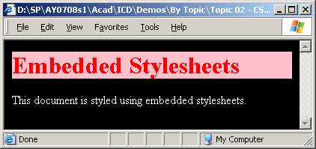
CSS (Embedded)
<html>
<head>
<!-- EMBEDDED style sheet -->
<style>
body {
color: white;
background: rgb(0,0,0);
}
h1 {color:red; background: pink;}
</style>
</head>
<body>
<h1>Embedded Stylesheets</h1>
This document is styled using embedded stylesheets.
</body>
</html>

Slide 8
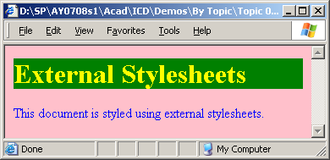
CSS (External)
<html>
<head>
<!– EXTERNAL style sheet -->
<link href="external.css" type="text/css" rel="stylesheet">
</head>
<body>
<h1>External Stylesheets</h1>
This document is styled using external stylesheets.
</body>
</html>
demo.htm
External.css
body {color: blue; background:pink;}
h1 {color:yellow; background: green;}

Slide 9
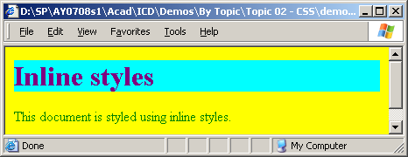
CSS (Inline)
<html>
<head>
</head>
<body style="color:green;background:yellow">
<!-- INLINE style sheet -->
<h1 style="color:purple;background:cyan;">
Inline styles</h1>
This document is styled using inline styles.
</body>
</html>
demo_inline.htm

Slide 10
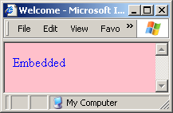
Embedded / Internal CSS
Define the styles within the <style> and </style> tags inside the <head> and </head> tags.
<html>
<head>
<title>Welcome</title>
<style>
body {
color: blue;
background: pink;
}
</style>
</head>
<body>
Embedded
</body>
</html>

Slide 11
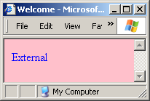
External CSS
In HTML code, use the <link> tag to specify an external stylesheet to import.
Rel: relation between html and css file.
<html>
<head>
<title>Welcome</title>
<link href="external1.css" rel="stylesheet" type="text/css">
</head>
<body>
External
</body>
</html>
body {
color: blue;
background: pink;
}
external1.css

Slide 12
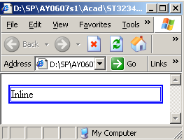
Inline styles
Inline styles are embedded as an attribute within the tag itself.
<html>
<head>
<title>ICD</title>
</head>
<body>
<!-- INLINE style sheet -->
<p style="border: medium double blue">Inline</p>
</body>
</html>

Slide 13
Structure of a CSS rule
A CSS style rule consists of two parts -- the selector and the declaration.
The selector is the name of the style.
It defines what elements the rule will be applied to
body
{
font-family: Arial;
width:100%;
height:95%;
background-color:pink;
}
The declaration defines what the style elements. It consists of:
the property (such as font-family)
the value (such as Arial).

Slide 14
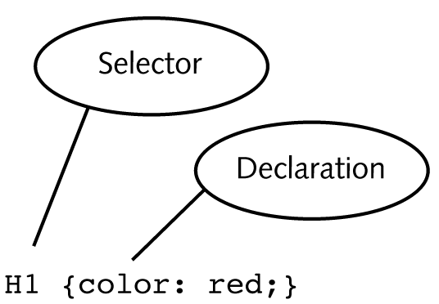
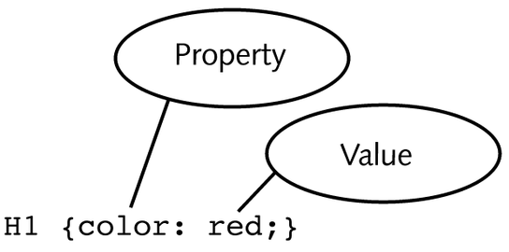
Structure of a CSS rule

Slide 15
Selectors
Selectors are one of the most important aspects of CSS as they are used to "select" elements on an HTML page so that they can be styled.
For this module, we shall cover these:
  Type / Tag selectors
  Class selectors
  ID selectors
  Contextual / Descendant selectors
  Pseudo-class selectors
  Universal selector

Slide 16
Selectors
Other selectors which we will NOT cover include:
  Child selectors
  Adjacent sibling selectors
  Attribute selectors

Slide 17
Tag / Type Selector
A tag / type selector matches every instance of a particular element type.
You typically use it to redefine the default properties of HTML tags
The following rule matches all paragraph elements in the document and sets their font size to 12 pt:
p { font-size: 12pt; }
This rule specifies that all table elements would have a background color of pink.
table { background-color: pink; }

Slide 18
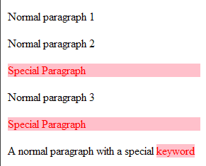
Class Selector
The class selector is represented by a full-stop, “.”, and targets elements based on the value of their class attribute.
The rule below applies to elements with class name of “sp”:
.sp { background:pink; color:red; }
An example of how to use the class selector
<p>Normal paragraph 1</p>
<p>Normal paragraph 2</p>
<p class="sp">Special Paragraph</p>
<p>Normal paragraph 3</p>
<p class="sp">Special Paragraph</p>
<p>A normal paragraph with a special <span class="sp">keyword</span></p>
Output

Slide 19
ID Selector
The ID selector is represented by a hash sign, “#”, and targets elements based on their id value.
ID selectors have higher specificity than class selectors.
An id value must be unique within a document, therefore an ID selector can only apply to a single element in a document.
#header {color:red; background:pink}
#navigation {color: blue}
Using an ID selector:
<h2 id=“header”>Welcome!</h2>
<p id=“navigation”>This p tag will be blue in color</p>

Slide 20
Contextual / Descendant Selector
A descendant selector is made up of two or more simple selectors separated by whitespace.
It matches elements that are descendants of an element that matches the first simple selector.
For example, the selector in this rule would match all p elements that are descendants of a div element:
div p { color:red; }
E.g.
<body> <div><p>This paragraph is red</p></div> </body>
It has no effect on the <p> tag outside the <div>:
<body> <p>No effect </p> <div><p>I am red</p></div>

Slide 21
The Pseudo-Class Selector
The pseudo-class selector allows you to style hyperlinks, drop-caps and specify a language to use in an element.
E.g. the CSS code below makes all unvisited hyperlinks red and underlined.
:link {color:red; text-decoration: underline}
Pseudo-class | Purpose
:active | Adds special style to an activated element
:focus | Adds special style to an element while the element has focus
:hover | Style an element with mouse cursor over it
:link | Style an unvisited link
:visited | Style a visited link
:first-child | Style an element that is the first child of some other element
:lang | Specify a language to use in a specified element

Slide 22
The Universal Selector
The universal selector is represented by an asterisk, “*”, and matches all elements in the document.
Seldom used in stylesheets, but you could do a “global whitespace reset” with the following CSS code:
* { margin:0; padding:0; }

Slide 23
Questions
What does CSS stand for? Why do we use them?
Name 3 types of CSS selectors.
Name 3 methods to apply CSS in our web pages.

Slide 24
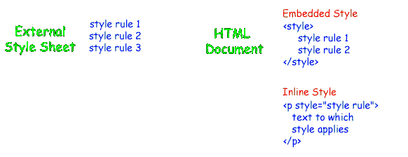
Cascading?
‘Cascading’ refers to the ability to have multiple stylesheets applied to same HTML page
‘Cascading’ also refers to how conflicts are resolved when style sheets refer to the same property.
Refer to slide 49 for the rules to resolve cascading conflicts.

Slide 25
What can we do with CSS?

Slide 26
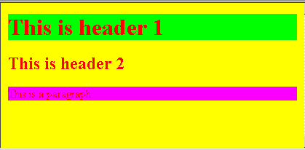
CSS background
(Set background color)
<html>
<head>
<style>
body {
background: yellow;
color: red;
}
h1 {background-color: #00ff00}
h2 {background-color: transparent}
p {background-color: rgb(250,0,255)}
</style>
</head>
<body>
<h1>This is header 1</h1>
<h2>This is header 2</h2>
<p>This is a paragraph</p>
</body>
</html>
http://www.w3schools.com/css/css_background.asp

Slide 27
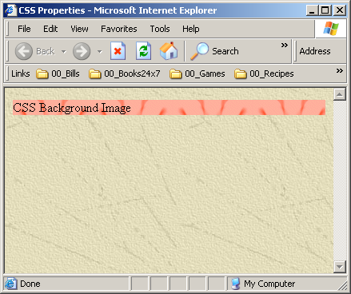
CSS background
(Set background image)
<head>
<title>CSS Properties</title>
<style>
body {
background:url(bg1.jpg);
}
p { background: url(bg2.gif) repeat;}
</style>
</head>
<body>
<p>CSS Background Image</p>
</body>
</html>
If not explicitly stated, the background image will by default, repeat in both the x-direction and y-direction.
explicity state that image should be repeated in both directions.
http://www.w3schools.com/css/css_background.asp

Slide 28
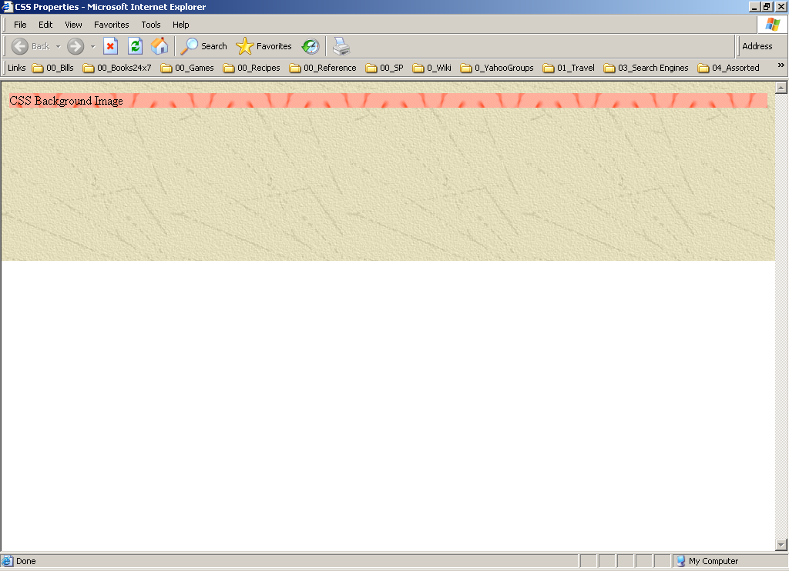
CSS background
(Set background image to repeat in x-direction)
<html>
<head>
<title>CSS Properties</title>
<style>
body {
background:url(bg1.jpg) repeat-x;
}
p { background: url(bg2.gif) repeat;}
</style>
</head>
<body>
<p>CSS Background Image</p>
</body>
</html>
You can also state that the background image be repeated in x-direction only.
http://www.w3schools.com/css/css_background.asp

Slide 29
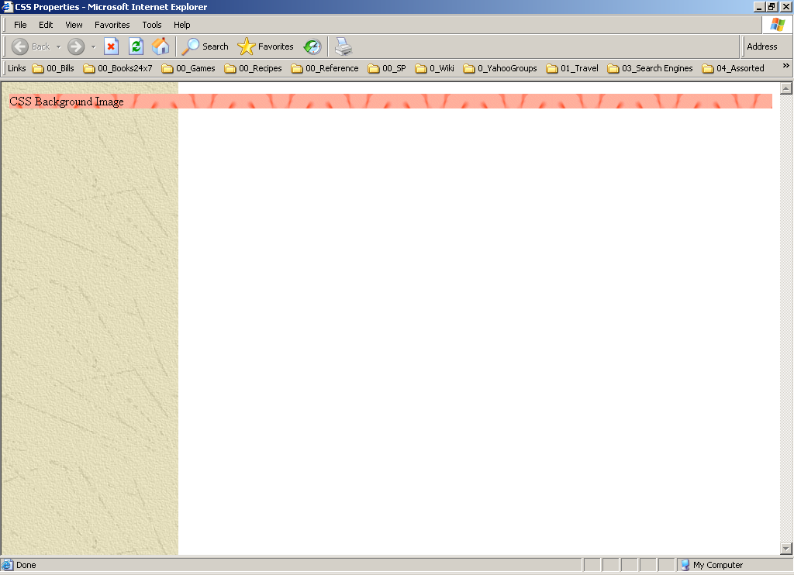
CSS background
(Set background image to repeat in y-direction)
<html>
<head>
<title>CSS Properties</title>
<style>
body {
background:url(bg1.jpg) repeat-y;
}
p { background: url(bg2.gif) repeat;}
</style>
</head>
<body>
<p>CSS Background Image</p>
</body>
</html>
You can also state that the background image be repeated in y-direction only.
http://www.w3schools.com/css/css_background.asp

Slide 30
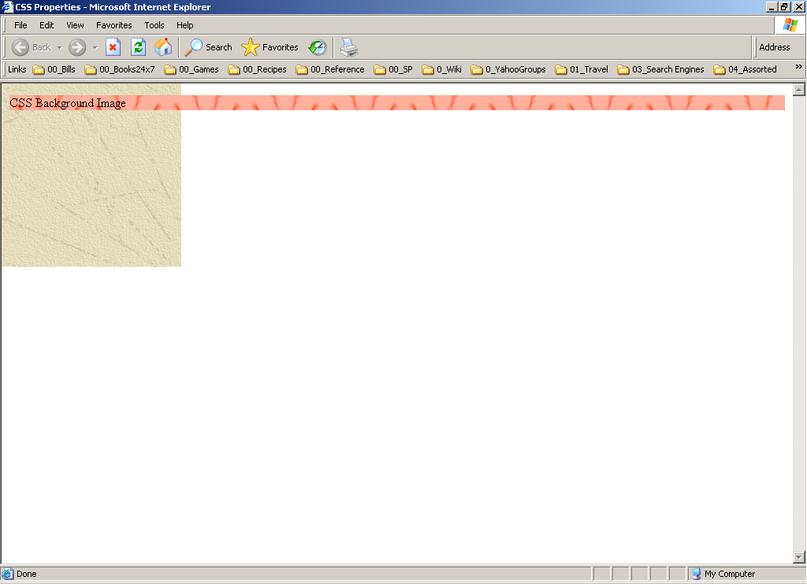
CSS background
(Set background image NOT to repeat)
<html>
<head>
<title>CSS Properties</title>
<style>
body {
background:url(bg1.jpg) no-repeat;
}
p { background: url(bg2.gif) repeat;}
</style>
</head>
<body>
<p>CSS Background Image</p>
</body>
</html>
You can also specify that the background image should NOT be repeated
http://www.w3schools.com/css/css_background.asp

Slide 31
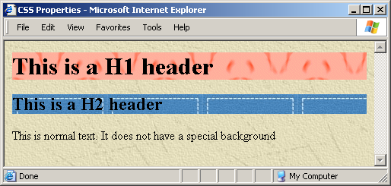
CSS background
(Setting background properties for <h1>, <h2> tags)
<head>
<title>CSS Properties</title>
<style>
body {background:url(bg1.jpg);}
h1 { background: url(bg2.gif);}
h2 { background: url(bg3.gif);}
</style>
</head>
<body>
<h1>This is a H1 header</h1>
<h2>This is a H2 header</h2>
This is normal text. It does not have a special background
</body>
</html>
Specify that:
the document uses bg1.jpg as background image
all <h1> tags should use bg2.gif as a background image.
all <h2> tags should use bg3.gif as a background image.
http://www.w3schools.com/css/css_background.asp

Slide 32

CSS color
<html>
<head>
<style type="text/css">
.highlight {
background:yellow;
color: red;
}
</style>
</head>
<body>
<p>
<span class="highlight">This is a text.</span> This is a text.
</p>
</body>
</html>
http://www.w3schools.com/css/css_text.asp

Slide 33
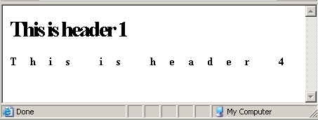
CSS letter-spacing
<html>
<head>
<style type="text/css">
h1 {letter-spacing: -3px}
h4 {letter-spacing: 0.5cm}
</style>
</head>
<body>
<h1>This is header 1</h1>
<h4>This is header 4</h4>
</body>
</html>

Slide 34
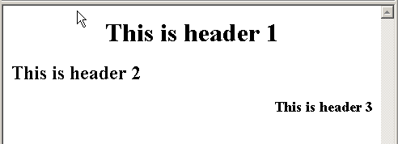
CSS text-align
<html>
<head>
<style type="text/css">
h1 {text-align: center}
h2 {text-align: left}
h3 {text-align: right}
</style>
</head>
<body>
<h1>This is header 1</h1>
<h2>This is header 2</h2>
<h3>This is header 3</h3>
</body>
</html>

Slide 35
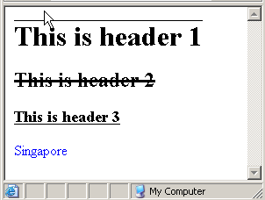
CSS text-decoration
<html><head>
<style type="text/css">
h1 {text-decoration: overline}
h2 {text-decoration: line-through}
h3 {text-decoration: underline}
a {text-decoration: none}
</style></head>
<body>
<h1>This is header 1</h1>
<h2>This is header 2</h2>
<h3>This is header 3</h3>
<a href="http://www. sg">Singapore</a>
</body></html>
http://www.w3schools.com/css/css_text.asp

Slide 36
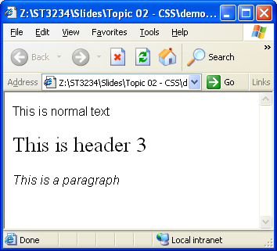
CSS Font
<html>
<head>
<style type="text/css">
body {font-family:arial;font-size:12pt;}
h3 {font-family: times;font-size:20pt;font-weight:500;}
p {font-style:italic;}
</style>
</head>
<body>
This is normal text
<h3>This is header 3</h3>
<p>This is a paragraph</p>
</body>
</html>
http://www.w3schools.com/css/css_font.asp

Slide 37
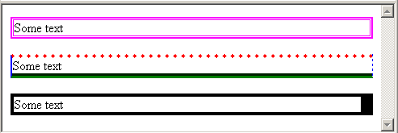
CSS Borders
<html><head>
<style type="text/css">
p.b1 {border: medium double rgb(250,0,255);}
p.b2 {
border-top: 5 dotted #ff0000;
border-left: thin solid blue;
border-bottom: thick groove green;
border-right: 1 dashed blue;
}
p.b3 {border-style: solid;border-right-width: 15px;}
</style>
</head>
<body>
<p class="b1">Some text</p><p class="b2">Some text</p><p class="b3">Some text</p>
</body></html>
http://www.w3schools.com/css/css_border.asp

Slide 38
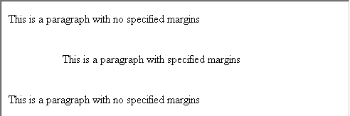
CSS Margins
<html>
<head>
<style type="text/css">
p.margin {margin: 1cm 0cm 1cm 2cm}
</style>
</head>
<body>
<p>This is a paragraph with no specified margins</p>
<p class="margin">This is a paragraph with specified margins</p>
<p>This is a paragraph with no specified margins</p>
</body>
</html>
http://www.w3schools.com/css/css_margin.asp

Slide 39
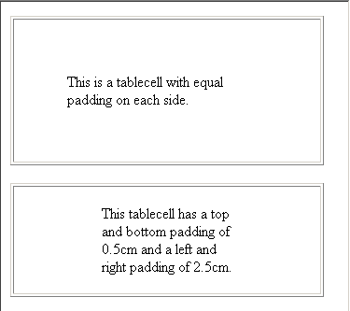
CSS Padding
<html><head>
<style type="text/css">
td.test1 {padding: 1.5cm}
td.test2 {padding: 0.5cm 2.5cm}
</style>
</head>
<body>
<table border="1">
<tr>
<td class="test1">tablecell with equal padding each side.</td>
</tr>
</table>
<br>
<table border="1">
<tr><td class="test2">
tablecell with top/bottom padding of 0.5cm and left right padding of 2.5cm.
</td></tr>
</table>
</body></html>
http://www.w3schools.com/css/css_padding.asp

Slide 40
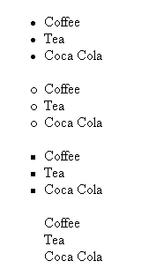
CSS Lists
<html>
<head>
<style type="text/css">
ul.disc {list-style-type: disc}
ul.circle {list-style-type: circle}
ul.square {list-style-type: square}
ul.none {list-style-type: none}
</style>
</head>
<body>
<ul class="disc">
<li>Coffee</li>
<li>Tea</li>
<li>Coca Cola</li>
</ul>
<ul class="circle">
<li>Coffee</li>
<li>Tea</li>
<li>Coca Cola</li>
</ul>
<ul class="square">
<li>Coffee</li>
<li>Tea</li>
<li>Coca Cola</li>
</ul>
<ul class="none">
<li>Coffee</li>
<li>Tea</li>
<li>Coca Cola</li>
</ul>
</body>
</html>
http://www.w3schools.com/css/css_list.asp

Slide 41
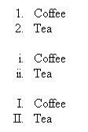
CSS Lists (Ordered) (1)
<head>
<title>CSS Properties</title>
<style>
<html>
<head>
<style type="text/css">
.decimal {list-style-type: decimal}
.lroman {list-style-type: lower-roman}
.uroman {list-style-type: upper-roman}
</style>
</head>
<body>
<ol class="decimal">
<li>Coffee</li>
<li>Tea</li>
</ol>
<ol class="lroman">
<li>Coffee</li>
<li>Tea</li>
</ol>
<ol class="uroman">
<li>Coffee</li>
<li>Tea</li>
</ol>
</body>
</html>

Slide 42
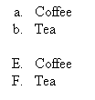
CSS Lists (Ordered) (2)
<html>
<head>
<style type="text/css">
.lalpha {list-style-type: lower-alpha}
.ualpha {list-style-type: upper-alpha}
</style>
</head>
<body>
<ol class="lalpha">
<li>Coffee</li>
<li>Tea</li>
</ol>
<ol class="ualpha" start="5">
<li>Coffee</li>
<li>Tea</li>
</ol>
</body>
</html>

Slide 43
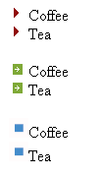
CSS Lists Images
<html>
<head>
<style type="text/css">
ul {list-style-image: url('b1.gif')}
.b2 {list-style-image: url('b2.gif')}
.b3 {list-style-image: url('b3.gif')}
</style>
</head>
<body>
<ul>
<li>Coffee</li>
<li>Tea</li>
</ul>
<ul class="b2">
<li>Coffee</li>
<li>Tea</li>
</ul>
<ul class="b3">
<li>Coffee</li>
<li>Tea</li>
</ul>
</body>
</html>

Slide 44
CSS Dimensions
control the height and width of an element.
Decrease / Increase the space between two lines.
Property | Description
height | Sets the height of an element
line-height | Sets the distance between lines
max-height | Sets the maximum height of an element
max-width | Sets the maximum width of an element
min-height | Sets the minimum height of an element
min-width | Sets the minimum width of an element
width | Sets the width of an element
http://www.w3schools.com/css/css_dimension.asp

Slide 45
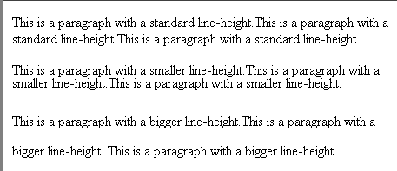
CSS Dimensions
<html>
<head>
<style type="text/css">
p.small {line-height: 0.4cm}
p.big {line-height: 0.9cm}
</style>
</head>
<body>
<p>
This is a paragraph with a standard line-height.This is a paragraph with a standard line-height.This is a paragraph with a standard line-height.</p>
<p class="small">
This is a paragraph with a smaller line-height.This is a paragraph with a smaller line-height.This is a paragraph with a smaller line-height.</p>
<p class="big">This is a paragraph with a bigger line-height.This is a paragraph with a bigger line-height. This is a paragraph with a bigger line-height.</p>
</body>
</html>

Slide 46

CSS Cursors
<html>
<head>
<title>CSS Properties</title>
<style>
h1 {cursor: crosshair;}
</style>
</head>
<body>
<p style="cursor:e-resize">e-resize</p>
<h1>This h1 has a crosshair cursor</h1>
The cursor is normal shaped here
</body>
</html>
http://www.w3schools.com/css/tryit.asp?filename=trycss_cursor

Slide 47
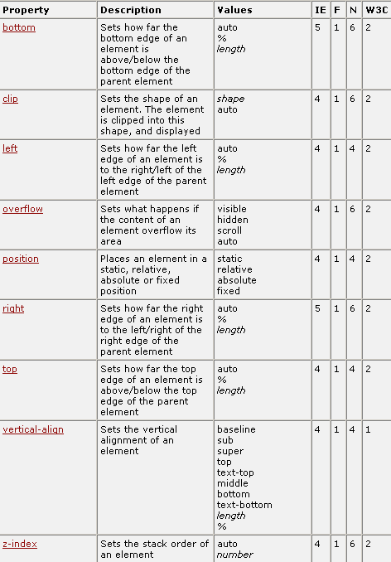
CSS Positioning
With CSS positioning elements,
you can have greater control
over how an element is placed
in your HTML page.
http://www.w3schools.com/css/css_positioning.asp

Slide 48
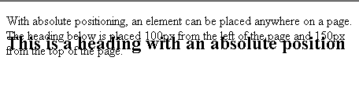
CSS Positioning
<html>
<head>
<style type="text/css">
.style1{
position:absolute;left:10px;top:40px;
}
</style>
</head>
<body>
<h2 class="style1">
This is a heading with an absolute position
</h2>
<p>With absolute positioning, an element can be placed anywhere on a page. The heading below is placed 100px from the left of the page and 150px from the top of the page.</p>
</body>
</html>

Slide 49
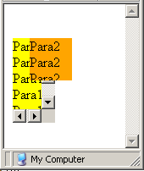
CSS Positioning
<html>
<head>
<style>
.p1 {
position:absolute;
left:10px;top:40px;
background-color:yellow;
width:50px; height:100px;
overflow:scroll;
}
.p2 {
position:absolute;
left:30px;top:40px;
background-color:orange;
overflow:hidden;
width:50px;height:50px;
}
</style>
</head>
<body>
<p class="p1">Para1<br>Para1<br>Para1<br>
Para1<br>Para1<br>Para1<br></p>
<p class="p2">Para2<br>Para2<br>Para2<br>
Para2<br>Para2<br>Para2<br></p>
</body>
</html>
Code continues here

Slide 50



CSS Pseudo-class
<html>
<head>
<style>
a:link {color: red; background-color:yellow;}
a:visited {color: blue;}
a:hover {background-color:gray;}
a:active {font-size:300%;}
</style>
</head>
<body>
This is a <a href=“http://www.sg”>link</a>
</body>
</html>

Slide 51
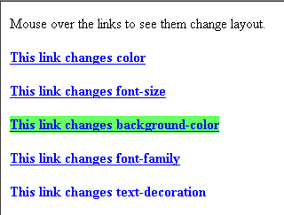
CSS Pseudo-class
<html>
<head>
<style type="text/css">
a.one:link {color: #ff0000}
a.one:visited {color: #0000ff}
a.one:hover {color: #ffcc00}
a.two:link {color: #ff0000}
a.two:visited {color: #0000ff}
a.two:hover {font-size: 150%}
a.three:link {color: #ff0000}
a.three:visited {color: #0000ff}
a.three:hover {background: #66ff66}
a.four:link {color: #ff0000}
a.four:visited {color: #0000ff}
a.four:hover {font-family: monospace}
a.five:link {color: #ff0000; text-decoration: none}
a.five:visited {color: #0000ff; text-decoration: none}
a.five:hover {text-decoration: underline}
</style>
</head>

Slide 52
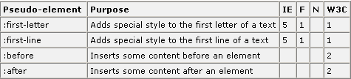
CSS Pseudo-elements
CSS pseudo-elements are used to add special effects to some selectors
http://www.w3schools.com/css/css_pseudo_elements.asp

Slide 53

CSS Pseudo-elements
<html>
<head>
<style type="text/css">
p:first-letter
{
color: #ff0000;
font-size:xx-large
}
</style>
</head>
<body>
<p>
You can use the :first-letter pseudo-element to add a special effect to the first letter of a text!
</p>
</body>
</html>

Slide 54
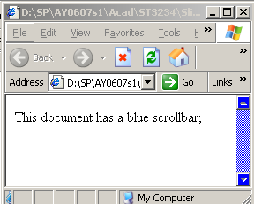
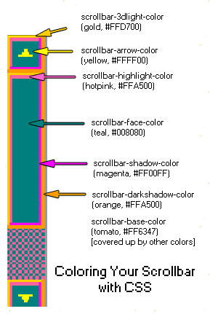
CSS Scrollbars
<html>
<head>
<style>
body {scrollbar-face-color:blue;}
</style>
</head>
<body>
This document has
a blue scrollbar
</body>
This works only on IE browsers!
http://websitetips.com/articles/css/scrollbars/

Slide 55
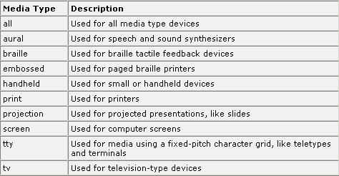
CSS Media Types
Media Types allow you to specify how documents will be presented in different media.
The document can be displayed differently on the screen, on the paper, with an aural browser, etc.
http://www.w3schools.com/css/css_mediatypes.asp

Slide 56
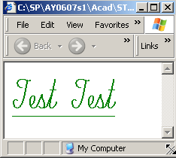
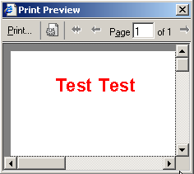
CSS Media Types
<html><head>
<style>
@media screen{
p {font-family:script; font-size:60px; color:green;text-decoration:underline;}
}
@media print{
p {font-family:arial;font-size:30px;color:red;}
}
@media screen,print {
p {font-weight:bold}
}
</style>
</head>
<body>
<p>Test Test</p>
</body></html>
screen view
print view

Slide 57
Cascading Order
!important
  Rules specified as !important will take precedence.
p { color: blue ! important}
Origin of Rules (Author's vs. Reader's)
  When rules between the author and reader’s conflict, the author's rules will win out over reader's
Order of Specification
  when two rules have the same weight, the last rule specified wins.
http://www.htmlhelp.com/reference/css/structure.html

Slide 58
Questions
Write a CSS rule that defines all <p> tags to have Arial font.
Write a CSS rule that creates a class selector named “bigbold” and renders all text in blue color with a green background.
Write a CSS rule that creates an ID selector named “menu” with font weight equal to 500.

Slide 59
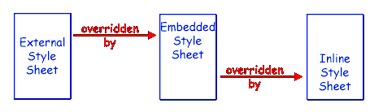
What are cascading stylesheets?
Summary
Set of rules that define how a web browser should display an HTML page.
Types of Style Sheets
  Inline
  Embedded
  External
What is meant by “Cascading”?

Slide 60



What can you format with CSS?
Summary
1. Font and background colors
2. Background images

Slide 61
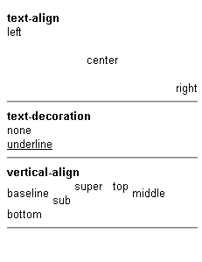
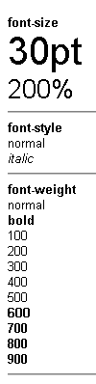
What can you format with CSS?
Summary
3. Text properties
4. Font properties

Slide 62
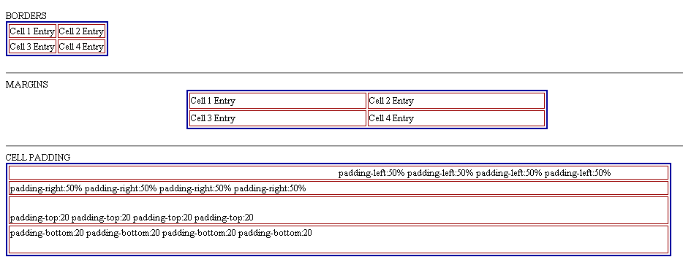
What can you format with CSS?
Summary
5. Box properties

Slide 63
CSS History
Appendix
CSS, Level 1 (1996)
  Concerned with applying simple styles to HTML elements
  http://www.w3.org/TR/REC-CSS1
CSS, Level 2 (1998)
  Supports media-specific style sheets (visual browsers, aural devices, printers, braille devices)
  http://www.w3.org/TR/REC-CSS2
CSS, Level 3 (draft 2001)
  Focused on modularization of the CSS specification
  http://www.w3.org/TR/css3-roadmap/
Notes:
See http://www.webreview.com/style/css1/charts/mastergrid.shtml for a summary of browser compatibility

Slide 64
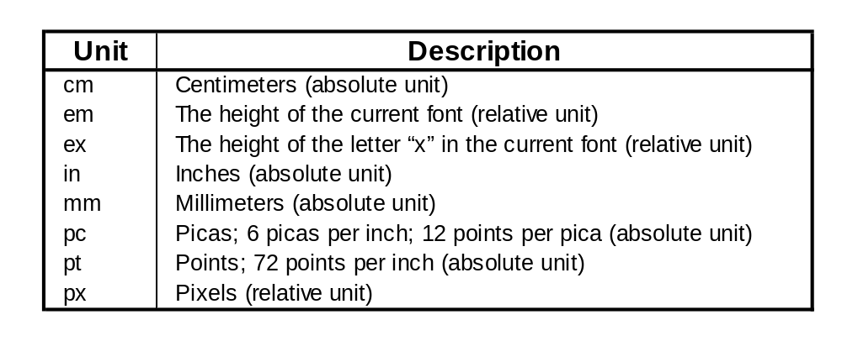
Length Units
Appendix

Slide 65
Links
Appendix
W3C CSS Validation Service
http://jigsaw.w3.org:80/css-validator
CSSCheck
http://www.htmlhelp.com/tools/csscheck/
Browser compatibility links @ Google
http://directory.google.com/Top/Computers/Data_Formats/Style_Sheets/CSS/Browser_Compatibility/
w3schools
http://www.w3schools.com/css/default.asp

Slide 66

Hints for Practical 03

Slide 67
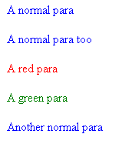
Practical 03 – Question 04
<html>
<head>
<style>
p {color:blue;}
.redpara {color:red;}
.greenpara {color:green;}
</style>
</head>
<body>
<p>A normal para</p>
<p>A normal para too</p>
<p class=“redpara”>A red para</p>
<p class=“greenpara”>A green para</p>
<p>Another normal para</p>
</body>
</html>
This question lets you practise how to create and apply class selectors.
Class selectors start off with a “.” (dot symbol) and are applied using “class=“

Slide 68
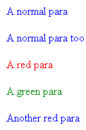
Practical 03 – Question 05
<html>
<head>
<style>
p {color:blue;}
.redpara {color:red;}
#greenpara {color:green;}
</style>
</head>
<body>
<p>A normal para</p>
<p>A normal para too</p>
<p class=“redpara”>A red para</p>
<p id=“greenpara”>A green para</p>
<p class=“redpara”>Another red para</p>
</body>
</html>
This question lets you practise how to create and apply ID selectors.
ID selectors start off with a “#” (hex symbol) and are applied using “id=“
ID selectors are the only tag that has that property in the whole page.

Slide 69
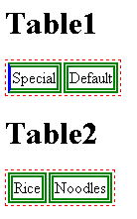
Practical 03 – Question 06
<html>
<head>
<style>
table {border: 1px dotted red;}
td {border: 5px double green;}
.special {border-left: 3px solid blue;}
</style>
</head>
<body>
<h1>Table1</h1>
<table>
<tr>
<td class=“special”>Special</td>
<td>Default</td>
</tr>
</table>
<h1>Table2</h1>
<table>
<tr><td>Rice</td><td>Noodles</td></tr>
</table>
</body>
</html>
Notice that both tables all have red dotted borders?
This is because CSS specifies that any “table” tag will have red borders.
The CSS “td” tag specifies all table cells (td) have green double borders.
But only the special cell has blue left border.

Slide 70

Practical 03 – Question 10
<html>
<body>
<h1 style="z-index:1;position:absolute;left:10;top:10;background-color:red">
Layer 1
</h1>
<h1 style="z-index:2;position:absolute;left:15;top:15;background-color:green">
Layer 2
</h1>
<h1 style="z-index:3;position:absolute;left:25;top:25;background-color:blue">
Layer 3
</h1>
</body>
</html>
This example teaches you how to create layered effects using the z-index property.
The higher the z-index, the more “on top” it is.

Slide 71
Appendices

Slide 72
Create different cursors with CSS
<html>
<body>
<p>Move the mouse over the words to see the cursor change:</p>
<span style="cursor:auto">Auto</span><br />
<span style="cursor:crosshair">Crosshair</span><br />
<span style="cursor:default">Default</span><br />
<span style="cursor:pointer">Pointer</span><br />
<span style="cursor:move">Move</span><br />
<span style="cursor:e-resize">e-resize</span><br />
<span style="cursor:ne-resize">ne-resize</span><br />
<span style="cursor:nw-resize">nw-resize</span><br />
<span style="cursor:n-resize">n-resize</span><br />
<span style="cursor:se-resize">se-resize</span><br />
<span style="cursor:sw-resize">sw-resize</span><br />
<span style="cursor:s-resize">s-resize</span><br />
<span style="cursor:w-resize">w-resize</span><br />
<span style="cursor:text">text</span><br />
<span style="cursor:wait">wait</span><br />
<span style="cursor:help">help</span>
</body>
</html>

Slide 73
Specifying “media” attribute
You can also specify the “media” attribute in the <link> or <style> tag to indicate to the browser that the stylesheet should only apply in certain cases
<html>
<head>
<style>
a:link {color: red; background-color:yellow;}
a:visited {color: blue;}
a:hover {background-color:gray;}

