Slide 1
RELATIONAL
MODEL DESIGN AND NORMALISATION

Slide 2
Relational Model and Normalization -
Learning Objectives
to understand the need to design databases
to learn about the Relational Model and how it pertains to the design of relational databases
to become familiar with some alternative terminologies and conventions used in Relational Models
to understand and be able to identify insertion, deletion and update anomalies in relations

Slide 3
Relational Model and Normalization -
Learning Objectives (cont)
to know the Normal Forms (NFs) and how each NF addresses problems or anomalies in databases
to learn how to apply the process of Normalization
to be able to understand database processing concepts
to be aware of some database applications
to recognise what knowledge is needed to work as a database application developer or database administrator

Slide 4
The Relational Model
Introduced in 1970
Created by E.F. Codd
  He was an IBM engineer
  The model used mathematics known as “relational algebra”
Now the standard model for commercial DBMS products
2-<number>

Slide 5
Important Relational Model Terms
Entity
Relation
Functional Dependency
Determinant
Candidate Key
Composite Key
Primary Key
Surrogate Key
Foreign Key
Referential integrity constraint
Normal Form
Multivalued Dependency
2-<number>

Slide 6
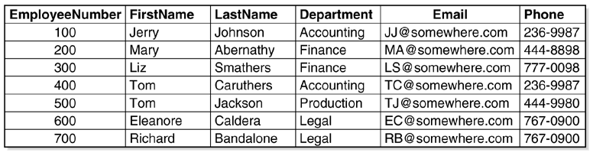
A Relation
A relation is a two-dimensional table :
  Rows contain data about an entity
  Columns contain data about attributes of the entity
  All entries in a column are of the same kind
  Cells of the table hold a single value
2-<number>

Slide 7
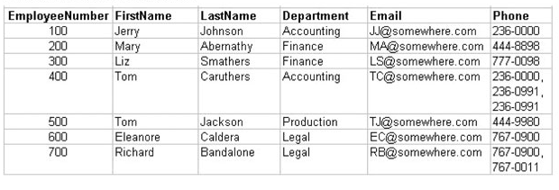
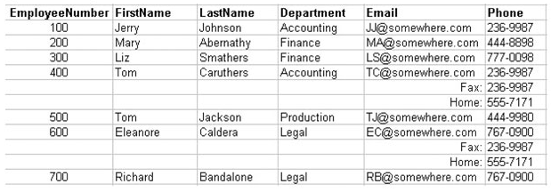
Tables That Are Not Relations:
1) multiple values in cell
2) required order of rows
2-<number>

Slide 8
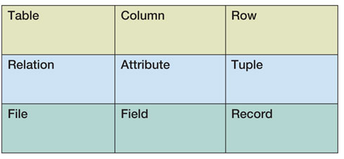
Alternative Terminology
Although not all tables are relations, the terms table and relation are normally used interchangeably
The following sets of terms are equivalent:
2-<number>

Slide 9
Functional Dependency
A functional dependency occurs when the value of one (a set of) attribute(s) determines the value of a second (set of) attribute(s):
    StudentID → StudentName
    StudentID → (DormName, DormRoom, Fee)
The attribute on the left side of the functional dependency is called the determinant
Functional dependencies may be based on equations:
  ExtendedPrice = Quantity X UnitPrice
  (Quantity, UnitPrice) → ExtendedPrice
Function dependencies are not equations!
2-<number>

Slide 10
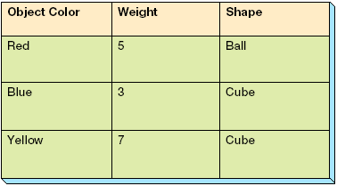
Functional Dependencies Are Not Equations
If A → (B, C), then A → B and A→ C
      ObjectColor → Weight
      ObjectColor → Shape
      ObjectColor → (Weight, Shape)
2-<number>

Slide 11
Composite Determinants
Composite determinant: A determinant of a functional dependency that consists of more than one attribute
(StudentName, ClassName) → (Grade)
If (A,B) → C, then neither A nor B alone determines C
2-<number>
Notes:
FUNCTIONAL DEPENDENCY RULES :
I) If A → (B, C), then A → B and A→ C
II) If (A,B) → C, then neither A nor B determines C by itself

Slide 12
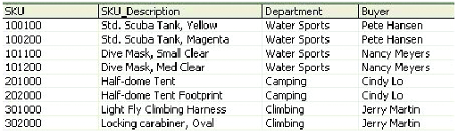
Functional Dependencies in the SKU_DATA Table
SKU → (SKU_Description, Department, Buyer)
SKU_Description → (SKU, Department, Buyer)
Does Department determine Buyer?
Buyer → Department
2-<number>

Slide 13
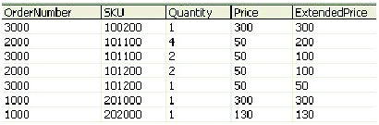
Functional Dependencies in the ORDER_ITEM Table
(OrderNumber, SKU) → (Quantity, Price, ExtendedPrice)
(Quantity, Price) → (ExtendedPrice)
2-<number>

Slide 14
What Makes Determinant Values Unique?
A determinant is unique in a relation if, and only if, it determines every other column in the relation
You cannot find the determinants of all functional dependencies simply by looking for unique values in one column:
  Data set limitations
  Must be logically a determinant
2-<number>

Slide 15
Keys
A key is a combination of one or more columns that is used to identify rows in a relation
A composite key is a key that consists of two or more columns
2-<number>

Slide 16
Candidate and Primary Keys
A candidate key is a key that determines all of the other columns in a relation
A primary key is a candidate key selected as the primary means of identifying rows in a relation:
  There is one and only one primary key per relation
  The primary key may be a composite key
  The ideal primary key is short, numeric and never changes
2-<number>

Slide 17
Surrogate Keys
A surrogate key as an artificial column added to a relation to serve as a primary key:
  DBMS supplied
  Short, numeric and never changes – an ideal primary key!
  Has artificial values that are meaningless to users
  Normally hidden in forms and reports
2-<number>

Slide 18
Surrogate Keys
NOTE: The primary key of the relation is underlined below:
RENTAL_PROPERTY without surrogate key:
RENTAL_PROPERTY (Street, City,
State/Province, Zip/PostalCode, Country, Rental_Rate)
RENTAL_PROPERTY with surrogate key:
  RENTAL_PROPERTY (PropertyID, Street, City,
  State/Province, Zip/PostalCode, Country, Rental_Rate)
2-<number>

Slide 19
Foreign Keys
A foreign key is the primary key of one relation that is placed in another relation to form a link between the relations:
  A foreign key can be a single column or a composite key
  The term refers to the fact that key values are foreign to the relation in which they appear as foreign key values
2-<number>

Slide 20
Foreign Keys
NOTE: The primary keys of the relations are underlined and any foreign keys are in italics in the relations below:
DEPARTMENT (DepartmentName, BudgetCode, ManagerName)
EMPLOYEE (EmployeeNumber, EmployeeName,
DepartmentName)
2-<number>

Slide 21
The Referential Integrity Constraint
A referential integrity constraint is a statement that limits the values of the foreign key to those already existing as primary key values in the corresponding relation
2-<number>

Slide 22
Foreign Key with a
Referential Integrity Constraint
NOTE: The primary key of the relation is underlined and any foreign keys are in italics in the relations below:
SKU_DATA (SKU, SKU_Description, Department, Buyer)
ORDER_ITEM (OrderNumber, SKU, Quantity, Price,
ExtendedPrice)
Where ORDER_ITEM.SKU must exist in SKU_DATA.SKU
2-<number>

Slide 23
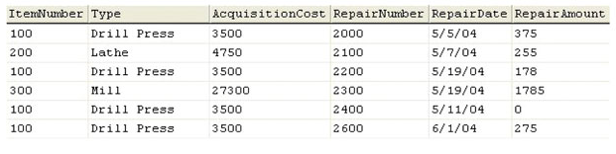
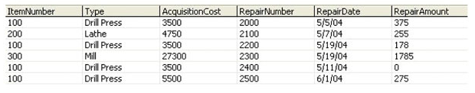
Modification Anomalies
1 Deletion Anomaly
2 Insertion Anomaly 3 Update Anomaly
Insert record for repair of new type (Chainsaw) : someone has to create ItemNumber, Type, AcCost first !
AcCost = 3500 or 5500 ????
incorrect update operation on AcquisitionCost for Drill Press
2-<number>
Notes:
1 Deletion anomaly – row 2 deleted, lathe cost is lost.
2 Insertion Anomaly – last row inserted with different acquisition cost
The EQUIPMENT_REPAIR table before and after an incorrect update operation on AcquisitionCost for Type = Drill Press:

Slide 24
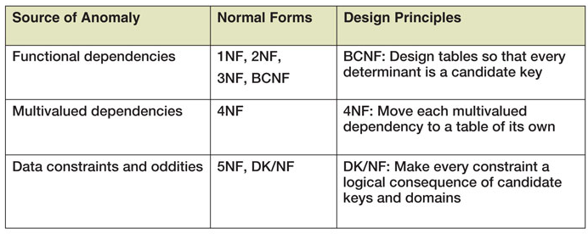
Normal Forms
Relations are categorized as a normal form based on which modification anomalies or other problems that they are subject to:
2-<number>

Slide 25
Normal Forms
1NF – A table that qualifies as a relation is in 1NF
2NF – A relation is in 2NF if all of its nonkey attributes are dependent on all of the primary key
3NF – A relation is in 3NF if it is in 2NF and has no determinants except the primary key
Boyce-Codd Normal Form (BCNF) – A relation is in BCNF if every determinant is a candidate key
2-<number>

Slide 26
The normalization process :
Starting with an Unnormalized table –
Remove repeating and multivalued attributes
    →1NF relation
Remove partially dependent attributes
    → 2NF
Remove transitively dependent attributes
    → 3NF
Apply additional normalization
: remove unwanted determinant such that all remaining determinant is a candidate key
→ BCNF
: put each multivalued attributes in a separate relation (some strict interpretation of 1NF would already avoid this)
→ 4NF
        → 5NF ???

Slide 27
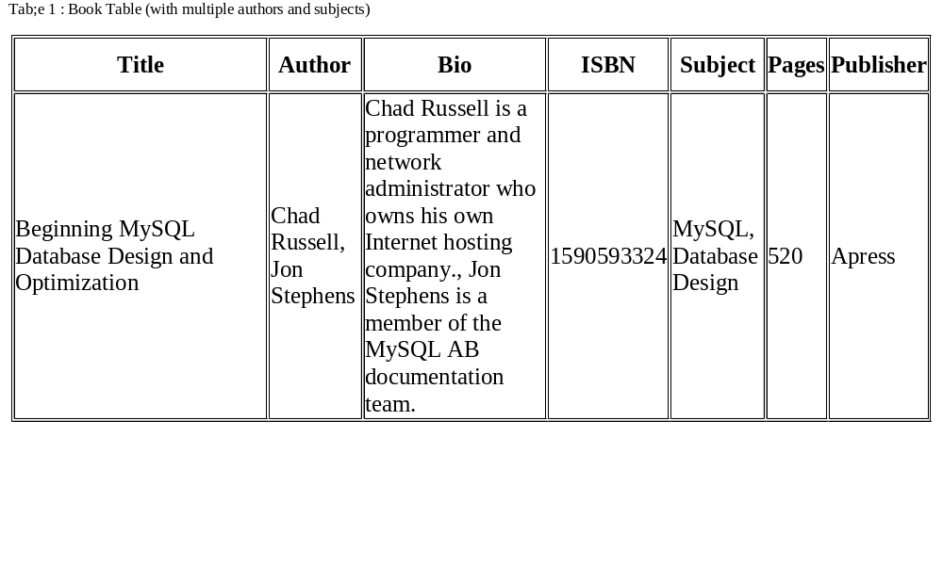
Reference : http://dev.mysql.com/tech-resources/articles/intro-to-normalization.html#03

Slide 28
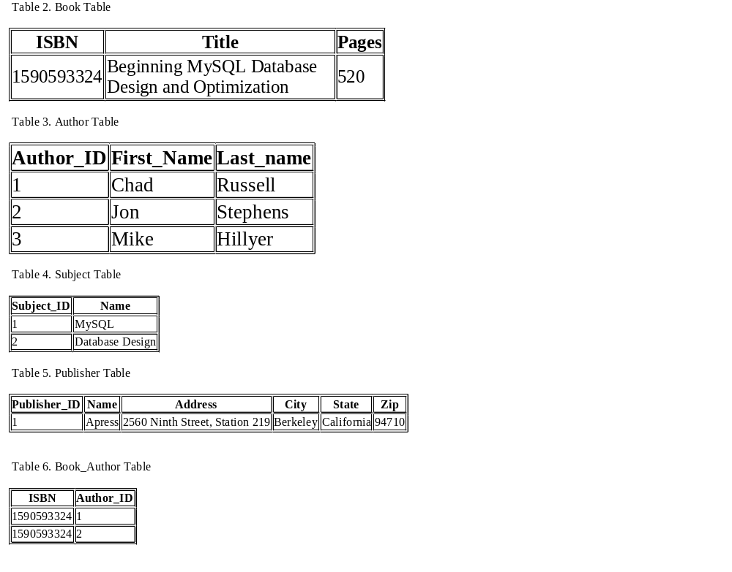
FIRST NORMAL FORM
No repeating groups

Slide 29
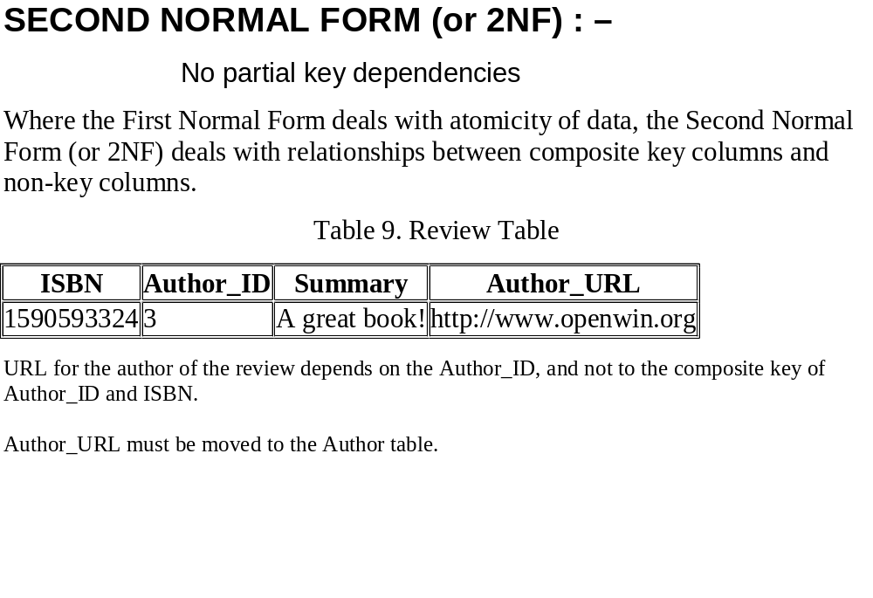
Reference : http://dev.mysql.com/tech-resources/articles/intro-to-normalization.html#03

Slide 30
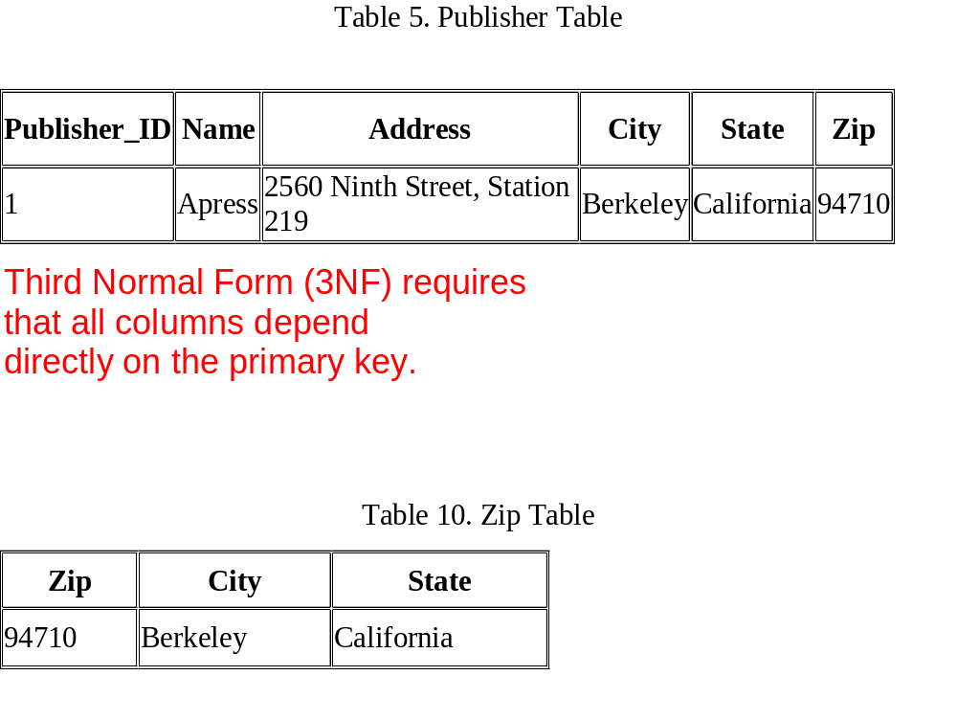
→ Remove Transitive Dependencies
Reference : http://dev.mysql.com/tech-resources/articles/intro-to-normalization.html#03

Slide 31
Putting a Relation into BCNF:
Eg 1 : EQUIPMENT_REPAIR
2-<number>

Slide 32
Putting a Relation into BCNF:
Eg 1 : EQUIPMENT_REPAIR
EQUIPMENT_REPAIR (ItemNumber, Type, AcquisitionCost,
RepairNumber, RepairDate, RepairAmount)
ItemNumber → (Type, AcquisitionCost)
RepairNumber → (ItemNumber, Type, AcquisitionCost,
RepairDate, RepairAmount)
ITEM (ItemNumber, Type, AcquisitionCost)
REPAIR (ItemNumber, RepairNumber, RepairDate, RepairAmount)
Where REPAIR.ItemNumber must exist in
ITEM.ItemNumber
2-<number>

Slide 33
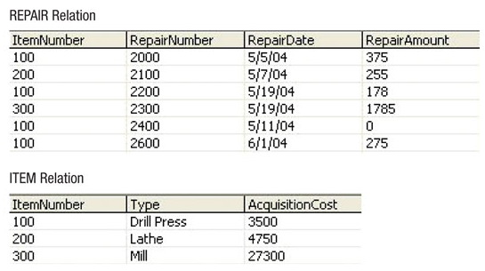
Putting a Relation into BCNF:
Eg 1 : New Relations
2-<number>

Slide 34
Putting a Relation into BCNF:
Eg 2 : SKU_DATA
2-<number>

Slide 35
Putting a Relation into BCNF:
Eg 2 : SKU_DATA
SKU_DATA (SKU, SKU_Description, Department, Buyer)
SKU → (SKU_Description, Department, Buyer)
SKU_Description → (SKU, Department, Buyer)
Buyer → Department
SKU_DATA (SKU, SKU_Description, Buyer)
BUYER (Buyer, Department)
Where SKU_DATA.Buyer must exist in BUYER.Buyer
2-<number>

Slide 36
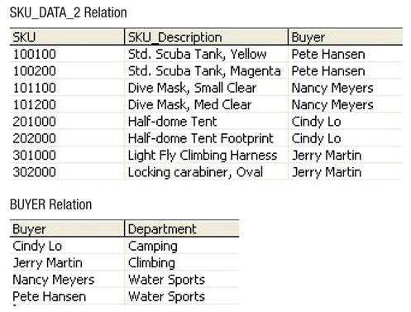
Putting a Relation into BCNF:
Eg 2 : New Relations
2-<number>

Slide 37
Multivalued Dependencies
A multivalued dependency occurs when a determinant determines a particular set of values:
Employee →→ Degree
  Employee →→ Sibling
  PartKit →→ Part
The determinant of a multivalued dependency can never be a primary key
2-<number>

Slide 38
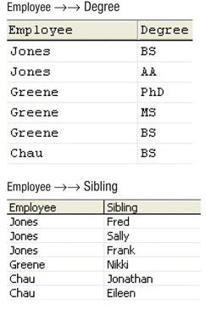
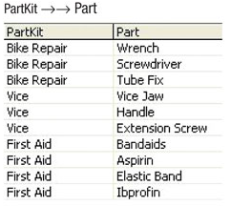
Multivalued Dependencies
2-<number>

Slide 39
Eliminating Anomolies from Multivalued Dependencies
Multivalued dependencies are not a problem if they are in a separate relation, so:
  Always put multivalued dependencies into their own relation
  This is known as Fourth Normal Form (4NF)
2-<number>

