Slide 1
STRUCTURED QUERY LANGUAGE (SQL)

Slide 2
SQL - Learning Objectives
to be able to assess the structure and content of existing data
to know the advantages and disadvantages of normalization
to be able to distinguish between the design principles applicable to read-only and updatable databases
to learn how to design read-only and updatable databases
to be able to determine when it is appropriate to extract data from an updatable database and store them in a read-only database
to recognize and be able to correct common design problems
  The multivalue, multicolumn problem.
  The inconsistent values problem.
  The missing values problem.
  The general-purpose remarks column problem

Slide 3
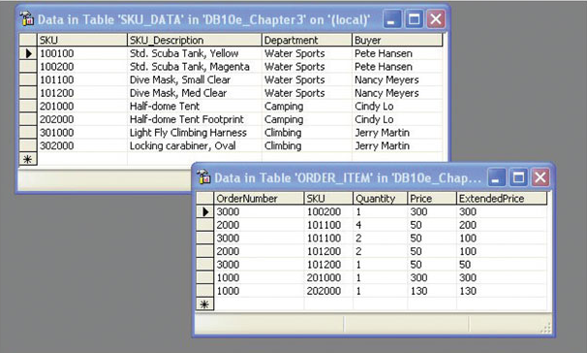
Received these tables of existing data….store as they are?
Or combine them in our new DB?
2-<number>

Slide 4
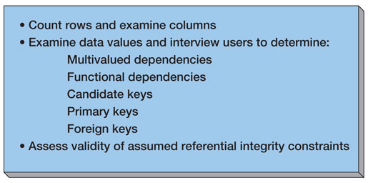
Assessing Table Structure
2-<number>

Slide 5
Counting Rows in a Table
To count the number of rows in a table use the SQL built-in function COUNT(*):
SELECT COUNT(*) AS NumRows
FROM SKU_DATA;
2-<number>

Slide 6
Examining the Columns
To determine the number and type of columns in a table, use an SQL SELECT statement
To limit the number of rows retreived, use the SQL TOP {NumberOfRows} keyword:
SELECT TOP (10) *
FROM SKU_DATA;
2-<number>

Slide 7
Checking Validity of Assumed Referential Integrity Constraints
Given two tables with an assumed foreign key constraint:
SKU_DATA (SKU, SKU_Description, Department, Buyer)
BUYER (BuyerName, Department)
Where SKU_DATA.Buyer must exist in BUYER.BuyerName
2-<number>

Slide 8
Checking Validity of Assumed Referential Integrity Constraints
To find any foreign key values that violate the foreign key constraint:
SELECT Buyer
FROM SKU_DATA
WHERE Buyer NOT IN
(SELECT Buyer
FROM SKU_DATA, BUYER
WHERE SKU_DATA.BUYER =
BUYER.BuyerName)
;
2-<number>

Slide 9
Type of Database:
Updateable database or read-only database?
If updateable database, we normally want tables in BCNF
  BCNF is used to control anomalies from functional dependencies
There are times when BCNF is not desirable
  The classic example is ZIP codes:
    ZIP codes almost never change
  Any anomalies are likely to be caught by normal business practices
  Not having to use SQL to join data in two tables will speed up application processing
If read-only database, we may not use BCNF tables
2-<number>
Notes:
BCNF is used to control anomalies from functional dependencies
There are times when BCNF is not desirable
The classic example is ZIP codes:
ZIP codes almost never change
Any anomalies are likely to be caught by normal business practices
Not having to use SQL to join data in two tables will speed up application processing

Slide 10
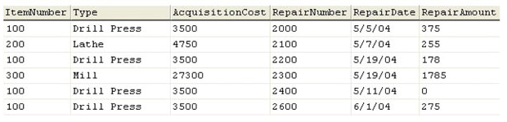
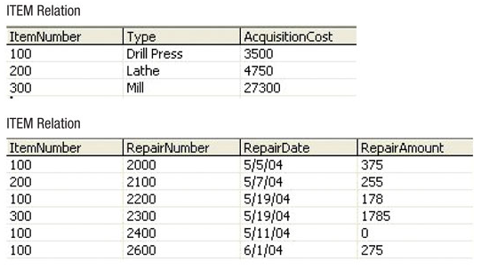
Non-Normalized Table:
EQUIPMENT_REPAIR
Advantages of Normalization:
Eliminate modification anomalies
Reduce duplicated data
  Eliminate data integrity problems
  Save file space
Normalized Tables:
ITEM and REPAIR
Disadvantages :
More complicated SQL required for multitable subqueries and joins
Extra work for DBMS means slower applications
2-<number>

Slide 11
Copying Data to New Tables
To copy data from one table to another, use the SQL command INSERT INTO TableName command:
INSERT INTO ITEM
SELECT DISTINCT ItemNumber, Type,
AcquisitionCost
FROM EQUIPMENT_REPAIR;
INSERT INTO REPAIR
SELECT ItemNumber, RepairNumber,
RepairDate, RepairAmmount
FROM EQUIPMENT_REPAIR;
2-<number>

Slide 12
Read-Only Databases
Read-only databases are non-operational databases using data extracted from operational databases
They are used for querying, reporting and data mining applications
They are never updated (in the operational database sense – they may have new data imported form time-to-time)
2-<number>

Slide 13
Denormalization
For read-only databases, normalization is seldom an advantage
  Application processing speed is more important
Denormalization is the joining of data in normalized tables prior to storing the data
The data is then stored in non-normalized tables
2-<number>

Slide 14
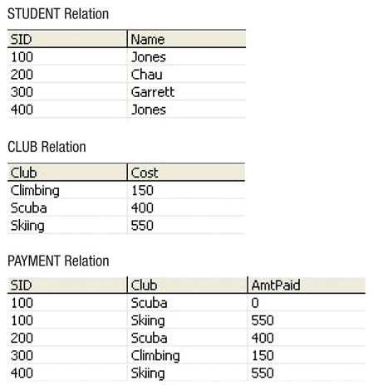
Normalized Tables
2-<number>

Slide 15
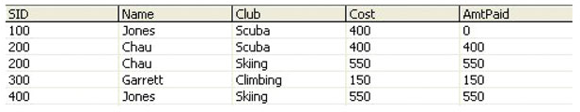
Denormalizing the Data
INSERT INTO PAYMENT_DATA
SELECT STUDENT.SID, Name, CLUB.Club,
Cost, AmtPaid
FROM STUDENT, PAYMENT, CLUB
WHERE STUDENT.SID = PAYMENT.SID
AND PAYMENT.Club = CLUB.Club;
2-<number>

Slide 16
SQL (contd)
- Learning Objectives
to learn what a query language is and what it is used for
to gain some basic knowledge of Structured Query Language (SQL)
to learn how to query a database table
to be able to filter the queries to display results meeting one or more conditions
to be able to perform calcutation functions in SQL queries
to be able to write queries in SQL to retrieve data from multiple tables using table JOINs.

Slide 17
SQL Built-in Functions
There are five SQL Built-in Functions:
  COUNT
  SUM
  AVG
  MIN
  MAX
1-<number>

Slide 18

SQL Built-in Functions (Continued)
SELECT SUM (ExtendedPrice)
AS Order3000Sum
FROM ORDER_ITEM
WHERE OrderNumber = 3000;
1-<number>

Slide 19

SQL Built-in Functions (Continued)
SELECT SUM (ExtendedPrice) AS OrderItemSum,
AVG (ExtendedPrice) AS OrderItemAvg,
MIN (ExtendedPrice) AS OrderItemMin,
MAX (ExtendedPrice) AS OrderItemMax
FROM ORDER_ITEM;
1-<number>

Slide 20

SQL Built-in Functions (Continued)
SELECT COUNT(*) AS NumRows
FROM ORDER_ITEM;
1-<number>

Slide 21

SQL Built-in Functions (Continued)
SELECT COUNT
(DISTINCT Department)
AS DeptCount
FROM SKU_DATA;
1-<number>

Slide 22
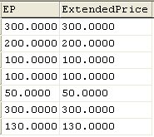
Arithmetic in SELECT Statements
SELECT Quantity * Price AS EP,
ExtendedPrice
FROM ORDER_ITEM;
1-<number>

Slide 23
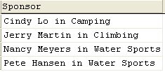
String Functions in SELECT Statements
SELECT DISTINCT RTRIM (Buyer)
+ ' in ' + RTRIM (Department) AS Sponsor
FROM SKU_DATA;
1-<number>

Slide 24
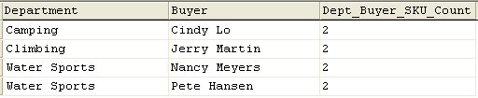
The SQL keyword GROUP BY
SELECT Department, Buyer,
COUNT(*) AS
Dept_Buyer_SKU_Count
FROM SKU_DATA
GROUP BY Department, Buyer;
1-<number>

Slide 25
The SQL keyword GROUP BY (Continued)
In general, place WHERE before GROUP BY. Some DBMS products do not require that placement, but to be safe, always put WHERE before GROUP BY.
The HAVING operator restricts the groups that are presented in the result.
There is an ambiguity in statements that include both WHERE and HAVING clauses. The results can vary, so to eliminate this ambiguity SQL always applies WHERE before HAVING.
1-<number>

Slide 26

The SQL keyword GROUP BY (Continued)
SELECT Department, COUNT(*) AS
Dept_SKU_Count
FROM SKU_DATA
WHERE SKU <> 302000
GROUP BY Department
ORDER BY Dept_SKU_Count;
1-<number>

Slide 27

The SQL keyword GROUP BY (Continued)
SELECT Department, COUNT(*) AS
Dept_SKU_Count
FROM SKU_DATA
WHERE SKU <> 302000
GROUP BY Department
HAVING COUNT (*) > 1
ORDER BY Dept_SKU_Count;
WHERE before GROUP BY
WHERE before HAVING
GROUP BY before ORDER BY
1-<number>

Slide 28

Querying Multiple Tables: Subqueries
SELECT SUM (ExtendedPrice) AS Revenue
FROM ORDER_ITEM
WHERE SKU IN
(SELECT SKU
FROM SKU_DATA
WHERE Department = 'Water Sports');
Note: The second SELECT statement is a subquery.
A subquery can only be used to retrieve data from the top table
1-<number>

Slide 29

Querying Multiple Tables: Subqueries (Continued)
SELECT Buyer
FROM SKU_DATA
WHERE SKU IN
(SELECT SKU
FROM ORDER_ITEM
WHERE OrderNumber IN
(SELECT OrderNumber
FROM RETAIL_ORDER
WHERE OrderMonth = 'January'
AND OrderYear = 2004));
1-<number>

Slide 30
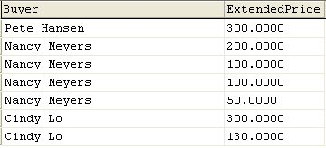
Querying Multiple Tables:
Joins
SELECT Buyer, ExtendedPrice
FROM SKU_DATA, ORDER_ITEM
WHERE SKU_DATA.SKU = ORDER_ITEM.SKU;
A Join can be used to get data from any/all of the tables
1-<number>

Slide 31

Querying Multiple Tables:
Joins (Continued)
SELECT Buyer, SUM(ExtendedPrice)
AS BuyerRevenue
FROM SKU_DATA, ORDER_ITEM
WHERE SKU_DATA.SKU = ORDER_ITEM.SKU
GROUP BY Buyer
ORDER BY BuyerRevenue DESC;
1-<number>

Slide 32
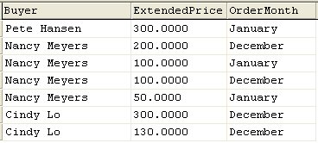
Querying Multiple Tables:
Joins (Continued)
SELECT Buyer, ExtendedPrice, OrderMonth
FROM SKU_DATA, ORDER_ITEM, RETAIL_ORDER
WHERE SKU_DATA.SKU = ORDER_ITEM.SKU
AND ORDER_ITEM.OrderNumber =
RETAIL_ORDER.OrderNumber;
1-<number>

