Slide 1

Chapter 10
Graphical User Interface

Slide 2
Introduction
Effectiveness & Acceptance of all systems depend on how easy it is to use
This depends primarily on the User Interface (UI)
Poorly designed UI leads to increased training cost and reduced productivity
Causes frustration and inefficiency
Can lead to otherwise great products being rejected

Slide 3
Graphical User Interface (GUI)
Good GUI Design required whenever users interact with controls or displays
Product’s usability, acceptance and marketability depends on product being easy to use and learn
A good GUI is intuitive, efficient and comfortable to use
User Experience is good
E.g. Military aircraft, vehicles, airports, audio equipment, computer peripherals

Slide 4
Graphical User Interface (GUI)
Conversely, if users find product difficult to learn and use, cumbersome and inefficient, they will reject it
Even excellent technical products will fail

Slide 5
Effective GUI Design

Slide 6
Effective GUI Design
Need for Good Usability
  The elegance, clarity and feel of an interface
  Must give impression of good quality
Human Factor Contribution **
  Consideration of how Humans think and work
  Optimised to increase learning speed and comfort level

Slide 7
Effective GUI Design
Ergonomically Designed **
  Interface design to fit the human body
  Enable good posture, ease of movement and appropriate use of muscles
Well Documented
  Interface must be well documented

Slide 8
Guidelines for Good Human Factor and Ergonomic Design

Slide 9



Guidelines for Ergonomic Design
Consistency
  Consistent interface behaviour across different screens
  Consistent terminology
  Consistent icons
Simplicity
  Breaks complex tasks into simpler ones
  Avoid long command sequences
  Use familiar icons to keep task simple
Wait Save Zoom

Slide 10
Guidelines for Ergonomic Design
Consider Human Memory Limitations
  Make commands available rather then require user to memorise
  Provide cues/navigation aids for long command sequences e.g. breadcrumbs, persistent menu displays, pop-up help menus
  Provide ongoing feedback
  Provide warnings and reminders if appropriate

Slide 11
Guidelines for Ergonomic Design
Cognitive Directness
  Simplify the mental process (e.g. don’t use Cntrl-I for Indent etc). Use icons instead.
  Use visual cues (direction arrows for movement etc)
  Use real world metaphors (desktop, trash can, folder)
Use Feedback Mechanisms
  E.g. Click sounds for select action, shadow for depressed keys, grey colours for disabled options
  E.g. Progress bar or % complete for long process
  Provide context-specific feedback customised to action rather than general feedback (difficult to do)

Slide 12
Guidelines for Ergonomic Design
Good System Messages
  Don’t intimidate the user – execution error 159, fatal error, run aborted, kill job, catastrophic error
Don’t Anthropomorphize
  Avoid giving objects human characteristics e.g. greetings like “How are you today?”, use of smiley etc

Slide 13



Guidelines for Ergonomic Design
Show Modality
  Show user which mode he is in e.g. insert or overwrite
  Allow escape routes
  Allow undo and redo
Appropriate Attention Grabbing
  Use appropriate icons and colours e.g. green tick, yellow warning signs, red crosses
  Don’t overuse beeping, flashing, video and audio
  Consider colour scheme carefully

Slide 14
Guidelines for Ergonomic Design
Display Issues
  Maintain display inertia – change screen as little as possible
  Manage screen complexity – hidden drop-down menus, command groups etc
Individual Differences
  Cater to individual preference
  Give different paths to same function – e.g. choice of using direct command, icon, drop down menu
  Allow customisation (e.g. in Nokia phones)

Slide 15
User Interfaces in Embedded Systems

Slide 16
UI in Embedded Systems
UI in embedded systems pose certain challenges
  Input devices are limited to switches, buttons & keypads
  Displays are usually LEDs or small LCD screens
  Whole, large screens unavailable
Poorly designed UIs make systems very hard to use
If users cannot get to the product features, they will remain underused
Consider a car audio set, home entertainment system or mobile phone. Are they easy to use?

Slide 17
UI in Embedded Systems
It is especially important that UI for embedded system is intuitive
Otherwise, users will keep referring to the user manual
Some companies study (and video tape) how users interact with their product prototypes without the benefit of manuals
They then improve their interfaces from there

Slide 18
UI in Embedded Systems
VCR
POWER
AM
PM
EVERY
SUN
<
>
1
2
3
4
5
6
TIMER
TV/VCR
MON
TUE
WED
THU
FRI
SAT
7
8
9
0
SP
EP
Poor GUI – Video Cassette Recorder

Slide 19
GUI in Embedded Systems
Some embedded systems have a sizable screen
If so, GUI can be used and interfaces can be more flexibly designed
But care must still be take because
  Screen usually not large enough to show everything – so must consider how to manage commands
  Touch and feel across different menus must be consistent – otherwise very odd to use

Slide 20
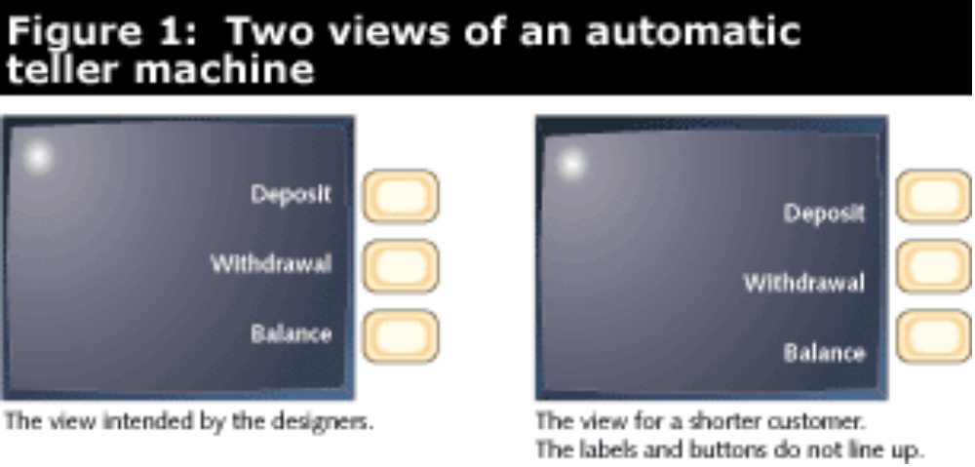
GUI in Embedded Systems
GUI of ATM Machine
Consider also a mobile phone or palm top GUI

Slide 21
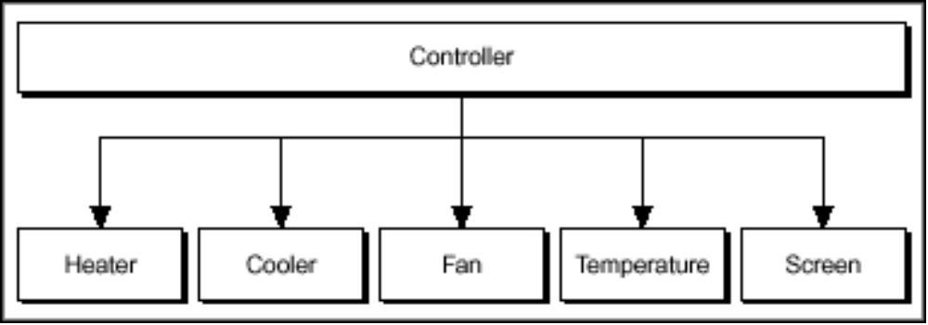
Case Study – Climate Control GUI
Consider a climate control and monitoring system
On or Off only
Speed control
User Selectable

Slide 22
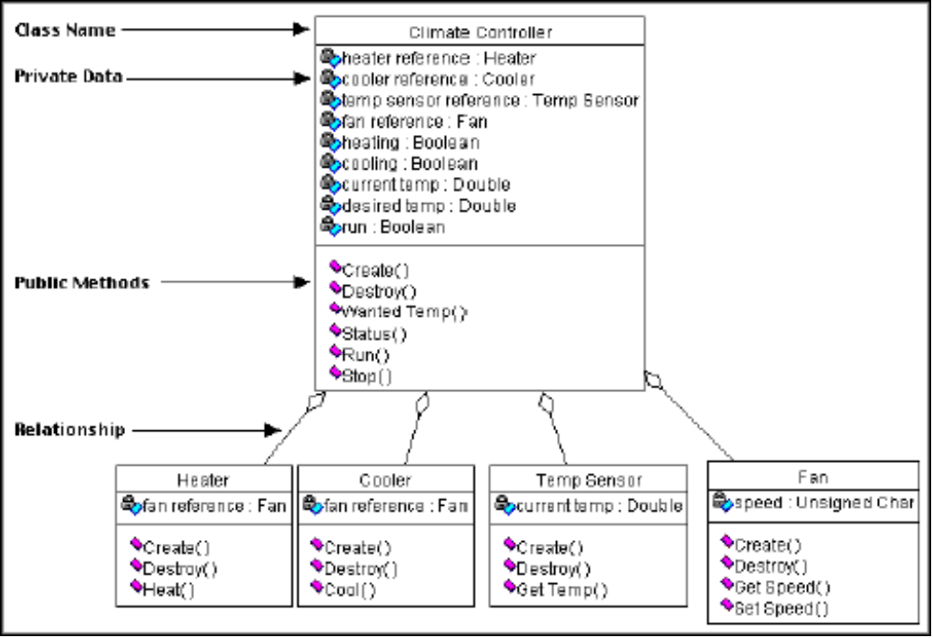

Slide 23
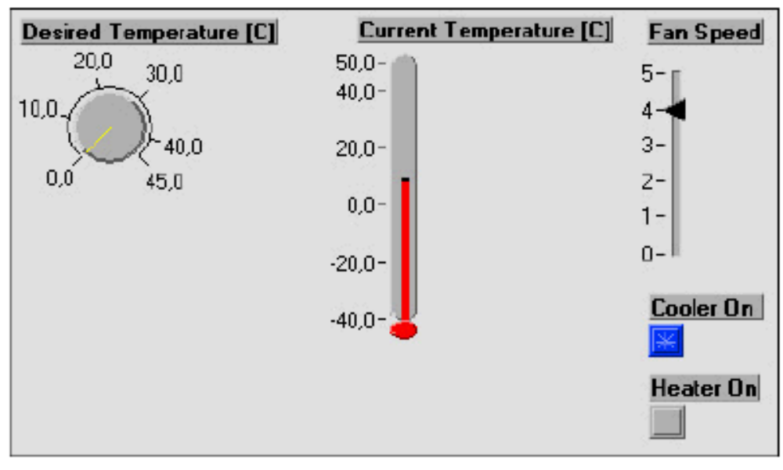
Case Study – Climate Control GUI
User Interface

Slide 24
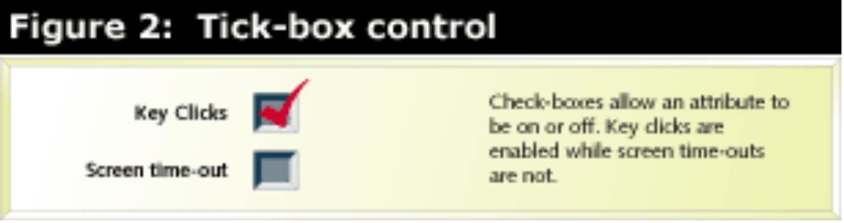
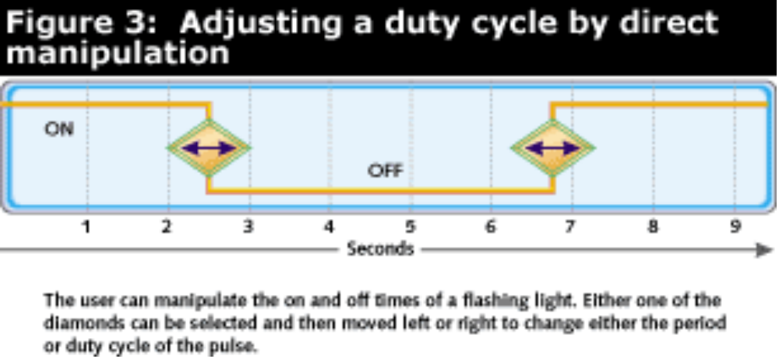
Other GUI possibilities
Tick Box Control
Direct Manipulation

Slide 25
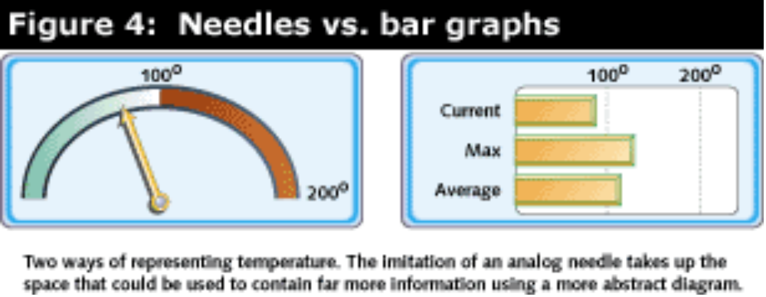
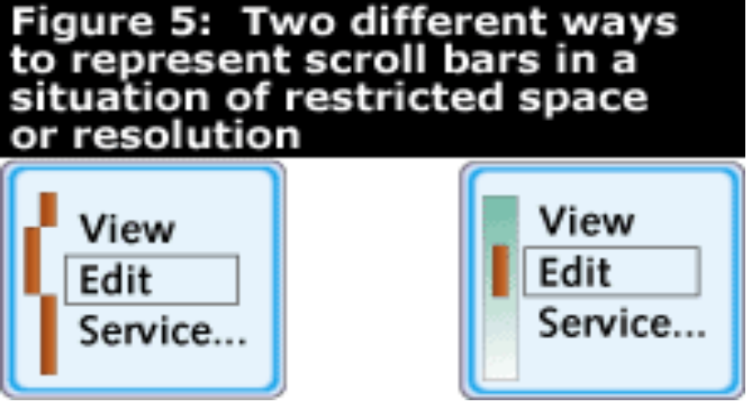
Other GUI possibilities
Needle and Bar Graphs
Scroll Bars

Slide 26
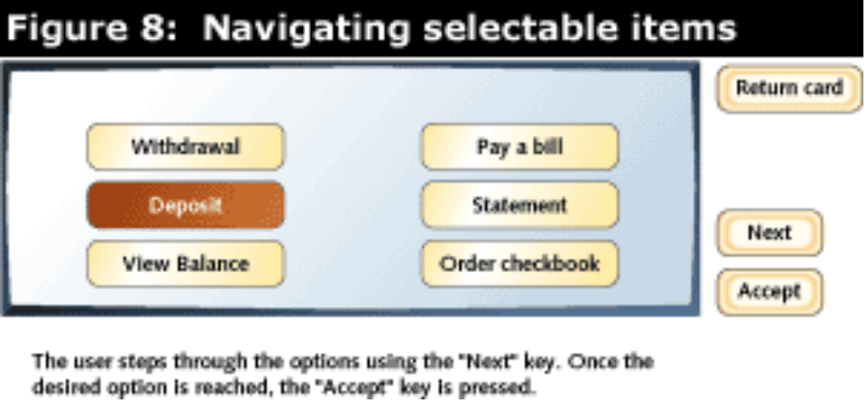
Other GUI possibilities
Navigation Select Buttons

