Slide 1
Chapter 5
Liquid Crystal Displays

Slide 2
Selecting a LCD module
What size and format: 1-4 lines, 16 to 40 characters per line, and 5x7 or 5x10 dot display fonts.
What optical characteristics will look best in the package and attract the user
Alphanumeric (A/N)/character: Fonts lib
Graphics: special symbol, foreign char

Slide 3
LCD Fluid Types
Fluid dye type determines the contrast ratio, viewing angle, and temperature range
TN (Standard type), NTN (high contrast type), and STN (premium high contrast type)
Backlit or not

Slide 4
Character LCD Controller HD44780
Built-in character generator with 192 character modified ASCII character set
Ability to program up to 8 user defined characters.
Bi-directional 8 or 4 bit bus interface
80 character RAM
Automatic reset on power up
Wide range of instruction functions

Slide 5
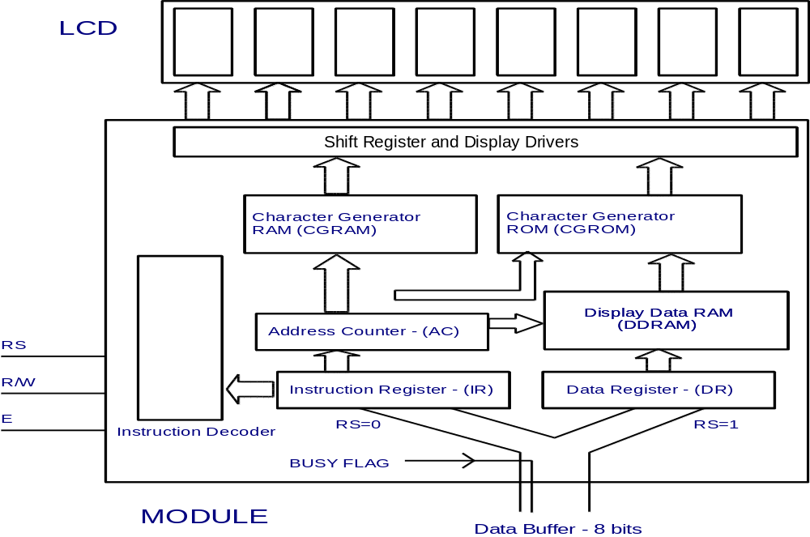
LCD Hardware overview

Slide 6
Some terms
Instruction register (IR)
Data register (DR)
DDRAM: Data display RAM, store display code. Address relates to display position.
CGROM/CGRAM: Character bit patterns
Busy Flag (BF): 1 means the module is in the internal operation mode
Address Counter (AC):
  access data in DDRAM or CGRAM: ++ or --
  7 bit, i.e., 128 address

Slide 7
Control signals
RS | R/W | Operation
0 | 0 | write to IR to start an internal operation (display clear, etc.)
0 | 1 | Read busy flag (DB7) and address counter (DB0 to DB6)
1 | 0 | write to DR for display (DR to DDRAM)
1 | 1 | read from DR the contents of DDRAM (DDRAM to DR)

Slide 8
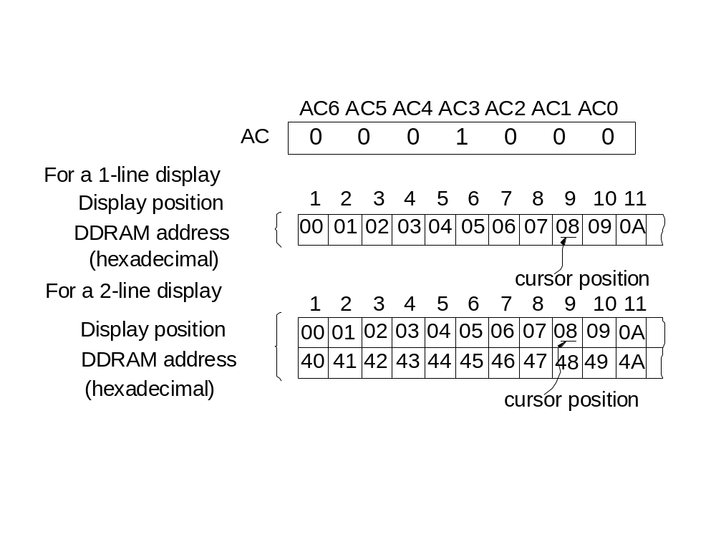
Relationship between DDRAM and Display Characters

Slide 9
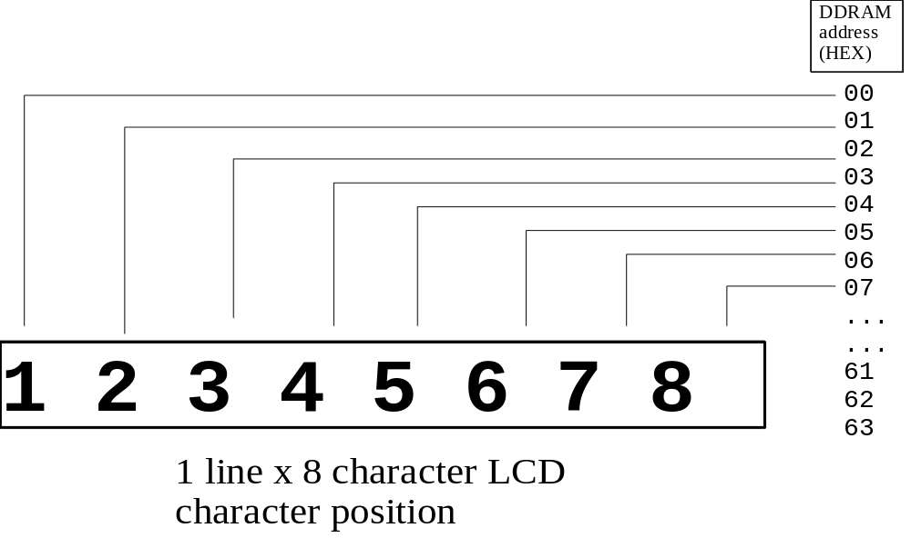
One line display

Slide 10
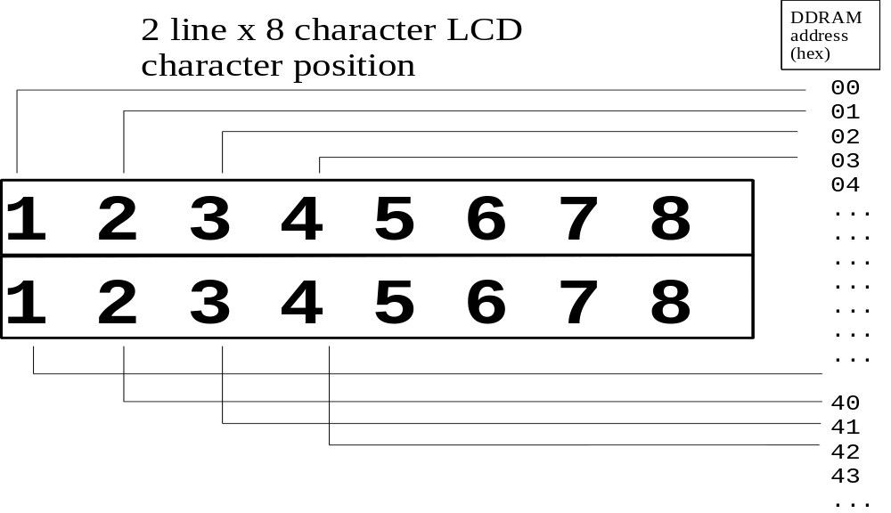
Two lines display

Slide 11
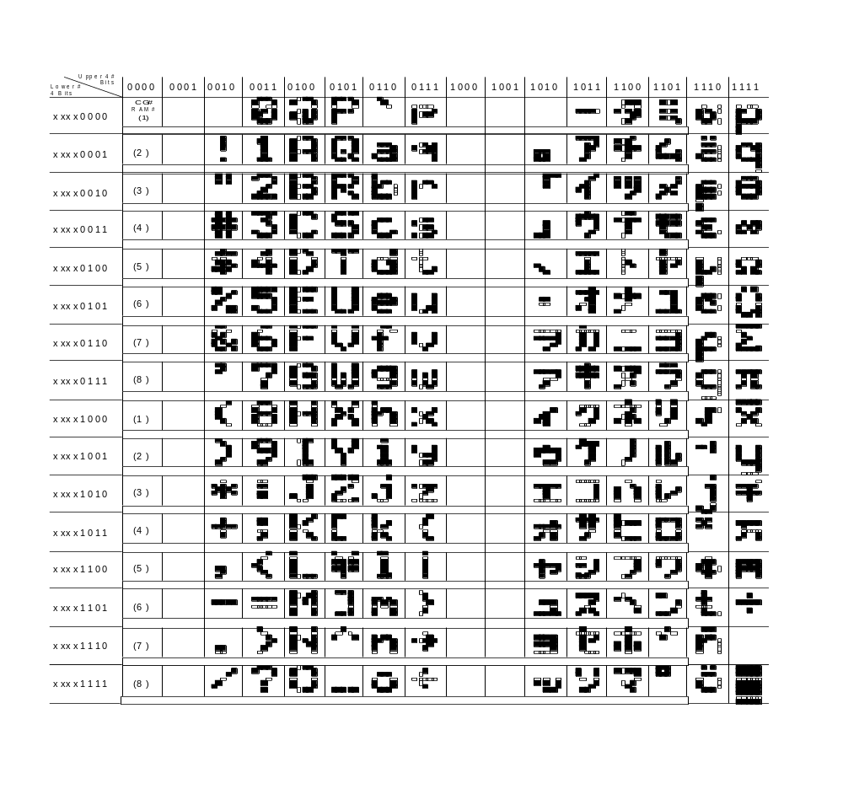

Slide 12
Default Initialisation
1. Clear Display
2. Function Set DL=1: 8 bits interface
N=0: 1 line display
F=0: 5x7 dot font
3. Display ON/OFF control D=0: Display OFF
C=0: Cursor OFF
B=0: Blink OFF
4. Entry Mode Set I/O=1: +1 increment
5. DDRAM is selected

Slide 13
Instructions: Clear display
D7 D0 Function
0 | 0 | 0 | 0 | 0 | 0 | 0 | 1 | Clears Display and returns cursor to the Home Position (Address 00) | 80uS = 1.64mS

Slide 14
Return home
0 | 0 | 0 | 0 | 0 | 0 | 1 | * | Returns cursor to Home Position. Returns shifted display to original position. Does not clear display

Slide 15
Entry Mode Set
0 | 0 | 0 | 0 | 0 | 1 | I/D | S | Sets DD RAM counter to increment or decrement (I/D) Specifies cursor or display shift during to Data Read or Write (S)

Slide 16
Display on/off
0 | 0 | 0 | 0 | 1 | D | C | B | Sets Display ON/OFF (D), cursor ON/OFF (C), and blink character at cursor position

Slide 17
Cursor or Display Shift
0 | 0 | 0 | 1 | S/C | R/L | * | * | Moves cursor or shifts the display w/o changing DD RAM contents

Slide 18
Function Set
0 | 0 | 1 | DL | N | F | * | * | Sets data bus length (DL), # of display lines (N), and character font (F)

Slide 19
Set CG RAM Address
0 | 1 | A_{CG} | Sets CG RAM address. CG RAM data is sent and received after this instruction

Slide 20
Set DD RAM Address
1 | A_{DD} (A6----A0) | Sets DD RAM address. DD RAM data is sent and received after this instruction

Slide 21
Busy Flag
BF | AC (A6----A0) | Reads Busy Flag (BF) and address counter contents

Slide 22
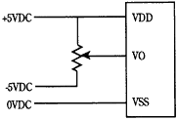
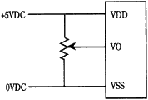
Power supply

Slide 23
8 bit interface
Host processor
DB
Control bits
LCD Module
D0~D7
ENABLE
RS
R/W

Slide 24
4 bit interface
Output Latch
Q7-Q4
Q3
Q2
Q1
Q0
D7
D6
D5
D4
LCD module
X
ENABLE
R/W
RS

Slide 25
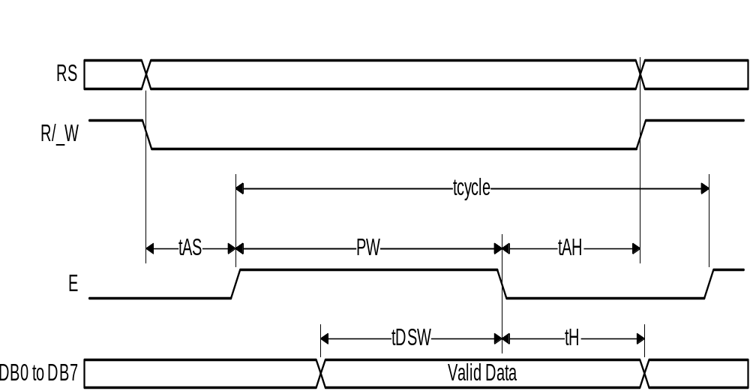
Typical LCD timing

