Slide 1
Chapter 3
Decoding on the PC/104 bus

Slide 2
READ & WRITE CYCLES

Slide 3
Accessing Memory Devices
The PC/104 bus extends the microprocessor’s busses into the following external connections consisting of
  An Address Bus (20 lines – A0 to A19)
  A Data Bus (8 lines – D0 to D7)
  A Control Bus (several different types of lines)
This feature is useful
  Amount of memory used is flexible
  Can combine RAM/ROM
  Use memory mapped I/O for fast access
Notes:
Although the PC/104 bus has 24 bits for addressing, we consider first the use of the first 20
bits for memory chips, then the first 10 bits for I O devices.
As we have considered the address, data and control busses from the processor point of view,
now we consider them from the memory point of view.

Slide 4
PARTIAL & FULL ADDRESS DECODING

Slide 5
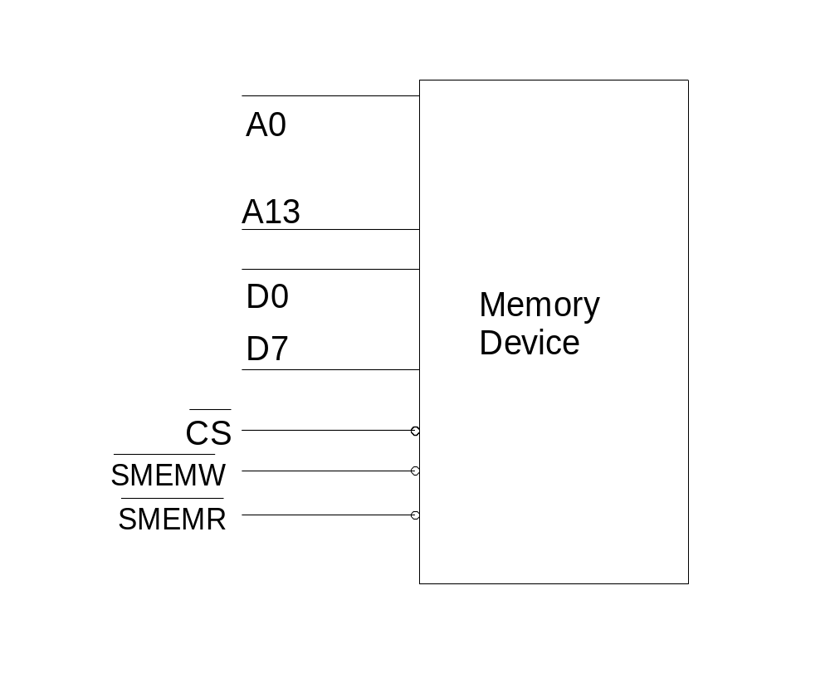
Signals on a RAM
RAMs typically contain several memory locations
To read/write to a particular location, an address must be provided and decoded
Memory decoding is necessary
This takes place within the RAM
Address Bus
A12
Data Bus
6264
(8k RAM)
Control Bus
Notes:
In contrast to the processor address bus, the memory address bus will tell a memory device
which particular location is being accessed. The number of memory address lines required
depends on the size of the memory device. (e.g. a device with 1 K (i.e. 1 0 2 4) locations,
requires 10 address lines, because 2 to the power of ten equals 1 0 2 4).
In the same way, the quantity of data stored at each memory location depends on the particular
memory device. It may be a single bit, or 4, 8 or 16 bits per location. Units of memory may be
connected in parallel to meet the processor data width. For example, four 8 bit memory
devices may be connected in parallel to a 32 bit processor.
The block diagram of a memory device is as shown. To access data, the following steps are
executed.
One, the address is placed on the address bus. The lower bits will be used by the memory device for
internal decoding, the higher bits go to a decoder chip which will generate a chip select C S
signal. This will then select one of the several memory devices.

Slide 6
Accessing Memory Devices
During a memory or I/O READ cycle,
  Processor puts address on Address Bus
  Processor generates a Read Signal
  Memory or I/O Device place data on Data Bus
  Processor reads Data Bus
Notes:
If doing a read operation, the processor will generate a read signal R D which is connected to
the output enable O E of the memory chip. The memory device will place the data from the
memory location after a short delay. The processor then reads in the data.

Slide 7
Accessing Memory Devices
During a memory or I/O WRITE cycle,
  Processor puts address on Address Bus
  Processor puts data on Data Bus
  Processor generates a Write Signal
  Memory or I/O Device will latch the data in
Notes:
If doing a write operation, the processor will places the data to be written on the data bus, then
generates a write W R signal, which is connected to the write enable W E of the memory
chip. The memory device will then latch the data in.

Slide 8
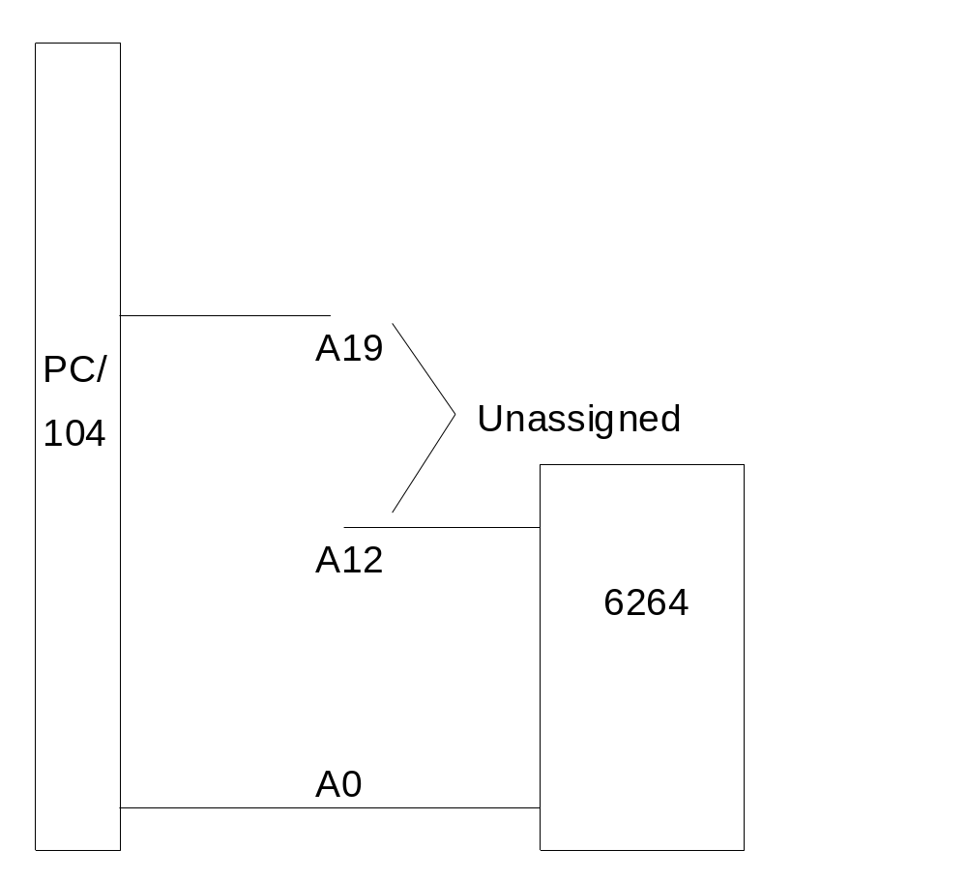
Partial and Full Address Decoding
Partial Address Decoding
CPU has 20 address lines (A0 – A19)
Some are used to address the RAM (A0 – A12)
Some are not used (A13 - A19)
This causes Memory Foldover - each location has > 1 address
A 13
E.g.
The following Addresses all access the same memory location in the RAM
01234H, 09234H and 81234H
Memory folds over 2⁷ or 128 times
Notes:
In most practical situations, the devices connected to a processor address bus require fewer address bits than there are bits provided on the address bus. The P C 1 0 4 has 20 pins while a 6 2 6 4 RAM has only 13 pins. Since there are 7 pins unused by the RAM chip, then this is a case of partial address decoding. If we have a memory system where all the address pins are used in memory access, we then have full address decoding.
When the 6 2 6 4 is connected to the P C 1 0 4 address bus as shown in only the states of the
address lines A 0 to A 12 will determine which location inside the RAM is accessed. The other
address lines A 13 to A 19 are ignored by the chip. Hence the location 0 0 0 0 0 0 0 0 0 0 0 0 0 B can be accessed by the addresses X X X X X X X 0 0 0 0 0 0 0 0 0 0 0 0 0 B. Therefore addresses from the processor bus hexadecimal 0 0 0 0 0, 0 2 0 0 0 and so on will all access the same memory location 0 0 0 0.
This is an inefficient way of using the address bus since even though 2 to the power of 20 or 1 0 4 8 5 7 6 locations can be selected individually, only 8 K are used, each responding to 1 0 4 8 5 7 6 over 8 1 9 2 = 1 2 8 different processor addresses.
As an illustration of how partial and full address decoding are implemented, we shall look at how a
memory chip can be connected to a 20-bit address bus.
When a memory address or group of physical addresses respond to several different
processor addresses, the effect is known as memory fold over. In the example above, there is a
1 2 8 times fold over.

Slide 9
Partial and Full Address Decoding
Full Address Decoding:
In full decoding, all CPU address pins are used
Pins not used by RAM are decoded externally
Output of external decoder connected to Chip Select of RAM
Each location now has a unique address
Decoder
A 13
CS

Slide 10
Address Decoding
Most systems contain >1 MEMORY chip
Each chip must occupy a different address range within the memory map
Each chip will already require some addressing pins to select their internal locations
They will require an external circuit that will select the chip itself
This is called “address decoding circuit”.
Notes:
In small systems, this is tolerable. But we see two problems here. First is that if more than one
device needs to be attached to the bus, how do we fit it in? Secondly is that a programmer may
access data from the wrong memory location.

Slide 11
TOOLS FOR DECODING

Slide 12
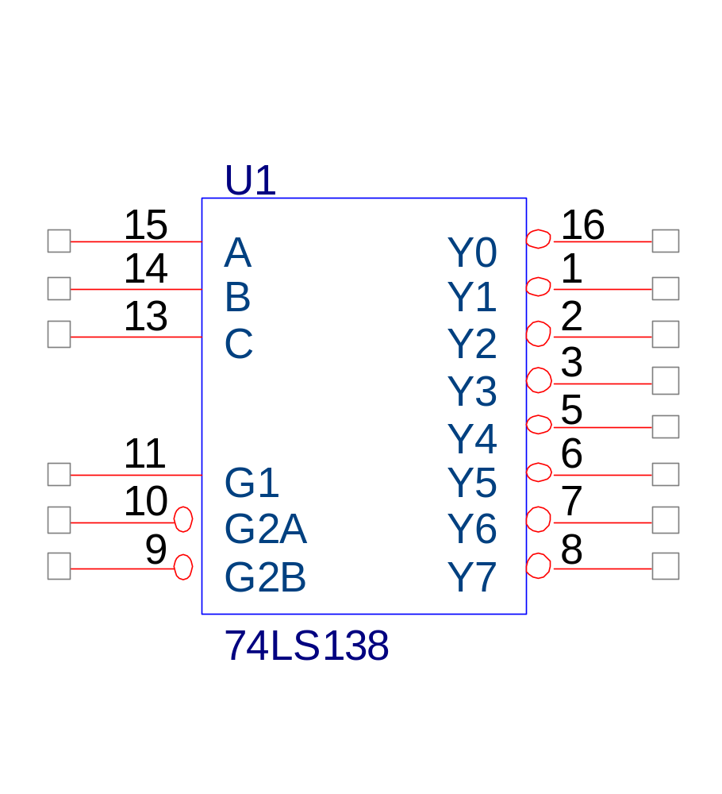
The 74LS138 3-8 Decoder
3 Input Pins
8 output Pins
3 pins, 8 combinations
Only 1 pin active at any one time
3 Chip Select Pins
To enable Decoder,
G1 = 1
G2A = G2B = 0
Notes:
When connecting several memory ICs to an address bus, we can use logic gates as address
decoders using K-Maps or standard Boolean logic. However, it is much easier to use
demultiplexers or decoders, because of the way memory is laid out, which in many cases is in
sequential blocks of addresses, as we will see shortly.
One of the most commonly used demultiplexers is the 7 4 1 3 8 1-of-8 demultiplexer.

Slide 13
74LS138 Truth Table
INPUTS |  |  |  |  |  | OUTPUTS
ENABLE |  |  | SELECT
G2B | G2A | G1 | C | B | A | Y0 | Y1 | Y2 | Y3 | Y4 | Y5 | Y6 | Y7
X | X | L | X | X | X | H | H | H | H | H | H | H | H
X | H | X | X | X | X | H | H | H | H | H | H | H | H
H | X | X | X | X | X | H | H | H | H | H | H | H | H
L | L | H | L | L | L | L | H | H | H | H | H | H | H
L | L | H | L | L | H | H | L | H | H | H | H | H | H
L | L | H | L | H | L | H | H | L | H | H | H | H | H
L | L | H | L | H | H | H | H | H | L | H | H | H | H
L | L | H | H | L | L | H | H | H | H | L | H | H | H
L | L | H | H | L | H | H | H | H | H | H | L | H | H
L | L | H | H | H | L | H | H | H | H | H | H | L | H
L | L | H | H | H | H | H | H | H | H | H | H | H | L
Notes:
Looking at the output pins, note that the pin that goes low will correspond to the binary input at pins A, B and C. For example, an input of 111 will cause pin Y7 to go low.
We see that the 74138 can select one of eight possible devices based on its ABC inputs. If we add
this to the thirteen inputs of the 6 2 6 4, we see that we now have sixteen (13 plus 3) inputs, which still causes foldover.

Slide 14
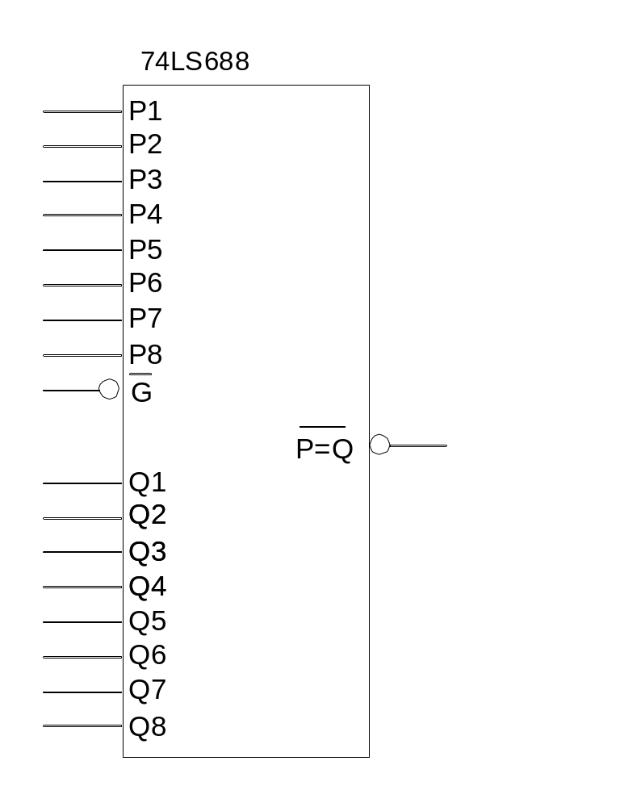

Comparator: 74LS688
Inputs
Data (P,Q) | Enable (-G)
P = Q | L | L
P > Q | L | H
P < Q | L | H
X | H | H
Enable
Notes:
To take care of this, we can still choose to use logic gates, but we introduce another device, the
7 4 6 8 8 8 bit comparator which may be rather overspecified for the task at hand, but it is versatile.
It has only one output, P equal Q bar . It is quite obvious that when the digital value at the P inputs equal the digital value at the Q inputs, then the output pin will go low.
What makes this device versatile is that we do not need inverted versions of address signals, which is true if we use the 7 4 1 3 8.
We can set the desired bit pattern at either the P or Q inputs.
Another important point is that there are other devices connected to the system that use up certain parts of the memory map. Thus we need flexibility in locating the starting address of our memory block.

Slide 15
A Design Example:
Design a 64K memory space starting from E0000H, using 6264 memory chips.
Notes:
In designing a full decoding system using a 7 4 1 3 8, we should note the number of address lines are used by the memory chip itself. This is because these lines cannot be used for decoding. Thus only the remaining lines on the host processor address bus is available.
To summarize, we may use the following steps:
1) Identify how many address pins the memory chip uses.
2) Calculate the number of chips that are required in the design.
3) Draw the memory map of the design. Do this by laying out the chips contiguously, that is,
the starting address of a chip follows immediately after the last address of the previous
chip. Write down the range of addresses of each chip in hexadecimal.
4) Draw a truth table. This is the binary representation of the range of addresses.
5) Looking at the bits, observe any pattern of numbers, for example, running binary numbers
in the bits.
6) Fit this pattern to the truth table of the 7 4 1 3 8. First, see which address pins are to be
assigned to inputs A, B and C. Then see how to assign the remaining address pins to the
Enable inputs of the 7 4 1 3 8.
7) If there are unassigned processor address pins, assign them to the 7 4 6 8 8.
Finally, produce the schematic.

Slide 16
Step 1
The memory device used is 6264
This is an 8192 bytes by 8 bit device
It uses address pins A0 to A12 (2¹³ = 8192)
Each chip will take up 8192₁₀ or 1FFFH address space
Notes:
Now, in greater detail:
1) The memory device to be used is a 6 2 6 4, which is a 8 1 9 2 by 8 bit device. This device uses 10 address pins A 0 to A 12. (2 to the power of 13 = 8 1 9 2). Each chip will take up 8 1 9 2 or 1 F F F H addresses.

Slide 17
Step 2
Since we require 64K bytes in the design, we need eight 6264 chips (64K/8K)
Start Address is E0000H
RAM 1 ‑ E0000H to E1FFFH
RAM 2 ‑ E2000H to E3FFFH
RAM 3 ‑ E4000H to E5FFFH
RAM 4 ‑ E6000H to E7FFFH
RAM 5 ‑ E8000H to E9FFFH
RAM 6 ‑ EA000H to EBFFFH
RAM 7 ‑ EC000H to EDFFFH
RAM 8 ‑ EE000H to EFFFFH
Notes:
2) Since we require 64 K bytes in the design, we need 8 chips. (64 K over 8 K).
3) This 64 K will occupy the range from hexadecimal E 0 0 0 0 to E F F F F . So the first memory chip will start from E 0 0 0 0 and occupy the address range E 0 0 0 0 to E 1 F F F. We continue until we get the following memory map:

Slide 18
Step 2 – continued
Start Address is E0000H
RAM 1 ‑ E0000H to E1FFFH
Convert range to binary
1111 0000 0000 0000 0000 (E0000H)
1111 0001 0111 1111 1111 (E1FFFH)
Replace changing bits by X
A19 A12 A0
1 1 1 1 0 0 0 X--------X. E0000 - E1FFFH
Notes:
To draw the truth table, let us look at the first chip. It occupies the address range hexadecimal E 0 0 0 0 to E 1 F F F. We can convert this range to binary, and note that the MSB is address line A19, as shown in the slide.
We are not interested in the address lines used by the chip at this point. Note that the 0's and 1's
change only at lines A 0 to A 12.
Now in order to simplify the design process, we will introduce a notation. Instead of writing two lines with all the 0's and 1's, we will represent the above range by the axes.
EX means that the value for the address line can be 0 or 1. The dashed line ex dash dash dash ex means that address lines from A 0 to A 12 can be 0 or 1. So they are not available for general use. This highlights the fact that only address lines A 19 to A 13 are available for decoding. Proceeding in similar fashion for the other chips, we have the following truth table.

Slide 19
Step 2 – continued
A19 A18 A17 A16 A15 A14 A13 A12 -- - - - - - - - - - A0
1 1 1 0 0 0 0 x------------------------x E0000-E1FFFH
1 1 1 0 0 0 1 x------------------------x E2000-E3FFFH
1 1 1 0 0 1 0 x------------------------x E4000-E5FFFH
1 1 1 0 0 1 1 x------------------------x E6000-E7FFFH
1 1 1 0 1 0 0 x------------------------x E8000-E9FFFH
1 1 1 0 1 0 1 x------------------------x EA000-EBFFFH
1 1 1 0 1 1 0 x------------------------x EC000-EDFFFH
1 1 1 0 1 1 1 x------------------------x EE000-EFFFFH
Much neater, can observe patterns in the bits easily
Notes:
To draw the truth table, let us look at the first chip. It occupies the address range hexadecimal E 0 0 0 0 to E 1 F F F. We can convert this range to binary, and note that the M S B is address line A 19, as shown in the slide.
We are not interested in the address lines used by the chip at this point. Note that the 0's and 1's
change only at lines A 0 to A 12.
Now in order to simplify the design process, we will introduce a notation. Instead of writing two lines with all the 0's and 1's, we will represent the above range by the axes.
EX means that the value for the address line can be 0 or 1. The dashed line ex dash dash dash ex means that address lines from A 0 to A 12 can be 0 or 1. So they are not available for general use. This highlights the fact that only address lines A 19 to A 13 are available for decoding. Proceeding in similar fashion for the other chips, we have the following truth table.

Slide 20
Step 3: Truth table
A19 A18 A17 A16 (For Full decoding) | A15 A14 A13 (chip selection) | A12 ……………A0 (Location select inside chip)
1 1 0 (E0000H) | 0 0 0 | 0 0 0 ---------- 0
1 1 0 (E1FFFH) | 0 0 0 (Y0) | 1 1 1 ----------- 1
1 1 0 (E2000H) | 0 0 1 | 0 0 0 ----------- 0
1 1 0 (E2FFFH) | 0 0 1 (Y1) | 1 1 1 ------------1
Notes:
1. Looking at the truth table, we can see the address lines A 15 to A 13 taking on values that
increment, starting from 000 to 111. If we assign these lines to a 7 4 1 3 8, we can enable up to 8 devices one at a time, depending on the values of A 15 to A 13.
2. Comparing this with the truth table of the 7 4 1 3 8, we see that A 15 should be assigned to
input C, A 14 to B and A 13 to A. Note that this incrementing bit pattern is only true for this
situation. Other situations will have different patterns at different address lines. The important thing is to look out for a pattern to fit to the truth table of the 7 4 1 3 8.
3. It is convenient to left A 19 to A 16 be enabled by the 7 4 6 8 8, so it activates when A 19 to A 16 has the value E.

Slide 21
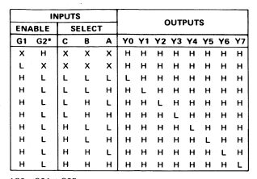
Step 3a:Truth table – look for pattern
A19 A18 A17 A16 A15 A14 A13 A12- - - - - - A0
1 1 1 0 0 0 0 x--------------x E0000-E1FFFH
1 1 1 0 0 0 1 x--------------x E2000-E3FFFH
1 1 1 0 0 1 0 x--------------x E4000-E5FFFH
1 1 1 0 0 1 1 x--------------x E6000-E7FFFH
1 1 1 0 1 0 0 x--------------x E8000-E9FFFH
1 1 1 0 1 0 1 x--------------x EA000-EBFFFH
1 1 1 0 1 1 0 x--------------x EC000-EDFFFH
1 1 1 0 1 1 1 x--------------x EE000-EFFFFH
Pattern of ascending bits! (can be others)
Fit on to the 74LS138 ===========➔

Slide 22
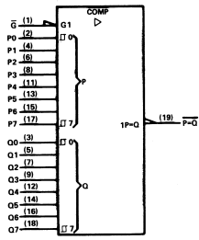
Step 3b:Truth table – remaining bits
A19 A18 A17 A16 A15 A14 A13 A12- - - - - - A0
1 1 1 0 0 0 0 x--------------x E0000-E1FFFH
1 1 1 0 0 0 1 x--------------x E2000-E3FFFH
1 1 1 0 0 1 0 x--------------x E4000-E5FFFH
1 1 1 0 0 1 1 x--------------x E6000-E7FFFH
1 1 1 0 1 0 0 x--------------x E8000-E9FFFH
1 1 1 0 1 0 1 x--------------x EA000-EBFFFH
1 1 1 0 1 1 0 x--------------x EC000-EDFFFH
1 1 1 0 1 1 1 x--------------x EE000-EFFFFH
All bits same - 74LS688 will activate when bits appear on address bus
Set once
DIP switch
When address bus data matches
the DIP switch settings, will indicate!
Changing address data
A19-A16

Slide 23
Step 4: Circuit
6264
6264
6264
6264
74LS688
A16
P1
A0
E0000H
E2000H
E4000H
E6000H
A17
P2
to
to
to
to
A18
P3
E1FFFH
E3FFFH
E5FFFH
E7FFFH
A12
A19
P4
CE
CE
CE
CE
P5
74LS138
P6
CS0
P7
A13
A
0
P8
A14
B
1
CS1
A15
C
2
CS2
P=Q
3
CS3
4
CS4
0
Q1
CS5
1
Q2
E1
5
Q2
CS6
1
Q3
E2
6
CS7
1
Q4
5V
E3
7
Q4
1K
Q5
Q6
CE
CE
CE
CE
Q7
Note: OE & WE pins
not shown, but MUST
be present on memory
These go to the
MEMR & MEMW on CPU
Q8
EE000H
EC000H
EA000H
E8000H
to
to
to
to
EFFFFH
EDFFFH
EBFFFH
E9FFFH
6264
6264
6264
6264

Slide 24
Trying out the circuit – click for animation
Let’s test the circuit out – e.g. E48000 is output on address bus
RAM3 selected and location 0800H accessed in chip
1110 0100 1000 0000 0000
CPU o/p on address lines A15-13 – 010
This sets CS2 to low
6264
6264
6264
6264
74LS688
A16
P1
A0
E0000H
E2000H
E4000H
E6000H
A17
P2
to
to
to
to
A18
P3
E1FFFH
E3FFFH
E5FFFH
E7FFFH
A12
A19
P4
CE
CE
CE
CE
P5
74LS138
P6
CS0
P7
A13
A
0
P8
A14
B
1
CS1
A15
C
2
CS2
P=Q
3
CS3
4
CS4
0
Q1
CS5
1
Q2
E1
5
Q2
CS6
1
Q3
E2
6
CS7
1
Q4
5V
E3
7
Q4
1K
Q5
Q6
CE
CE
CE
CE
Q7
Q8
EE000H
EC000H
EA000H
E8000H
CPU o/p on address lines A19-16 – 1110
Bit pattern 1110 is set on Q inputs
The P=Q pin will go low
to
to
to
to
EFFFFH
EDFFFH
EBFFFH
E9FFFH
6264
6264
6264
6264

Slide 25
Input/Output Decoding
I/O interfacing often uses buffer and latch
Buffer or latch needs 1 address only
PC I/O space is quite limited, some already used by system or I/O card
Use AEN (low) to check if bus is used by DMA controller
Decoding output to select the buffer or latch by _CS or _OE
Notes:
As we saw before, memory devices use only some of the available address lines. The lower address lines will select a single memory location in the memory device. The higher address lines from the system are used by a decoder to select one of several memory devices. Also, the memory device will have an Output Enable pin for a read and a RAM device will also have a Write Enable pin.

Slide 26
Example
Design an input port of address 330H and an output port of address 331H
Truth Table
A9 A8 A7 A6 A5 A4 A3 A2 A1 A0 Address
1 1 0 0 1 1 0 0 0 1 331H (output port)
1 1 0 0 1 1 0 0 0 0 330H (input port)
(To be constrained by 74LS688) (C B A of 74138)
Notes:
However, buffers and latches have only a single address location. The PC architecture has used up
quite a few I O addresses so that there are few left for the user. Also, other devices connected to the system may have used up other address.
Thus we need to decode each device exactly, so we do not activate other I O by accident.
What this means is that for a 16 bit I O address space such as that available on Intel
microprocessors we need to use all address lines, giving us theoretically 64 K addressable I O
devices. But we saw that the PC implementation only uses 10 bits, making the hardware
requirements somewhat simpler.
Another consideration is that since the address bus is shared by the main processor and
D M A processes, the D M A operation may activate the I O addresses accidentally. The ISA bus
provides for this by using the A E N signal to signify that a DMA operation is taking place when the A E N signal is high. This is used in decoding.
Also, since buffers have only one control pin ( normally the Enable pin ) and latches use the clock
pin, we need an external gate to control the access, so that processor reads are directed to buffers
and writes are directed to latches. Of course, if there is no confusion as to the assignment of
addresses, the gates may not be required.

Slide 27
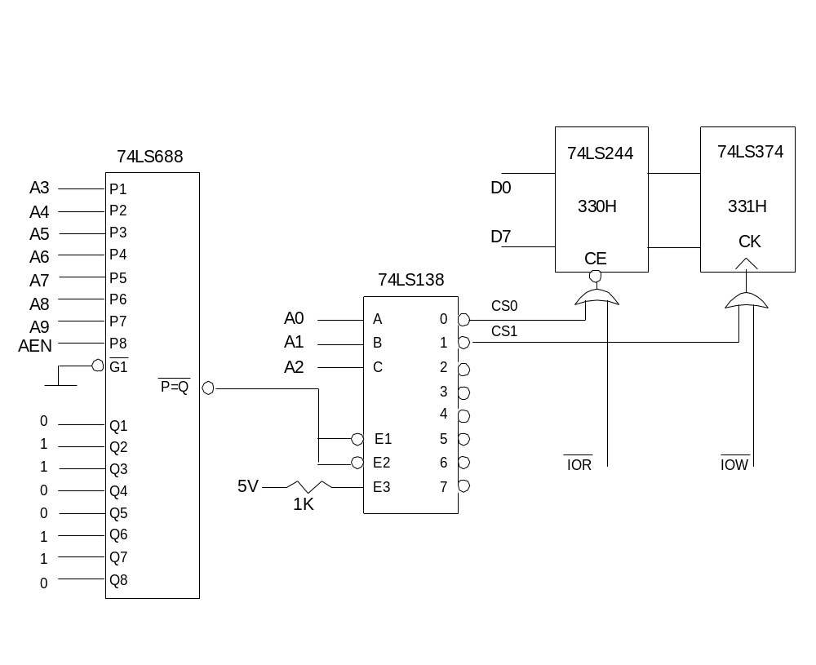
Input Device
(Buffer)
Output Device (Latch)
Notes:
We let A 0-A 2 be decoded by the 7 4 1 3 8. The bit pattern on the ‘Q’ inputs correspond to bits A 3- A 9. We decode when AEN is low, namely when no DMA is occurring.
As we see, the 7 4 6 8 8 in conjunction with a 7 4 1 3 8 allows us to decode individual I/O addresses.
The 7 4 6 8 8 activates a block of 8 devices through the 7 4 1 3 8. The starting address of this block will have the A 0 to A 2 pins at logic 0. This address is known as the base address as all the other I O addresses are simply added to the base to get its address.

Slide 28
Summary of Input/Output Decoding
Selecting memory chip enables device only
  Internal decoder selects memory location
Buffers/latches need full decoding
Control signals for memory have a dedicated pin
Buffers latches may need extra logic gate for this
Notes:
Memory devices contain many storage locations within itself. Selecting a memory chip through a decoder only enables the chip. Internal decoding circuitry within the memory chip will select individual memory locations.
Buffers and latches, being individual devices, need full decoding to be done externally as it does not have the circuitry internally.
In addition to enable pins, memory devices have control pins which determine whether data is written or read to.
Buffers and latches are normally activated through a single control pin. Again, external gates may be needed to correctly decode the signal.

