Slide 1
Digital-to-Analog, Analog-to-Digital Interfacing
Chapter 7

Slide 2
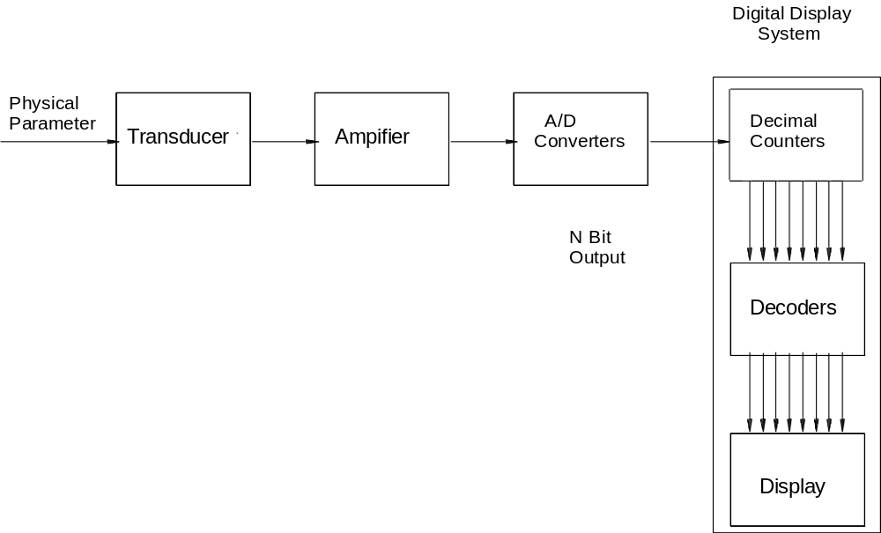
Why A to D?
Microprocessor

Slide 3
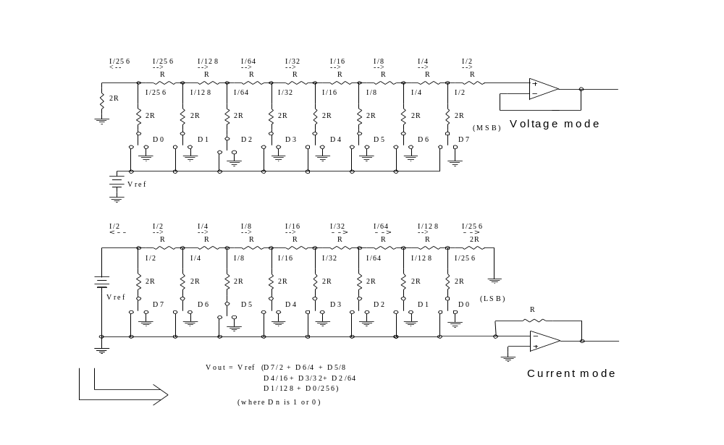
D/A converter structure

Slide 4
D/A components
A typical DAC consisting of:
a. a resistor network
b. current/voltage switches
c. a reference voltage source
d. an output amplifier for converting current to voltage.

Slide 5
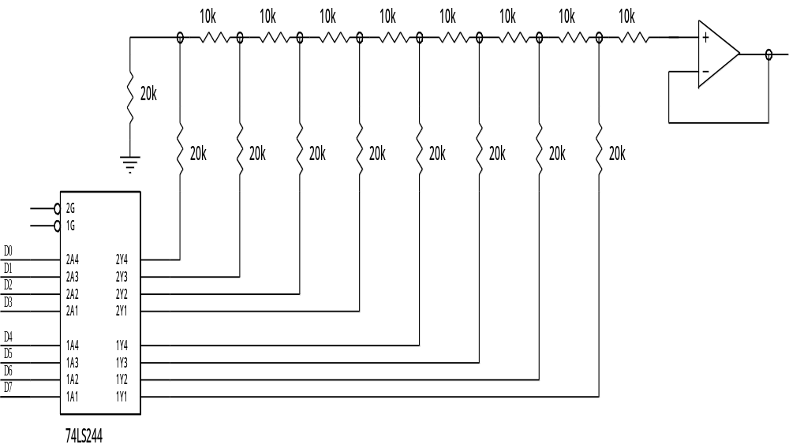
Implementing a Resistance-ladder network

Slide 6
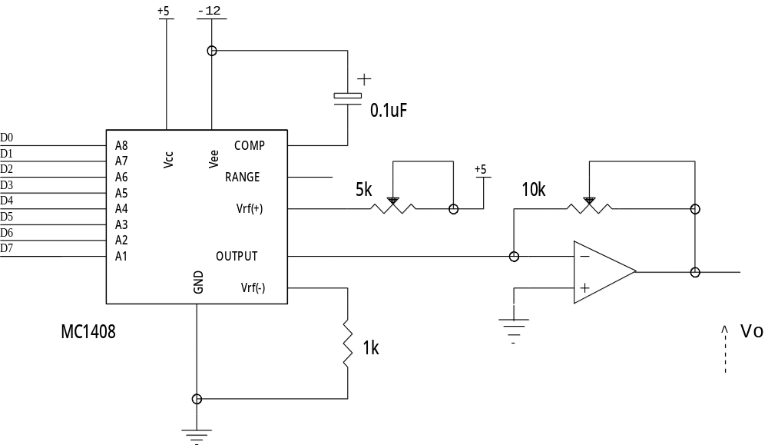
Interfacing a DAC1408

Slide 7
Generating waveforms: synthesis
Manually compute the digital values of waveform and put these into a lookup table, or even put it into an EPROM.
Factors to consider concerning the waveform:
  a) The maximum analogue value
  b) The output frequency: CPU, D/A speed
  c) The number of samples per period

Slide 8
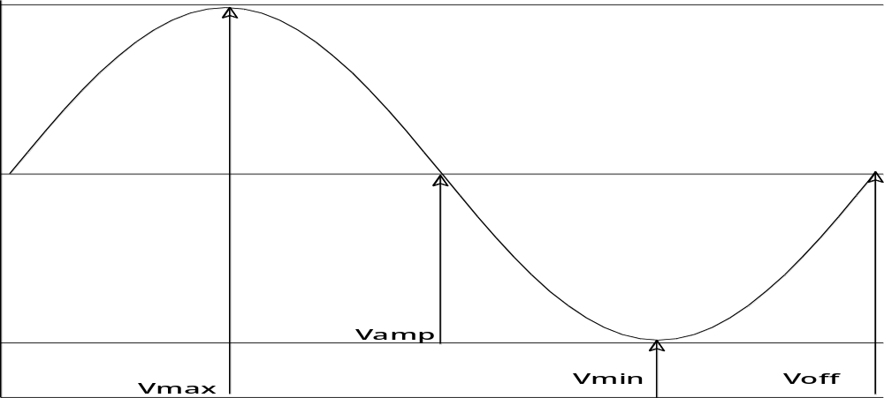
Sine wave
V= Vamp*sin Θ + Voffset

Slide 9
Resolution
8 bit DAC , outputs from 0 to 5V
an input of FFH (255_{D}) will result in 5 volts being output.
Thus for 1 volt, the equivalent digital value is:
255/5 = 51
We call this the scale factor.

Slide 10
Samples per period
Now let us specify that we want 24 samples per period. We need to compute the value of the sinusoid at each sample point.
To compute the value of the sinusoid at each sample point, we will divide 360 by the number of samples.
Nyquist criterion: sampling frequency should be twice that of the highest frequency present in the signal.

Slide 11
Calculate Waveform points
S/no | ө | sin ө | V = 2(1 + sin ө) | F_{scale} * V | Rounded
0 | 0 | 0 | 2 | 102 | 102
1 | 15 | 0.2588 | 2.5176 | 128.3976 | 128
2 | 30 | 0.5 | 3 | 153 | 153
3 | 45 | 0.7071 | 3.4142 | 174.1242 | 174
4 | 60 | 0.866 | 3.732 | 190.332 | 190
5 | 75 | 0.9659 | 3.9318 | 200.5218 | 201
6 | 90 | 1 | 4 | 204 | 204

Slide 12
Output frequency
Equal to 1 / (waveform period).
The waveform period is the number of samples per period multiplied by the time between samples.
In the above example, if the time delay between each period is 50 us for example, the frequency of the sine wave above will be 1 / (24 * 50us).
If we have a large number of samples per period, we will need a shorter time period between samples in order to get the same frequency.
This time period between samples has a minimum value which is determined by the speed of the processor.

Slide 13
Software Generation
const unsigned char WaveTable[Count] =
{ 102 102,128,153,174,190,201,204,201,190,174,153,128,
102,76,51,30,14,0,3,14,30,51,76 };
void main (void)
{ /* main entry for program */
unsigned char i;
while (1)
{
for (i = 0 ; i <= Count; i++)
{
Sleep(1); /*delay */
DACPort = WaveTblPtr[i]; /* op to data port */
}
}
}

Slide 14
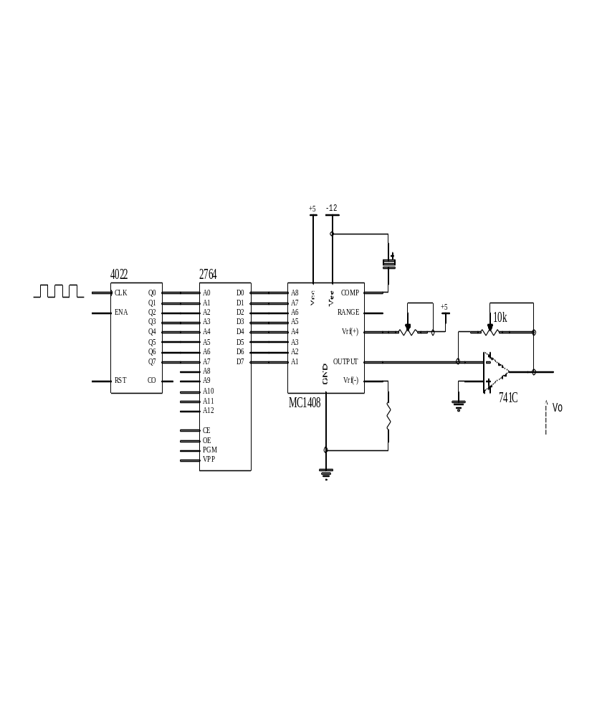
Hardware Generation

Slide 15
Analog-to-Digital Conversion Techniques
Four working principles:
  Integrating
  Counter Ramp
  Successive Approximation
  Flash converter

Slide 16
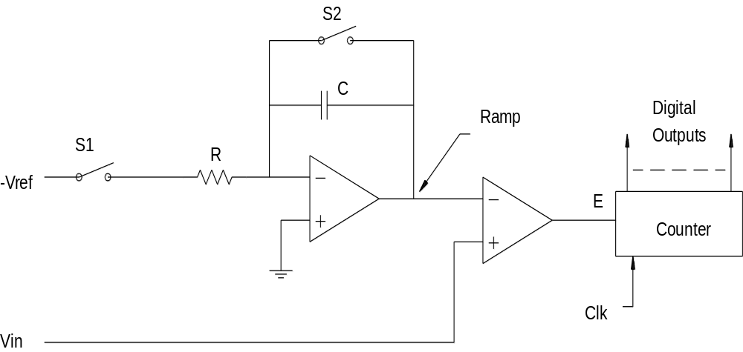
Integrating Techniques of AD conversion

Slide 17
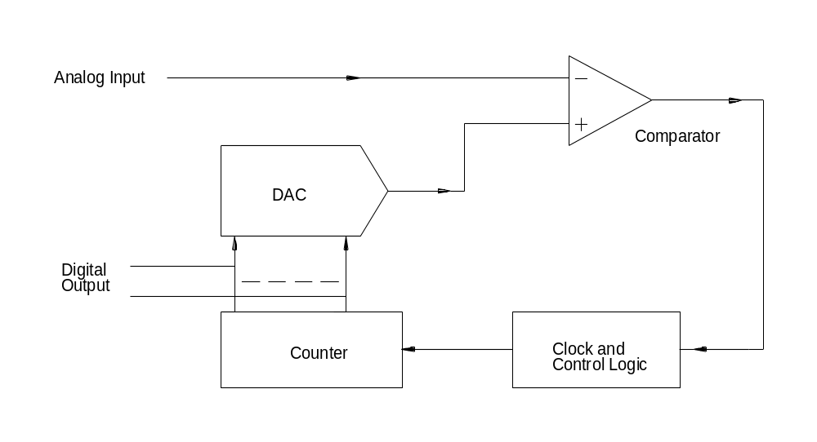
Counter Ramp ADCs

Slide 18
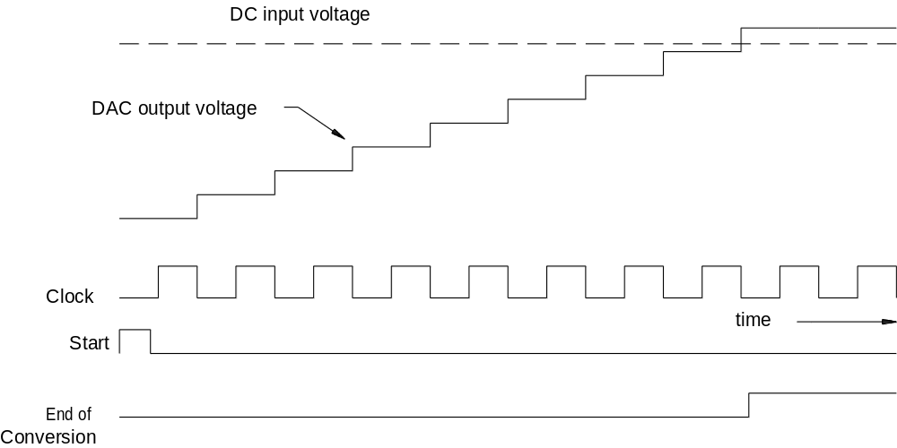
Timing Sequence for Counter Ramp ADC

Slide 19
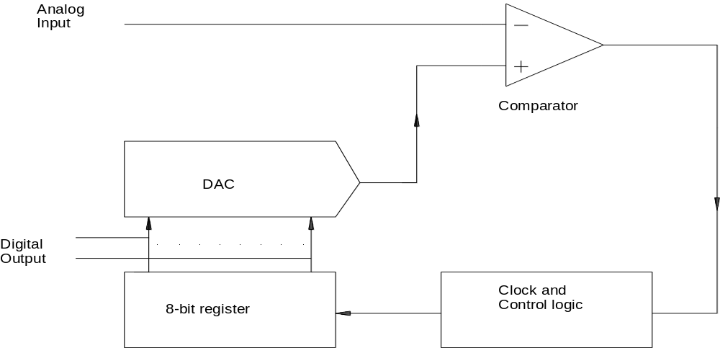
Successive Approximation ADC

Slide 20
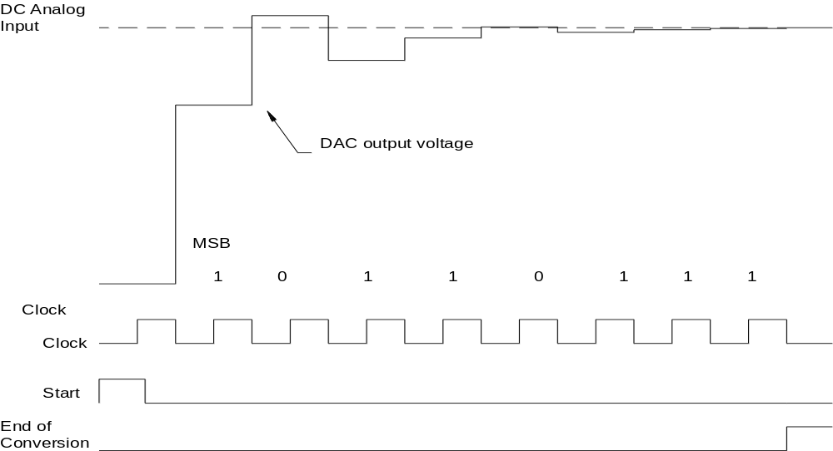
Timing Diagram for the Successive Approximation ADC

Slide 21
Register value-bit ptr | Decimal | DAC voltage | < Input voltage? | Action
1000 0000 - bit 8 | 128 | 2.51 | Yes | Keep bit
1100 0000 - bit 7 | 192 | 3.76 | No | Clear bit
1010 0000 - bit 6 | 160 | 3.13 | Yes | Keep bit
1011 0000 - bit 5 | 176 | 3.45 | Yes | Keep bit
1011 1000 - bit 4 | 184 | 3.61 | No | Clear bit
1011 0100 - bit 3 | 180 | 3.53 | Yes | Keep bit
1011 0110 - bit 2 | 182 | 3.57 | Yes | Keep bit
1011 0111 - bit 1 | 183 | 3.59 | No | Clear bit

Slide 22
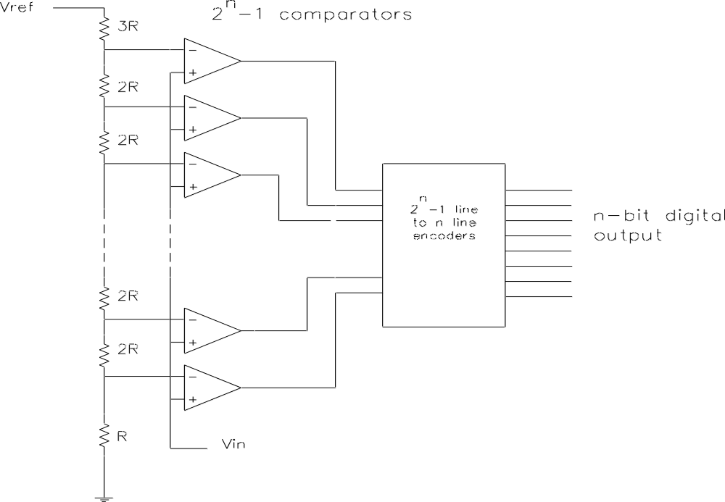
Parallel/Flash ADCs

Slide 23
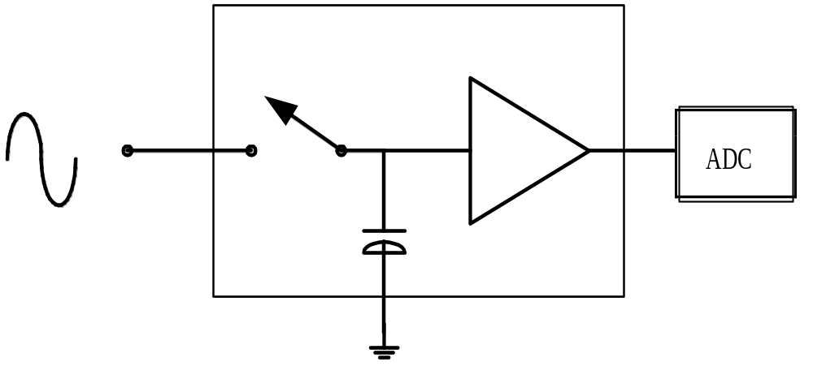
Sample Hold Amplifier

Slide 24
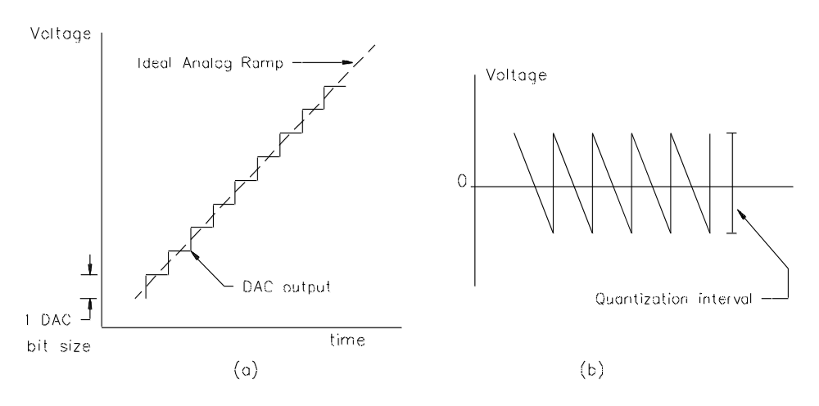
Quantization Errors in D/A Conversion

Slide 25
Quantization Error / Resolution
The difference between D/A output and ideal analogue waveform represent an error in the system
As this difference in voltage arises from the quantized nature of the output of the DAC, it is called Quantization Error.
To reduce the quantization error, a DAC must be controlled by more input bits. If the full-scale voltage remains the same, the increase in bits will reduce the quantization interval. Quantization error is also often referred to as Resolution.
Resolution can be expressed in several ways.... eg for an 8-bit A/D:
  as a number of bits ............................ 8-bit resolution.
  as a percentage ................................... 0.39% (1/28 * 100)
  as the relative size of the LSB........... 1 in 256
  as an absolute value (say 5v range)... 19mV (5V/28)

