Slide 1
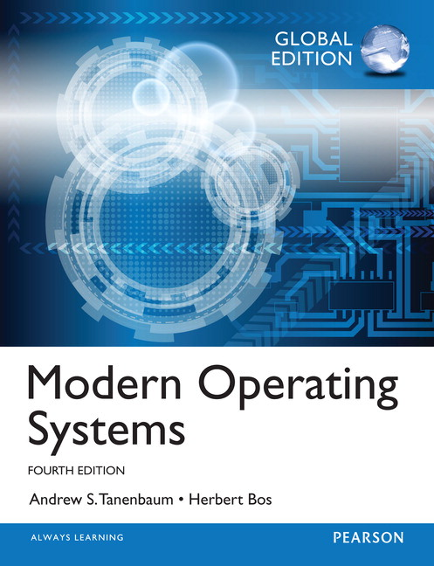
Operating Systems ET0023
Modern Operating Systems: Global Edition, 4/e
Author : Tanenbaum
Publisher : Pearson
ISBN : 9781292061429
Available now at Booklink SP

