Slide 1
Chapter 11
Embedded Operating Systems & Multitasking

Slide 2
Embedded Operating Systems

Slide 3
Embedded Operating Systems
Most Embedded Systems typically deal with the same types of I/O and Processes
Programs written to service these I/Os became standard and were stored in Operating Systems
  Getting Inputs from Users
  Sending outputs to Displays or Printer
  Creating, Reading or Writing Files
  Load, Run and Terminate Computer Programs (Task Management)
But developments in Tasks Management within an OS became more sophisticated

Slide 4
Embedded Operating Systems
Task Management
  CPU can only run 1 program at a time
  But speed of CPU allows it to run several programs a portion of the time in succession
  If this is done fast enough, illusion of multiprocessing is created
  This is known as multitasking

Slide 5
Embedded Operating Systems
Distinguish between these terms
  Task
    Basic unit of programming as seen by an OS. A task can be classified further as a process or thread
  Process
    Instructions currently executed by a computer, data related to these instructions and current state of CPU
  Thread
    Program loaded into computer once but can be used by multiple users. OS keeps track of each users data

Slide 6
Multitasking Systems

Slide 7
Multitasking Systems
Method in which multiple tasks can share a common processing resource e.g. CPU
Tasks can be classified as
  Processes (separately executing programs)
  Threads (separately executing parts of a single program)
OS can assign (or schedule) CPU to different tasks at different times
CPU is said to undergo “context switch”
If done rapidly, we get illusion of parallelism

Slide 8
Multitasking Systems
Multithreading more common in Embedded Systems compared to multiprocessing
In multithreading, different parts of the same program runs in “parallel”
E.g. Sensor monitoring, image processing, route planning, motor control in a robot
Benefits of multithreading
  More efficient programs – no need to wait for slow inputs
  Ability to handle different tasks “simultaneously”

Slide 9
Multiprocessing & Multithreading
Multiprocessing
  All programs are written in programming code
  All processes consist of
    Unique collection of usable memory areas
    A current CPU state (state of IP, SP, Flags, DP and HP etc)
  OS allocates unique usable memory area when process is first launched
  When process is running, memory and CPU state changes
  When process is suspended, CPU state is stored in memory (stack area) before CPU is context switched to another process

Slide 10
IP
Code
SP
Stack
Flags
Data
General
Registers
Heap
CPU States
System
Context of a Process
Memory Areas

Slide 11
Multiprocessing & Multithreading
Multiprocessing (cont’d)
  Multiprocessing - running more than one process at a time
  OS runs multiple processes by constantly switching from one process to another
  OS switches context by
    Suspending the execution of current process
    Saving the CPU state into its stack area
    Loading the context of next process to run
  A scheduler determines when to terminate current process and which process runs next

Slide 12
Multiprocessing & Multithreading
Multithreading
  Threads - independent flows of execution within a process
  Every process contains 1 or more threads
  All threads share common memory area (except stack) and can assess common global variables
  Each thread has separate CPU states and stack areas
  Threads are more tightly linked and interact with each other much more than processes
  Multithreading – running more than 1 thread at a time
  Context switching in threads involves the same steps as context switching in processes

Slide 13
IP
Code
SP
Flags
Stack
Thread #1
General
Registers
Data
Common
Memory Area
IP
Heap
SP
Thread #2
Flags
General
System
Registers
Context of a Thread

Slide 14
Scheduling

Slide 15
Scheduling
Multitasking OS Scheduler switches context from one task to another for a fixed amount of time
Amount of time allocated is a time slice
When time slice ends, scheduler determines which task will start next
All tasks have 3 states
  Running
  Ready – waiting for time slice to run
  Blocked – not ready to run

Slide 16
Scheduling
Scheduler maintains internal lists for keeping track of state of each task
  Ready list
  Blocked list
Head of ready list is usually next to run while tasks completing time slice are usu. added to bottom of list
Blocked tasks that become unblocked added to ready list
Scheduling strategies
  FIFO
  Round Robin

Slide 17
Scheduling
Round robin scheduling
  Scheduler pulls task from head of ready list and changes its state to “running”
  Tasks run for a time slice and at the end, scheduler saves state of task (switching our the task context)
  Scheduler places task at end of ready list
  Pulls next task from top to list and continues
Scheduler may allocate priority to task (-15 to 15)
If so, next highest priority task is pulled out and run
Must have scheme where priority can be demoted to give others a chance

Slide 18
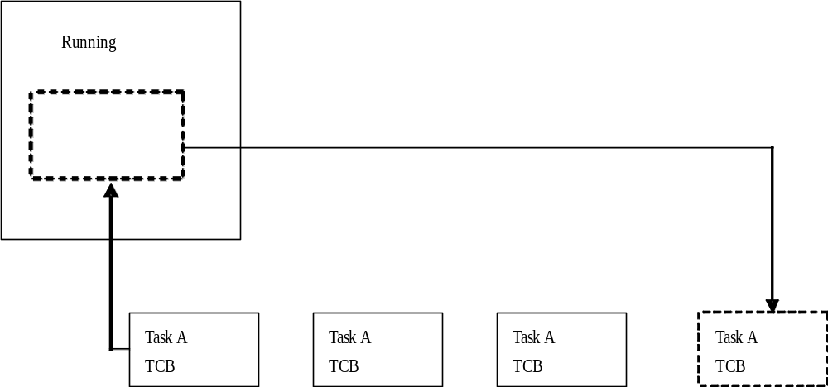
Round robin scheduling algorithm

Slide 19
Synchronization

Slide 20
Synchronization
Problems can arise because multitasking tasks can assess same resources
Race condition may occur
Problems can arise because multitasking tasks can assess same resources
Race condition may occur
counter – common resource
Start of time slice
LOADA counter
INCRA
STOREA counter
= 3
LOADA counter
INCRA
STOREA counter
= 4
= 4
= 5
= 4
= 5
End of time slice
Task 1
Task 2

Slide 21
Synchronization
Start of time slice
End of time slice
LOADA counter
INCRA
STOREA counter
= 3
LOADA counter
INCRA
STOREA counter
= 3
= 4
= 4
= 4
= 4
End of time slice
Start of time slice
Task 1
Task 2
Depending on chance of time slice, results are different
Task 2’s increment is deemed useless
Better if we can lock the 3 statements together
Synchronization allows us to do that

Slide 22
Synchronization
3 types of synchronization objects
  Mutually Exclusive (Mutex) Objects
  Semaphore Objects
  Event Objects

Slide 23
Synchronization
MUTEX Objects
  Mutex Object is a critical section of code (e.g. the 3 lines in previous slide) that has to run together
  Owned by only one task at a time
  Has 2 states
    Owned
    Free
  OS supporting Mutex provides 2 function calls
    Wait call
    Release call

Slide 24
Synchronization
  Tasks requiring a Mutex will issue a WAIT call
  If Mutex is FREE, WAIT call returns and calling task has acquired the Mutex.
  Mutex becomes OWNED
  At end of Mutex, task RELEASES it, and Mutex becomes free again
  If Mutex was OWNED, WAIT call will wait for Mutex becomes FREE before returning

Slide 25
Synchronization
Semaphore Objects
  A semaphore object guards a Resource (e.g. counter in previous program)
  All semaphores have a data item called count that is initially set to a positive value
  OS supporting semaphore objects provides 2 operations
    Wait
    Release
  When a task acquires the resource, it issues the WAIT operation and count is decreased
  When a task releases the resource, it issues a RELEASE operation and count is increased

Slide 26
Synchronization
  Before a task acquires a resource, count must be > 0
  Otherwise it will have to wait
  For Counter (in previous program), semaphore count would be set to 1
  But semaphores can also be used to allow multiple tasks to access a resource e.g. a network connection

Slide 27
Synchronization
Event Objects
  Used for synchronizing tasks rather than controlling access
  Allows tasks to go to sleep until event object takes place
  OS allows tasks to be
    Set to Signaled
    Reset to Non-signaled
  Objects can be created initially in either state
  Tasks waiting on a Non-Signaled object that is in the Signaled state will have to wait until another task resets it
  Similarly, tasks waiting on a Signaled object in the Non-Signaled state will have to wait till another task sets it
  Objects can be auto-reset or manual-reset

Slide 28
Embedded System Startup Options

Slide 29
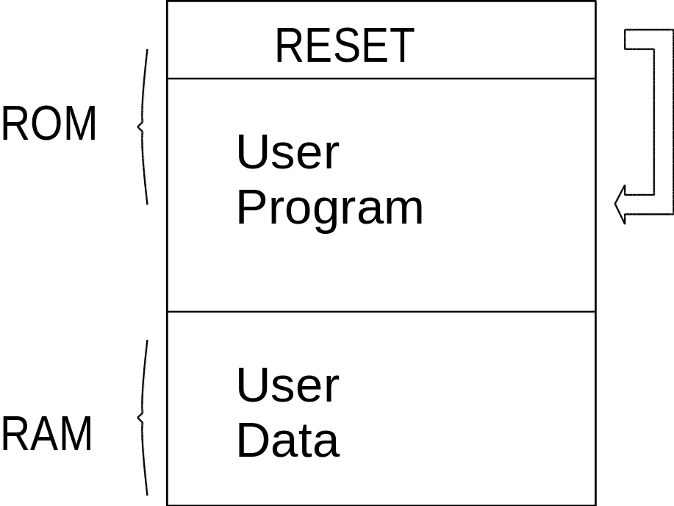
Embedded System Startup Option
Boot Option
User Program stored in ROM
Program is run directly from ROM
RAM used to store user data
Advantages
Uses least amount of memory
Disadvantages
Difficult to set up
Absence of BIOS and OS
Hardware dependent

Slide 30
Embedded System Startup Option
Boot Option
BIOS and OS are present
OS in Flash started by BIOS
OS runs User Program in ROM
User data stored in RAM
RESET
ROM
BIOS
User
Operating System
Program
Advantages
OS provides many system ftns
Disk (Flash)
User
RAM
Data
Disadvantages
Hardware dependent
May need to pay for OS license

Slide 31
Embedded System Startup Option
Boot Option
BIOS and OS present
OS in Flash stated by BIOS
User Program stored in Flash
OS loads program to RAM before running
User data stored in RAM
RESET
ROM
BIOS
User
Operating System
Program
Advantages
OS provides many system functions
User program stored in Flash can be more lengthy
Easy to setup and is flexible
RAM
User Program
User
Data
Disk (Flash)
Disadvantages
May need to pay for OS license

Slide 32
The End

