Slide 1
Chapter 2
PC Architecture

Slide 2
PC AND THE ISA BUS

Slide 3
PC/AT Computer
PC is made up of many subsystems
  Timers & Interrupt processors
  DMA & Real time clock
  Bios ROM and RAM
  External Devices - VDU, FDD, HDD, Serial & Parallel ports
All these subsystems are connected to Main Processor via a bundle of wires or connections (called bus)
A common standard bus used is the ISA bus

Slide 4
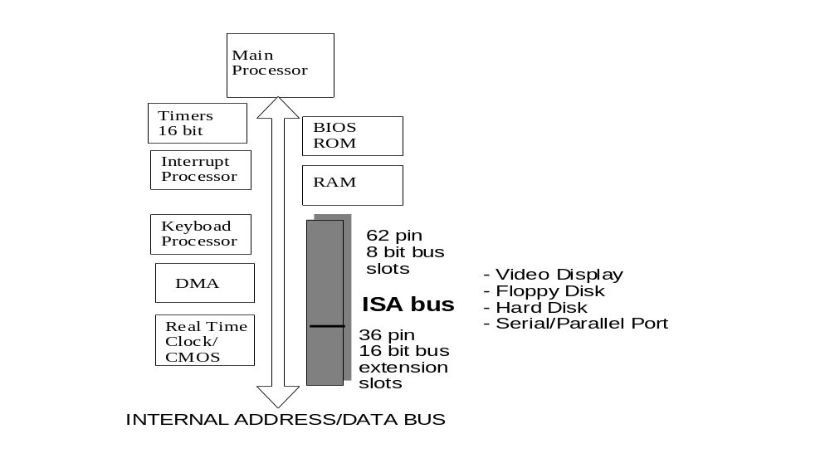
PC/AT computer
ISA:
Industry Standard Architecture
(formerly called PC AT Bus)

Slide 5
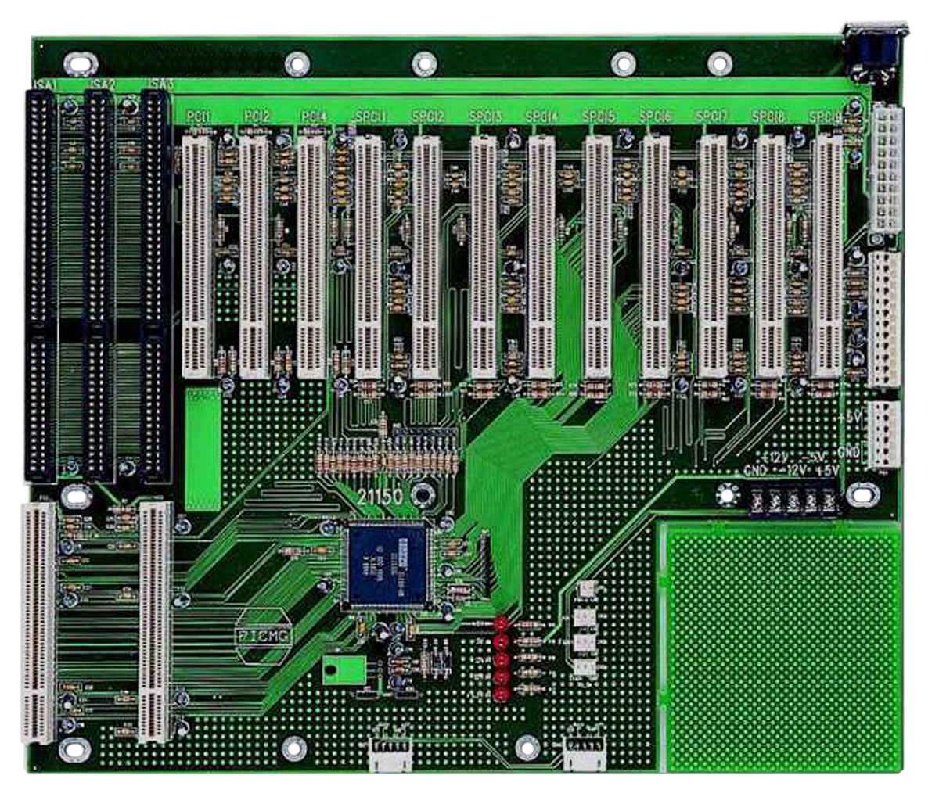
ISA Bus

Slide 6
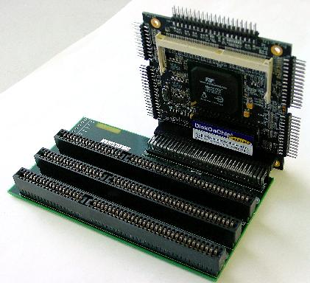
ISA Bus

Slide 7
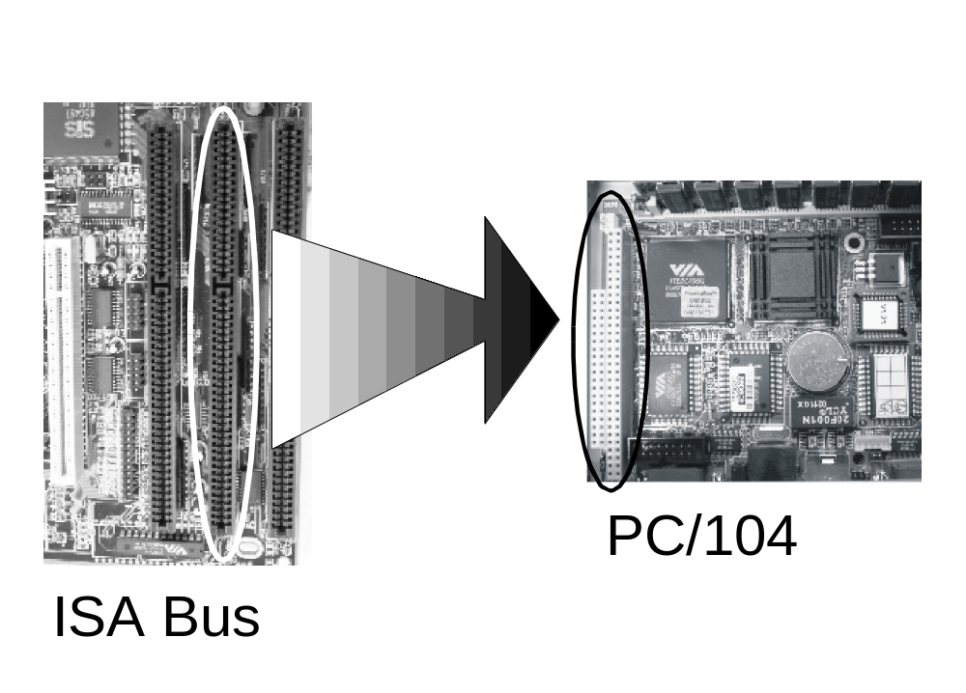
ISA Bus to PC/104
104 pins
PC104 is a later development
62+36 = 98 pins

Slide 8
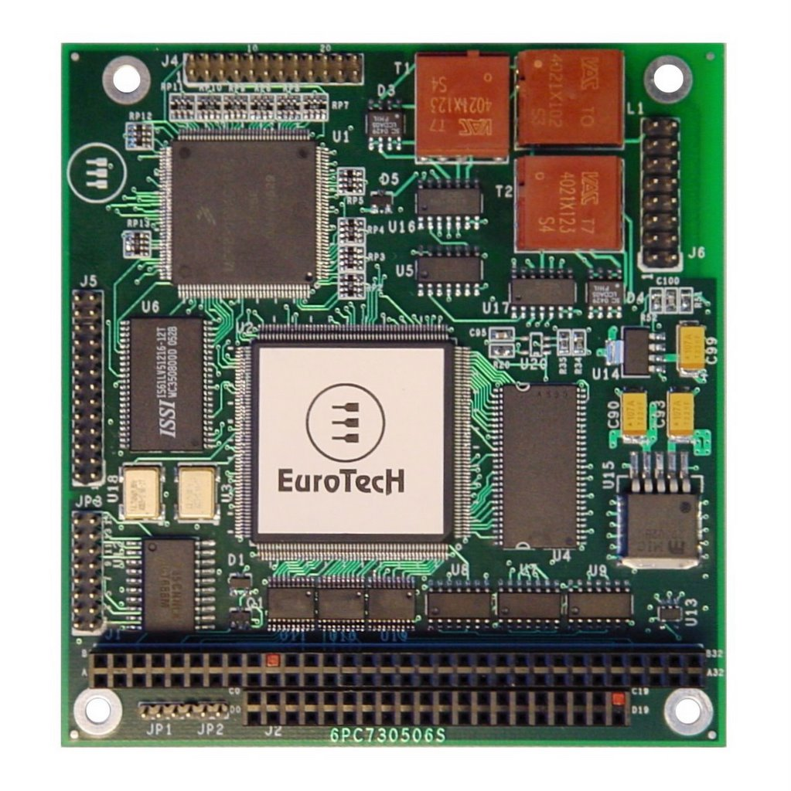
PC104 Bus

Slide 9
ISA Bus Signals
A0-A23 (Address Bus):
Made up of SA0-19 (Small Address) and LA17-23 (Large Address). Note that, LA17-19 overlap.
16 MB of memory accessible (2²⁴ = 16MB)
Only SA0-15 are turned on during I/O operations and only SA0-9 are actually used.
SD0-15 (Data Bus):
SD7 to SD0 used for transfer of data with 8-bit devices.
SD15 to SD0 are used for 16-bit devices.

Slide 10
ISA Bus Signals
AEN (Address Enable)
Signal is active when the system DMA controller has control of the address, data and control buses
Signal should be included as part of ISA board select decodes to prevent incorrect board selects during DMA cycles.
-IOR (I/O Read)
Indicates that controller of the ISA bus is doing an I/O read. The selected I/O device should output data to the data bus.
-IOW (I/O Write)
Indicates that controller of ISA bus is doing an I/O write. The selected I/O device should capture the data on the data bus.

Slide 11
ISA Bus Signals
-MEMR (Memory Read)
Instructs a selected memory device to drive data onto the data bus. It is active on all memory read cycles.
-MEMW (Memory Write)
Instructs a selected memory device to store the data currently on the data bus. It is active on all memory write cycles.
-I/O CH RDY
As processors are very much faster than I/O devices, wait states have to be inserted to slow it down. This signal is used to indicate to the processor that it needs to wait

Slide 12
What we use in this module
20 bit Memory Address (1MB) – 24 are available
10 bit I/O Address (1K) – 16 are available
8 bit Memory and I/O data – 16 are available
Note that:
Intel processors use different instructions for I/O (IN, OUT) and memory operations (MOV)
This is known as having an I/O mapped I/O

Slide 13
I/O Mapped I/O
Memory mapped I/O | I/O mapped I/O
Uses processor’s main memory address space for I/O | Uses separate address space for I/O
May interfere with program memory allocation. We have to take note of “special” locations that are not standard memory (but I/O instead). | No such worries as all address in I/O map is I/O, and all addresses in memory map is memory
Need to use flexible addressing modes to access data. | Normally all data passes through accumulator - can be slow.

Slide 14
OTHER FEATURES OF A PC

Slide 15
PC AT Memory and I/O Map
Apart from the ISA bus, a PC also has a memory map
The first 640k of memory is system memory (00000H – 9FFFFH)
Addresses above A0000H are used for memory on vendor cards inserted into ISA bus (see Appendix)
Intel provides a separate address area for I/O called the I/O map.
I/O addresses that are reserved by the system can be found in Appendix

Slide 16
Timers and Interrupts
2 important hardware functions also present are
  the timer and
  the interrupt system
Two 16-bit 1.8432MHz timers are present for use to time system functions and providing delays in programs
The real time clock is a separate counter
The Interrupt System supports up to 16 device interrupts. Many are already used for system functions. Details in Appendix.

Slide 17
MEMORY DEVICES

Slide 18
Memory Devices on ISA bus
Memory Devices can be plugged into the ISA bus
These memory are often found on Plug-in cards
They may carry
  Program on card (EEPROM, EPROM)
  Data storage on card (Static RAM)
Plug-in memory is allocated Address above A0000H in the memory map

Slide 19
Types of Memory devices
RAM ROM
Volatile yes no
Random Access yes yes
Read by processor yes yes
Write by processor yes no
RAM Types: static and dynamic RAM
ROM Types: PROM, EPROM, EEPROM, Flash

Slide 20
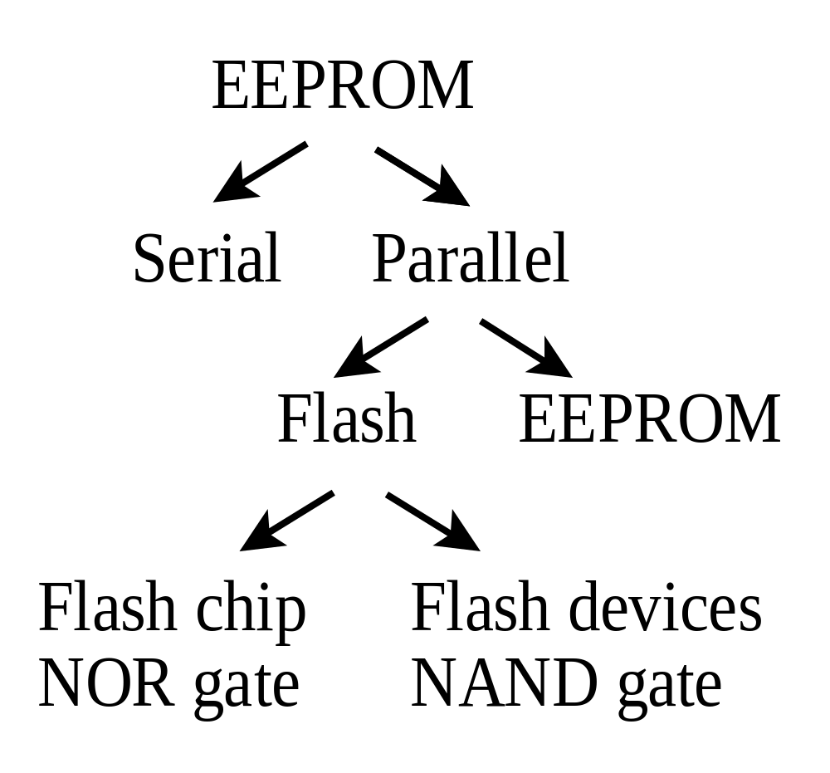
EEPROM Types
Access
Technology
Availability

Slide 21
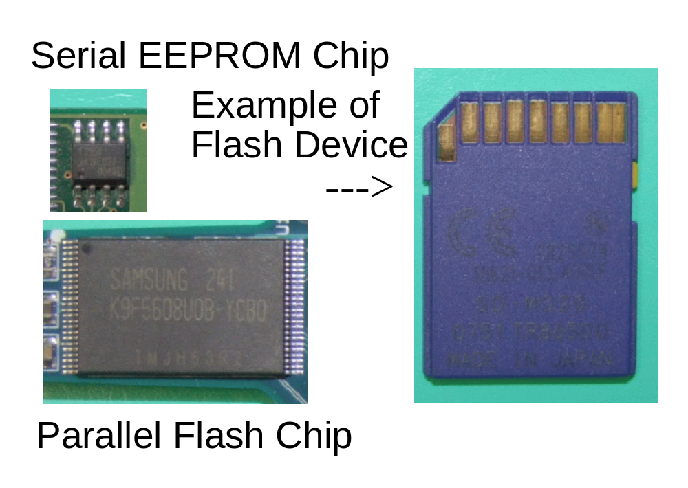
EEPROM Types

Slide 22
BUFFERS AND LATCHES

Slide 23
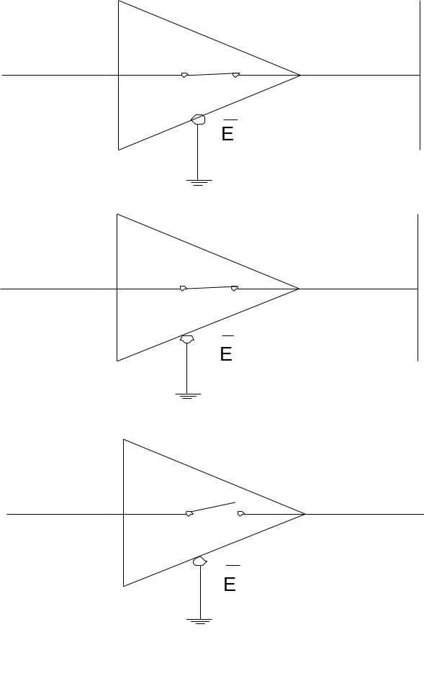
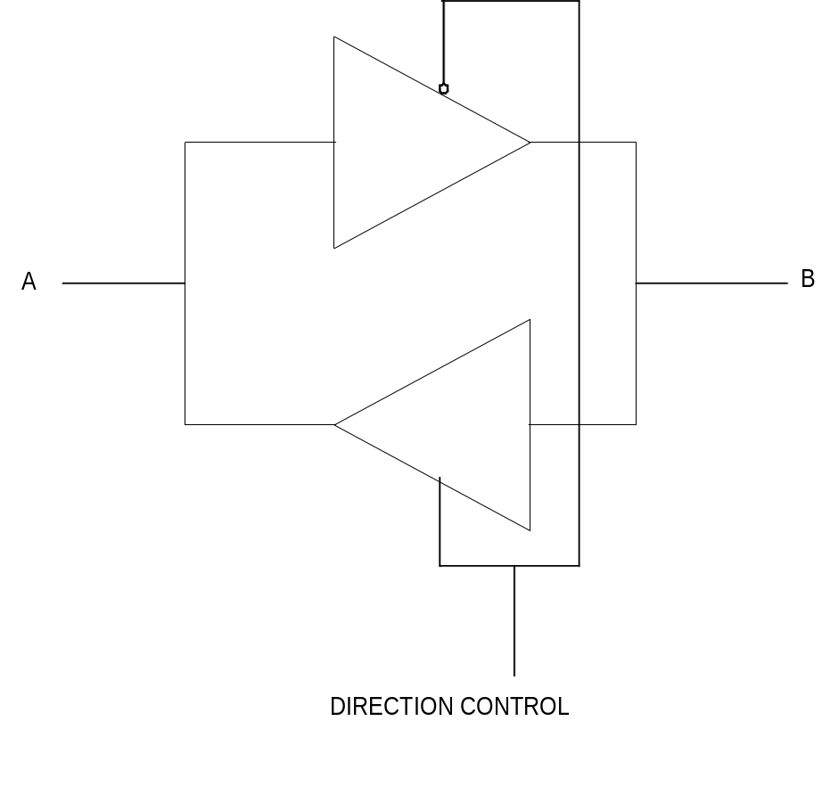
Buffer and Latch
“0”
Active Low
“0”
“0”
“1”
“1”
“0”
Active High
“0” or “1”
High Impedance
“1”
Bi-directional Buffers
Tri-state Buffers

Slide 24
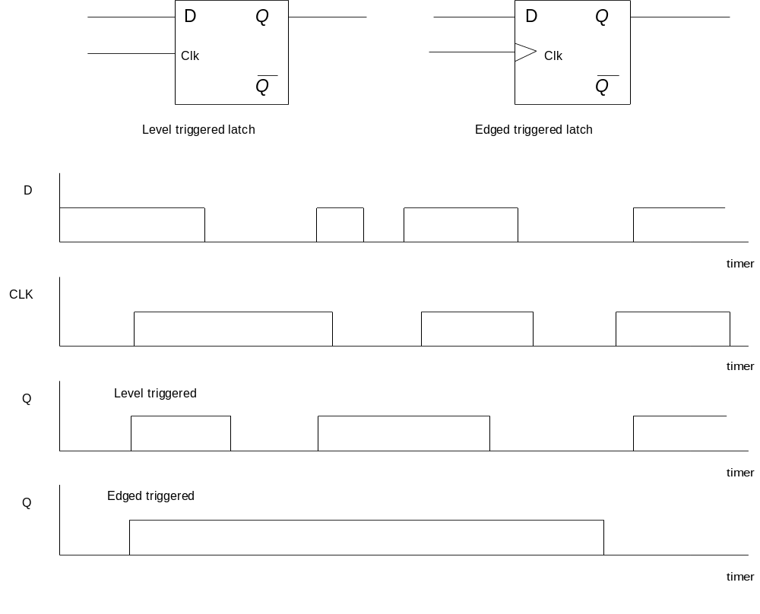
Edge triggered latch
Input
Output
Input
Output

Slide 25
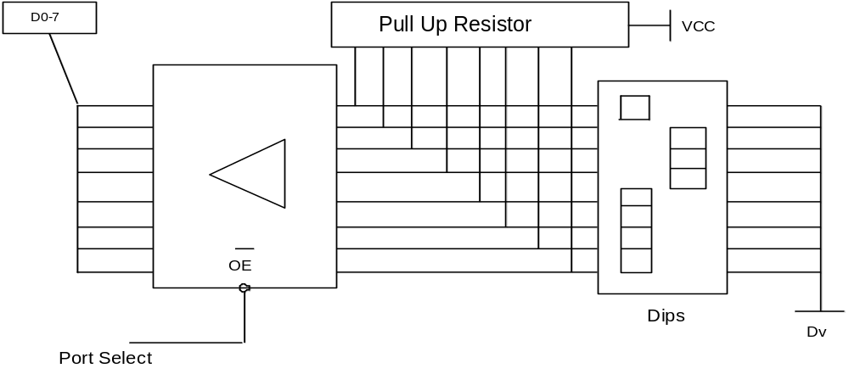
Input Port using Buffer

Slide 26
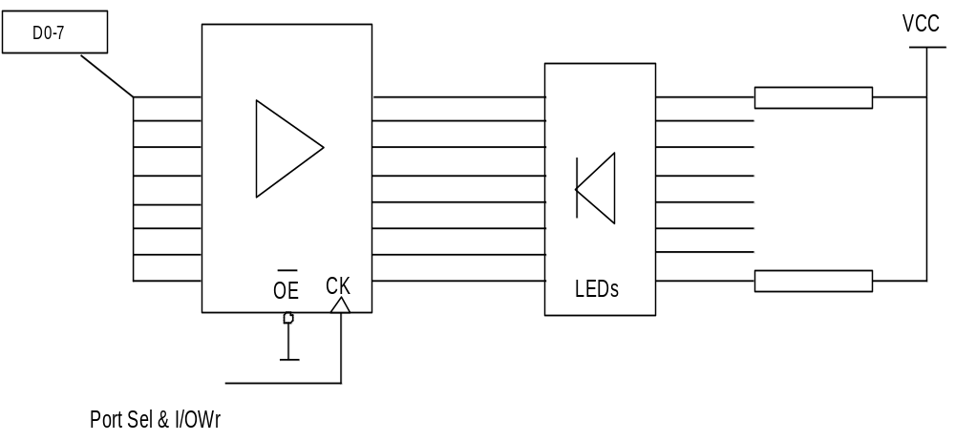
Output Port using Latch

Slide 27
MONITOR PROGRAMS & BIOS

Slide 28
Monitor Program
A simple basic program residing in ROM of Microprocessor
Fundamental tasks
  simple output to the screen
  keyboard handling
  output to printer
  serial communications and so on.
This allowed users to
  quickly bring a system up to productive use
  use common routines to do input and output.

Slide 29
BIOS: Basic I/O system
A more sophisticated monitor program
Usually found in a PC
More routines were added
  Secondary storage devices like hard and floppy disks
  Support for Time-Of-Day routines
A BIOS may occupy as much as 64K of ROM - not practical for small processors
(Monitor programs rarely exceed 2K)

Slide 30
Bootstrap Program
In Microprocessor Systems
  On reset or power up, performs a jump to location 0FF000H
  0FF000H is usually a ROM location
  Executes the code there (which is usually a jump instruction to more substantial code)

Slide 31
Boot up Program for PC
In a BIOS function
  On reset or power up, Microprocessor searches for FDD or HDD
  Reads boot sector of device (512 bytes long)
  Puts contents in boot sector in location 7C000H
  Jumps to that location and executes code
  (which usually contains instruction to load other larger files to initialise PC)

