Slide 1
Chapter 4
Keypad Interfacing

Slide 2
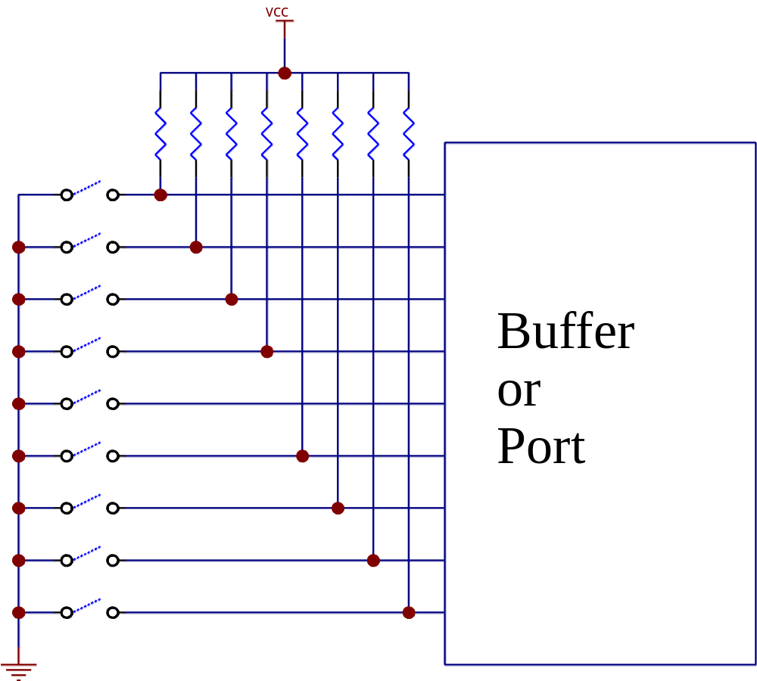
Simple keyboard reading
Active low keys

Slide 3
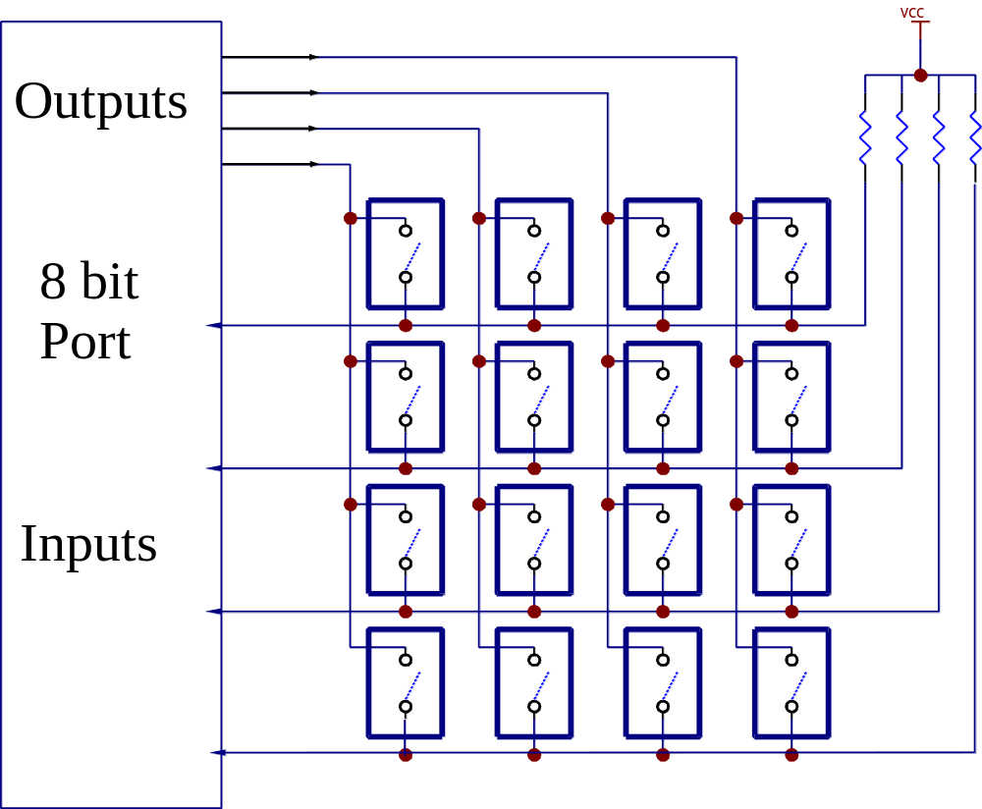
Matrix Organization

Slide 4
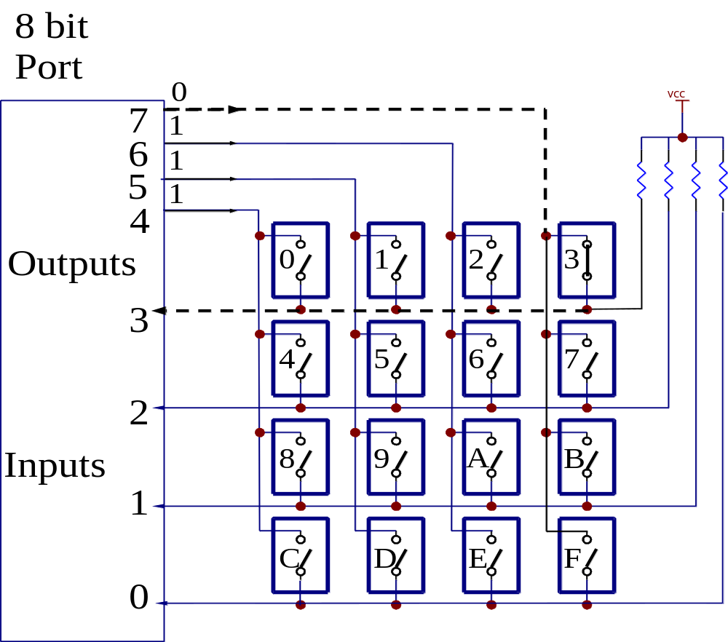
Scanning the keypad

Slide 5
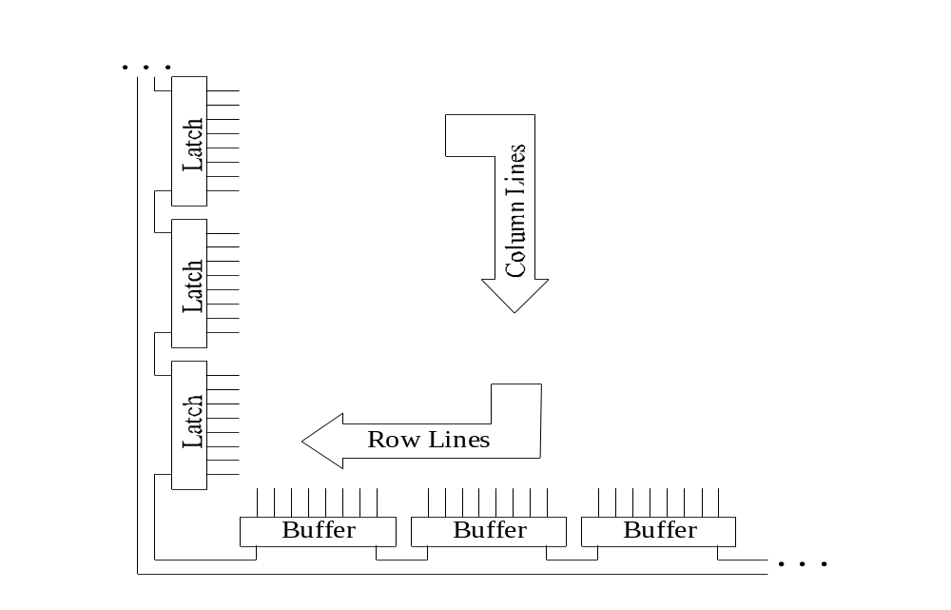
Large keyboard detection using latches
Guideline:
Use more latches for column output than buffers for lines reading

Slide 6
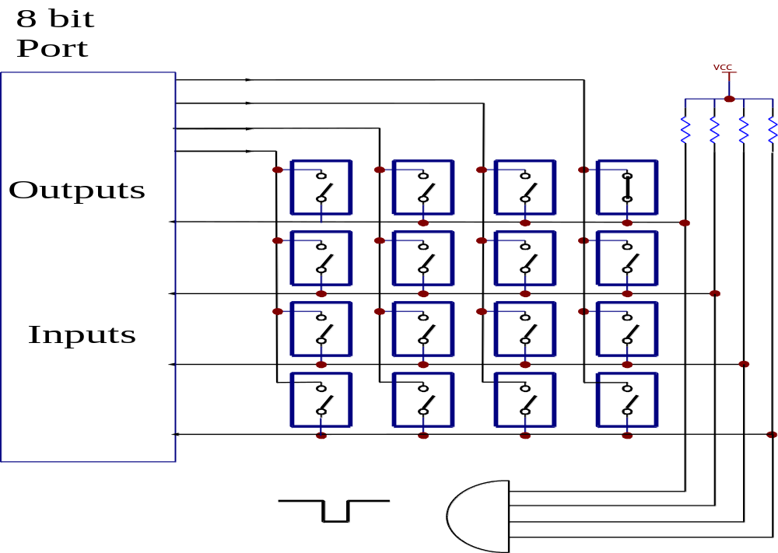
Interrupt Driven Keyboard

Slide 7
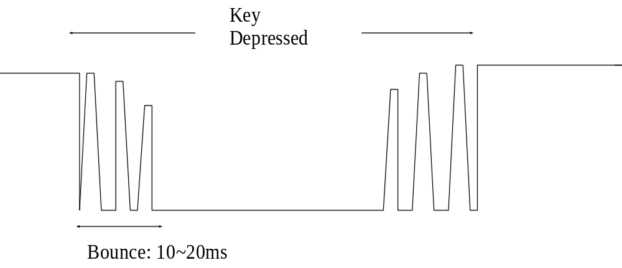
Common problem: Key bouncing

Slide 8
Multiple key presses
N-key rollover:
  Software: ignore the reading from the keyboard until only one key closure is detected.
  Hardware: later key prevented from generating a strobe until the earlier ones are released

Slide 9
Multiple key presses
N-key lockout:
  N-key lock-out takes into account only one key pressed
  it may be the first key pressed which will generate the code, or else the last key pushed

Slide 10
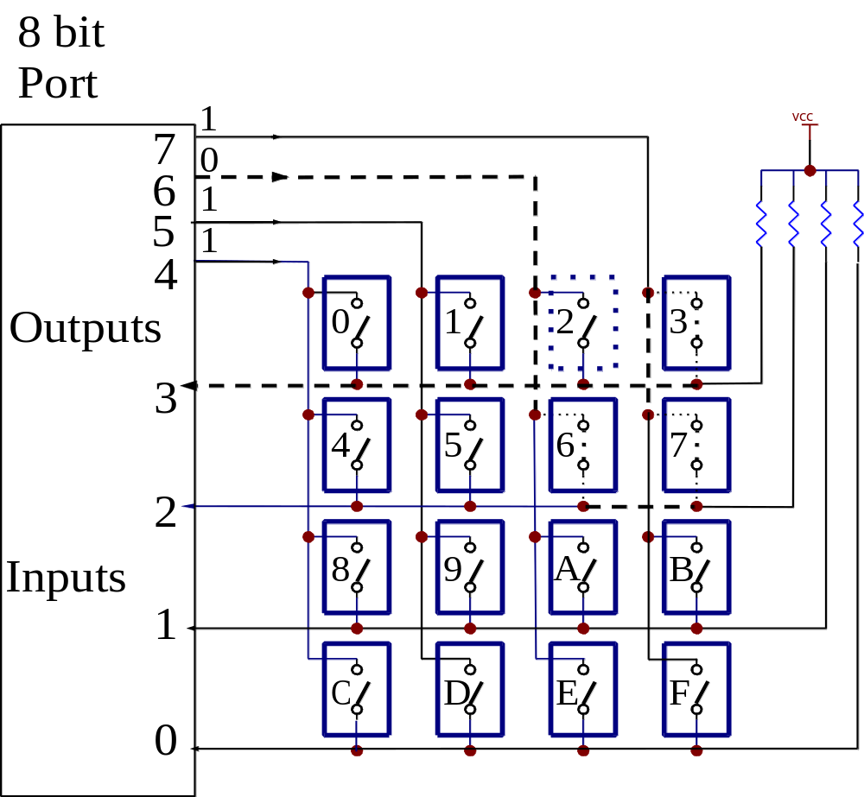
Phantom Key

Slide 11
Example code (1)
unsigned char ScanKey ();
unsigned char ProcKey ();
#define Col7Lo 0x7F /* column 7 scan */
#define Col6Lo 0xBF /* column 6 scan */
#define Col5Lo 0xDF /* column 5 scan */
#define Col4Lo 0xEF /* column 4 scan */

Slide 12
Example code (2)
unsigned char ScanKey()
{
KbdPort = Col7Lo; /* bit 7 low */
ScanCode = KbdPort; /* Read */
ScanCode |= 0xF0; /* high nybble to 1 */
ScanCode &= Col7Lo; /* AND back scan value */
if (ScanCode != Col7Lo)
/* in<>out: get key & disp */
return ProcKey();

Slide 13
Example code (3)
unsigned char ProcKey()
{
unsigned char i; /* index of scan code returned */
for (i = 0 ; i <= 12; i++)
if (ScanCode == ScanTable[i]) /* search in table */
return i; /* exit loop if found */
if (i == 12)
return 0xFF; /* if not found, return 0xFF */
}

