Slide 1
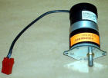

Chapter 6
Step Motor

Slide 2
Introduction
Step motor moves in steps: positional control.
Step size: angular degrees per step
Types of motor:
  Permanent magnet
    PM on rotor
    Coils of wire on stator casing
  Variable reluctance
  Hybrid types

Slide 3
Introduction ---
Phase: Number of sets of wire windings on the stator. Normally 4.
Wire windings: by applying electric signal to it, it will generate magnetic field, which will either attract or repel the rotor, so the motor turns.
Relation between phase and step size
Depends on motor construction.

Slide 4
Take note!
For convenience, we will consider a motor with a step angle of 90 degrees. In reality, a motor with such a large angle is not common. We will also assume it has four coils on its stator. This corresponds to four phases - A, B, C, D and a permanent magnet rotor with a single magnet.

Slide 5
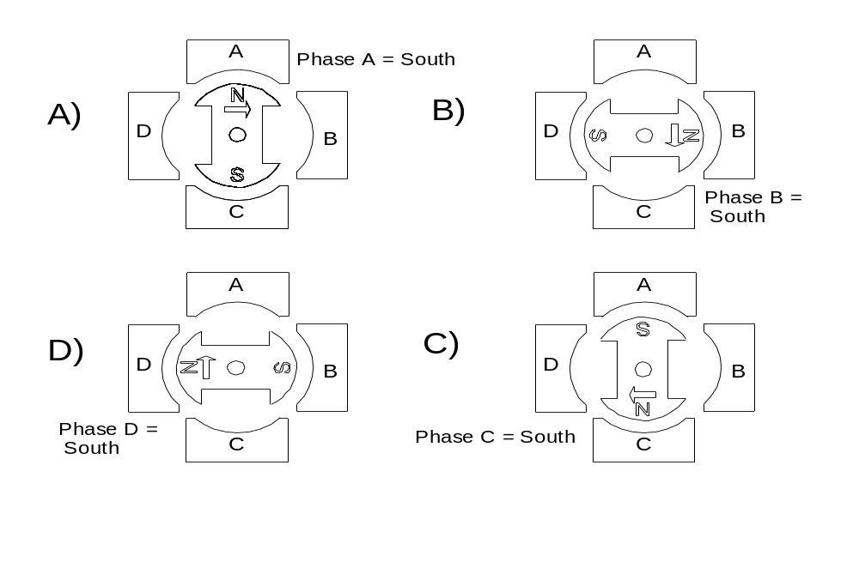
Basic motor control

Slide 6
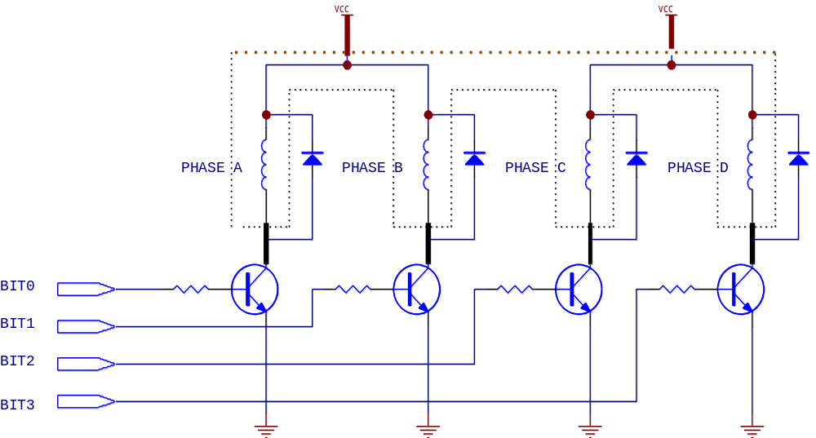
Schematic of a four phase stepper motor circuit

Slide 7
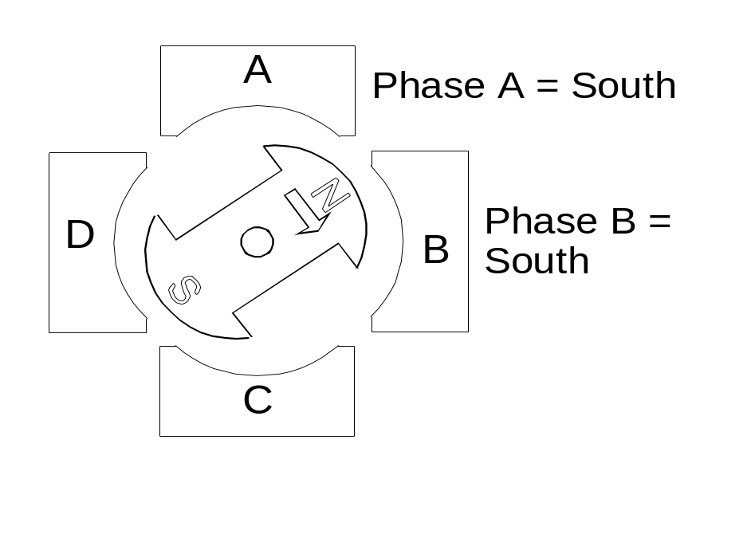
Methods of position control
Full step: One phase on at one time, motor moves the full step.
Half step: Two phases on at one time, motor moves between 2 phases.

Slide 8
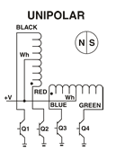
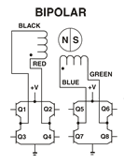
Motor driving
Unipolar: Bipolar: more torque

Slide 9
Full Step
Step | Phase D | Phase C | Phase B | Phase A | Value
1 | 0 | 0 | 0 | 1 | 1
2 | 0 | 0 | 1 | 1 | 3
3 | 0 | 0 | 1 | 0 | 2
4 | 0 | 1 | 1 | 0 | 6

Slide 10
Half Step Control
Step | Phase D | Phase C | Phase B | Phase A | Value
1 | 0 | 0 | 0 | 1 | 1
2 | 0 | 0 | 1 | 1 | 3
3 | 0 | 0 | 1 | 0 | 2
4 | 0 | 1 | 1 | 0 | 6
5 | 0 | 1 | 0 | 0 | 4
6 | 1 | 1 | 0 | 0 | C
7 | 1 | 0 | 0 | 0 | 8
8 | 1 | 0 | 0 | 1 | 9
1 | 0 | 0 | 0 | 1 | 1

Slide 11
Some control issues
Micro-stepping: Not supply full current
Moving direction: Depends on sequence of energizing of phases, A-B-C-D, or D-C-B-A
Speed: Time delay between two phases energizing signal
High speed problems:
  Loss of synchronization
  Resonance

Slide 12
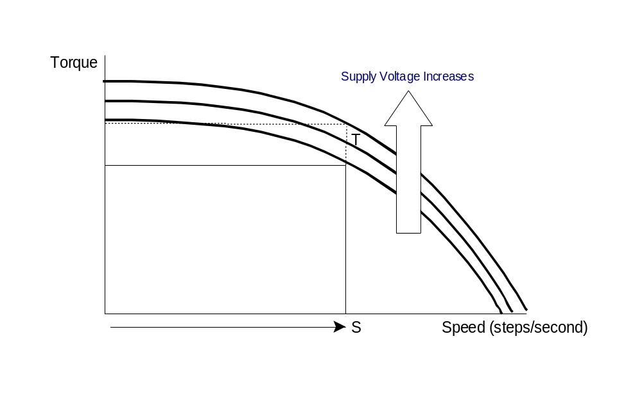
Torque speed curve

Slide 13
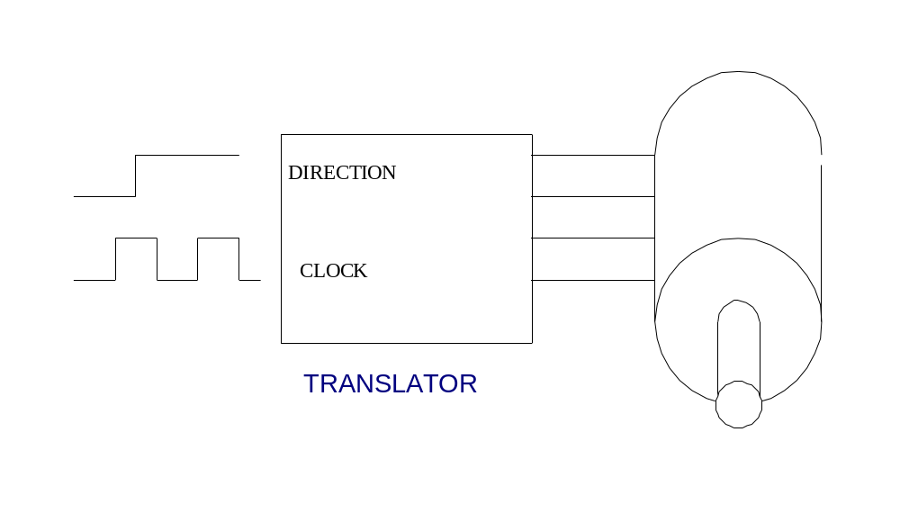
Translator

Slide 14
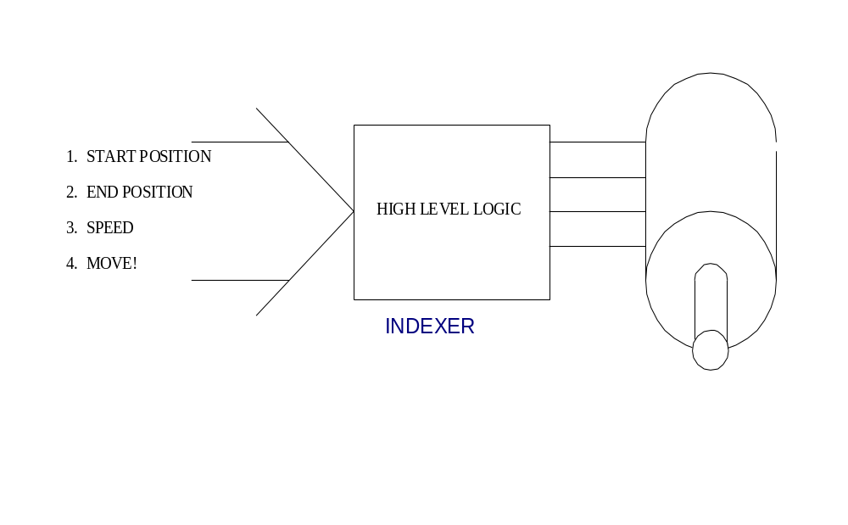
Indexer

Slide 15

Some calculation
A stepper motor rotates 1.8 degree per step. What step rate is needed to make it rotate at 10 revolutions per minute (rpm) ? Assume that the program execution time is negligible. You also have access to a routine called Delay1ms which provides a 1 millisecond delay. Use the motor in FULL step mode.

Slide 16
Calculation
We need to convert from rpm to steps per second.
10 rpm = 360 degrees/minute * 10
This is equal to 3600 / 60 degrees/second
Since one step is 1.8 degrees, we need to issue 60 / 1.8 = 33.33 steps per second
Or 1/33.33 seconds per step = 0.03 which is 30 milliseconds per step.

