Slide 1
Chapter 8
Top Down Design

Slide 2
Microprocessor based design
Embedded system:
  Unit cost is low;
  Development cost tends to be high
MPU offers opportunities for products and product features which are not achievable by other means.
Implications of Incorporating a Microprocessor
  Extensive and thorough testing of hw and sw
  A/D and D/A signal converters

Slide 3
Trends in electronics industry
Products tend to have a shorter product life, but each new version of it has better price/performance features due to increased competition
As a result, manufacturers need to
  shorten product design cycle
  invest on tools & resources

Slide 4
Product Design and Development Activities
Product Requirement
System Analysis
System Specification
System Design & Development
  Hardware design
  Software design
System Integration/Test
Production

Slide 5
Need for Product Requirement
Avoid 'creeping featurism’
  interfere continually with product specification during development
Avoid 'missing features‘
  some required features were missed out

Slide 6
Goals and Constraints
AREA OF CONSTRAINTS | EXAMPLES
Microprocessor | Particular type specified by customer
Other hardware | Some or all of additional hardware specified
Field‑repairable | PCBs must be plug‑in
Power Supply | Must run from batteries
Environment | Must be insensitive to radio interference
Size | Must fit into particular box
Unit Component Cost | μP and interfaces must cost less than a particular limit
Development Cost | Amount available for supporting equipment, consultants, etc
Development Time | Prototype available for demo at an exhibition

Slide 7
System Analysis
Identifying hardware constraints
Subsystem Identification
Tasks and algorithms
Feasibility studies and/or simulation
  feasibility studies and/or simulation can remove much of the uncertainty without the expense of designing to the prototype stage

Slide 8
Task Identification
Type of algorithm
Human interaction
  Human beings are goal-oriented
  Machine is operation-oriented
Environment
  How to extract the signals of interest from a noisy environment
Hardware interface complexity
Data storage factors

Slide 9
Feasibility Studies/Simulation
may involve some hardware or software design, but should be much more rapidly completed than the building of a full prototype of the proposed product
A simulation is a system which in some ways, behaves like the actual product
Various versions of the proposed system can tried out without extensive redesign

Slide 10
System Specification
Specification of the product function.
A complete description of what the system should do
The performance requirements it must meet
Specific details of the operator/system interaction
Specification of the system's interface with the external environment
Procedures for error handling and diagnostics
Constraints on the design and on the development project
Goals to aim for in the design

Slide 11
System Specification
A useful way of providing the specification on how the product is to interact with its environment is to produce a USER'S MANUAL

Slide 12
Decision making in system design
Build or buy ready made parts
Choice of microprocessor
  Software availability
  Chips availability, second sources?
  Development tools
  Processor capability
Hardware or software
  Hw: less develop effort, higher processing speed
  Sw: no component cost, more development, slow

Slide 13
Design example
A microprocessor based egg timer. This device will show the egg type and boil it for a specified period of time depending on the egg type. It will sound an alarm to signal when it finishes and show a message as well. It must be waterproof.

Slide 14
Goals and constraints
Goal - develop a system that will boil an egg for a given period, when the egg type is specified. To display the egg type and announce when the egg has been boiled.
Constraints - Waterproof.

Slide 15
Universal Modelling Language (UML)
Language for:
Specifying / Visualizing / Constructing / Documenting - System Features
Latest methodology
1.Expressive visual modeling language
- ease of development
2.Can be extended and specialized
3. Independence
- programming languages / development processes.
4.Gives formal basis to understand modeling language.
5. Supports higher-level development concepts
- collaborations, frameworks, patterns, components.
6. Combines best practices in software development

Slide 16
UML diagrams
UML diagrams
Allows viewing of proposed system
Six types – use only 2 for this course
1. use case Diagrams
- based on on C ‘case’ statement
- what are possible options of system (‘case’)
- e.g. On/Off/Operate…
2. Interaction Diagrams
Sequence Diagram: display the time sequence of the objects participating in the interaction.
- vertical dimension (time)
- horizontal dimension (different objects).
b. Collaboration Diagram: these diagrams display an interaction organized around the objects and their links to one another.

Slide 17
Design example
You are required to design a microprocessor based egg timer. This device will show the egg type and boil it for a specified period of time depending on the egg type. It will sound an alarm to signal when it finishes and show a message as well. It must be waterproof.
Perform System Analysis and System Design using UML. Draw a case and interaction diagram of the proposed system. Develop two of the modules that you will use.
SUBSYSTEM IDENTIFICATION
- microprocessor
- alarm
- timer
- LCD
- heating coil
- keypad

Slide 18
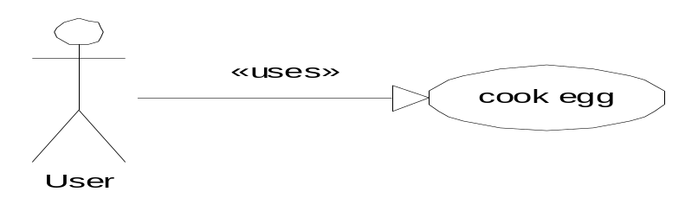
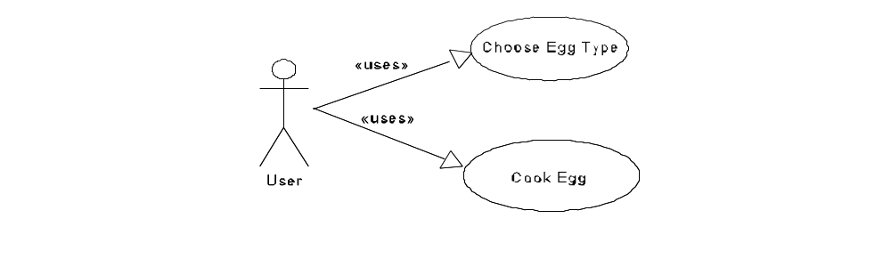
Design example
You are required to design a microprocessor based egg timer. This device will show the egg type and boil it for a specified period of time depending on the egg type. It will sound an alarm to signal when it finishes and show a message as well. It must be waterproof.
Perform System Analysis and System Design using UML. Draw a case and interaction diagram of the proposed system. Develop two of the modules that you will use. Use pseudo-code to describe the control instructions of the module.
use case – starts from “cook egg” but additional functions added

Slide 19
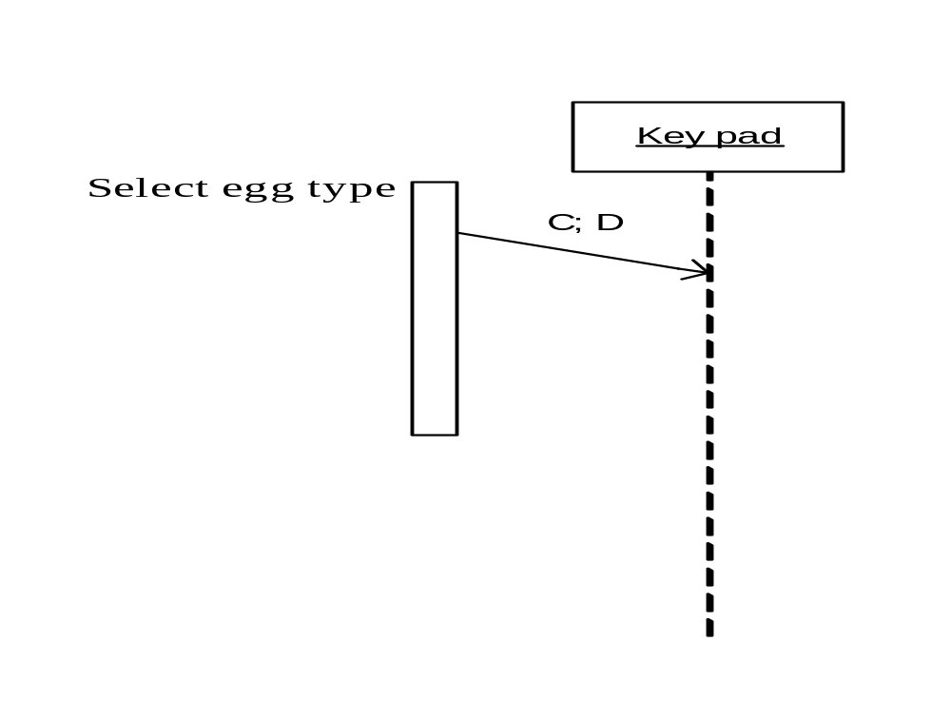
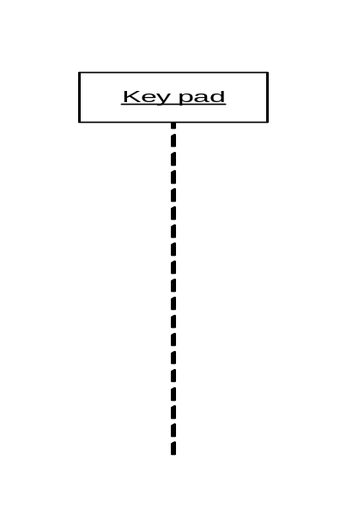
Interaction Diagram
Describes interaction between user and system-
Horizontally – among subsystems
Vertically – in time
One for EACH use case –
CHOOSE EGG TYPE - Start with initial user contact with system (normally is the keypad)
USER
Subsystem

Slide 20
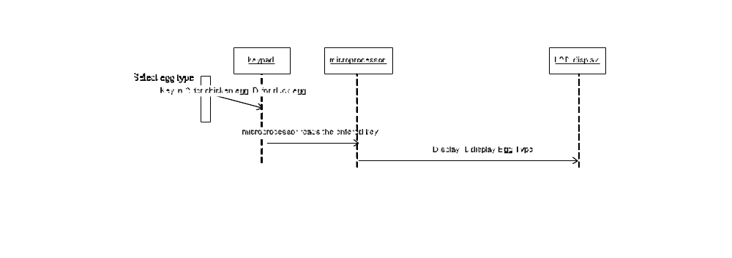
Interaction Diagram 2
Microprocessor processes the key press
Display Egg Type
Keeps choice of Egg in memory for later
use

Slide 21
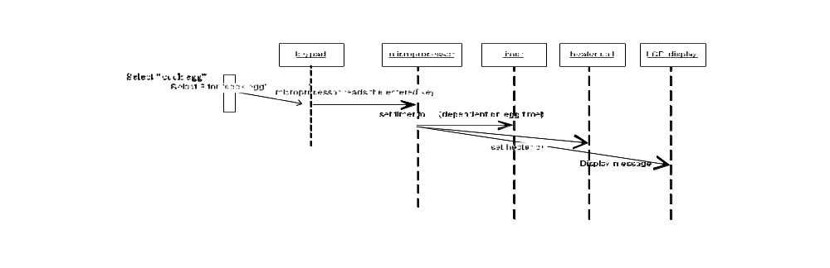
Interaction :Cook Egg (1)
After user selects egg
Can start cooking
more subsystems are used
Consider first part – start cook cycle
Start timer
Start heating
Show on LCD status of cooking

Slide 22
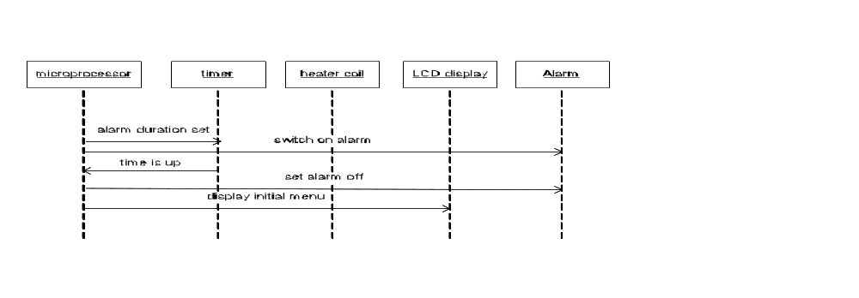
Interaction :Cook Egg (2)
Activate alarm when finished
Display Initial menu

Slide 23
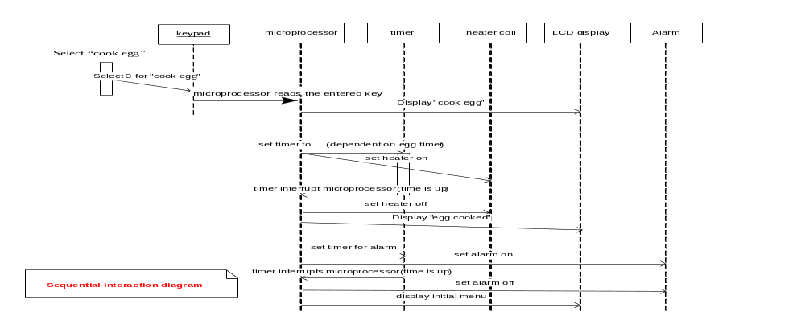
Interaction:Cook Egg (3)
Note Time Delay
FINAL COMBINED DIAGRAM for COOK EGG case

