Slide 1
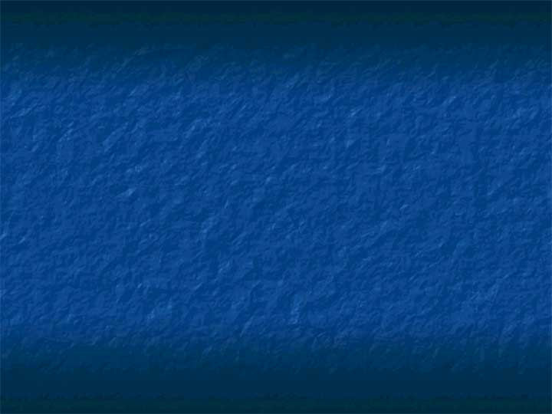
Chapter 9
Graphic Display Technology

Slide 2
Introduction
Visual Computer Interface is much preferred to text based ones
But computer displays were originally text based because Graphical User Interfaces (GUI) were computationally expensive
Now GUI is feasible in many electronic devices e.g.
  iPods
  Portable DVD players and TVs
  PSP etc

Slide 3
Graphical Displays
Section 9.2

Slide 4
Computer Displays vs. Television
Early Graphical Computer Displays
  Vector based displays
  Monochrome (green or B&W)
Commercial TV Displays
  Raster based displays
  Initially gray coloured images (B&W)
  Later full coloured images
2 technologies have merged and graphical computer displays are now raster based

Slide 5
Computer Displays vs. Television
What is Raster Technology?
  Image created by a series of horizontal lines drawn from top to bottom of screen
  In CRT displays, electron beam scans from top LH corner to bottom RH corner
  At each location, beam characteristic changes creating a different colour, thus forming an image
  Scanning typically done 50 or 60 frames/sec

Slide 6
Introduction to Television
Television design is bound by many constraints
  Interference by power supply frequency (50/60 Hz)
  Persistence of human eye (>50 Hz)
  Transmission bandwidth
    Interlacing (alternate line scanning on a phosphor screen to save bandwidth)
Number of raster lines governed by 2 main standards: NTSC (525 lines) or PAL (625 lines)
Number of raster lines same regardless of TV size
So very large screens have scanned look -> HDTV

Slide 7
Introduction to Television
What is Interlacing?
  Scanning alternates between even and odd lines
  Phosphor coating on screen modified so that image stays on a little longer
  In this way scanning rate (and bandwidth) can be halved

Slide 8
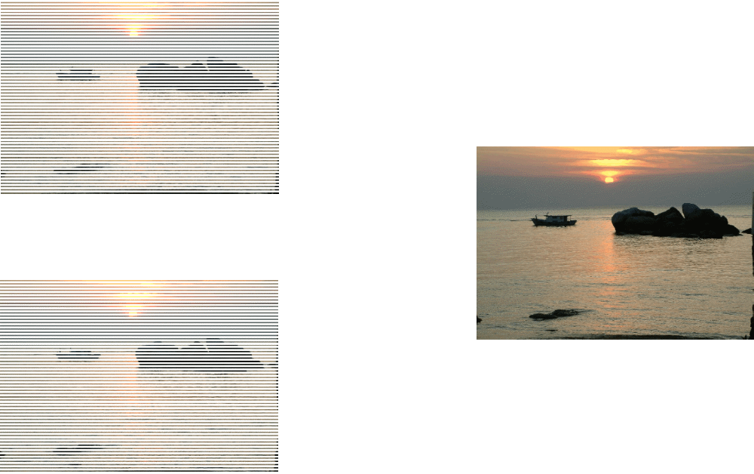
Introduction to Television
Odd lines
Even lines
Interlacing

Slide 9
Nature of Computer Image
Section 9.3

Slide 10
Nature of Computer Image
Computer displays gets its tradition from TV
How it works
  Computer Image is digital in nature
  Made up of picture elements (pixels)
  Resolution of a picture = Total # pixels = # horizontal pixels * # vertical pixels
  VGA standard has 640 * 480 = 307,200 pixels
  Each pixel has a colour value

Slide 11
Nature of Computer Image
  Amount of data contained in each pixel’s colour value is called colour depth
  Typically colour depth is 24 bits (3 bytes) in size
  Memory space required per frame in VGA = 307200 * 3 = 921,600 bytes
  Whole digital image is stored in frame buffer (memory) and transferred to DAC to convert to analog colour to be displayed on screen

Slide 12
Nature of Computer Image
Display Technology
  CRT
    Beam of electrons controlled by magnetic fields draws an image one line at a time
    Scanning is done systematically from top LH corner to bottom RH corner
    When electrons hits phosphor coated screen it glows
    Type of glow depends on nature of electron beam
    Scan rate is at least 25 frames per second
    Visual persistence make eye believe that image is not flickering

Slide 13
Nature of Computer Image
Display Technology
  LCD
    Early LCD displays are Text based
    But Graphical LCD now common
    Image made up of individual LCD pixels
    Voltage across LCD electrodes varied to affect reflectivity of dye between glass plates
    Each pixel is adjusted so that an image is produced

Slide 14
Nature of Computer Image
Scanning Frequencies
  Graphical displays no longer follow TV standards but they have developed their own standards
  E.g. Graphical displays do not interlace
  And they have 640 lines per frame (VGA) instead of 525 lines (NTSC)

Slide 15
Nature of Computer Image
Colour depth
  All images are made up of pixels
  Colour of each pixel represented by digital data
  Possible representation
    1 bit (just black or white)
    4 bits (16 colour levels)
    8 bit (Gray or Colour with dithering)
    24 bit (True colour)
    32 bit
  Most common is 24-bit colour (3 bytes per pixel)
  Each byte contains value of pixel’s RGB colour component

Slide 16
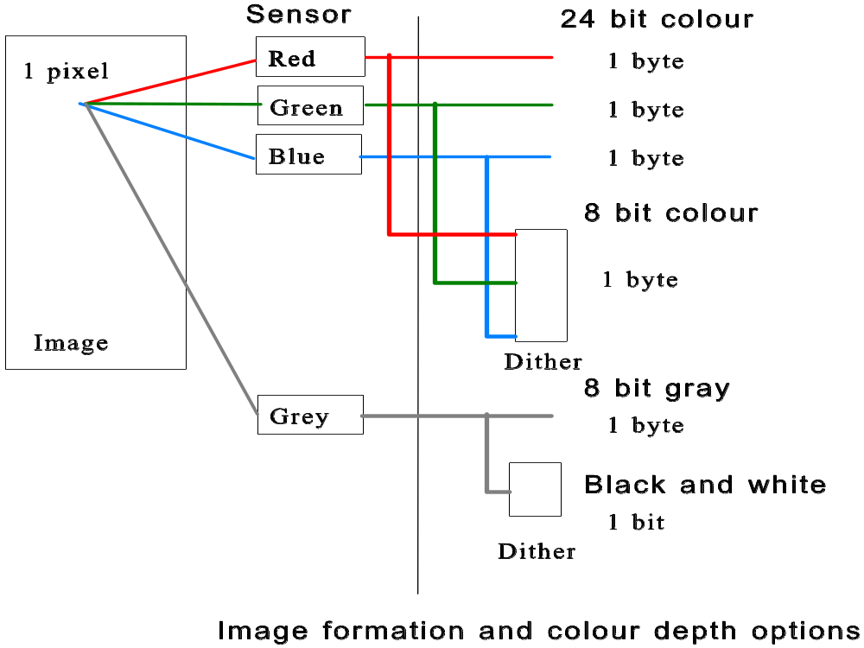
Nature of Computer Image

Slide 17
Nature of Computer Image
But 24 bit colour is very memory intensive
Colour data can be compressed from 24 bit to 8 bit by Dithering Saves memory and computation
  But it causes loss of colour detail
  Leads to “posterization” – large patches of one colour instead of smoothly changing colours
  Look-up table needed to map 8-bit pixel value to actual 24-bit colour to be displayed

Slide 18
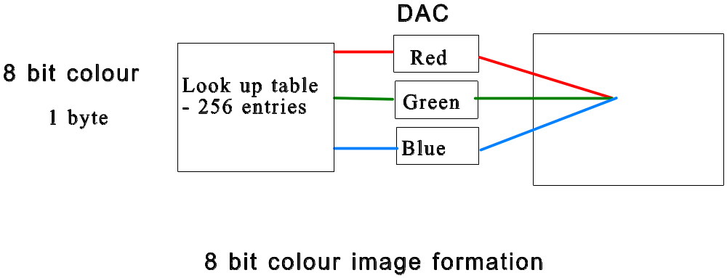
Nature of Computer Image

Slide 19
Nature of Computer Image
Computer Display sizes
  VGA – 640 * 480
  QVGA – 320 * 240 (quarter VGA)
  SVGA – 800 * 600
All have 4:3 aspect ratio
For VGA 24-bit display, frame buffer size = 640*480*3 = 921,600 bytes
If refresh rate is 60Hz, data rate to DAC = 921,600* 60 = 55.3Mbytes/sec

Slide 20
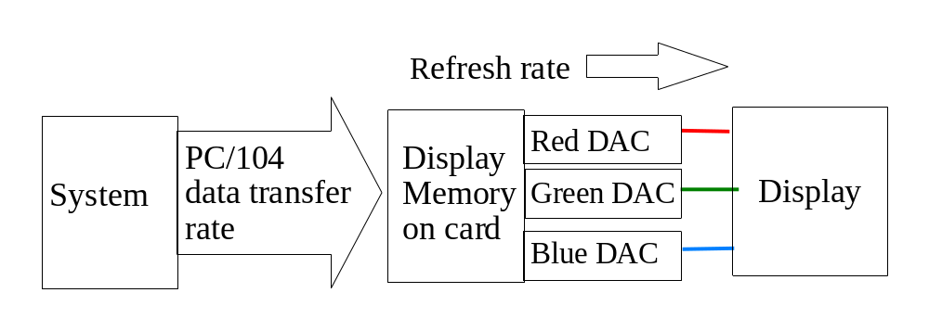
Nature of Computer Image
Refresh rate represents speed of DAC
It is NOT the transfer rate from CPU to frame buffer, which is usually much less
Affects playback of videos

Slide 21
Computer Display Interfaces
Section 9.4

Slide 22
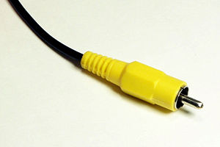
Computer-Display Interfaces
Displays are connected to and controlled by a source (usually a computer)
Following information is obtained from source
  Brightness
  Colour
  Timing (vertical & horizontal)
  Audio
In TV, these are transmitted over a single wire interface called composite video
Due to bandwidth limitation, compression is required and loss in colour results

Slide 23
Computer-Display Interfaces
For Computer Graphics Display, the interface used are
  S-Video (Separate-Video)
  RGB / Component
  Digital
  Direct Connection from Computer to Screen

Slide 24
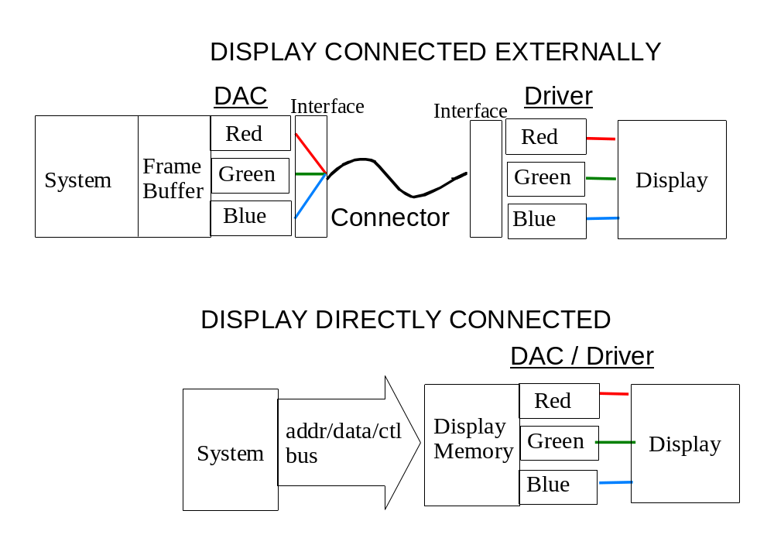
Computer-Display Interfaces

Slide 25
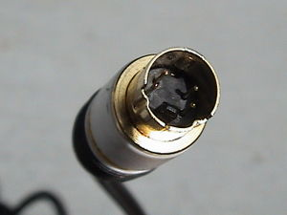
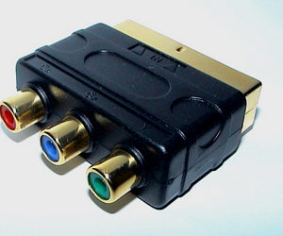
Computer-Display Interfaces
S-Video
  Uses 2 wires
    Brightness + Timing (Y-Signal)
    Colour (C-Signal)
  Better bandwidth (colour) than C-Video
RGB/Component
  Uses 3 wires
    R, G and B with timing on each wire
    Standard for VGA

Slide 26
Computer-Display Interfaces
Digital
  Digital information transmitted (in series) from computer to display (HD format)
  Eliminates noise problems
  Digital compression may be required because of limited bandwidth

Slide 27
Computer-Display Interfaces
Direct Connection
  Computer had direct access to display’s memory
  To display an image, simply write values directly to display
    Memory mapped
    I/O mapped
  Possible only in embedded systems with small screens

Slide 28
Computer-Display Interfaces
Compare and Contrast
Connection type | Advantages | Disadvantages
S-video | Middle picture quality, good compatibility | Can be difficult to find.
RGB | Good picture quality, may be compatible | Varying horizontal scan rates cause compatibility problems
Composite video | Very wide compatibility | Picture quality low
Direct | Small size, less interfacing hardware | Hardware interfacing required

