Slide 1
Web Interface for Power-Factory Tool

Slide 2

Objective
The goal of this project is to create a web interface for Digsilent Power-Factory, a software tool used for power system simulations.
The interface will be designed with buttons that correspond to various Power Factory functionalities, such as running simulations.
This will streamline the simulation process and make it more user-friendly, as users will be able to perform simulations without needing to navigate the complex Power Factory software.

Slide 3
PANEL

Slide 4
Panel
The "panel" library is a Python package that provides a high-level interface for creating interactive web-based dashboards and applications. It is designed to work seamlessly with other popular data science and visualization libraries in Python, such as Pandas, Matplotlib, and Bokeh.
Panel allows you to build custom interactive web interfaces for your data analysis, visualization, and machine learning workflows. It provides a set of flexible and powerful components for creating interactive plots, tables, sliders, buttons, and other widgets, which can be organized and arranged in a layout that suits your needs.
With Panel, you can create interactive dashboards and applications directly from your Python code.

Slide 5

INSTALLATION PROCESS
1. SETUP VIRTUAL ENVIRONMENT:
→mkdir folder_name → creates a new folder
→cd folder_name → go to folder which you have created
→python -m venv file_name → creating a virtual env
→file_name\Scripts\activate → activating the virtual env

Slide 6
Installation Process :
2. Installations :
open the cmd and run the below commands.
Pip install panel.
Pip install bokeh.
Pip install pandas.
pip install pip install mysql-connector-python.

Slide 7
Structure:
Panel.py ---> Main code
LoadCalculations.py → code to run Loadflow calculations
RmsSimulations.py → code to run the rms simulations
Panel.py
LoadCalculations.py
RmsSimulations.py

Slide 8
How to run the panel :
Navigate to the folder and activate the virtual environment.[refer slide5]
Enter the command : panel serve <pyfile> --show --autoreload

Slide 9
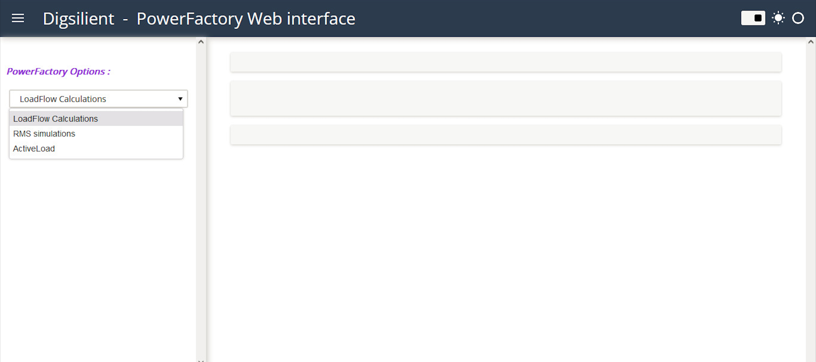
OUTPUT TEMPLATES
Main Screen with the Power factory Options :

Slide 10
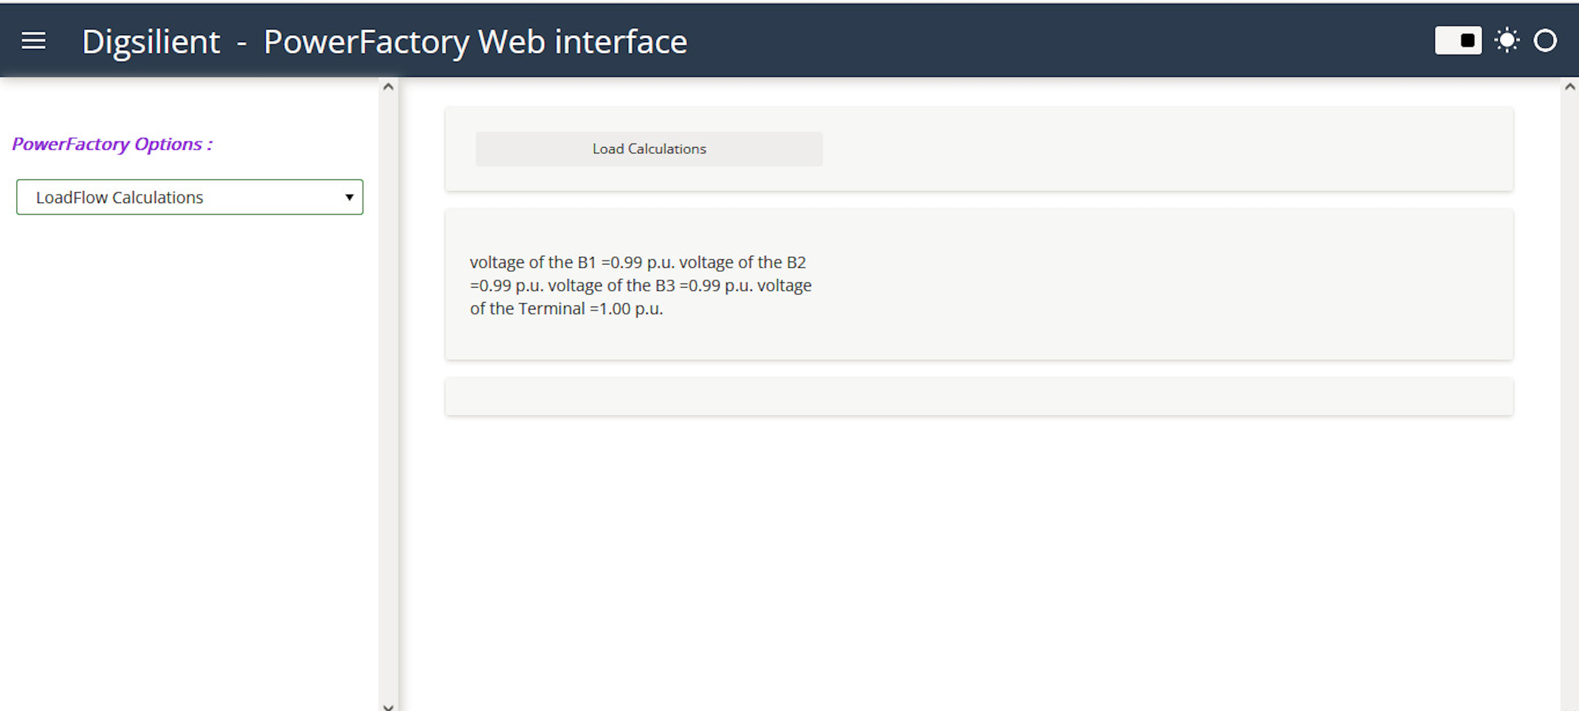
LoadFlow Calculation output:

Slide 11
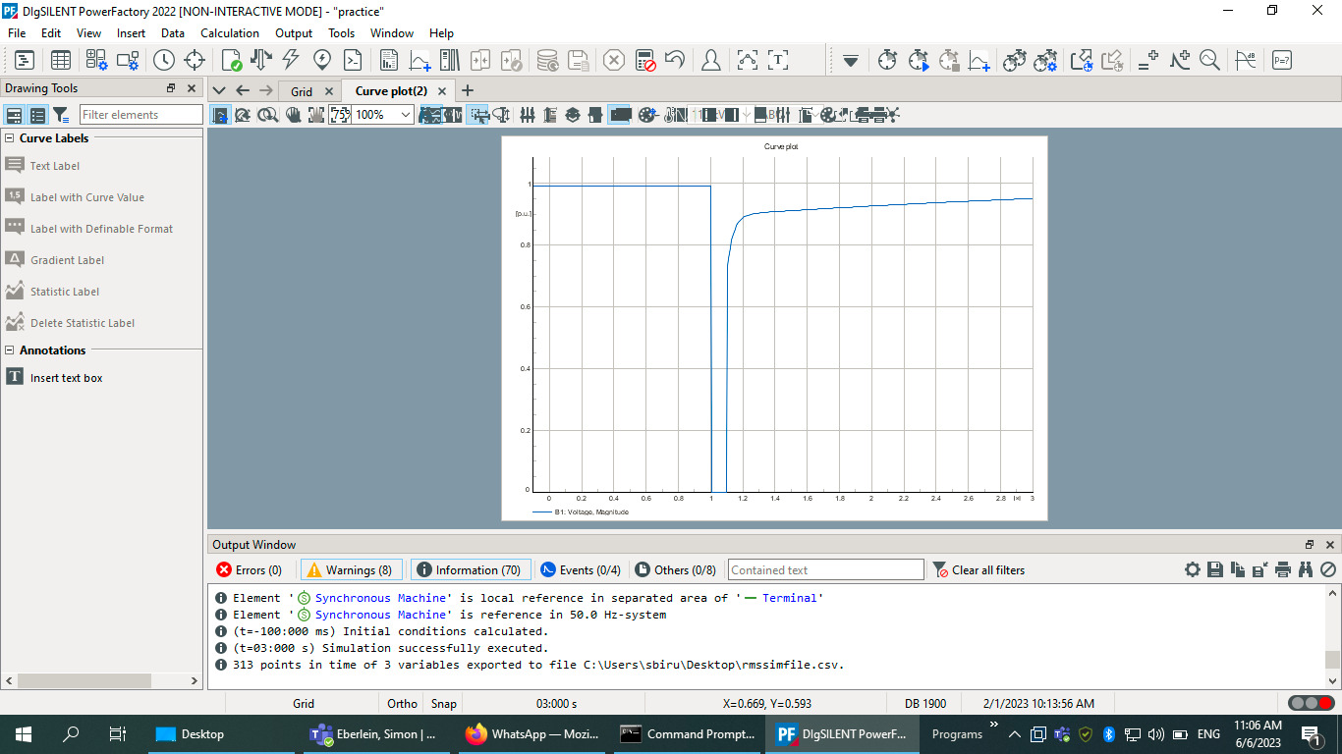
RMS Plot on power-factory

Slide 12
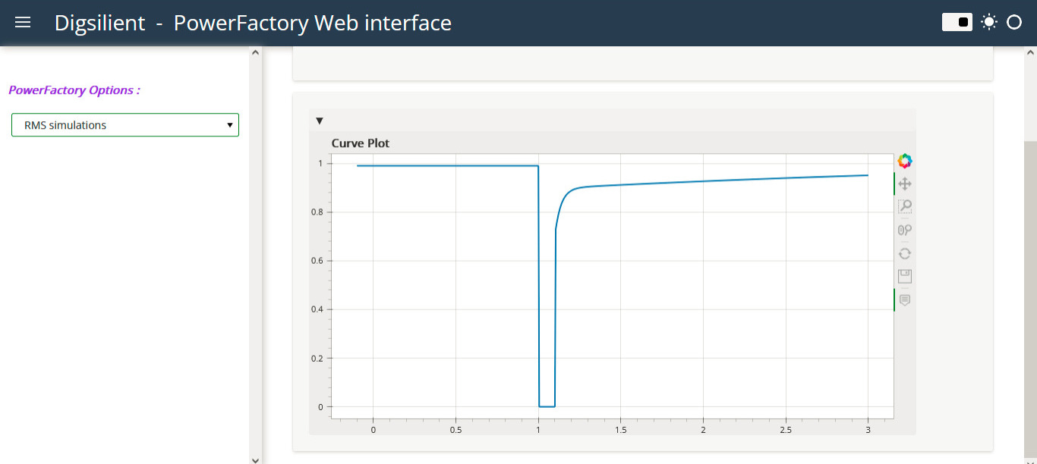
RMS Simulation Output:

