Slide 1
Web Interface for Power-Factory Tool

Slide 2

Objective
The goal of this project is to create a web interface for Digsilent Power-Factory, a software tool used for power system simulations.
The interface will be designed with buttons that correspond to various Power Factory functionalities, such as running simulations.
This will streamline the simulation process and make it more user-friendly, as users will be able to perform simulations without needing to navigate the complex Power Factory software.

Slide 3
PANEL

Slide 4

INSTALLATION PROCESS
1. SETUP VIRTUAL ENVIRONMENT:
→mkdir folder_name → creates a new folder
→cd folder_name → go to folder which you have created
→python -m venv file_name → creating a virtual env
→file_name\Scripts\activate → activating the virtual env

Slide 5
Installation Process :
2. Installations :
open the cmd and run the below commands.
Pip install panel.
Pip install bokeh.
Pip install pandas.
pip install pip install mysql-connector-python.

Slide 6
Structure:
Panel.py ---> Main code
LoadCalculations.py → code to run Loadflow calculations
RmsSimulations.py → code to run the rms simulations
Panel.py
LoadCalculations.py
RmsSimulations.py

Slide 7
How to run the panel :
Navigate to the folder and activate the virtual environment.
Enter the command : panel serve <pyfile> --show --autoreload

Slide 8
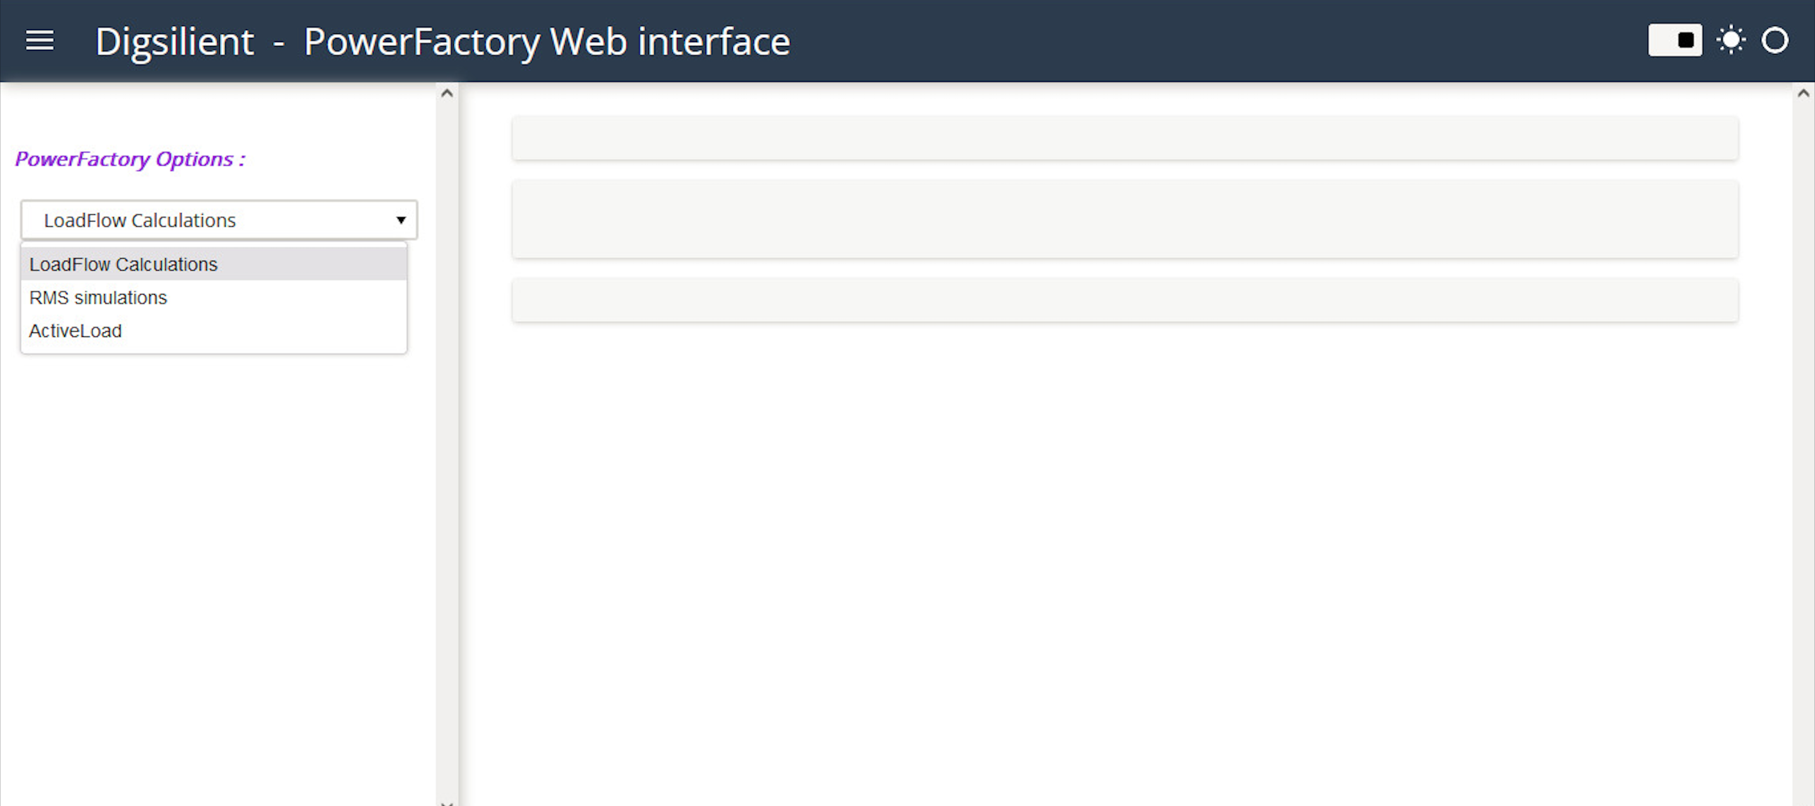
OUTPUT TEMPLATES
Main Screen with the Power factory Options :

Slide 9
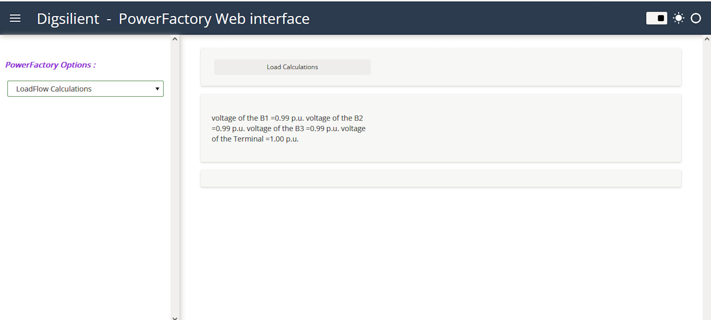
LoadFlow Calculation output:

Slide 10
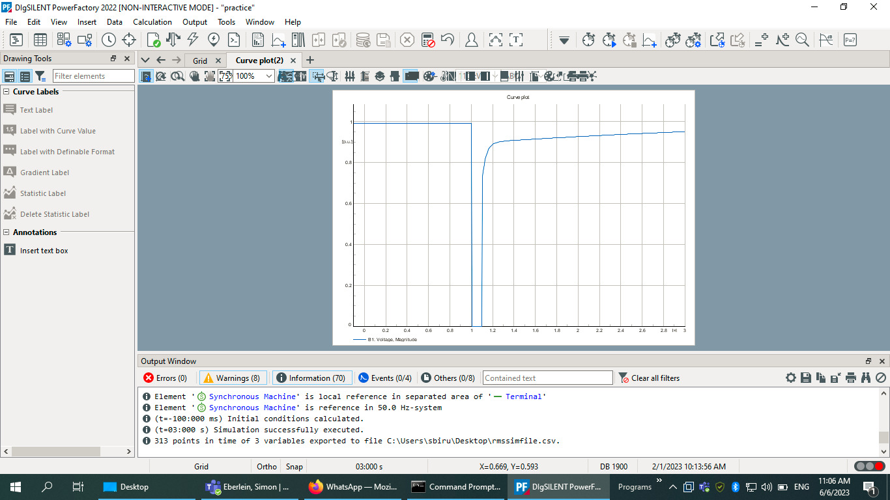
RMS Plot on power-factory

Slide 11
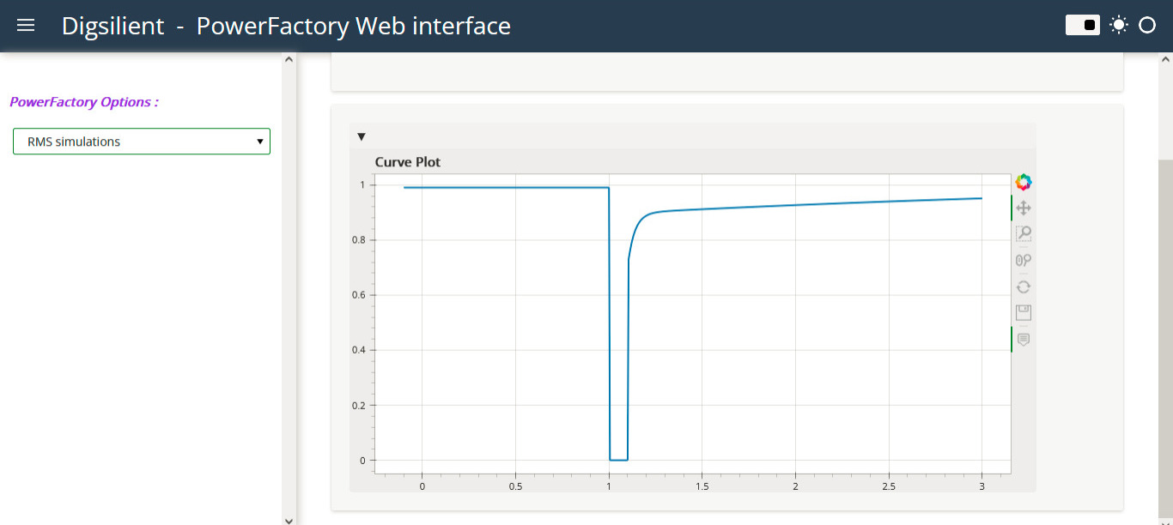
RMS Simulation Output:

