Slide 1


Concourse
CI that scales with your project

Slide 2
Continuous Integration & Delivery
Benefits
AUTOMATION.
Integrate tools and automate processes from testing to builds and deployment
SPEED.
Release more frequently with smaller bits will reduce complexity and improve time-to-market
QUALITY.
Reduce feedback loop using test-driven development to surface problems sooner and be responsive
AGILITY.
Push updates on regular basis with no downtime to improve customer experience and time to market
Concepts
Commit Code Change
Automate Build & Test
Store Binaries & Build Artifacts
Automated Integration Testing
Acceptance, Performance & Load
Zero Downtime Upgrade to Production
Pipeline
Notes:
Continuous Integration (CI) is a development practice that requires developers to integrate code into a shared repository several times a day. Each check-in is then verified by an automated build, allowing teams to detect problems early.
Continuous Delivery is the natural extension of Continuous Integration: an approach in which teams ensure that every change to the system is releasable, and that we can release any version at the push of a button. Continuous Delivery aims to make releases boring, so we can deliver frequently and get fast feedback on what users care about.
Concourse enables CI/CD by realizing the conceptual delivery model in visual pipelines.

Slide 3






Why Concourse?
Travis CI
2
3
1
Notes:
1) Jenkins servers become snowflakes. More and more important shell script gets pasted into those little textboxes, plugins get installed, and dependencies are installed on the slaves. It's possible to try and store this state but Jenkins servers are extremely resistant to being declaratively configured.
2) We began using Travis CI in order to open up our builds and their results to the open source community. Travis gets a lot of things right. They don't let you have any snowflake configuration outside of your .travis.yml file. Builds are run inside a container to avoid pollution. It also has great support for building your GitHub pull requests. This is something that Concourse cannot yet do but we have plans to allow the same workflow in the future.
Unfortunately it still doesn't have support for pipelines and only very simple builds are possible. It also brings the frustration that if something doesn't pass in CI you normally need to send up lots of little debugging commits to work out why it's behaving differently. Concourse lets you submit your local working directory up to the server to be run in exactly the same manner as CI.
3) goCD – How to configure difficult. Hard to connect running job to its config. Deep and Complex hierarchy for piplines… stage, jobs, tasks. Ramp of new devs tough

Slide 4

What we found in other CI systems
Snowflakes
lots of plugins
system dependencies
textbox scripting
Usability
complicated UIs
endless menus
too many clicks to get logs
Pipelines
no first-class support
complex job sequencing
Execution Hierarchy
deep and complex
Environment Parity
works locally, breaks on server
lots of debugging commits
Scalability
hard to scale vertically or horizontally
Notes:
http://concourse.ci/concourse-vs.html

Slide 5
Concourse Principles
Simple
Concourse is a response to the complexity introduced by other systems. It is built on the idea that the best tools can be learned in one sitting.
Usable
Concourse is optimized for quickly navigating to the pages you most care about. From the main page, a single click takes you from a pipeline view to the log of a job's latest failing build.
Isolated Builds
Every build task is executed in a container defined by its own configuration, by stateless workers. This eliminates build pollution and ensures multiple teams can use the same Concourse deployment without worrying about the state of the worker VMs.
Notes:
http://concourse.ci/what-and-why.html

Slide 6
Concourse Principles
Scalable, reproducible deployment
No Concourse deployment is a snowflake. There are no boxes to check; no configuration happens at runtime.
Flexible
Features that other systems implement in the core of the product, Concourse implements in "userland", as resources. This keeps the core of Concourse small and simple, and proves out the extensibility introduced by this simple interface.
Local iteration
Concourse supports running one-off builds from local task configuration that allows you to trust that your build running locally runs exactly the same way that it runs in your pipeline.
Notes:
http://concourse.ci/what-and-why.html

Slide 7
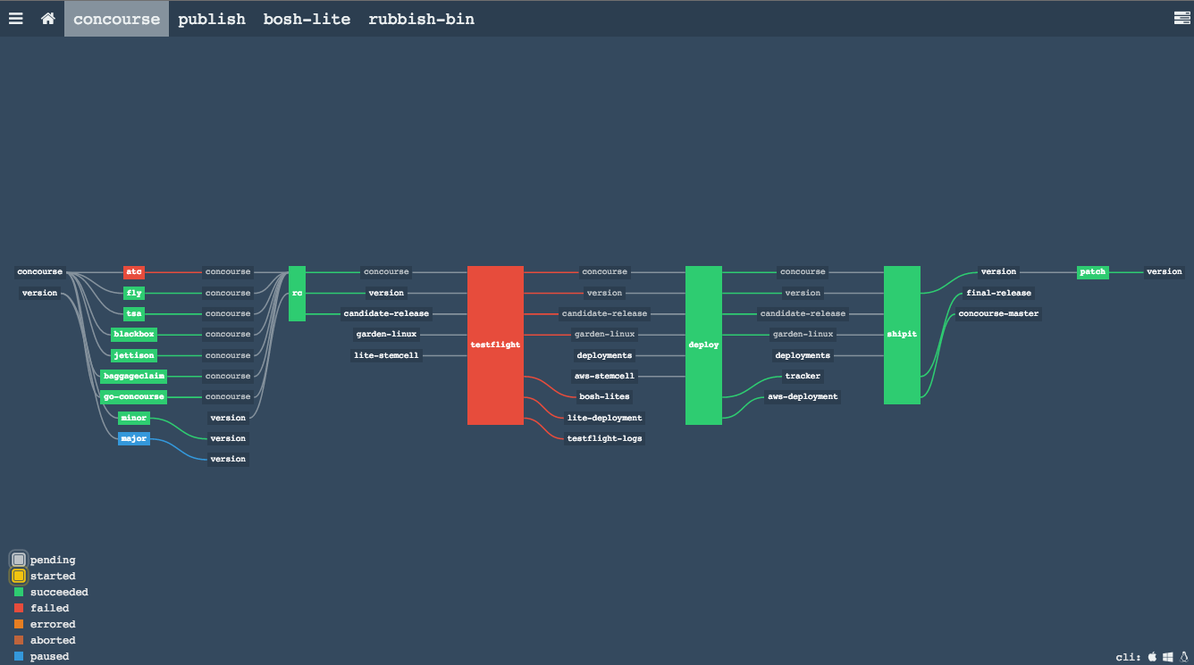
Notes:
Anger Optimized UI - You shouldn’t get angry at your CI because you can’t find the broken build in your pipeline, or click through a lot of menus to get to the logs. Concourse provides an intuitive view of your pipeline to let you know the current state at a glance.

Slide 8
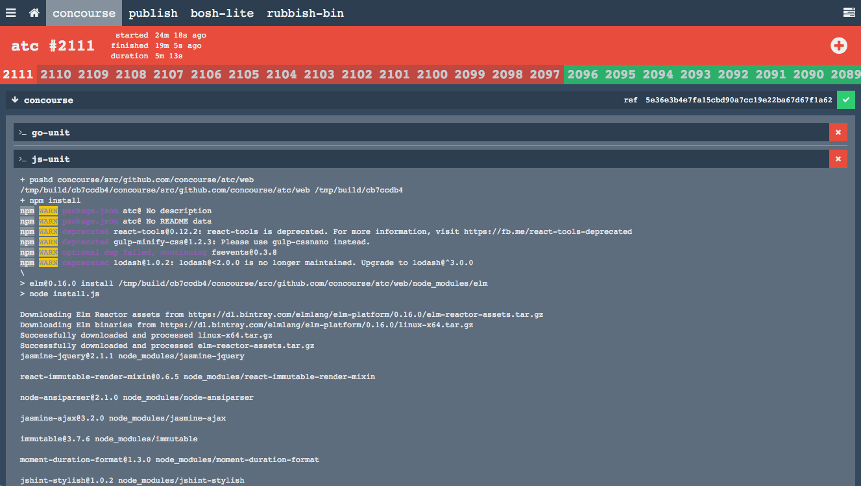
Notes:
A single click of a job in the pipeline shows current build status, including terminal colors and formatting (a helpful feature lacking in some other CI tools!).

Slide 9
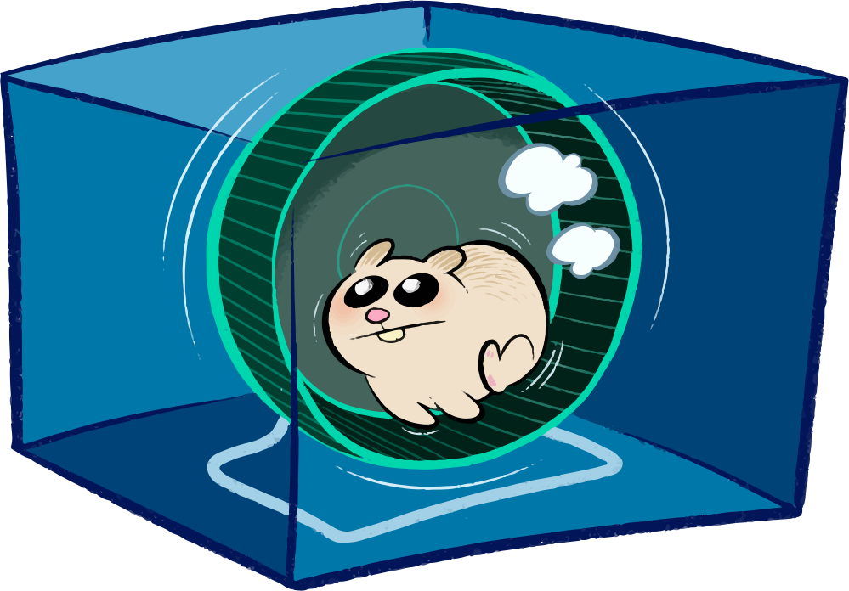
Concourse Architecture
Concourse
Baggageclaim: Volume management for garden containers
Garden runC: container runtime
etcd
etcd
Postgres
API/UI Requests
Auctioneer
Auctioneer
Auctioneer
Converger
ATC
Converger
Converger
TSA
Workers
Load Balancer
Baggageclaim
ATC: Runs web UI and REST API. Responsible for pipeline scheduling.
TSA: custom-built SSH server responsible for securely registering works w/ ATC.
Garden runC
Even More Detailed: https://www.gliffy.com/go/publish/10463597

Slide 10
Concourse Concepts: simple primitives
Resources
detecting, fetching, creating of external versioned “things”
encapsulation of some external resource
replaces plumbing scripts
results in intuitive pipeline semantics
many first-class concepts from other systems are implemented in terms of resources (ex: timed triggers)
only pluggable interface
# pipeline.yml
resources:
- name: pcfdemo
type: git
source:
uri: https://github.com/.../PCF-demo.git
branch: master
git repo, s3 bucket, docker image, bosh deployment, bosh.io release, bosh.io stemcell, pivnet Pivotal Tracker, github release, cf, vagrant cloud/atlas, time, semver, http
Notes:
Interact within Jobs as get, put, check
get :: version -> input
put :: output -> version
check :: version? -> [version]
ex: git resource:
get = git clone git@github.com:...
put = git push origin [branch]
check = git pull && git log abcdef..HEAD

Slide 11
Concourse Concepts: simple primitives
Tasks
run a script in a container with its dependent inputs
Execution of unit of work in isolated env. (a container)
All tasks executed in separate of each other
Typically contains definition of:
- platform
- base container image
- inputs and outputs
- command or script to execute
# unit.yml
platform: linux
image: docker:///java#8
inputs:
- name: pcfdemo
run:
path: mvn
args: [ clean, test ]
OR
run:
path: program.sh
# program.sh
#!/bin/bash
echo “do something…”

Slide 12
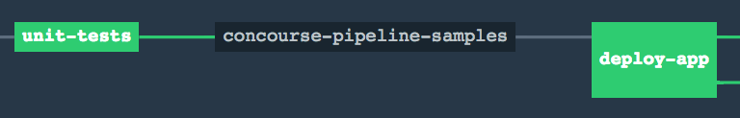
Concourse Concepts: simple primitives
Jobs
compose resources and tasks together to do something (run tests, ship, etc.)
Describes a set of actions to perform in a Build Plan
Build Plan defines tasks, sequencing, success/failure triggers, upstream triggers, timeouts, retries, etc
Individual execution of Job is a Build
# pipeline.yml
jobs:
- name: QA
plan:
- get: pcfdemo
trigger: true
- file: pcfdemo/unit.yml
Jobs

Slide 13
Concourse Concepts: pipelines
# pipeline.yml
resources:
- name: pcfdemo
type: git
source:
uri: https://github.com/.../PCF-demo.git
branch: master
# unit.yml
platform: linux
image: docker:///java#8
inputs:
- name: pcfdemo
run:
path: mvn
args: [ clean, test ]
OR
run:
path: program.sh
# program.sh
#!/bin/bash
echo “do something…”
jobs:
- name: QA
plan:
- get: pcfdemo
trigger: true
- task: do-something file: pcfdemo/unit.yml
Notes:
A resource is identified by an arbitrary name which is used in jobs and tasks

Slide 14
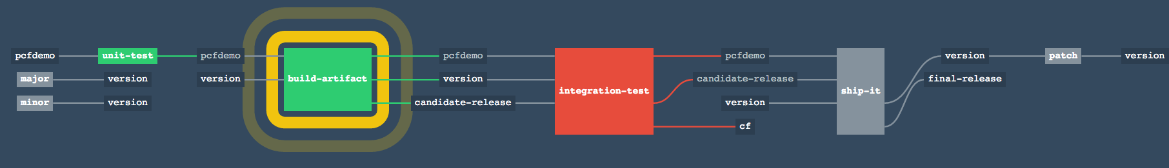
Concourse Concepts: pipelines
the resulting flow of resources through jobs
fancy visualization UI for build monitor
many isolated pipelines per deployment

Slide 15
fly execute: run task with local bits
~/git/PCF-demo » fly execute -c ci/tasks/build.yml -i pcfdemo=.
executing build 92
% Total % Received % Xferd Average Speed Time Time Time Current
Dload Upload Total Spent Left Speed
100 58.8M 0 58.8M 0 0 28.1M 0 --:--:-- 0:00:02 --:--:-- 28.1M
initializing with docker:///java#8
running pcfdemo/ci/tasks/build.sh
[INFO] Scanning for projects...
[INFO]
[INFO] ------------------------------------------------------------------------
[INFO] Building pcf-demo 1.0.0-BUILD-SNAPSHOT
[INFO] ------------------------------------------------------------------------
...
[INFO] Packaging webapp
[INFO] Assembling webapp [pcf-demo] in [/tmp/build/e55deab7/pcfdemo/target/pcfdemo]
[INFO] Processing war project
[INFO] Copying webapp resources [/tmp/build/e55deab7/pcfdemo/src/main/webapp]
[INFO] Webapp assembled in [61 msecs]
[INFO] Building war: /tmp/build/e55deab7/pcfdemo/target/pcfdemo.war
[INFO] WEB-INF/web.xml already added, skipping
[INFO] ------------------------------------------------------------------------
[INFO] BUILD SUCCESS
[INFO] ------------------------------------------------------------------------
[INFO] Total time: 33.423 s
[INFO] Finished at: 2016-02-03T12:56:54+00:00
[INFO] Final Memory: 20M/217M
[INFO] ------------------------------------------------------------------------
succeeded

Slide 16
fly hijack: hop into build’s container
~/git/PCF-demo » fly hijack -j pcfdemo/build-artifact
1: build #10, step: version, type: get
2: build #10, step: prepare-build, type: task
3: build #10, step: candidate-release, type: put
4: build #10, step: version, type: put
5: build #10, step: pcfdemo, type: get
6: build #10, step: version, type: get
7: build #10, step: candidate-release, type: get
8: build #10, step: build, type: task
choose a container: 2
root@bqvgog0t9s0:/tmp/build/5020c204# ls -al
total 8644
drwxr-xr-x 1 root root 84 Feb 3 13:14 .
drwxr-xr-x 1 root root 16 Feb 3 13:14 ..
drwxr-xr-x 1 root root 14 Feb 3 13:14 build
-rw-r--r-- 1 root root 8849783 Feb 3 13:14 pcf-demo-1.1.0-rc.4.war
drwxr-xr-x 1 root root 242 Feb 3 11:24 pcfdemo
drwxr-xr-x 1 root root 12 Feb 3 13:14 version
root@bqvgog0t9s0:/tmp/build/5020c204# echo `cat version/number`
1.1.0-rc.4
root@bqvgog0t9s0:/tmp/build/5020c204#

Slide 17
fly set-pipeline: iterate on pipeline
~/git/PCF-demo » fly set-pipeline -p pcfdemo -c ci/pipeline.yml -l ~/.concourse/pcfdemo-properties.yml
resources:
resource cf has changed:
name: cf
type: cf
source:
api: https://api.local.micropcf.io
organization: micropcf-org
password: admin
skip_cert_check: true
skip_cert_check: false
space: micropcf-space
username: admin
apply configuration? [yN]:

Slide 18


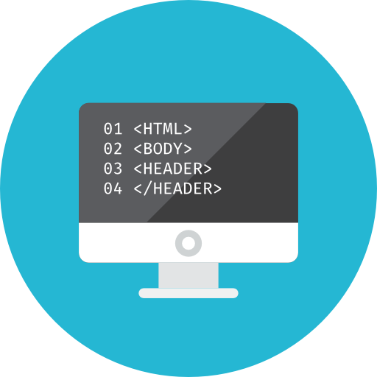
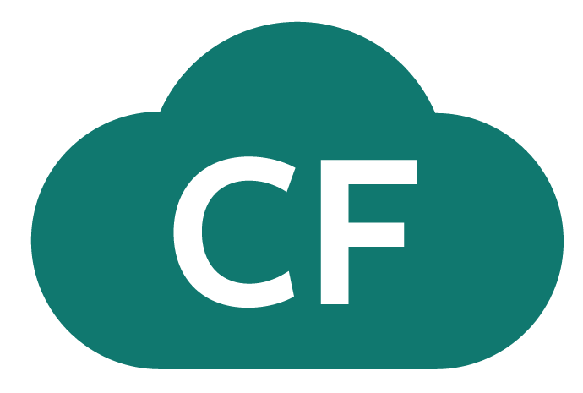
D E M O
Commit Code Change
Automate Build & Test
Deploy to PCF

Slide 19
Open.
Agile.
Cloud-Ready.

