Slide 1
Customer booking analysis

Slide 2
Abstract
Predicting the customer behaviour using Random Forest Model.
Helps airlines optimize revenue and improve customer satisfaction

Slide 3
Random Forest
A Random Forest Classifier is a powerful machine learning algorithm commonly used for predicting customer behavior. It's well-suited for this task due to its ability to handle large datasets.

Slide 4
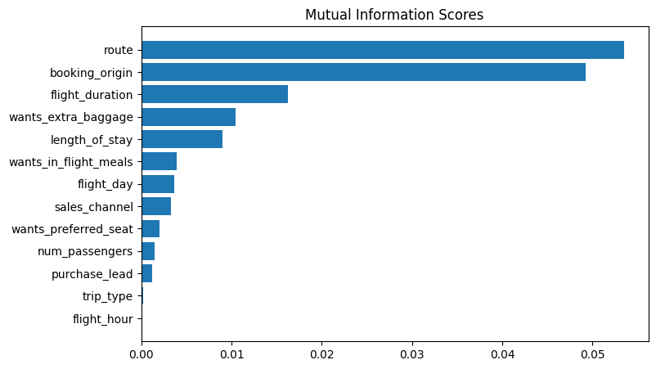
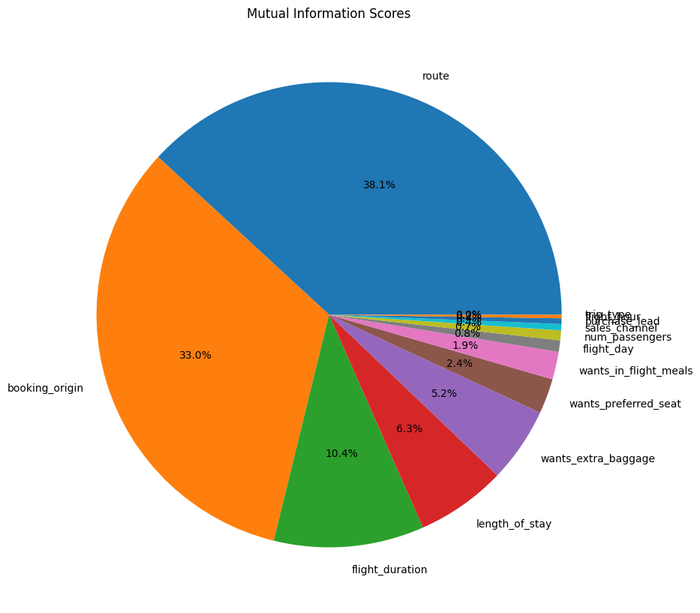
ACCURACY: 82.16 AUC score: 0.5002407834360953 The Random Forest model can accurately predict booking completion

