Slide 1
ATTENDANCE MANAGEMENT USING FACIAL-RECOGNITION
DESIGN SEMINAR ON [project-1]
Batch no : 18-group e-18
Group members:
B shiva sundar – 18311a05q6
K vinay reddy – 18311a05t8
M manish kumar -17311a05v6
Under the guidance of:
Mr.sreenivasa rao devevarapu
Assistant professor

Slide 2
CONTENTS
ABSTRACT
ARCHITECTURE
UML DIAGRAMS
REFERENCES

Slide 3
ABSTRACT
Attendance being a very necessary side of administration may normally become an arduous, redundant activity, pushing itself to inaccuracies.
The traditional approach of making roll calls proves itself to be a statute of limitations as it is very difficult to call names and maintain its record especially when the ratio of students is high.
Some organizations use document-oriented Approach and others have implemented these digital methods such as biometric fingerprinting techniques and card swapping techniques. however, these methods prove to be a statute of limitations as it subjects students to wait in a time-consuming queue.

Slide 4
ABSTRACT(2)
The system of intelligent attendance is generally implemented with biometrics help. Recognition of face is one of the Biometric ways of improving this system. Face recognition proved to be a productive method for taking attendance.
It requires very few hardware resources hence it is a cost-friendly system.

Slide 5
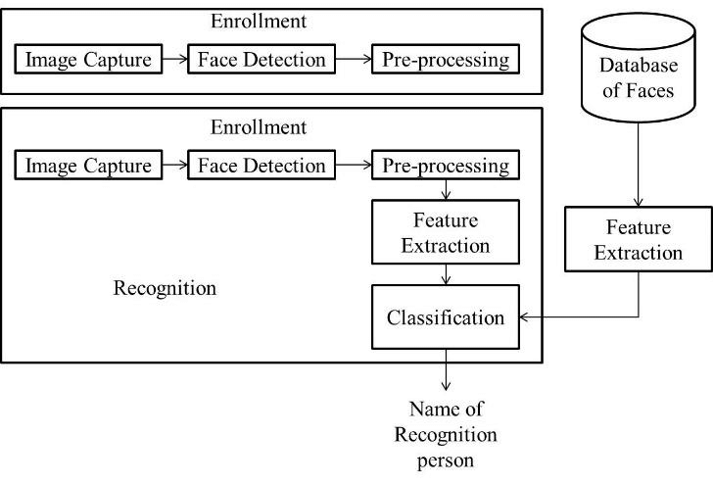
ARCHITECTURE

Slide 6
UML DIAGRAMS
The Unified Modeling Language (UML) is a general-purpose, developmental, modeling language in the field of software engineering that is intended to provide a standard way to visualize the design of a system.
It is analogous to the blueprints used in other fields, and consists of different types of diagrams.

Slide 7
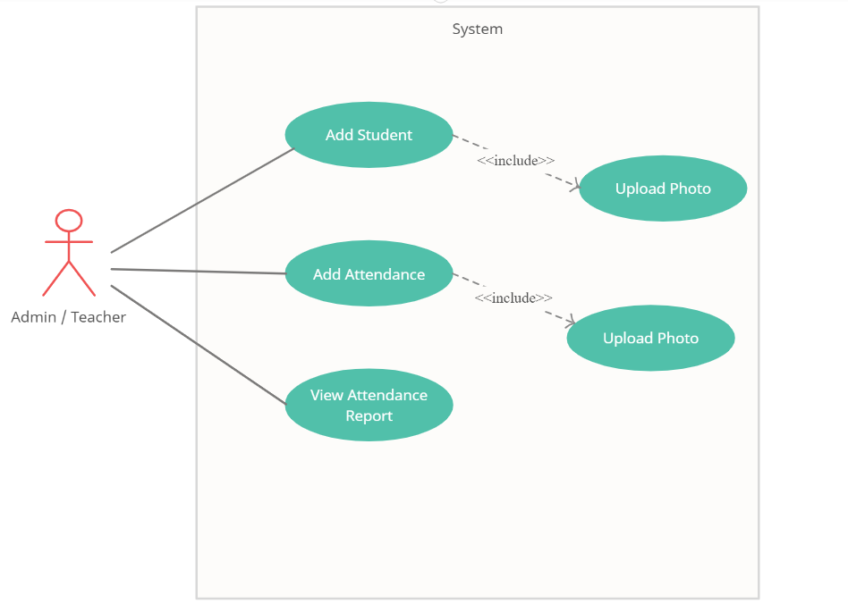
USE CASE DIAGRAM

Slide 8
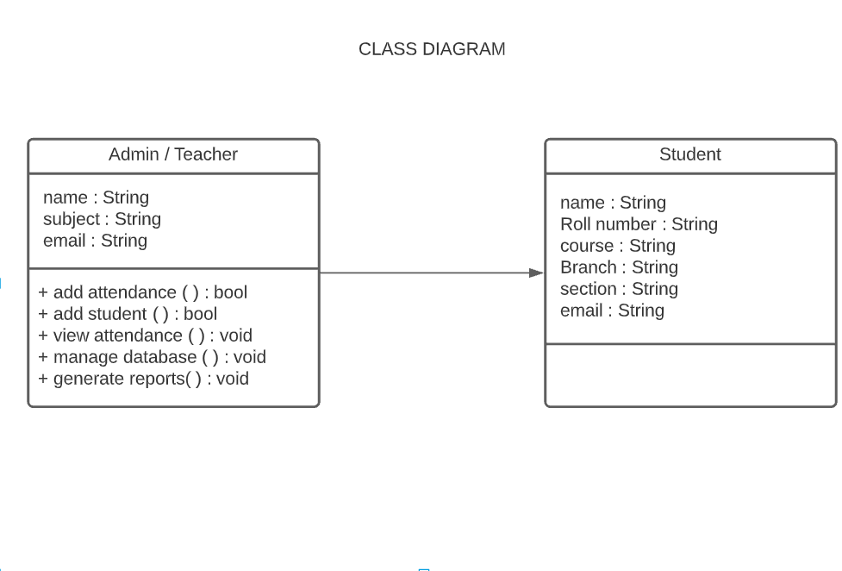
CLASS DIAGRAM

Slide 9
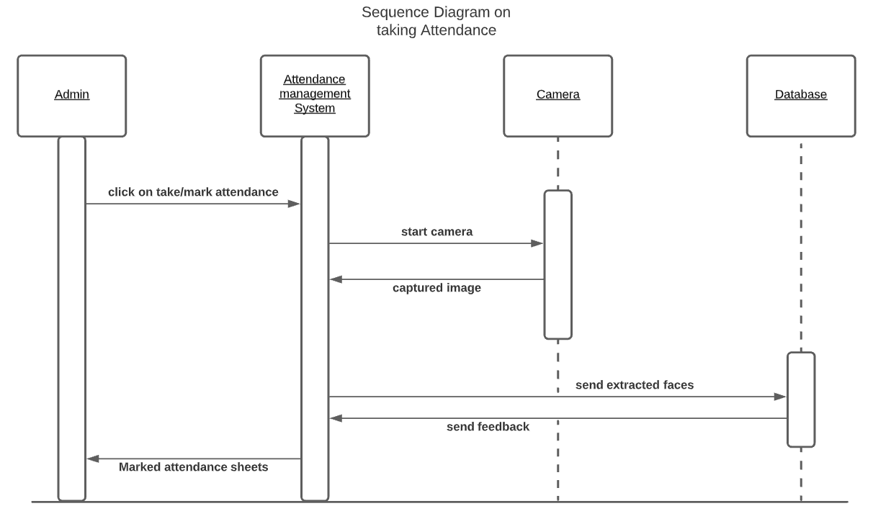
SEQUENCE DIAGRAM

Slide 10
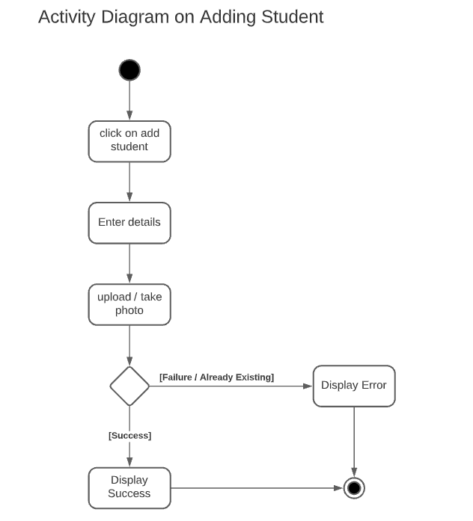
ACTIVITY DIAGRAM

Slide 11
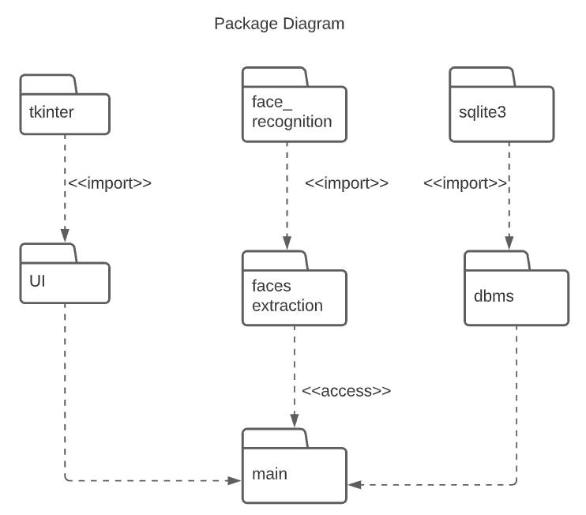
PACKAGE DIAGRAM

Slide 12
REFERENCES
Student Attendance System using Face Recognition by Samridhi Dev, Tushar Patnaik .
( https://ieeexplore.ieee.org/document/9215441 )
Upgrad - https://www.upgrad.com/blog/image-processing-projects-ideas-topics/
Creatly - https://creately.com/blog/diagrams/uml-diagram-types-examples/

Slide 13


