Slide 1
ATTENDANCE MANAGEMENT USING
FACIAL-RECOGNITION
IMPLEMENTATION SEMINAR ON [project-1]
Batch no : 18-group e-18
Group members:
B shiva sundar – 18311a05q6
K vinay reddy – 18311a05t8
M manish kumar -17311a05v6
Under the guidance of:
Mr.sreenivasa rao devavarapu
Assistant professor

Slide 2
CONTENTS
ABSTRACT
INTRODUCTION
EXISTING AND PROPOSED SYSTEMS
SCOPE
SOFTWARE AND HARDWARE REQUIREMENTS
ARCHITECTURE

Slide 3
CONTENTS
UML DIAGRAMS
CODE IMPLEMENTATION
CONCLUSION AND FUTURE SCOPE
REFERENCES

Slide 4
ABSTRACT
Face recognition is among the most productive image processing applications and has a pivotal role in the technical field.
Attendance system using face recognition is a procedure of recognizing students by using face biostatistics based on the high definition monitoring and other computer technologies.
The development of this system is aimed to accomplish digitization of the traditional system of taking attendance by calling names and maintaining pen-paper records.

Slide 5
ABSTRACT(2)
Present strategies for taking attendance are tedious and time –consuming.
Attendance records can be easily manipulated by manual recording.
The traditional process of making attendance and present biometric systems are vulnerable to proxies.
This project is therefore proposed to tackle all these problems.

Slide 6
INTRODUCTION
Attendance being a very necessary side of administration may normally become an arduous, redundant activity, pushing itself to inaccuracies.
The traditional approach of making roll calls proves itself to be a statute of limitations as it is very difficult to call names and maintain its record especially when the ratio of students is high.
Some organizations use document-oriented Approach and others have implemented these digital methods such as biometric fingerprinting techniques and card swapping techniques. however, these methods prove to be a statute of limitations as it subjects students to wait in a time-consuming queue.

Slide 7
INTRODUCTION(2)
The system of intelligent attendance is generally implemented with biometrics help. Recognition of face is one of the Biometric ways of improving this system. Face recognition proved to be a productive method for taking attendance.
It requires very few hardware resources hence it is a cost-friendly system.

Slide 8
EXISTING AND PROPOSED SYSTEMS
The existing system makes the use of Haar classifiers, KNN, CNN, SVM, Generative adversarial networks, and Gabor filters.
The proposed system makes use of face_recognition library.

Slide 9
SCOPE
This project can be used in schools ,colleges and in organizations ,where ever the attendance is calculated or considered.

Slide 10
SOFTWARE AND HARDWARE REQUIREMENTS
SOFTWARE REQUIREMENTS:
Operating System : Windows 10
IDE:SPYDER
Language : Python 3.8 and other libraries likes tkinter,opencv2,etc..
HARDWARE REQUIREMENTS:
Processor : i5
RAM : 8 GB RAM
Hard disk : 1TB

Slide 11
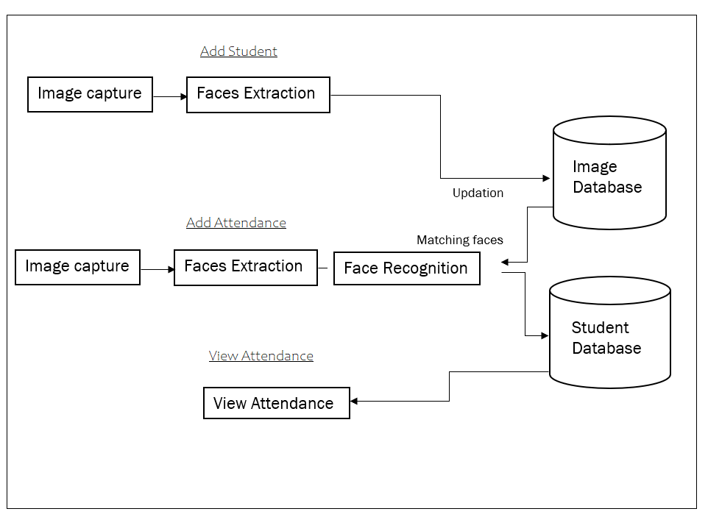
ARCHITECTURE

Slide 12
UML DIAGRAMS
The Unified Modeling Language (UML) is a general-purpose, developmental, modeling language in the field of software engineering that is intended to provide a standard way to visualize the design of a system.
It is analogous to the blueprints used in other fields, and consists of different types of diagrams.

Slide 13
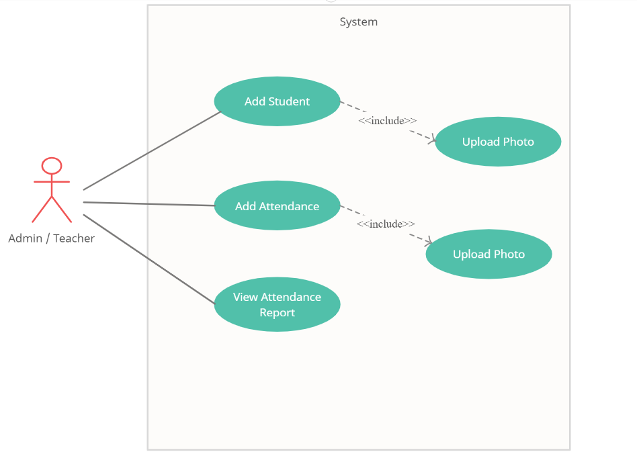
USE CASE DIAGRAM

Slide 14
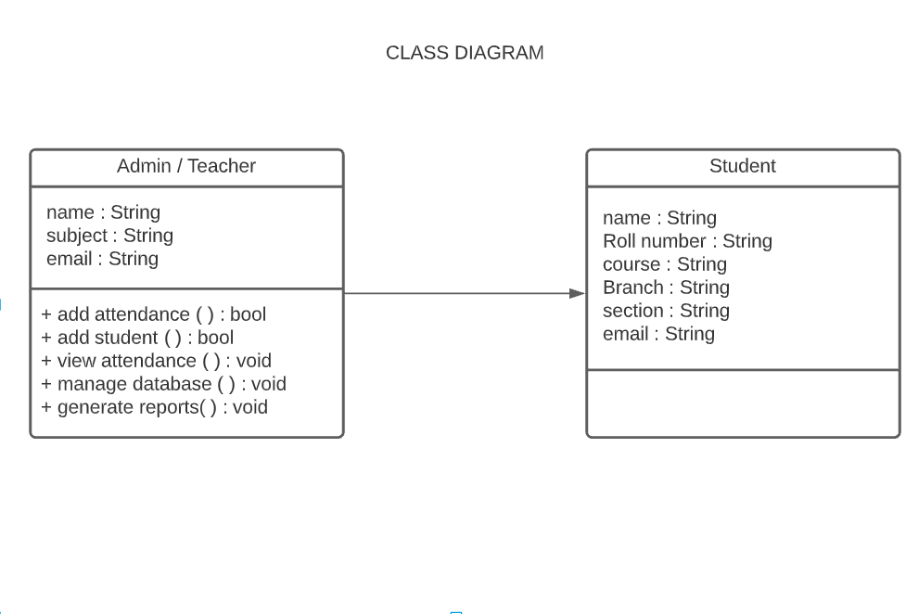
CLASS DIAGRAM

Slide 15
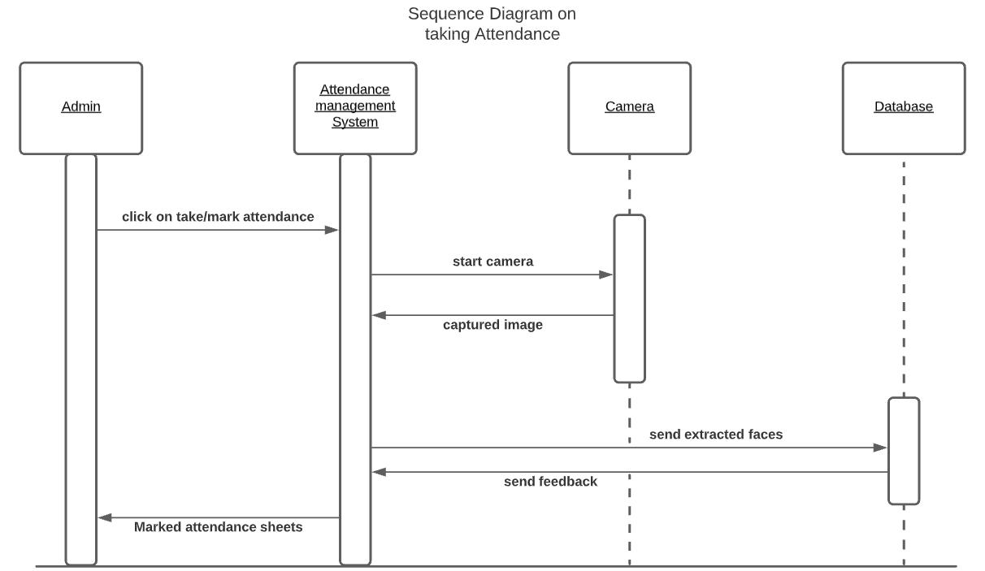
SEQUENCE DIAGRAM

Slide 16
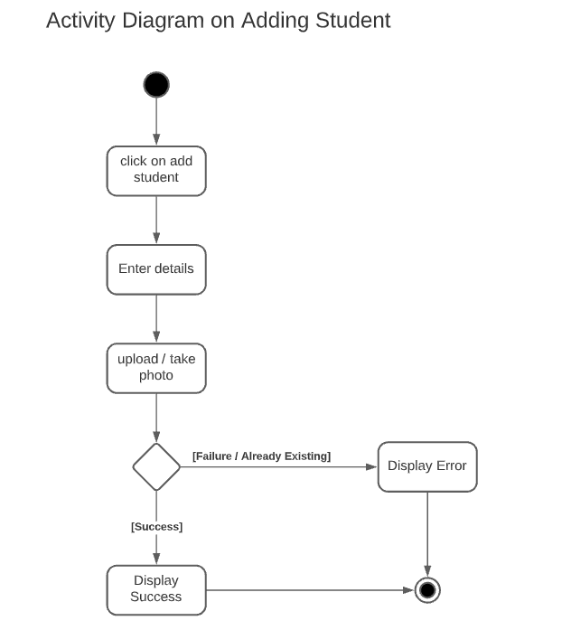
ACTIVITY DIAGRAM

Slide 17
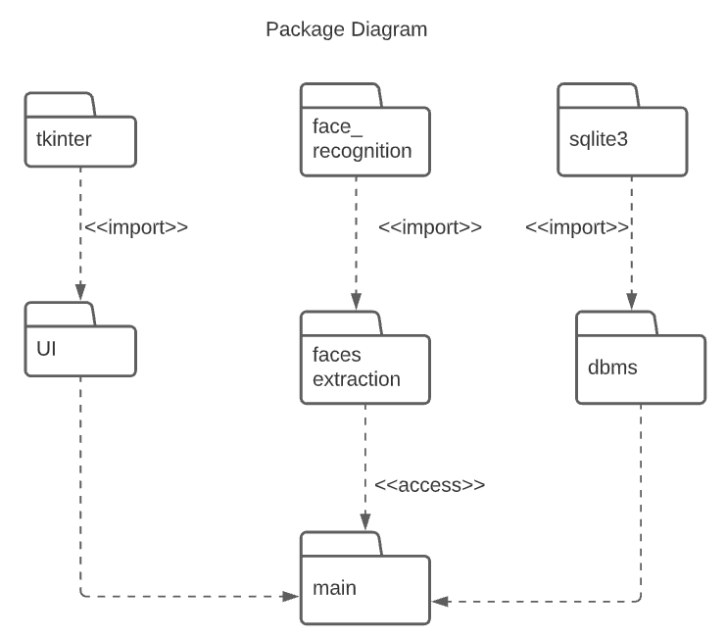
PACKAGE DIAGRAM

Slide 18
Code implementation

Slide 19
required libraries
Required libraries are ..
face_recognition
tkinter
openpyxl
PIL
matplotlib
etc…

Slide 20
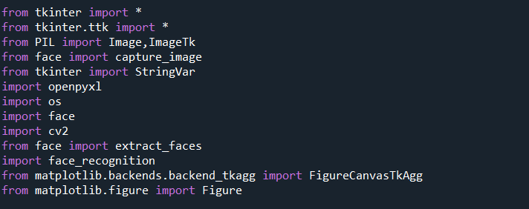
required libraries(2)

Slide 21
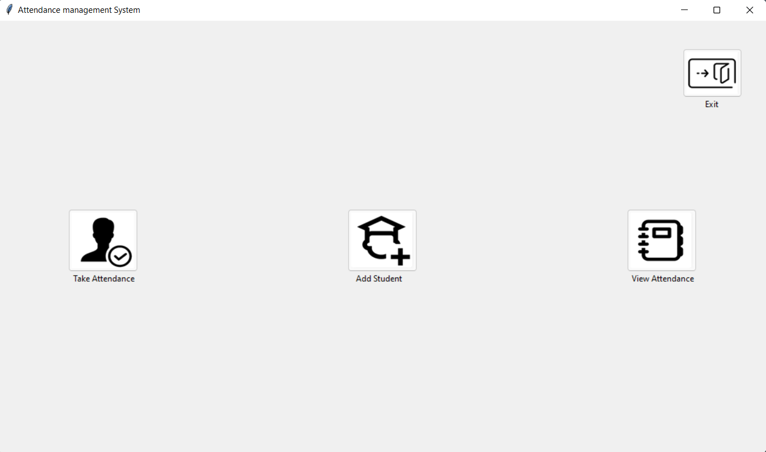
Main window - ui

Slide 22
Main window (2)
In the main window we have 4 buttons for functionality:
Take Attendance – to take attendance
Add student – to add student
View Attendance – to view attendance of a student
Exit – to close the window

Slide 23
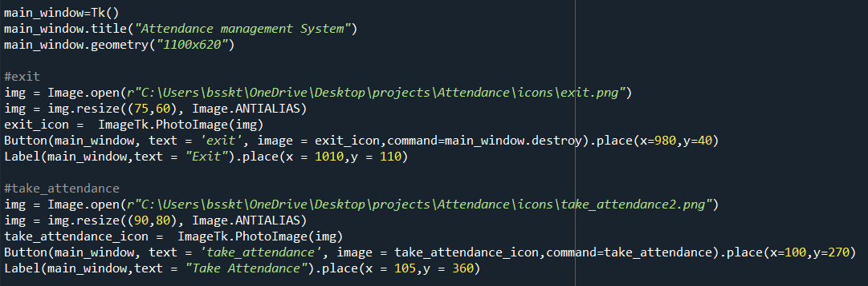
MAIN WINDOW (3)

Slide 24
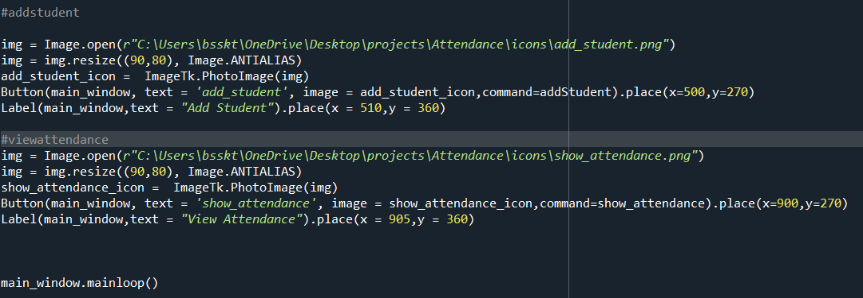
MAIN WINDOW (4)

Slide 25
Take attendance - ui

Slide 26
Take attendance (2)
After clicking the “Take Attendance” Button ,a window named “Take Image” pops out asking to capture a image (By pressing “space” we can capture image and by pressing “q” or “esc” we can close window).
Here we implement two functions (capture_image() and extract_faces() )

Slide 27
Capturing an image
We are capturing an image by using the cv2 module which takes access to the camera.
OpenCV is a vast library that helps in providing various functions for image and video operations.
With OpenCV, we can capture a video from the camera.
It lets you create a video capture object which is helpful to capture videos/capture images through webcam and then we can perform desired operations on that video/image.

Slide 28
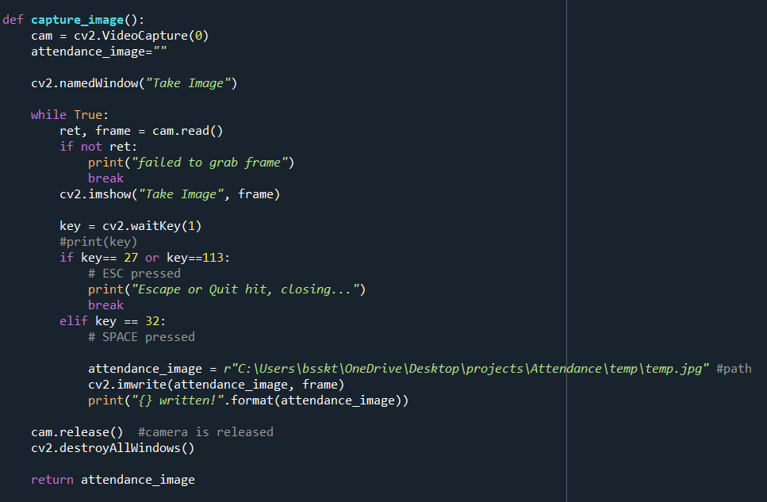
Capturing an image(2)

Slide 29
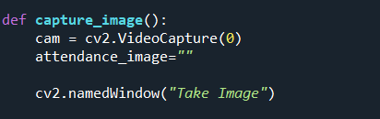
Capturing an image(3)
cv2.VideoCapture(0) - is used to get a video capture object for the camera.
Cv2.namedWindow() – is used to name the window.

Slide 30
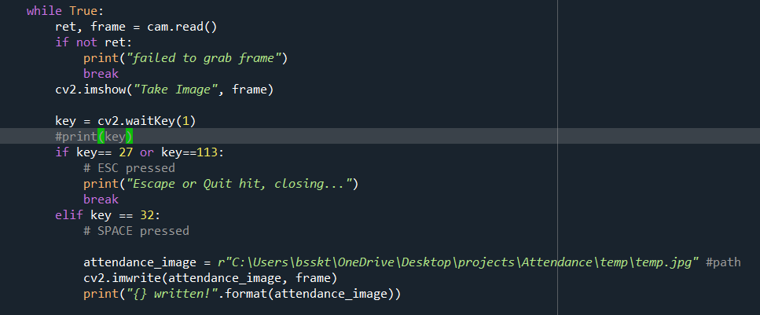
Capturing an image(4)
read() - method to read the frames using the above created object.
imshow() - method to show the frames in the video.
If space is pressed then the image(frame) is saved in the given path

Slide 31

Capturing an image(5)
If esc or q is pressed then we can come out of the infinite loop and the camera window closes.
Camera object is released and all the windows belong to cv2 were destroyed and
path of the image is returned.

Slide 32
Take attendance (3)
After capturing a image extraction of faces comes next.

Slide 33
Extracting faces
Here we use face_recognition module to extract faces.
face_recognition is a module in python used to locate or recognize faces.
Here we implement extract_faces function to extract the faces and store into a folder named extracted_faces.

Slide 34
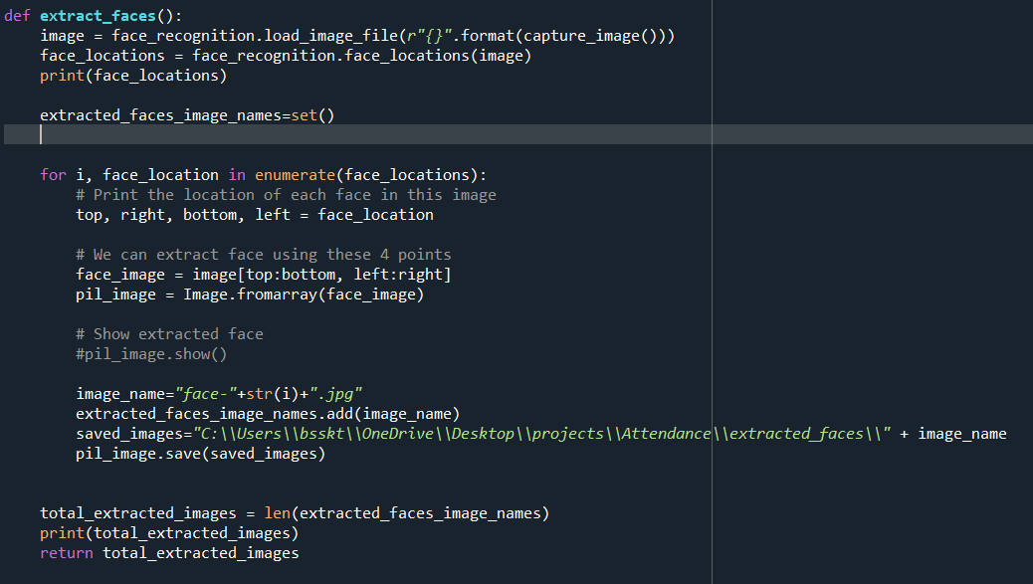
Extracting faces (2)

Slide 35
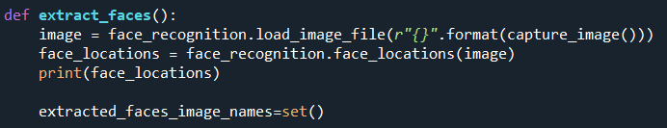
Extracting faces (3)
load_image_file - is used to load the image by giving path to the image (we have returned the captured image path in capture_image() function)
face_locations– is used to get all the face locations , it returns a list of tuples of face locations.

Slide 36
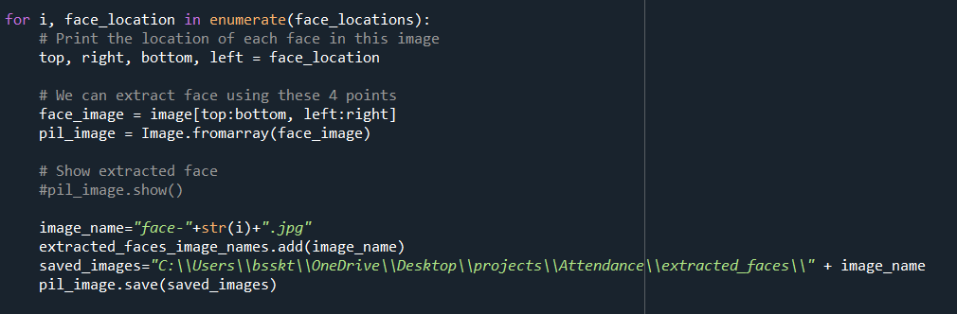
Extracting faces (4)
The “Image” module provides a class with the same name which is used to represent a PIL image. The module also provides a number of factory functions, including functions to load images from files, and to create new images.

Slide 37

Extracting faces (5)
Image.forarray() - Creates an image memory from an object exporting the array interface (using the buffer protocol).
Then we are saving the extracted faces into extracted_faces folder
We are returning no.of faces extracted in the image.

Slide 38
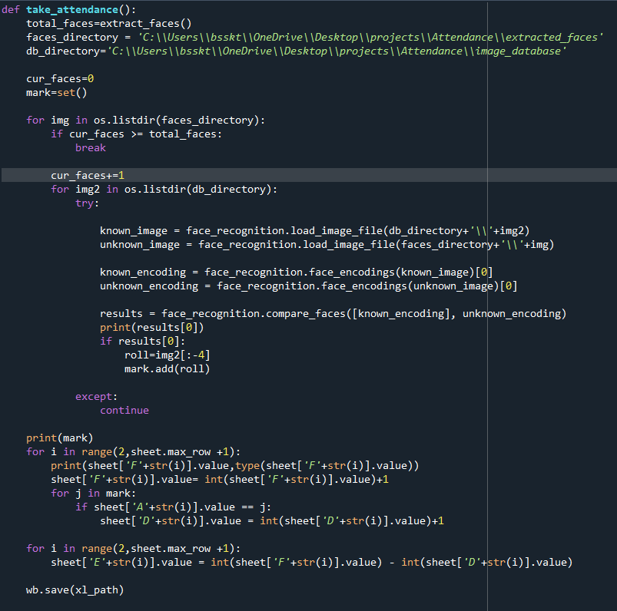
Take attendance (4)

Slide 39
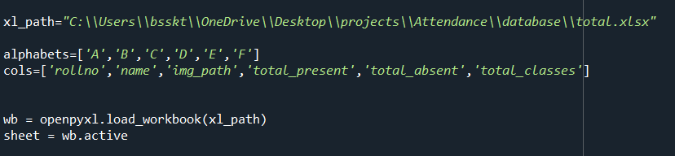
Take attendance (5)
openpyxl is a Python library for reading and writing Excel files.
The openpyxl module allows Python program to read and modify Excel files.
load_workbook () – method loads the excel file.
active – attribute grabs the active worksheet.

Slide 40
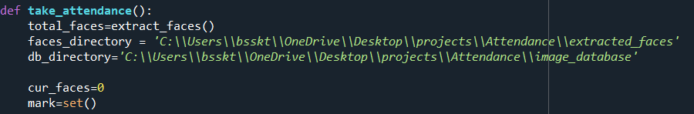
Take attendance (6)
In total_faces variable we have the total faces that we extracted (extract_faces() function call will be done here) using extact_faces method.
In faces_directory we have extracted faces and in db_directory we have the student image_database.

Slide 41
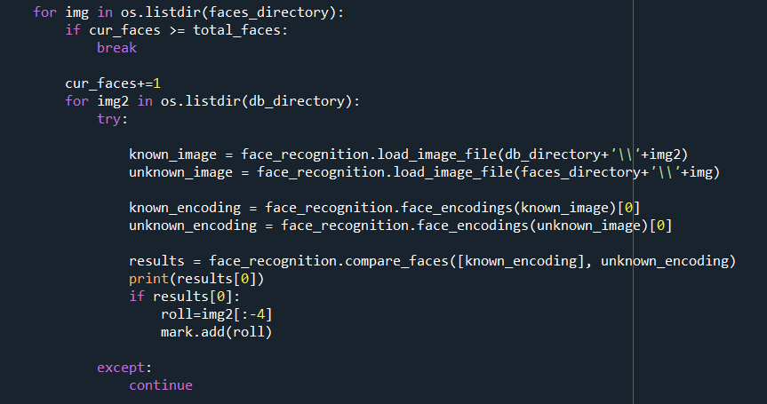
Take attendance (7)
Here we are iterating through two directories (image_database and extracted_faces) and we are matching the faces in extracted_faces and image_database.

Slide 42
Take attendance (8)
We are comparing two faces using compare_faces() function.If the two faces match then we insert the roll no into mark set.
Before comparing two faces we do encoding of faces using face_encoding() function.
We maintain current faces (cur_faces) variable to count the faces extracted in this particular instance.

Slide 43
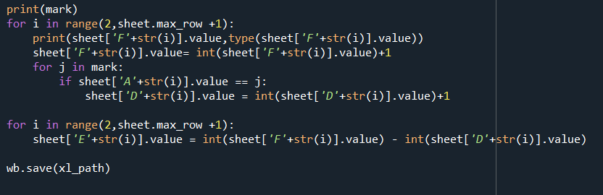
Take attendance (9)
We are updating the results in mark set into the excel sheet that we are maintaining (here column ‘F’ - for total classes , ‘E’ – for total absent, ‘D’ – for total present ).
save() method is used to save the worksheet.

Slide 44
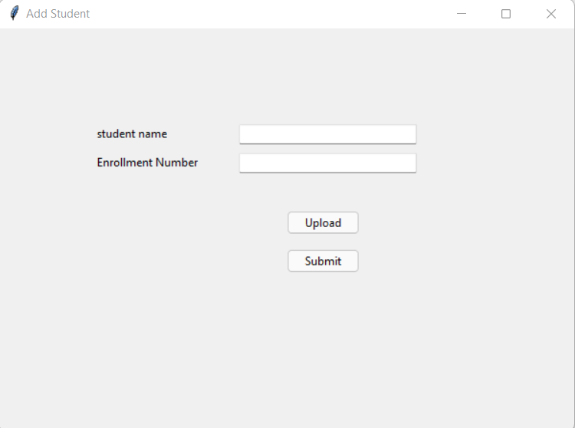
Add student - ui

Slide 45
Add student (2)
In add student UI we have two labels and two fields to fill (name and enrollment number).
Upload button is used to upload the image of the student.
Submit button is used to submit the entered details.
Upload button follows the same functionality of extract_faces() function but here the extracted face is saved in image_database folder.
The Tkinter StringVar helps you manage the value of a widget such as a Label or Entry more effectively.

Slide 46
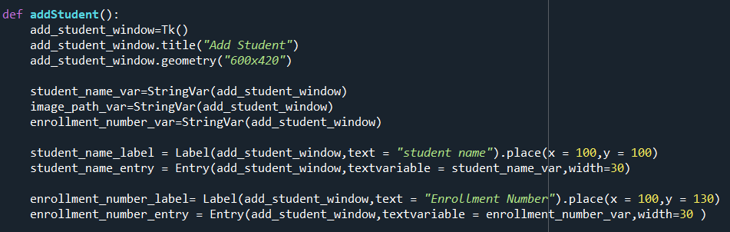
Add student (3)
The Tkinter StringVar helps us to manage the value of a widget such as a Label or Entry more effectively.

Slide 47
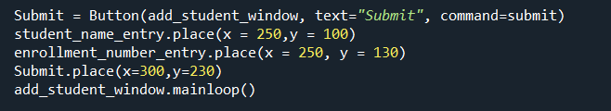
Add student (4)

Slide 48
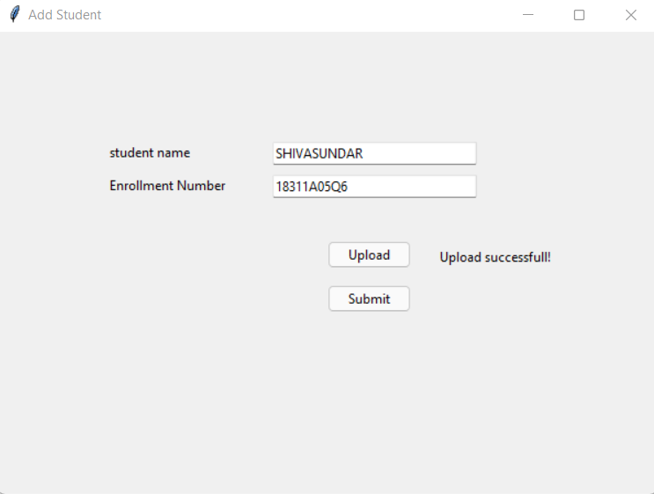
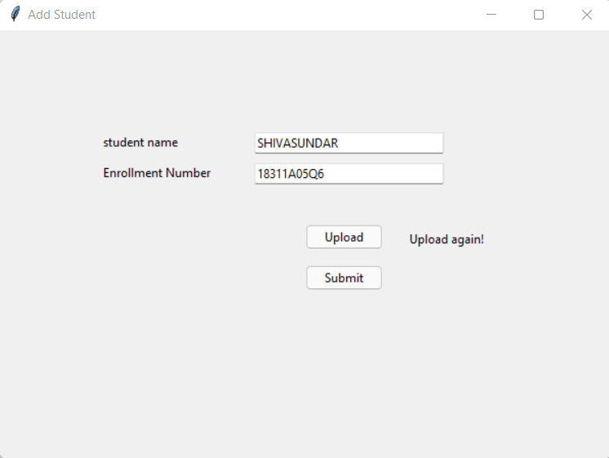
Add student (5)
In the upload function if the image is uploaded , if it finds any faces it shows message as upload successful or if it doesn’t recognize any faces it shows a message to upload again.

Slide 49
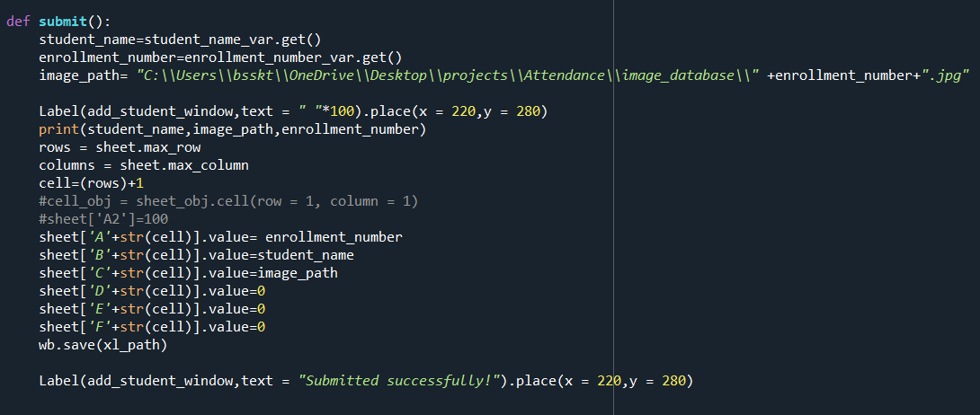
Add student (6) –submit button
After clicking submit name, roll no and image path are added to the excel sheet.

Slide 50
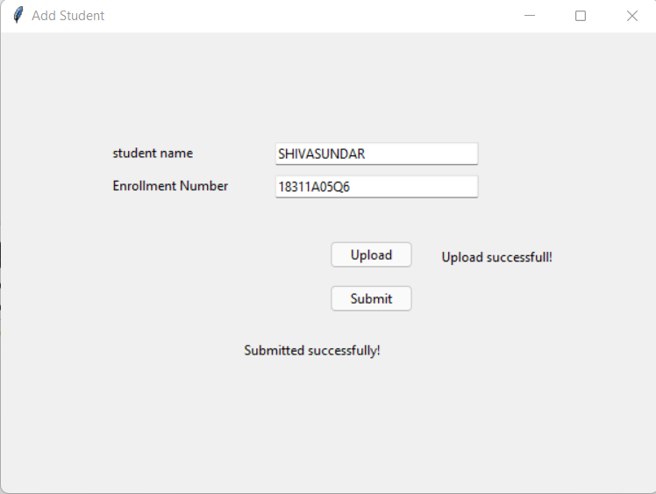
Add student (7)
In the submit function ,if the details are submitted (added in the excel sheet) then it displays the message as submitted successfully.

Slide 51
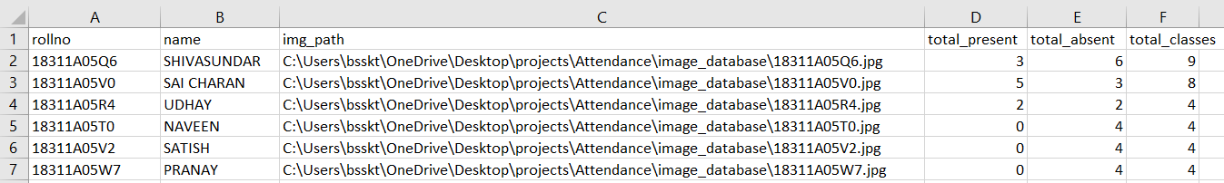
Add student (8)
This is how the excel sheet (student database) looks like after a few operations.

Slide 52
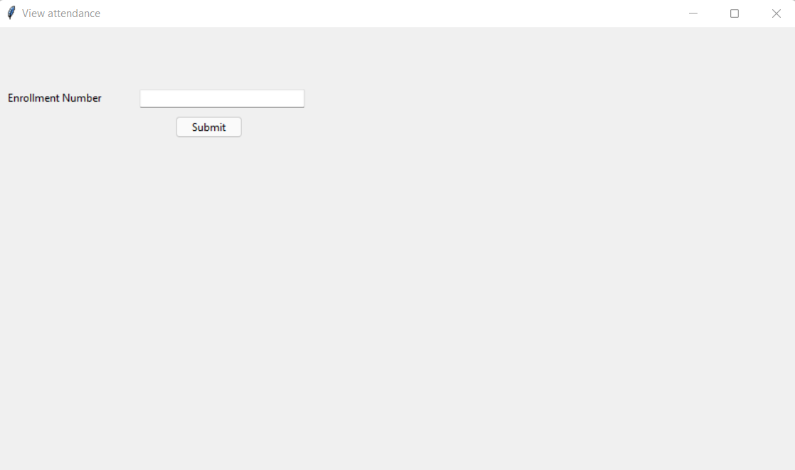
View attendance - UI

Slide 53
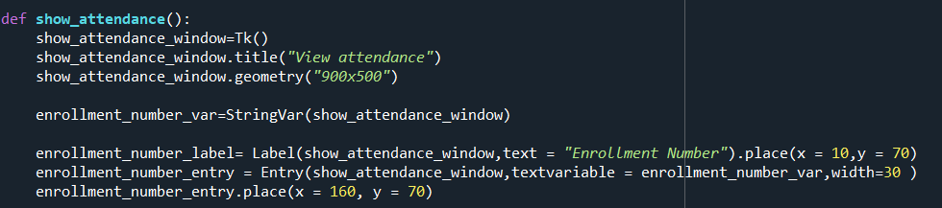
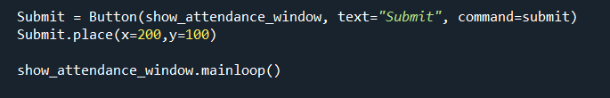
View attendance – ui code

Slide 54
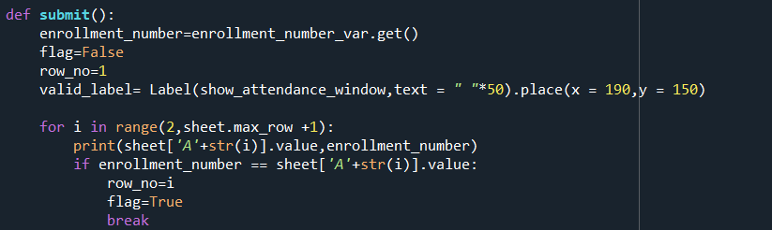
View attendance (3)
In the submit button we are verifying whether the entered roll no is present in the database or not
If it is present we are setting flag as True.

Slide 55
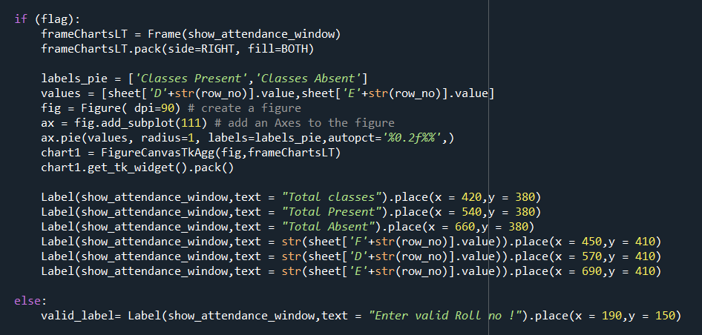
View attendance (4)
If the given roll no is present we are providing outputs else a message is displayed.

Slide 56
View attendance (5)
Here we are placing a matplotlib chart into the tkinter window.
Figure() – is used to create a object that contains the plot.
add_subplot() – is used to add axes to the figure.
Pie() – to plot a pie chart.
FigCanvasTkAgg() – it contains the matplotlib plot.

Slide 57
View attendance–ui overview (6)
After entering the enrollment number in the entry, after hitting submit it checks whether the enrollment number is present in the database or not.
If it is in the database it gives us the output
If not it displays a message to enter valid enrollment number.

Slide 58
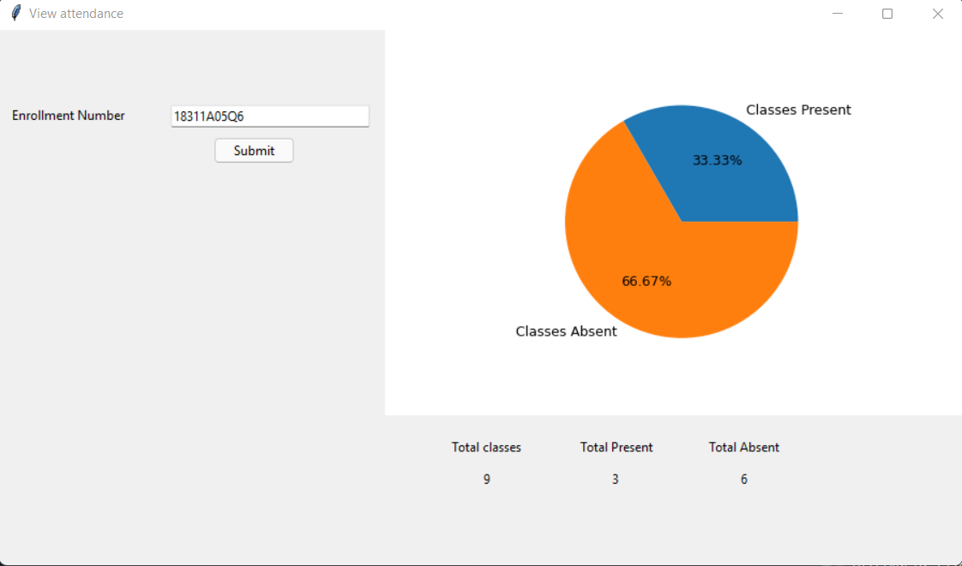
View attendance (7)

Slide 59
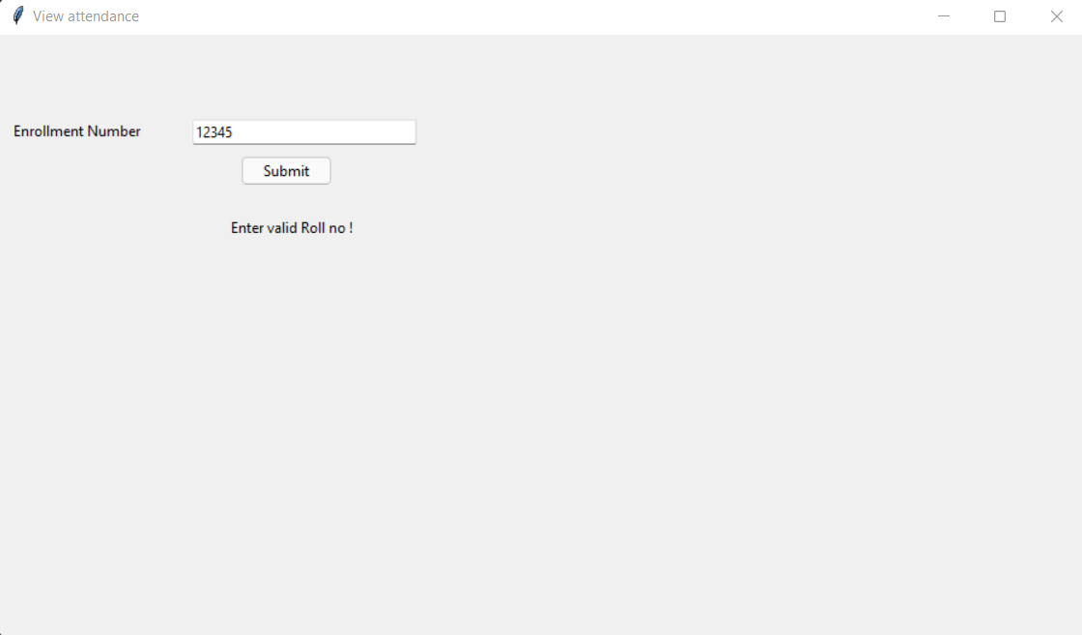
View attendance (8)

Slide 60
Conclusion and future scope
We have successfully implemented all the features of attendance management system using tkinter GUI.
The overall accuracy depends of the project depends on the face_recognition module accuracy, camera quality and lighting while taking a image.
This project can be used in schools ,colleges and in organizations ,where ever the attendance is calculated or considered.
Future scope of this project is , we can implement an web interface so that any mobile or laptop device can access , a login system and a real database updation using backend languages etc..

Slide 61
REFERENCES
Student Attendance System using Face Recognition by Samridhi Dev, Tushar Patnaik .
( https://ieeexplore.ieee.org/document/9215441 )
Upgrad - https://www.upgrad.com/blog/image-processing-projects-ideas-topics/
Creatly - https://creately.com/blog/diagrams/uml-diagram-types-examples/
String Var - https://www.pythontutorial.net/tkinter/tkinter-stringvar/
PIL - https://www.geeksforgeeks.org/python-pillow-a-fork-of-pil/
https://pillow.readthedocs.io/en/stable/reference/Image.html

Slide 62
REFERENCES
Openpyxl - https://www.geeksforgeeks.org/python-reading-excel-file-using-openpyxl-module/
Face recognition - https://face-recognition.readthedocs.io/en/latest/readme.html
Image button - https://www.geeksforgeeks.org/python-add-image-on-a-tkinter-button/
Opencv - https://www.geeksforgeeks.org/python-opencv-capture-video-from-camera/

Slide 63


