Slide 1
Enabling Reproducible Audit Evidence for Phishing-Report Workflows in a State Agency
Shiva H. Thapa M.S. Cyber Operations – CYBR 698-51 Fa25 Cyber Operations Capstone Project December 7, 2025 Repo: https://github.com/shiva-thapa-cohort6/repro_lab
Notes:
Speaker notes
This project builds a small, containerized pipeline that makes phishing-report logs reproducible and auditable in a state-agency context, aligned with NIST standards for logging, monitoring, and measurement.

Slide 2
Phishing Reports Without Reliable Logs Undermine Response
State agencies depend on staff phishing reports to detect targeted email attacks, but “Report Phish” workflows and logs are fragmented across email, ticketing, and SIEM tools.
Inconsistent audit evidence slows investigations and weakens monitoring and compliance.
Week-1 objectives call for a 25% increase in verified phishing reporting and a ≤ 2-hour median time to detect, but those targets are hard to reach when phish-report logs are inconsistent and incomplete.
Notes:
Speaker notes
This slide shows why fragmented phish-report workflows matter: they slow investigations and monitoring and make Week-1 goals for higher verified reporting and faster detection harder to reach.

Slide 3
Evidence Snapshot From Prior Work
Source | Key Finding | Relevance to Design
Althobaiti et al., 2021 [2] | User phishing reports increase situational awareness but overwhelm analysts when evidence is inconsistent. | Motivates a standardized phish-report logging pipeline.
Killcrece & Ruefle, 2021 [3] | Structured, well-documented incident communication improves response quality and reduces confusion. | Supports clear, shareable log records for SOC and leadership.
ACSC, 2020 [4] | Legacy and opaque systems weaken monitoring despite formal control catalogs. | Justifies containerized, version-pinned analysis workflows with explicit metrics.
Notes:
Speaker notes
These three sources justify focusing on structured logging, clearer evidence flows, and containerized, version-controlled workflows for synthetic phish-report events.
References:
[2] K. Althobaiti, A. D. G. Jenkins, and K. Vaniea, “A Case Study of Phishing Incident Response in an Educational Organization,” Proc. ACM Hum.-Comput. Interact., vol. 5, no. CSCW2, art. 338, Oct. 2021.
[3] J. Killcrece and R. Ruefle, Communicating During Cybersecurity Incidents. Pittsburgh, PA, USA: Software Engineering Institute, Carnegie Mellon Univ., 2021.
[4] Australian Cyber Security Centre, Managing Legacy Information and Communications Technology Security Risks. Canberra, Australia: Australian Signals Directorate, 2020.

Slide 4
Containerized Phish-Report Logging Pipeline
Synthetic phish-report events
Containerized logging & metrics script
Evidence in docs/
Single documented command builds the container image and regenerates all outputs from synthetic phish-report events.
No real email content or identifiers are stored; all records are synthetic and schema-controlled.
Metrics are computed automatically and written into docs/metric.txt for reuse in traceability discussions.
Key measures : Reproducible Analysis Run Success Rate, Audit Record Retention Coverage, and Field Completeness Score (details on Evaluation slide).
Notes:
Speaker notes
The pipeline mirrors a future “Report Phish” button at small scale. One Docker command rebuilds the environment and generates logs and metrics from synthetic events.

Slide 5
Standards Anchors: CSF 2.0 and Zero Trust
Row / Block 1 – CSF Outcome
CSF 2.0 Outcome (Protect – Protective Security): PR.PS-04: “Log records are generated and made available for continuous monitoring.” (NIST CSF 2.0, Appendix A, p. 20)
Design link: Each container run generates structured log records and metrics into known files (docs/log.txt, docs/metric.txt, docs/chart.png), making them available for continuous monitoring activities.
Row / Block 2 – ZTA Tenet
Zero Trust Tenet (SP 800-207): “The enterprise monitors and measures the integrity and security posture of all owned and associated assets.” (NIST SP 800-207, Sec. 2.1, p. 7)
Design link: Metrics such as run success rate and audit coverage treat the logging pipeline itself as an asset whose posture is monitored over time.
Notes:
Speaker notes
Here I quote PR.PS-04 from CSF 2.0 Appendix A, p. 20, and Tenet 5 from SP 800-207, Sec. 2.1, p. 7, then show how the containerized pipeline satisfies these expectations.

Slide 6
Ethics, Data Management, and C-SCRM
Ethics & privacy (ETHICS.md): Only synthetic phish-report events are used; no real names, internal email addresses, or message bodies are stored. Follows “minimum necessary” collection aligned with AC-6 and PT-3 in NIST SP 800-53 Rev. 5 AC-6 and PT-3.
Data handling (DMP.md): Synthetic events in data/, code in src/, output in docs/. Stored on encrypted local storage and a restricted cloud workspace; retention bounded to course requirements.
C-SCRM (docs/cscrm_note.md): Dependency risk from base container images and Python libraries is mitigated through version pinning, a simple SBOM, and basic hash checks before and after runs.
Notes:
Speaker notes
This slide summarizes the synthetic-only ethics stance, the structured Data Management Plan, and how supply-chain risks are mitigated through version pinning, SBOM, and hash checks documented in the repo.

Slide 7
Evaluation Plan: SMART Metrics and Traceability
Reproducible Analysis Run Success Rate = successful container runs that produce expected outputs ÷ total runs in a defined period.
Audit Record Retention Coverage = events with logs spanning the configured time window ÷ total synthetic events.
Field Completeness Score = logs containing all required fields ÷ total logs sampled.
**Traceability chain:**
Risk → Requirement → Metric → Evidence:
missing or incomplete phishing audit records → NIST SP 800-171r3 03.03.03 → Reproducible Analysis Run Success Rate → evidence in docs/log.txt, docs/metric.txt, and docs/traceability.*.
Notes:
Speaker notes
Run: docker build -t reproducibility-lab . && docker run --rm -v "$PWD":/work reproducibility-lab. These three metrics show how well requirement 03.03.03 is met using evidence in docs/log.txt, docs/metric.txt, and docs/traceability.*.

Slide 8
CSF 2.0 Current → Target Profile
PR.PS-04 – Log records for continuous monitoring Current: Phish-related logs are fragmented and not demonstrably reproducible or complete. Target: Synthetic phish-report events consistently produce reproducible, documented log records and metrics aligned with PR.PS-04.
DE.CM-01 – Networks and services are monitored Current: Monitoring of phishing events depends on scattered logs and manual reconstruction. Target: Logging workflow provides a small, testable feed of structured events that can plug into broader monitoring.
GV.IM-03 – Measurement and improvement Current: Logging reliability and coverage are not measured consistently. Target: Metrics and evidence in docs/ support routine evaluation of log generation and retention.
PR.PS-04: “Log records are generated and made available for continuous monitoring.” (NIST CSF 2.0, App. A, p. 20)
Notes:
Speaker notes
Use the CSF Profile idea from NIST SP 1301: concise Current and Target states for PR.PS-04, DE.CM-01, and GV.IM-03, with the PR.PS-04 Outcome quoted directly from CSF 2.0 Appendix A, p. 20.

Slide 9
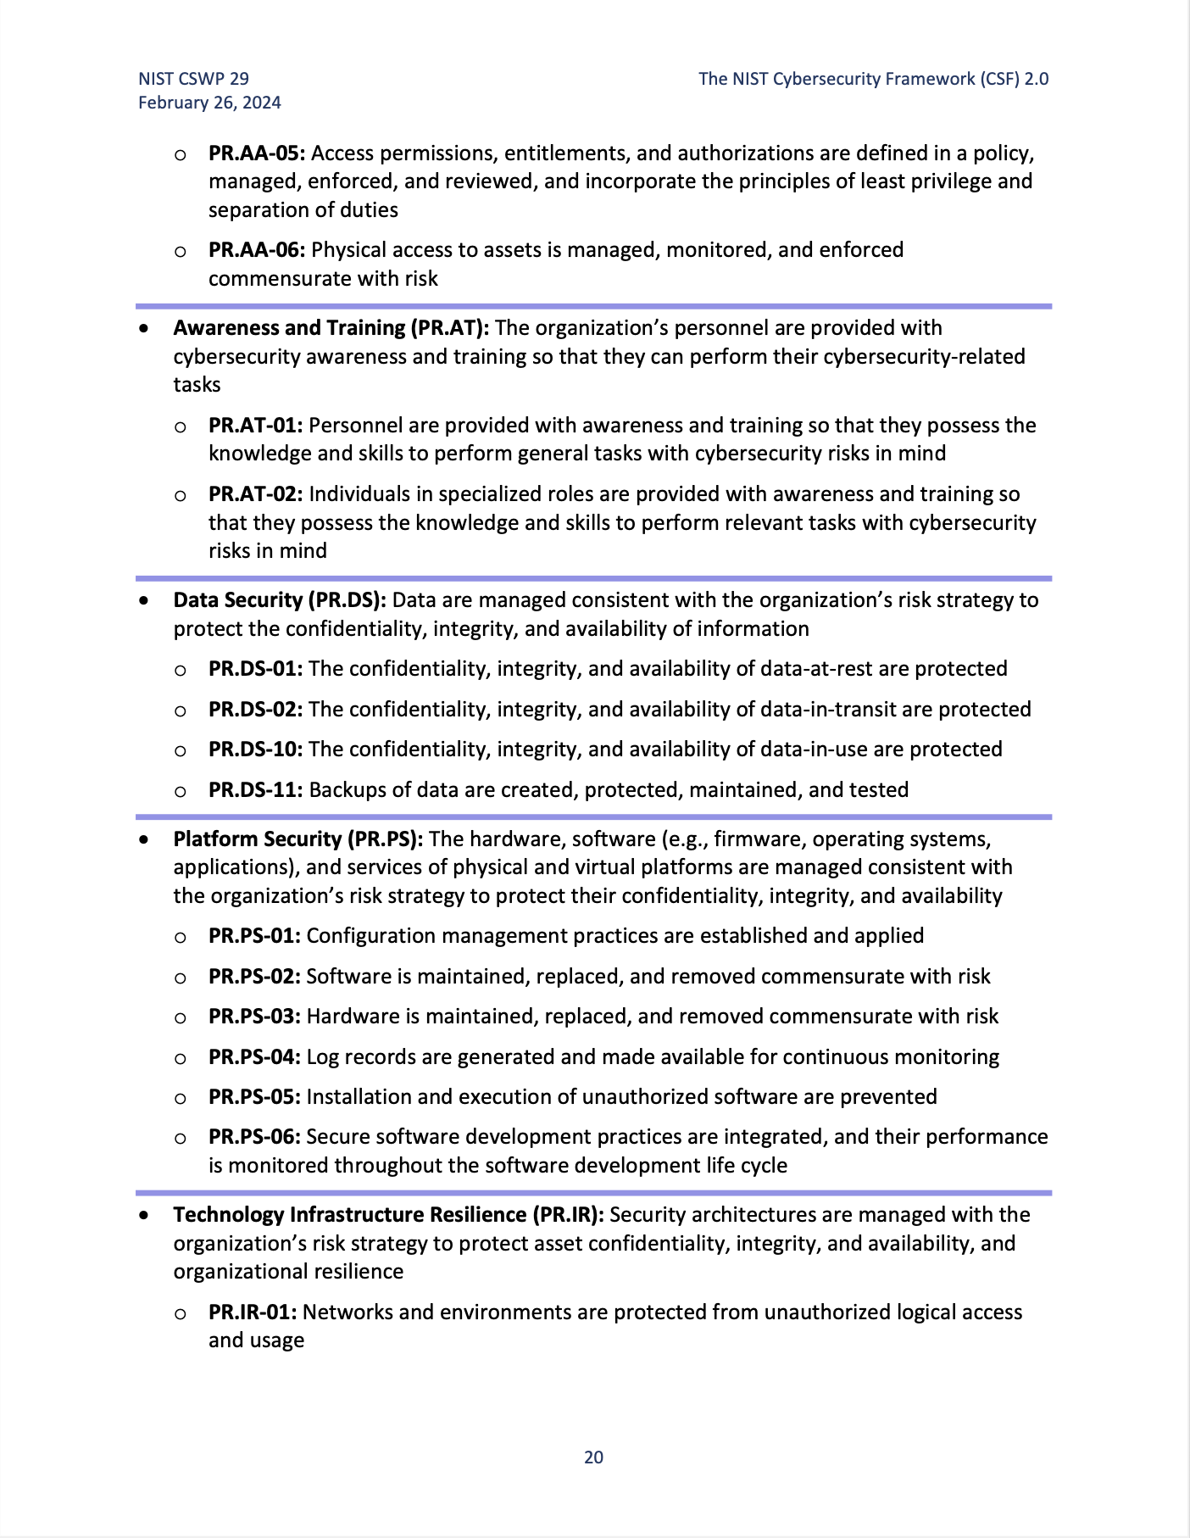
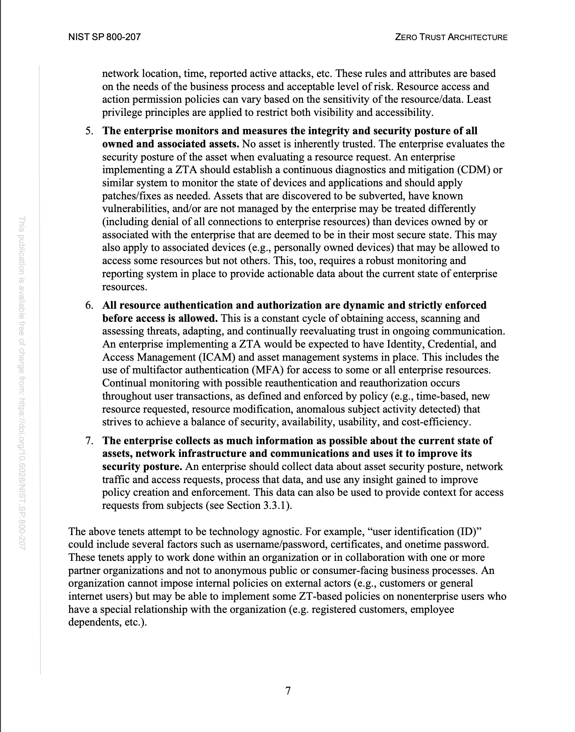
Evidence-Standards Pages Used in Slides
NIST CSF 2.0, Appendix A, p. 20 – PR.PS-04
NIST SP 800-207, p. 7 – Tenet 5

