Slide 1
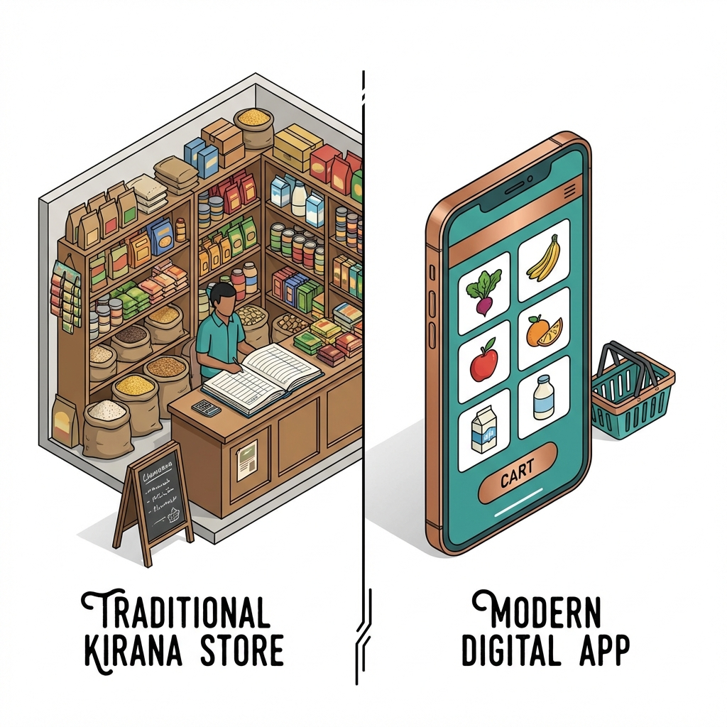
ABSTRACT
Problem vs Solution
• The Problem Gap
Traditional retailers are losing to quick-commerce giants due to lack of digital tools.
• NEST Solution
A hyper-local marketplace bridging customers to neighborhood shops.
• Dual-User Ecosystem
Shop Owners: Inventory, Billing, Analytics Customers: Discovery, Search, Ordering
• Key Value
Offline-first, Zero-hardware cost, Scalable.

Slide 2
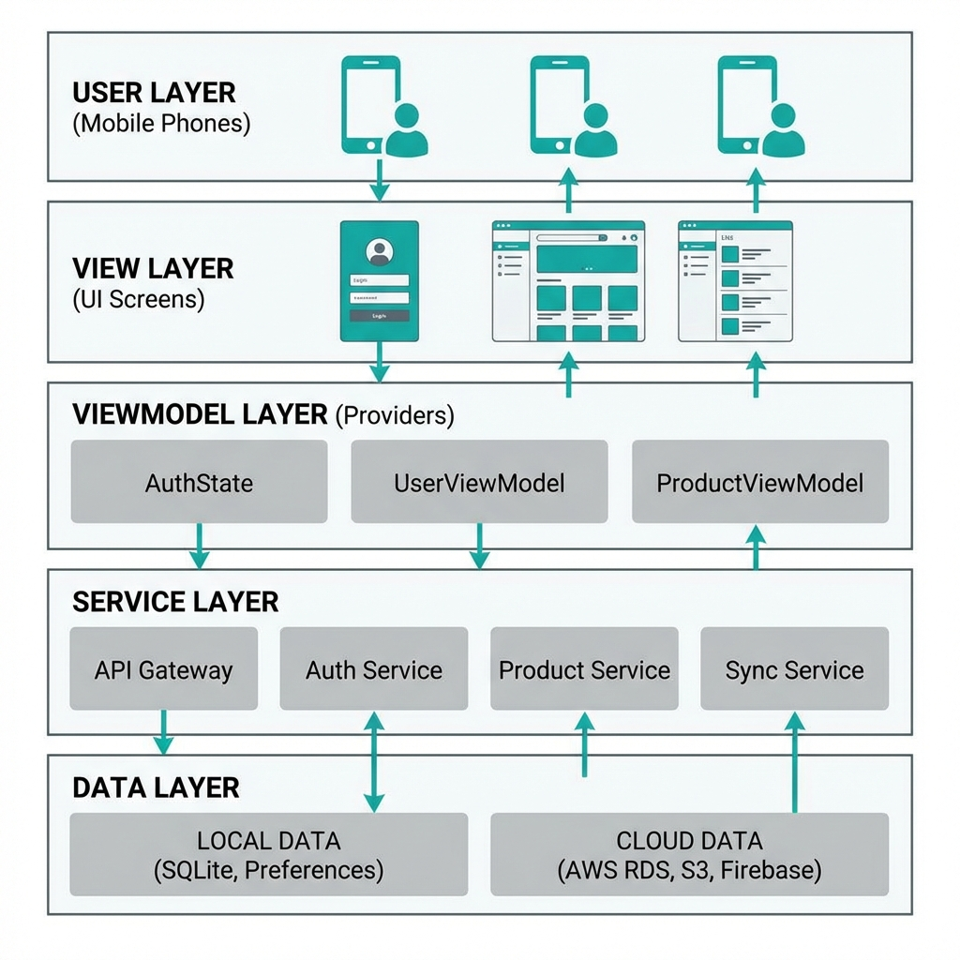
WORKING ARCHITECTURE
System Flow
• Modular Layers
Separation of Concerns: View, ViewModel, Service, Data.
• Reactive UI View
Flutter Screens observing Provider state changes.
• Smart Service Layer
Handles complex logic: Geolocation, Search, Tax Calc.
• Hybrid Data Strategy
Local Storage for speed + Cloud Firestore for scale.
• Offline-First
Critical ops work without internet; syncs later.

Slide 3
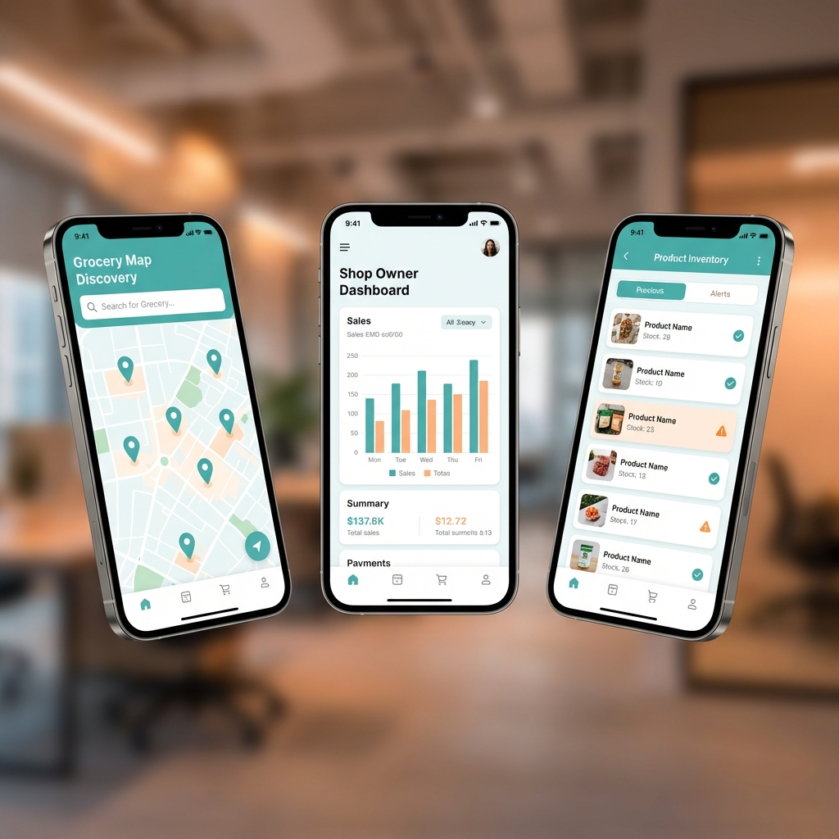
FRONTEND TECHNOLOGIES
Flutter 3.x Ecosystem
• Core Framework
Flutter 3.x with Dart (Null Safety).
• Performance
Compiled to native ARM code, consistently running at 60 FPS.
• State Management
Provider Pattern for efficient, partial UI rebuilds.
• Key Capabilities
Interactive Google Maps, Real-time Charts, Image Caching.

Slide 4
BACKEND TECHNOLOGIES
Serverless Cloud Infrastructure
• Google Firebase Firestore
NoSQL database handling flexible product schemas.
• Authentication
Secure, token-based phone/email login management.
• Local Persistence
SharedPreferences for instant-load user sessions.
• Scalability
Serverless architecture scales automatically with user load.

Slide 5
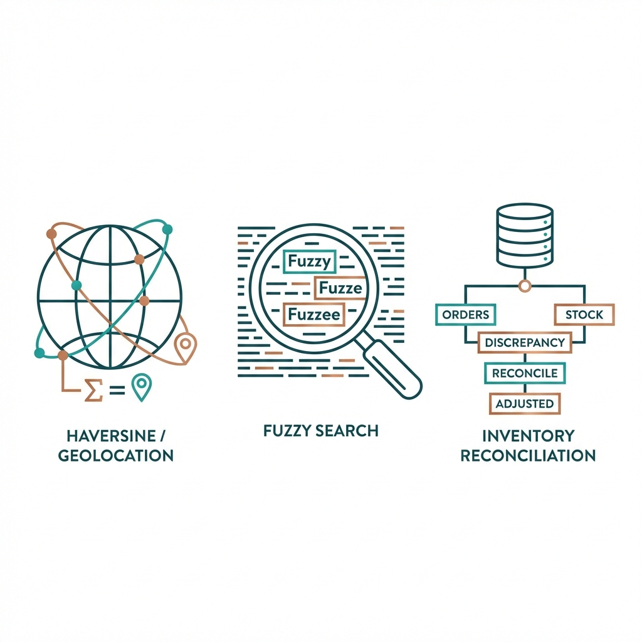
CORE ALGORITHMS
The Intelligence Inside
• Geospatial Sorting
Haversine Formula to rank shops by real-time distance.
• Fuzzy Product Search
Levenshtein Distance for handling typos (e.g. 'Biskt' -> 'Biscuit').
• Inventory Reconciliation
Atomic decrement logic to prevent negative stock during billing.
• Data Aggregation
Time-series bucketing for daily/weekly sales analytics.

Slide 6
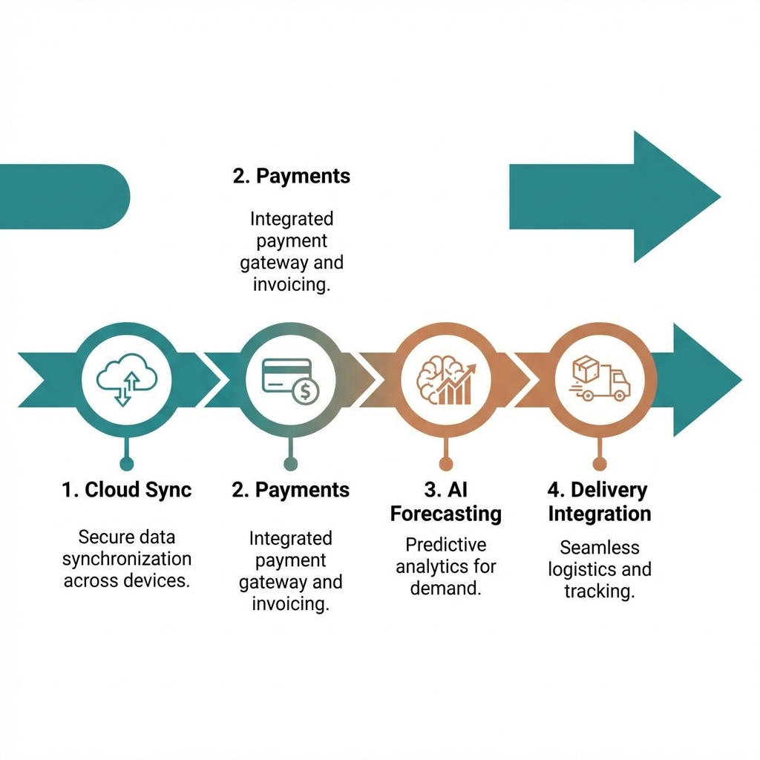
FUTURE ROADMAP
Scaling to SaaS
• Phase 1: Cloud Sync
Real-time multi-device synchronization.
• Phase 2: Payments
UPI & Gateway integration for in-app settlements.
• Phase 3: AI Forecasting
Predictive models for stock replenishment.
• Phase 4: Logistics
Hyperlocal delivery partner integration.

