Slide 1
Iphone
Generated by Slide Generator AI

Slide 2
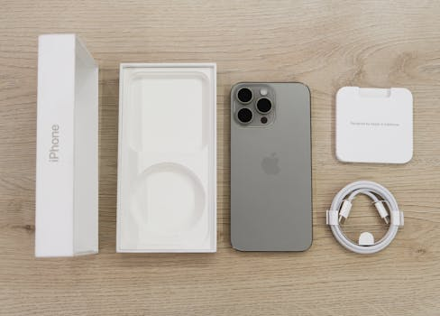
The iphone was first introduced
The iPhone was first introduced by Apple Inc. in 2007.
The iPhone runs on Apple's iOS operating system.
The iPhone is known for its sleek design and user-friendly interface.
The iPhone revolutionized the smartphone industry with its touch screen technology.
The iPhone App Store offers thousands of apps for users to download.

Slide 3
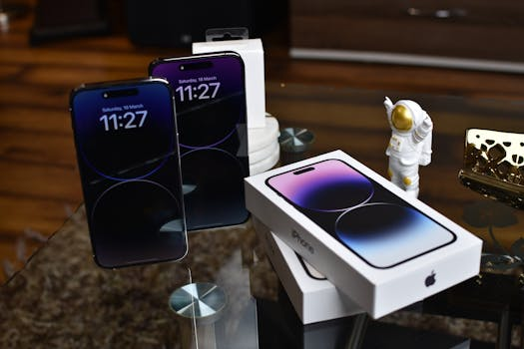
The iphone comes in various
The iPhone comes in various models, including the iPhone 12, iPhone 11, and iPhone SE.
The iPhone's camera capabilities have improved significantly over the years.
The iPhone features Siri, Apple's virtual assistant.
The iPhone is compatible with iCloud, Apple's cloud storage service.
The iPhone supports Face ID for secure authentication.

Slide 4

The iphone is known for
The iPhone is known for its powerful performance and smooth operation.
The iPhone's display features Retina technology for crisp, clear images.
The iPhone offers various biometric authentication options, including Touch ID.
The iPhone's battery life has improved with each new model.
The iPhone features wireless charging capabilities.

Slide 5
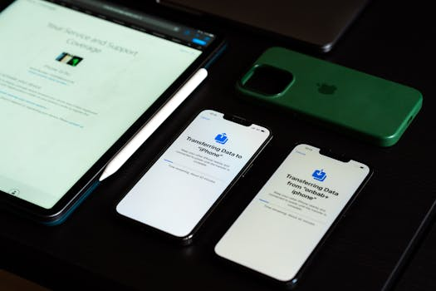
The iphone supports fast charging
The iPhone supports fast charging for quick power-ups.
The iPhone supports 5G connectivity for faster data speeds.
The iPhone offers advanced security features to protect user data.
The iPhone is compatible with Apple Pay for contactless payments.
The iPhone's built-in health app helps users track their fitness and wellness goals.

Slide 6

The iphone's facetime feature allows
The iPhone's FaceTime feature allows users to make video calls.
The iPhone's iMessage app offers encrypted messaging for secure communication.
The iPhone's A-series chipsets deliver high-speed performance.
The iPhone's TrueDepth camera enables features like Animoji and Memoji.
The iPhone's dual-camera system delivers professional-quality photos.

Slide 7
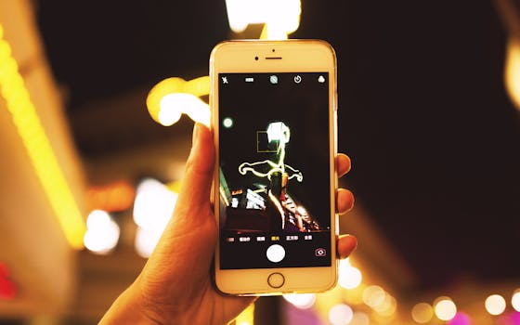
The iphone's night mode feature
The iPhone's Night mode feature enhances low-light photography.
The iPhone's Smart HDR feature optimizes photo quality in various lighting conditions.
The iPhone's Portrait mode adds depth-of-field effects to photos.
The iPhone's ProRAW format enables photographers to capture images in high fidelity.
The iPhone's Deep Fusion technology enhances image detail and texture.

Slide 8
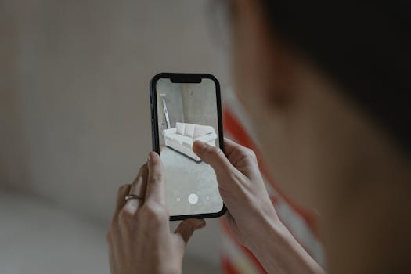
The iphone's lidar scanner enhances
The iPhone's LiDAR scanner enhances augmented reality experiences.
The iPhone's MagSafe technology allows for easy attachment of accessories.
The iPhone's ceramic shield offers improved durability and drop protection.
The iPhone's water and dust resistance make it suitable for outdoor use.
The iPhone's Super Retina XDR display offers vivid colors and high contrast.

Slide 9

The iphone's true tone technology
The iPhone's True Tone technology adjusts display brightness based on ambient light.
The iPhone's Night Shift feature reduces blue light exposure for better sleep quality.
The iPhone's spatial audio feature enhances audio quality for immersive experiences.
The iPhone's Dolby Atmos support delivers cinematic sound quality.
The iPhone's dual SIM capability allows users to have two phone numbers on one device.

Slide 10

The iphone's privacy features give
The iPhone's privacy features give users control over their personal data.
The iPhone's app tracking transparency feature gives users the option to block ad tracking.
The iPhone's accessibility features cater to users with disabilities.
The iPhone's Screen Time feature helps users monitor and limit their screen usage.
The iPhone's Family Sharing feature allows family members to share purchases and resources.

Slide 11
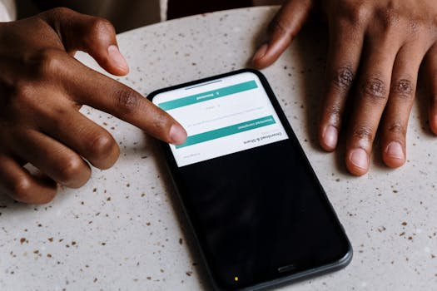
The iphone's carplay feature integrates
The iPhone's CarPlay feature integrates the device with the user's car for a seamless experience.
The iPhone's HomeKit feature allows users to control smart home devices from their phone.
The iPhone's Find My app helps users locate lost or stolen devices.
The iPhone's AirDrop feature enables easy sharing of files and media with other Apple devices.
The iPhone's AirPlay feature allows users to stream content to compatible devices.

Slide 12
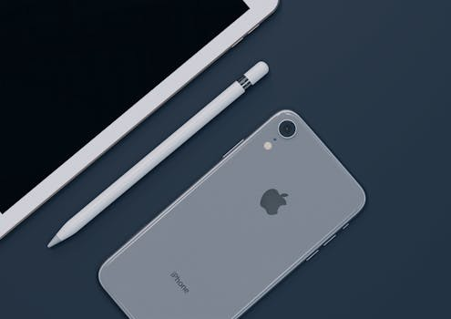
The iphone's handoff feature lets
The iPhone's Handoff feature lets users seamlessly switch between devices.
The iPhone's Sidewalk feature enables communication between nearby Apple devices.
The iPhone's camera offers ProRAW and ProRes video recording capabilities.
The iPhone's Face ID feature adapts to changes in the user's appearance over time.
The iPhone's dual SIM capability supports both physical and eSIM cards.

Slide 13

The iphone's truedepth camera enables
The iPhone's TrueDepth camera enables Face ID, Animoji, and Portrait mode features.
The iPhone's LiDAR scanner enhances augmented reality experiences and improves camera focus.
The iPhone's MagSafe technology allows for easy attachment of magnetic accessories.
The iPhone's ceramic shield offers four times better drop performance than previous models.
The iPhone's battery life has improved significantly, with the iPhone 12 Pro Max lasting up to 20 hours of video playback.

Slide 14
The iphone supports fast charging,
The iPhone supports fast charging, with the ability to charge up to 50% in just 30 minutes.
The iPhone's A14 Bionic chip delivers industry-leading performance and efficiency.
The iPhone's camera system includes a new ultra-wide lens for capturing stunning landscape photos.
The iPhone's Night mode allows for improved low-light photography.
The iPhone's Deep Fusion technology combines multiple images for enhanced detail and sharpness.

Slide 15
Image References
Photo by Zana Latif via Pexels
Photo by Avinash Kumar via Pexels
Photo by Leif Bergerson via Pexels
Photo by Sami Abdullah via Pexels
Photo by cottonbro studio via Pexels
Photo by 祝 鹤槐 via Pexels
Photo by Tima Miroshnichenko via Pexels
Photo by Jakub Zerdzicki via Pexels
Photo by Stefan Coders via Pexels
Photo by cottonbro studio via Pexels
Photo by Nana Dua via Pexels
Photo by Gustavo Fring via Pexels
Photo by Sami Abdullah via Pexels

