Slide 1
Turing
Generated by Slide Generator AI

Slide 2
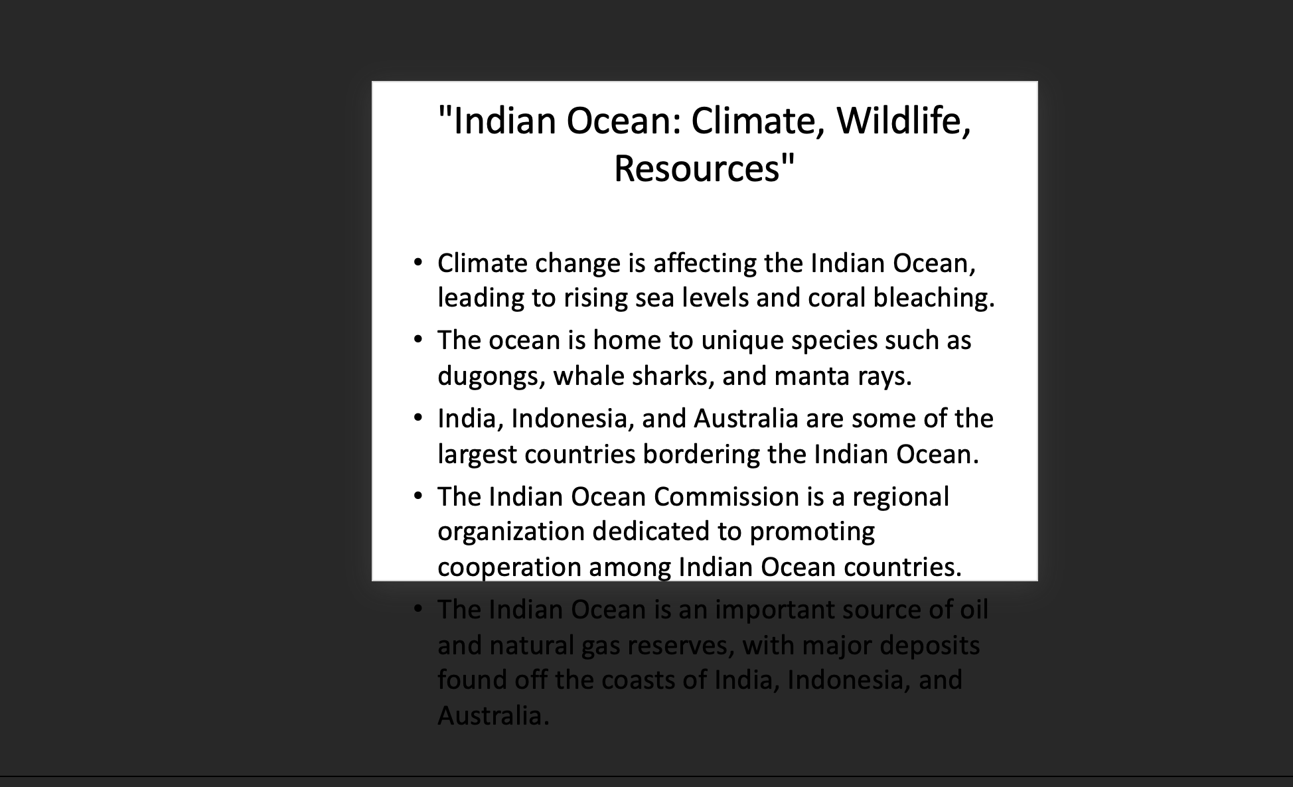
Turing was a mathematician and
Turing was a mathematician and computer scientist.
He is considered the father of theoretical computer science.
Alan Turing was born in London in 1912.
He studied at Cambridge University.
Turing is best known for his work on codebreaking during WWII.

Slide 3

He developed the bombe machine
He developed the Bombe machine to crack the German Enigma code.
His work helped Allied forces win the war.
Turing also formalized the concept of algorithms and computation.
He proposed the concept of the Turing machine.
The Turing machine is a theoretical model of computation.

Slide 4
It consists of a tape,
It consists of a tape, a head, and a set of rules.
Turing's work laid the foundation for modern computer science.
He also contributed to the field of artificial intelligence.
Turing proposed the Turing test for intelligence.
The Turing test evaluates a machine's ability to exhibit human-like behavior.

Slide 5
Turing's work on artificial intelligence
Turing's work on artificial intelligence continues to influence the field today.
In 1950, Turing published a paper on computing machinery and intelligence.
This paper is considered a landmark in the field of AI.
Turing was also a pioneer in the early development of computer programming.
He worked on early computers like the ACE and Manchester Mark 1.

Slide 6
Turing was appointed obe for
Turing was appointed OBE for his contributions to codebreaking.
Despite his accomplishments, Turing faced discrimination for his homosexuality.
In 1952, Turing was prosecuted for "gross indecency."
He was given the choice of imprisonment or chemical castration.
Turing chose chemical castration.

Slide 7
Turing's conviction led to the
Turing's conviction led to the revocation of his security clearance.
He was barred from working on sensitive government projects.
Turing died in 1954 at the age of 41.
The cause of death was ruled as cyanide poisoning.
Turing's death was officially ruled as suicide.

Slide 8
However, some believe foul play
However, some believe foul play was involved.
In 2009, the UK government issued a formal apology for Turing's treatment.
In 2013, Turing was granted a posthumous royal pardon.
Turing's life was adapted into the film "The Imitation Game."
The film brought renewed interest in Turing's work and legacy.

Slide 9
Turing's contributions to cryptography have
Turing's contributions to cryptography have had a lasting impact.
His work laid the foundation for modern encryption and cybersecurity.
The Turing Award is named in his honor.
The Turing Award is considered the "Nobel Prize of computing."
Turing's legacy continues to inspire future generations of computer scientists.

Slide 10
His work on computation has
His work on computation has influenced fields beyond computer science.
Turing's ideas have implications for philosophy and cognitive science.
He was a pioneer in the study of machine intelligence.
Turing's work helped shape the modern world of technology and computing.
His mathematical theories have practical applications in software engineering.

Slide 11
Turing's contributions expanded the possibilities
Turing's contributions expanded the possibilities of what machines can do.
His work on logic and computation revolutionized the field of mathematics.
Turing was a visionary who foresaw the potential of computers to change society.
His ideas have inspired innovations in robotics and automation.
Turing's work on computation has influenced the development of AI.

Slide 12
He believed in the possibility
He believed in the possibility of machines exhibiting human-like intelligence.
Turing's theories challenged traditional notions of human cognition.
His work on algorithms has practical applications in data analysis.
Turing's legacy extends beyond his groundbreaking research in computer science.
His work laid the foundation for modern computing and information technology.

Slide 13
Turing's intellectual curiosity led him
Turing's intellectual curiosity led him to explore diverse fields of study.
He was a polymath who made significant contributions to multiple disciplines.
Turing's impact on cryptography and cybersecurity is felt to this day.
His insights into machine intelligence have influenced the field of AI research.
Turing's work on computation has philosophical implications for the nature of mind.

Slide 14
His ideas have inspired advancements
His ideas have inspired advancements in human-computer interaction.
Turing's pioneering work on algorithms has practical applications in software development.
His theoretical contributions have had a lasting impact on the field of computer science.
Turing's legacy continues to shape the future of technology and innovation.
His groundbreaking research has paved the way for advancements in computing.

