Slide 1
CampusFix
REPORT
A Role-Based College Complaint and
Maintenance Management System
ASSIGN
Fourth-Year CSE Mini Project | Academic Session 2026-27
[Student Name] • [Roll Number]
Guide: [Faculty Guide Name]
RESOLVE
Notes:
Introduce CampusFix as a working local Django application that connects Students, Maintenance Staff, and Administrators through one accountable workflow.

Slide 2
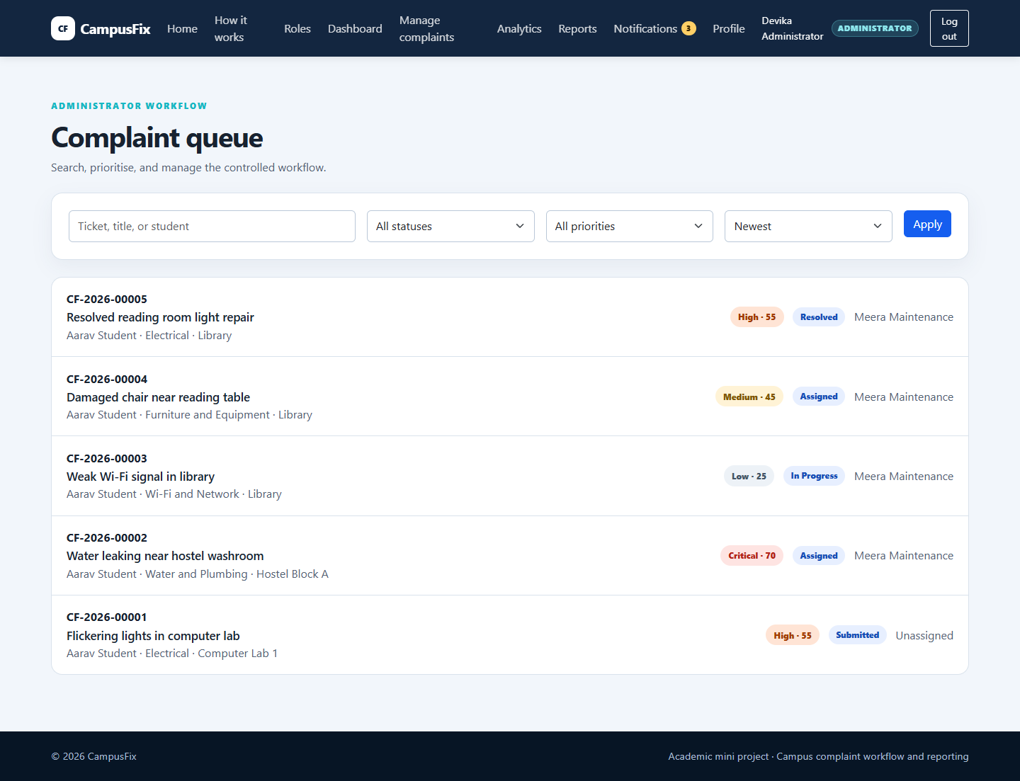
Problem Statement
Informal reporting loses ownership, status, and evidence
A maintenance issue may be reported quickly—then become difficult to trace.
• No unique ticket or shared source of truth
• Unclear assignment and responsibility
• No permanent record of status changes
• Students cannot see progress
• Administrators lack workload evidence
02
Notes:
Explain the real operational gap. The project is not just a complaint form; it connects reporting, responsibility, progress, and evidence.

Slide 3
Why CampusFix
One shared ticket from report to verified completion
1
Traceability
Unique ticket and permanent timeline
2
Responsibility
Role-specific assignment and actions
3
Visibility
Notifications, analytics, and reports
Outcome: every accepted complaint has an owner, a state, and an inspectable history.
03
Notes:
Connect each need to a visible implementation: ticket number, assigned Staff, timeline, notifications, and reports.

Slide 4
Project Objectives
• Centralise campus maintenance complaints
• Enforce Student, Staff, and Administrator permissions
• Control the complaint lifecycle through valid transitions
• Preserve permanent workflow history
• Provide transparent priority and private notifications
• Measure outcomes through feedback, analytics, and reports
• Verify behaviour with automated and live HTTP tests
04
Notes:
Present the objectives as measurable implementation targets. Each objective has a corresponding working screen or automated test.

Slide 5
Existing Problems and CampusFix Solution
Existing approach
CampusFix
Verbal or scattered messages
→
One searchable ticket record
No clear owner
→
Controlled assignment to active Staff
Status known only by asking
→
Live status, timeline, notifications
Subjective urgency
→
Explainable priority score
No review evidence
→
Analytics, feedback, CSV, print reports
05
Notes:
Avoid claiming that CampusFix replaces an existing institutional product. Compare the common informal process with the implemented workflow.

Slide 6
User Roles
Permissions are enforced on the server
STUDENT
Submit and track own tickets
Submit feedback
MAINTENANCE STAFF
View assigned work
Start and resolve
ADMINISTRATOR
Assign and control workflow
Analytics and reports
Server-side role, ownership, and assignment checks
06
Notes:
Emphasise that navigation visibility is only usability. Security comes from decorators plus ownership and assignment checks in the view and service layers.

Slide 7
System Architecture
ORM
SQLite
Database
HTTP
Django Application
Views • Forms • Services
Users
Browser
Django Templates
Bootstrap UI
Local Media
Storage
validated files
07
Notes:
Describe the request path in plain language. The application is a modular Django monolith: simple to deploy locally and easy to test.

Slide 8
Complaint Lifecycle and Role Workflow
Administrator
Maintenance Staff
Submitted
Under Review
Assigned
In Progress
Resolved
Closed
Rejected
Every successful transition appends a permanent history event.
08
Notes:
Walk left to right. Administrators review and assign, assigned Staff start and resolve, and Administrators close. Rejection is controlled from the early states.

Slide 9
Database Design
Seven connected models preserve identity, workflow, and evidence
ComplaintHistory
User
many events
student / assigned Staff
Complaint
ComplaintCategory
Notification
CampusLocation
ComplaintFeedback
zero or one feedback
09
Notes:
Complaint is the central model. Reference data keeps categories and locations consistent. History, notification, and feedback records provide traceability and outcomes.

Slide 10
Technology Stack
Python
Django 6.1.1
SQLite
Application language
Auth • ORM • forms • tests
Local transactional database
Bootstrap 5.3.8
Chart.js 4.4.7
Pillow 11.3.0
Responsive interface
Administrator charts
Image content validation
10
Notes:
Give one reason for each technology. SQLite is appropriate for the local academic scope; production would normally use PostgreSQL and managed media.

Slide 11
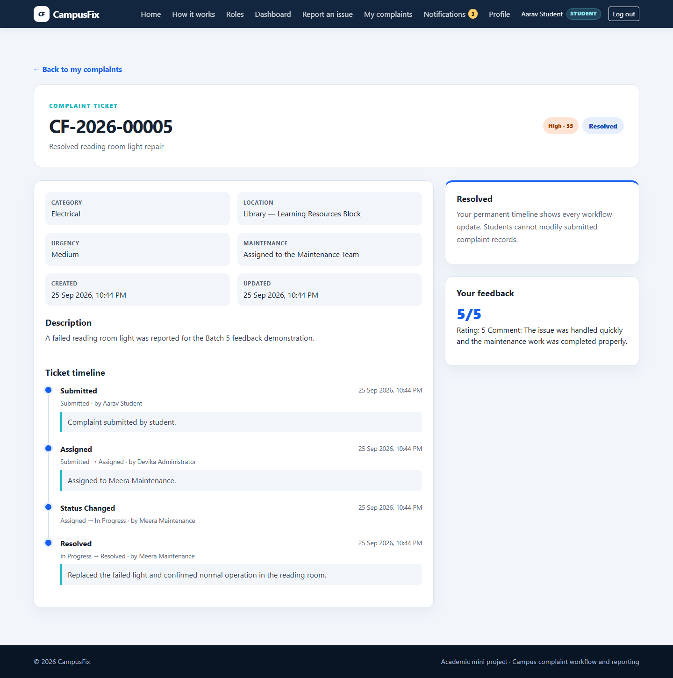
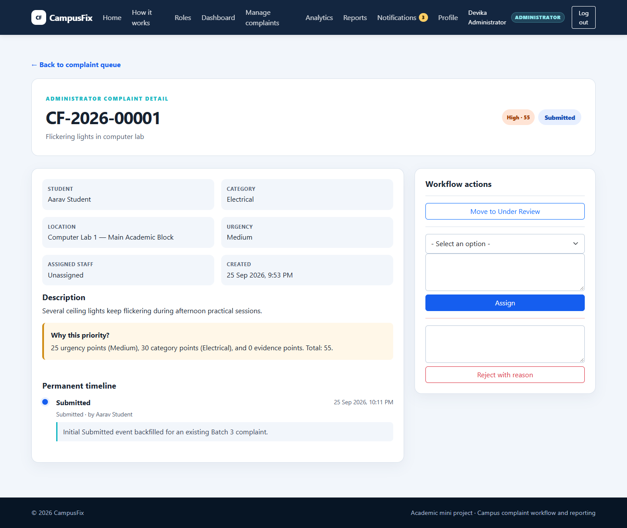
Major Features
Student evidence and timeline
Administrator controls and audit trail
11
Notes:
Point out the same ticket information seen from different authorised roles. The Student view is read-only; the Administrator view exposes only currently valid actions.

Slide 12
Priority Scoring and Notifications
Urgency
10 • 25 • 40
Low <30
Medium 30–49
High 50–69
Critical ≥70
Total Score
Category
10 to 40
Image evidence
+5
Notifications are private database records created for affected users and protected by deduplication keys.
12
Notes:
State clearly that this is transparent rule-based scoring, not machine learning. The system stores an explanation with each complaint.

Slide 13
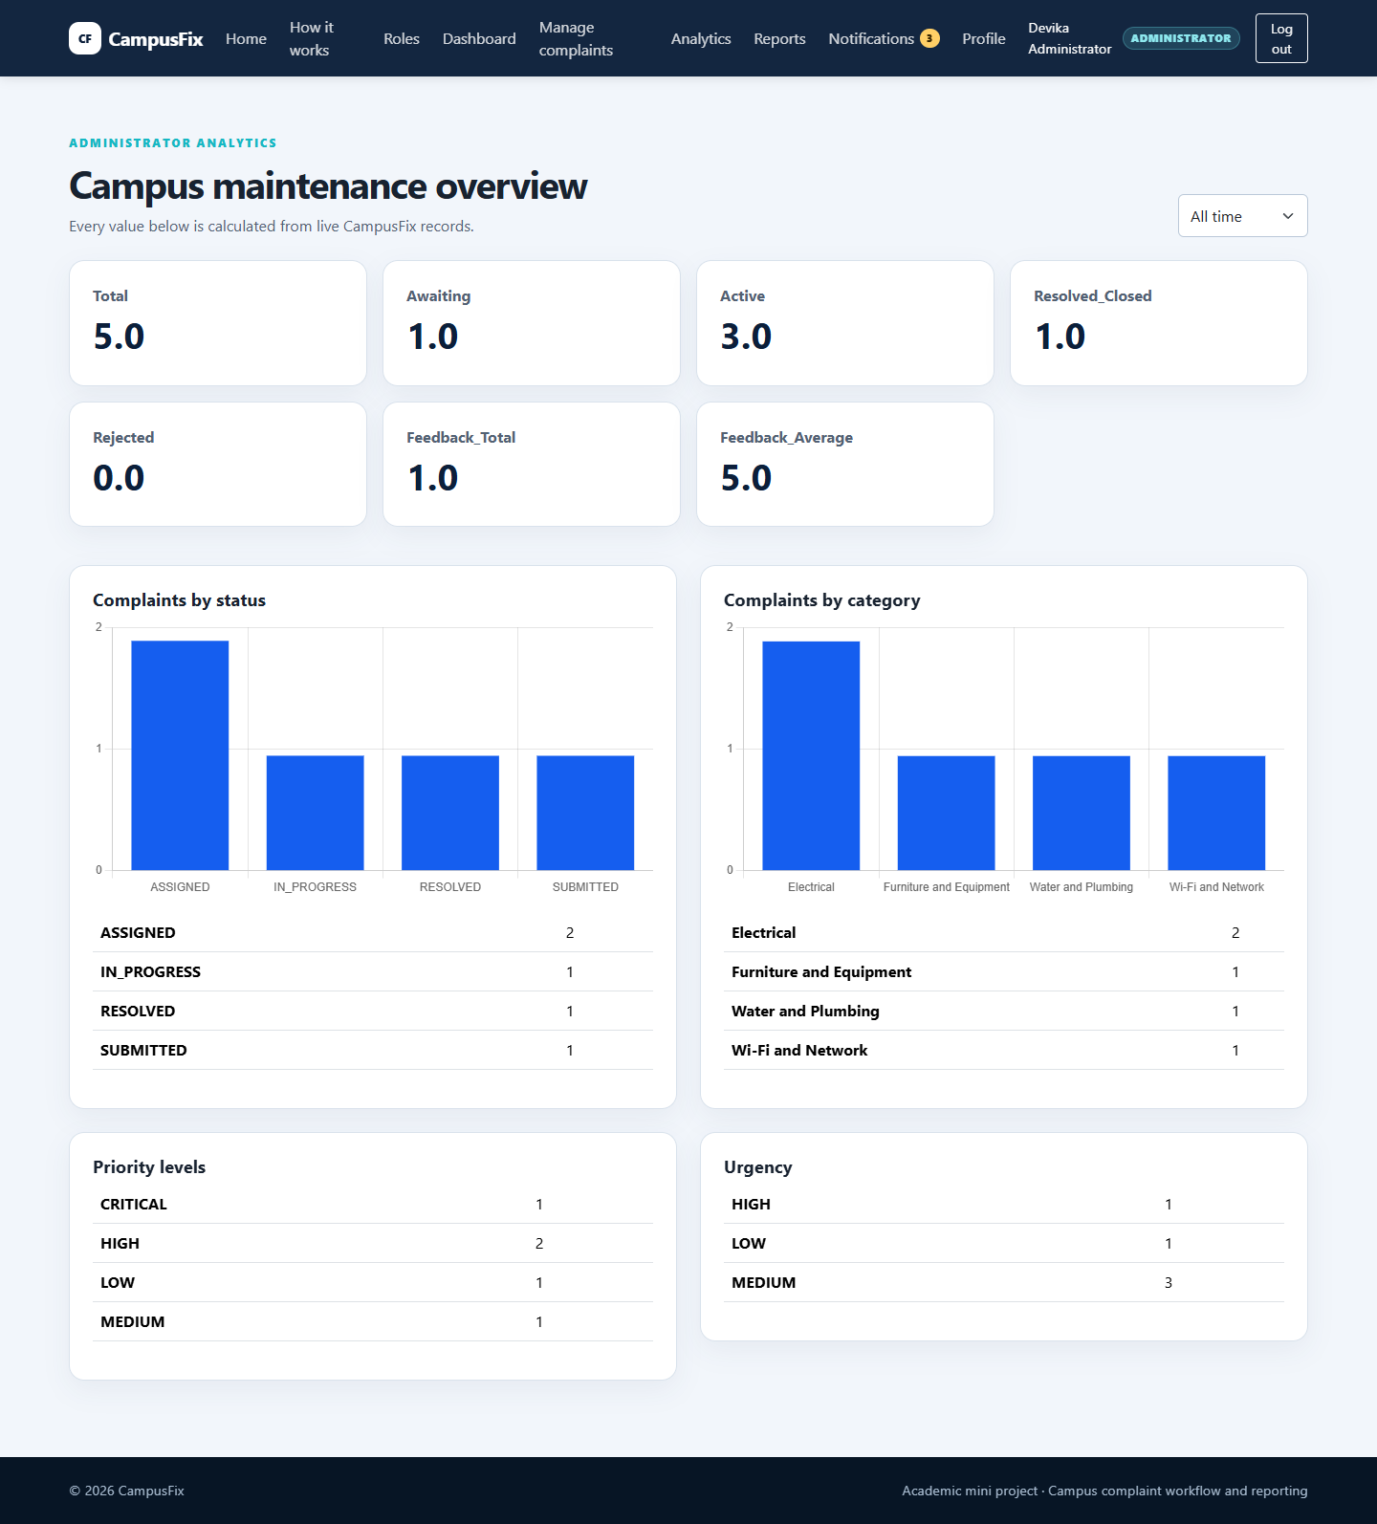
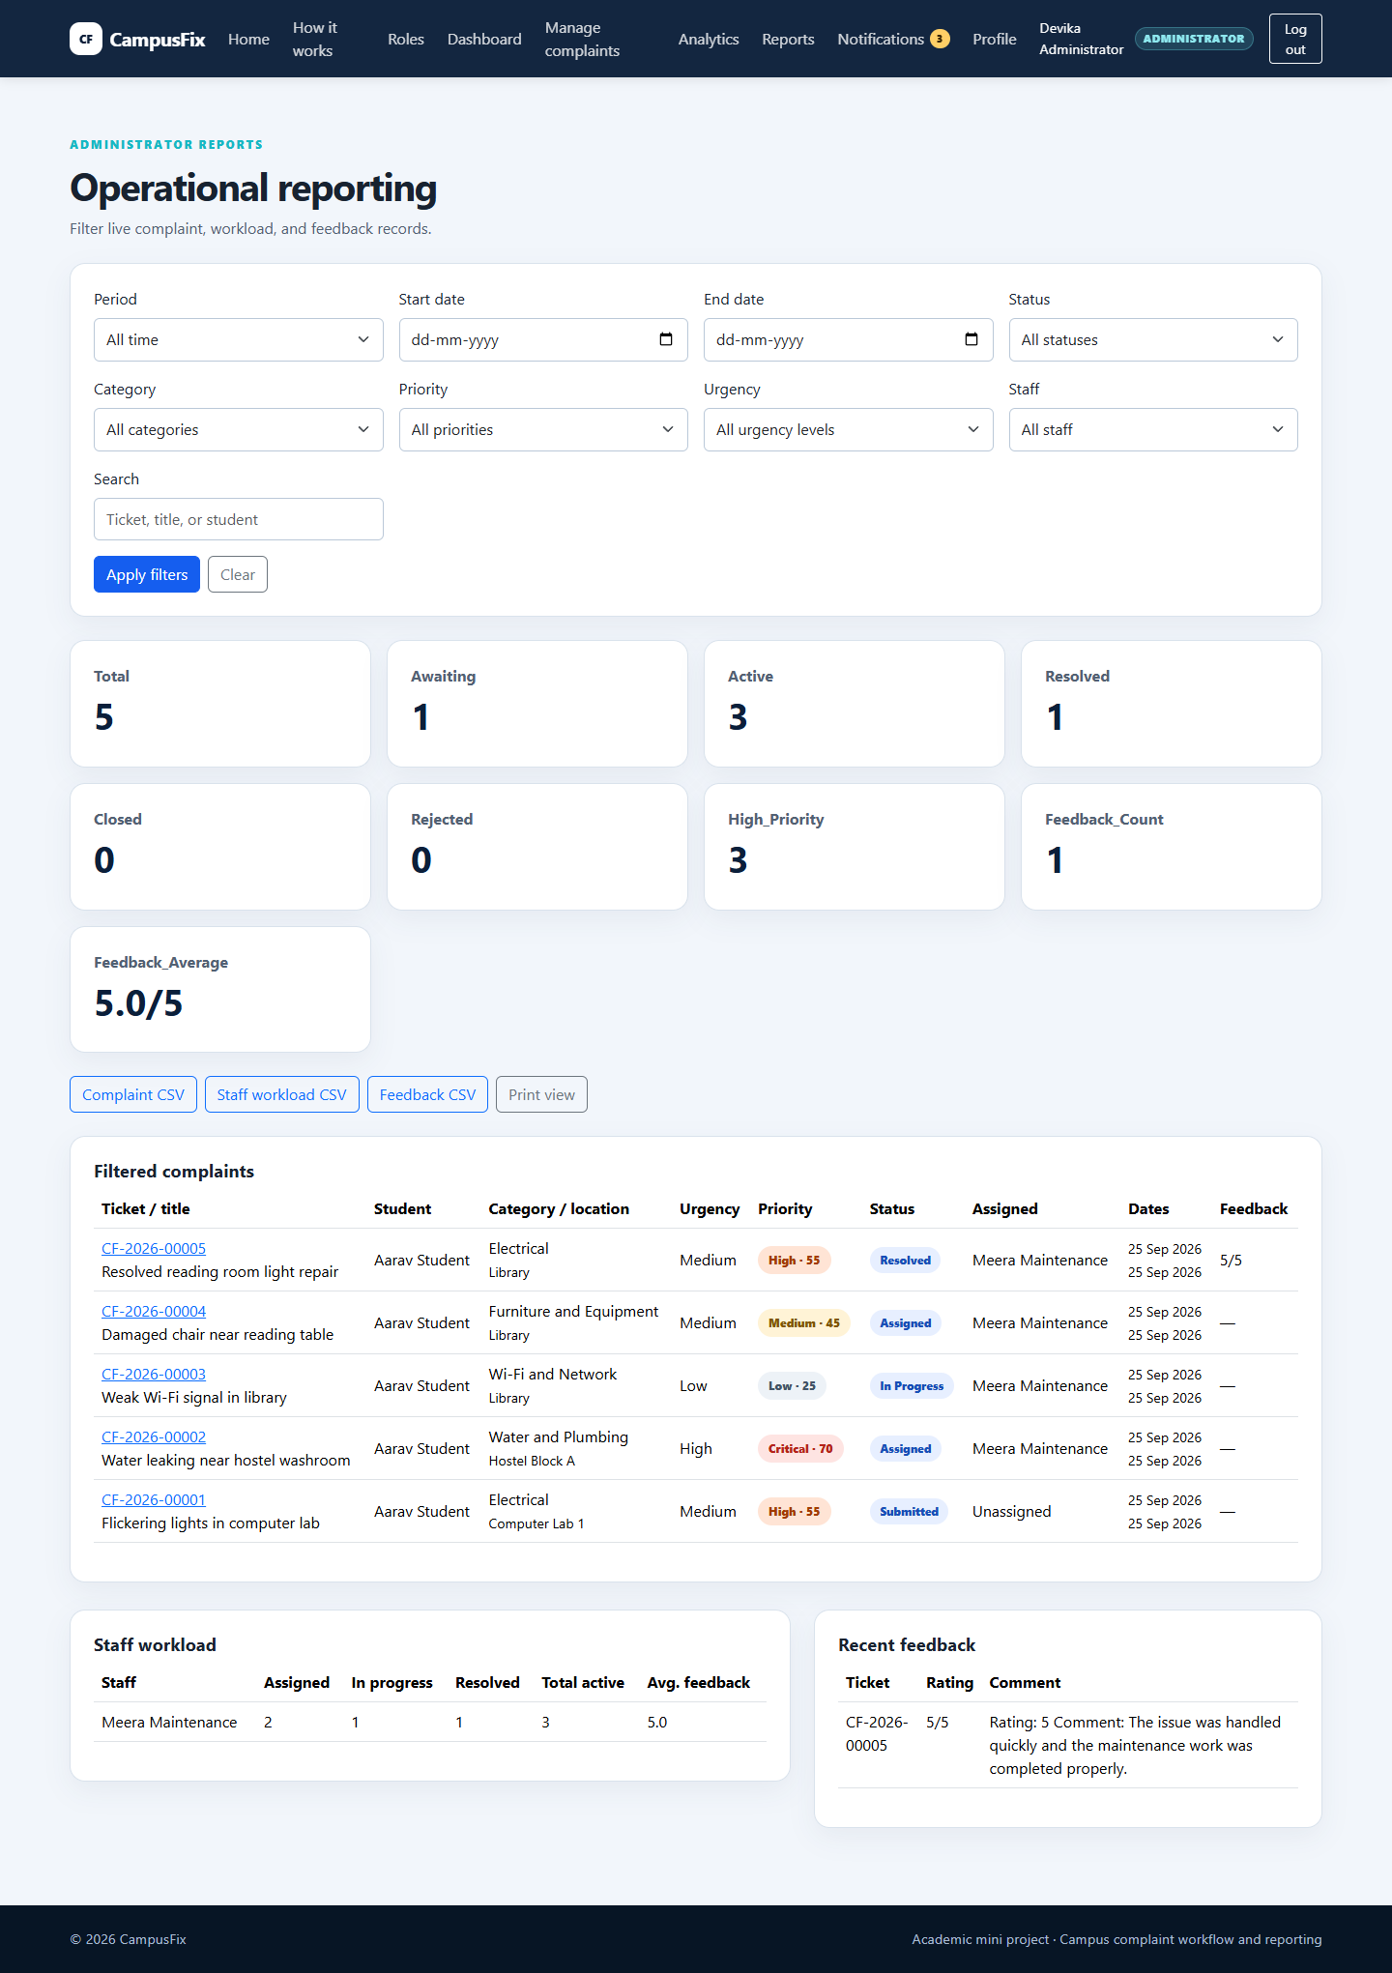
Analytics and Reporting
Live database records become operational evidence
Charts plus accessible tables
Filters • workload • feedback • CSV • print
13
Notes:
Explain that the report filters are reused for totals, table rows, print output, and all three exports. Non-administrators receive HTTP 403.

Slide 14
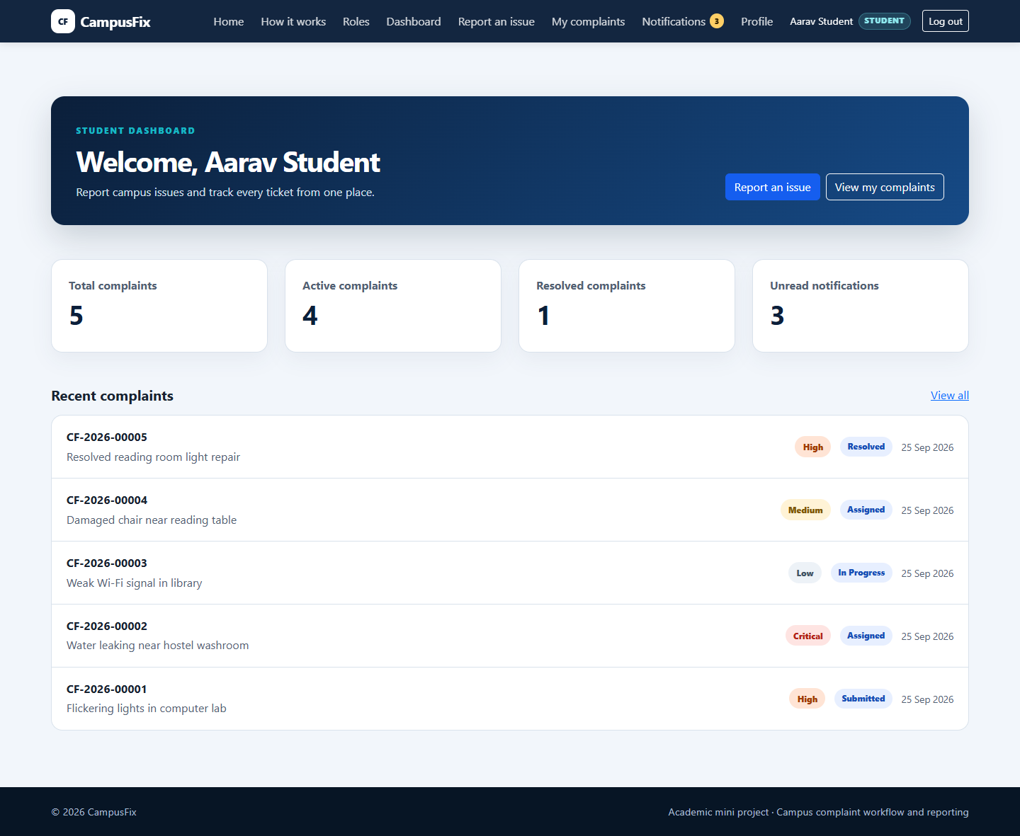
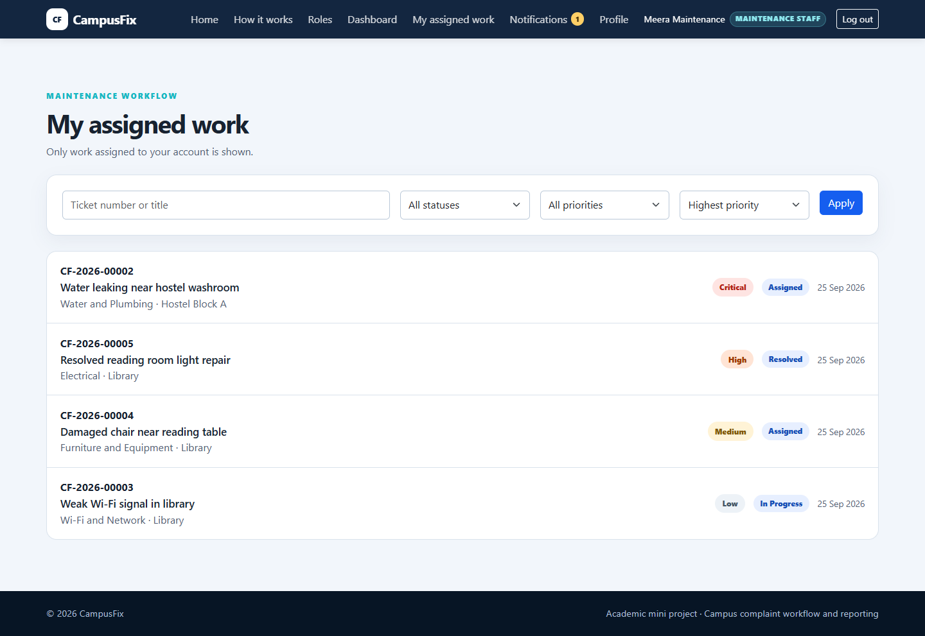
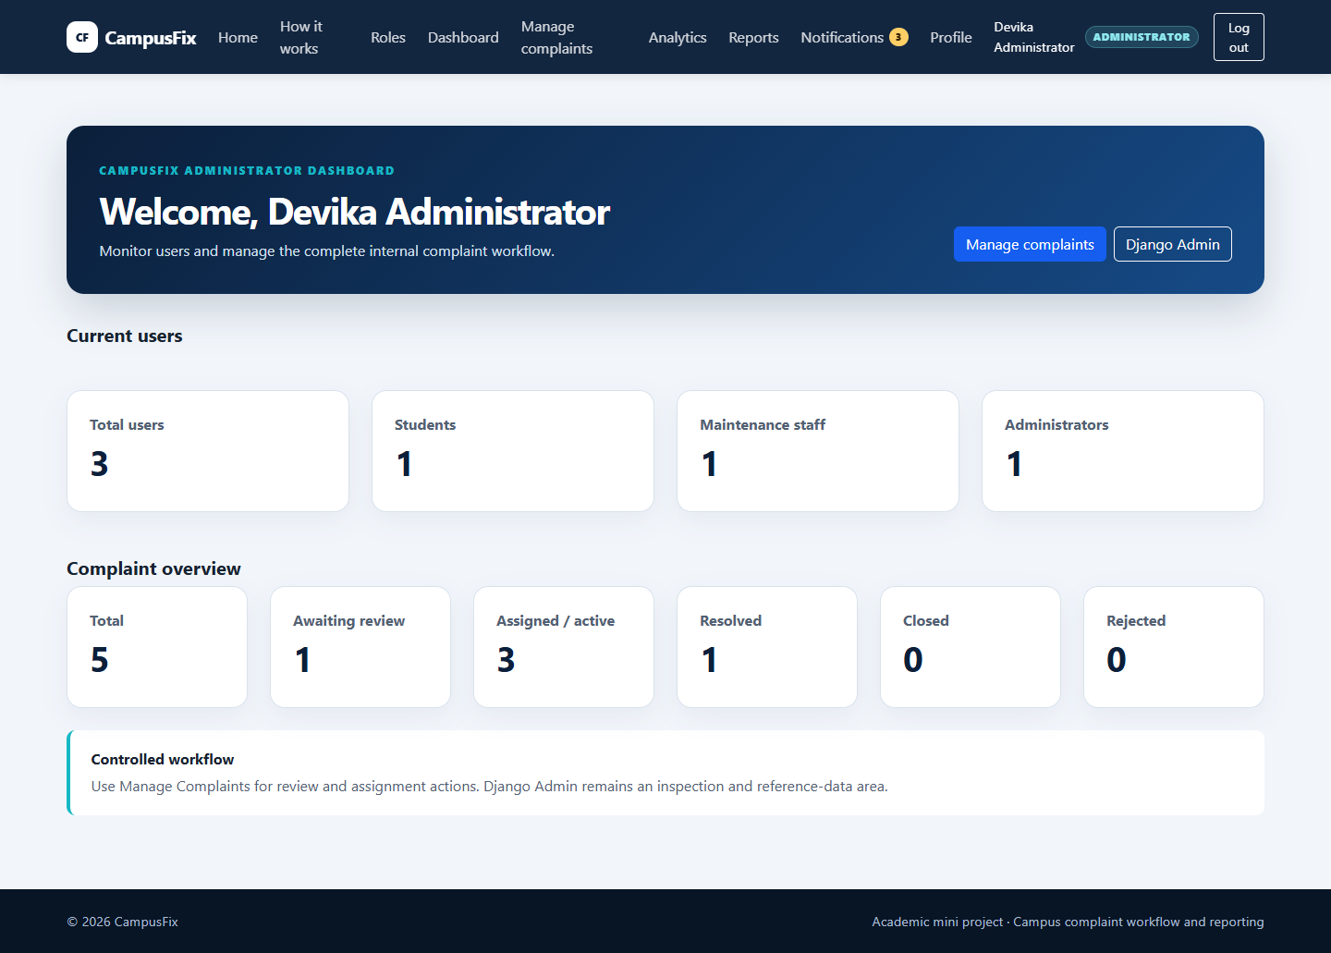
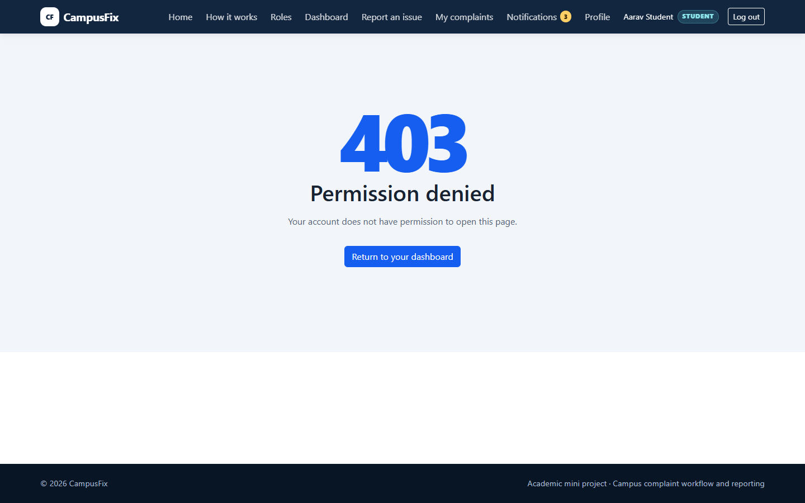
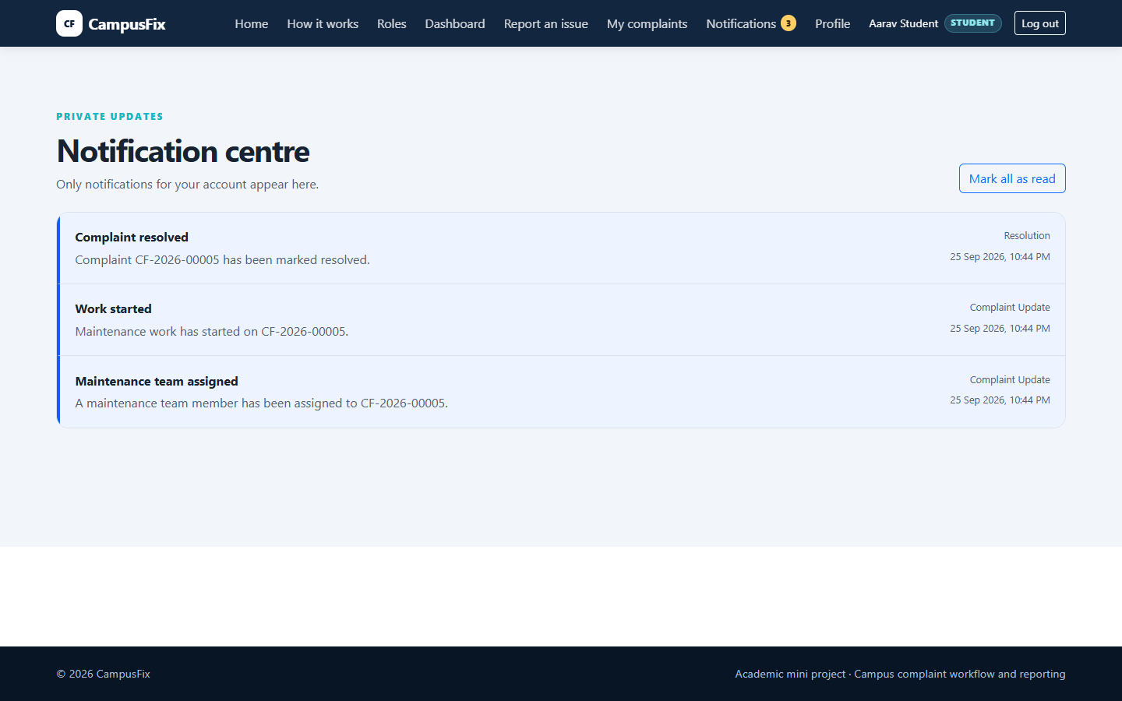
Working Demonstration Evidence
14
Notes:
Use this slide as evidence that each role has a distinct, working interface. The 403 screen proves server-side rejection of cross-role access.

Slide 15
Testing and Results
End-of-Batch-6 verification
84
0
0
200
403
tests passed
system-check issues
missing migrations
admin report HTTP
student / staff reports
• Model, form, page, ownership, and permission tests
• Controlled workflow and permanent history tests
• Notification, feedback, analytics, and reporting tests
• CSV headers, filters, UTF-8, and formula-safety tests
• Live no-reloader server smoke checks
15
Notes:
Use the exact verified figures. The full suite passed 84 tests in 131.552 seconds after the final Batch 6 correction.

Slide 16
Conclusion and Future Scope
COMPLETED IMPLEMENTATION
FUTURE SCOPE
• Role-based end-to-end complaint workflow
• Permanent timeline and private notifications
• Explainable priority, feedback, analytics, and reports
• Responsive interface and verified security boundaries
• Email and SMS notifications
• Mobile or progressive web application
• PostgreSQL, cloud media, HTTPS, backups, and monitoring
• Predictive maintenance and richer service analytics
• Multilingual interface
Current implementation remains local and intentionally stops before production deployment.
16
Notes:
Conclude with what is working today, then separate future work clearly. Do not describe future items as implemented features.

Slide 17
Thank You
?
Questions and Discussion
CampusFix
[Student Name] • [Roll Number]
Notes:
Invite questions. If unsure, connect the question to a visible feature or tested rule and avoid claiming functionality outside the accepted scope.

