Slide 1
CAPSTONE PROJECT · DATA ANALYTICS · WARSAW, POLAND
Warsaw EV Charging
Network Analysis
SQL Analysis · Power BI Dashboard
Presented by
Shivam Dhunotiya
114K
65
18
8K
Data Analyst · Warsaw EV Infrastructure Team
Sessions
Stations
Districts
Customers
Tool Stack: MySQL · Power BI ·

Slide 2
PART ONE
SQL Analysis
14 queries — from basic exploration to advanced infrastructure gap analysis
Q1–Q5
Q6–Q10
Q11–Q14
Basic
Intermediate
Advanced
Districts · Stations · Plugs · Sessions · Avg kWh
Revenue · Energy · Top Stations · Cost by Tier
EV vs Plugs Gap · Demand per EV · Readiness Ranking

Slide 3
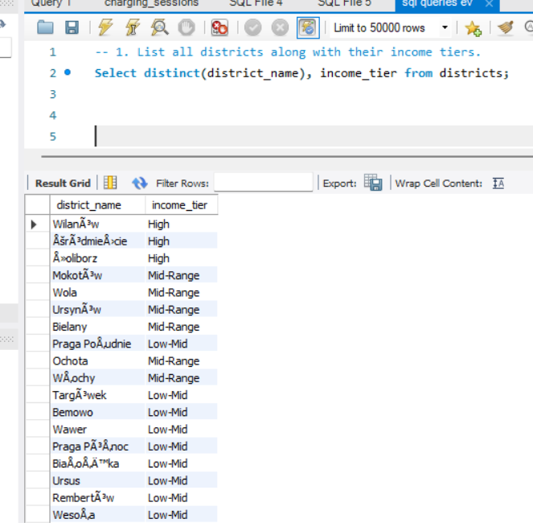
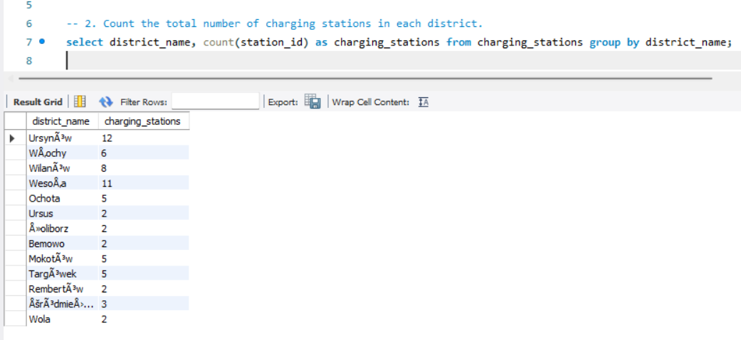
SQL · Q1 & Q2 · BASIC LEVEL
Districts, Income Tiers & Station Count
Setting the foundation — understanding how Warsaw's districts and stations are distributed
Query 1 — Districts & Income Tiers
Query 2 — Stations per District
💡 3 income tiers across 18 districts — High: 3, Mid-Range: 6, Low-Mid: 9. Income tier directly shapes charging cost and revenue per session.
💡 Ursynów leads with 12 stations, Wesoła has 11. Several districts have only 2, and 5 districts have zero stations entirely — a clear infrastructure gap.

Slide 4
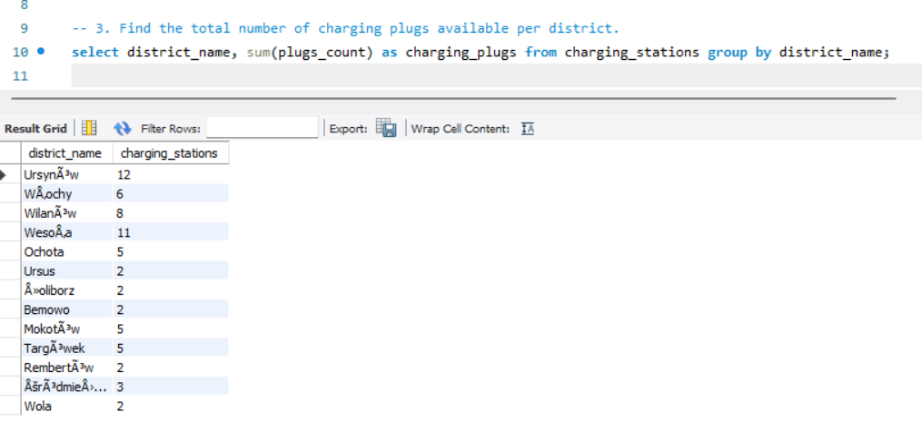
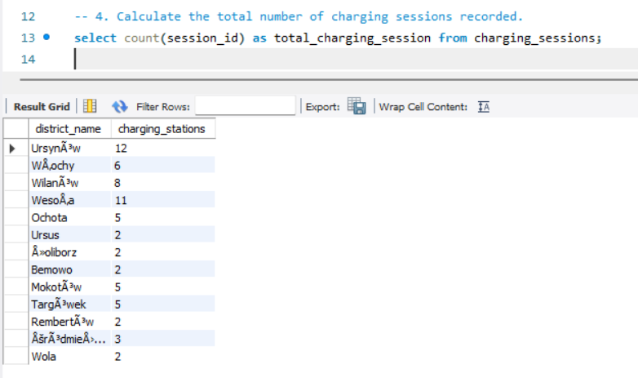
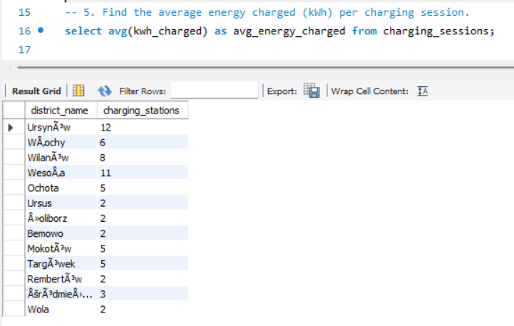
SQL · Q3, Q4 & Q5 · BASIC LEVEL
Plugs, Sessions & Average Energy
Core network metrics — how many plugs exist, how many sessions happened, and how much energy was delivered
Q3 — Total Plugs per District
Q4 — Total Charging Sessions
Q5 — Avg Energy per Session (kWh)
💡 Ursynów has 72 plugs, Wesoła 66. Total of 390 plugs across 13 districts — 5 districts have zero plug coverage.
💡 114,000 total sessions recorded across all stations. This is a substantial dataset showing strong and consistent EV usage across Warsaw.
💡 39.13 kWh average per session. Premium EVs like Audi e-tron (62 kWh) and Porsche Taycan (60 kWh) push this average up significantly.

Slide 5
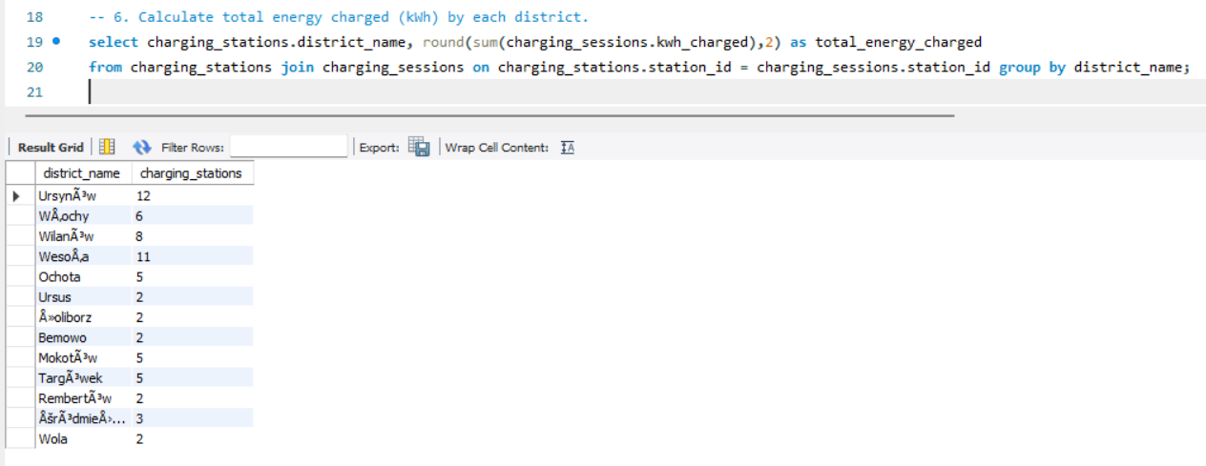
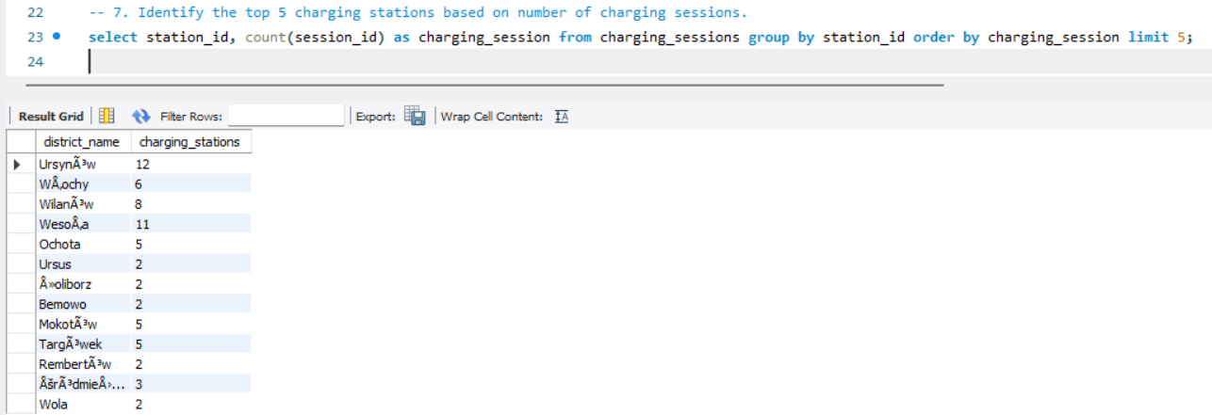
SQL · Q6 & Q7 · INTERMEDIATE LEVEL
Energy by District & Top Stations
Which districts deliver the most energy, and which stations handle the highest session load?
Q6 — Total Energy Charged (kWh) by District
Q7 — Top 5 Stations by Session Count
💡 Ursynów leads with 820,630 kWh, followed by Wesoła at 767,641 kWh. Together they account for 36% of all energy delivered across the network.
💡 Top 5 stations range from 1,811 to 1,856 sessions — a very tight spread of just 45, which shows these high-demand stations are all working at near-equal capacity.

Slide 6
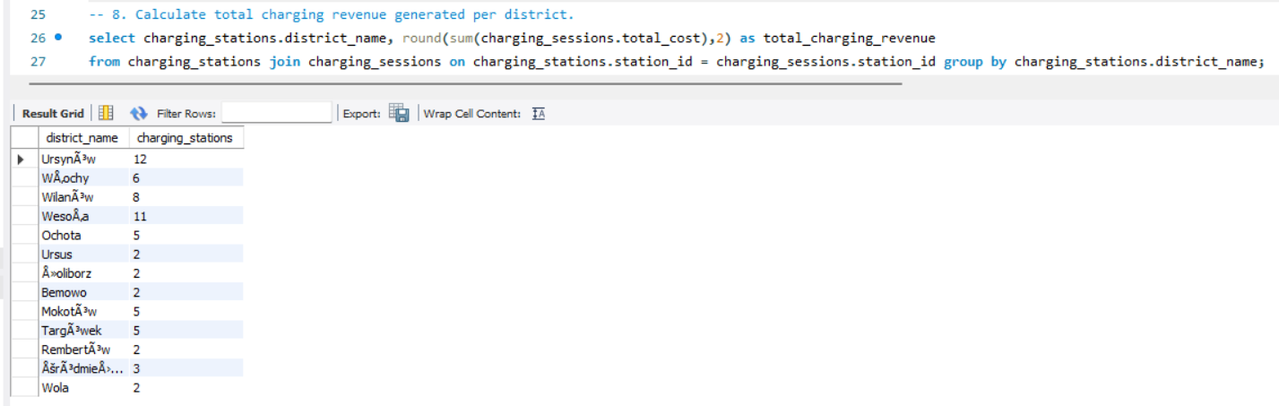
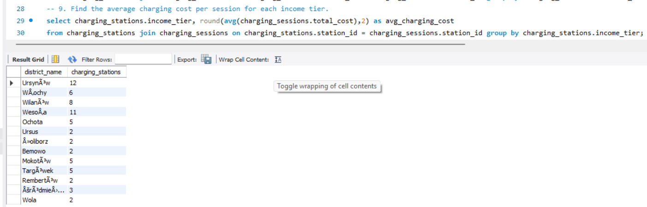
SQL · Q8 & Q9 · INTERMEDIATE LEVEL
Revenue by District & Cost by Income Tier
Where is the money coming from — and which customer segment pays the most per session?
Q8 — Total Revenue per District (zł)
Q9 — Avg Session Cost by Income Tier (zł)
💡 Ursynów generated zł2.10M and Wesoła zł1.96M — together 36% of total zł11.42M revenue. Revenue closely mirrors session volume and plug count.
💡 High-income customers pay zł142.45 per session — that's 89% more than Low-Mid customers (zł75.19). Yet High-income zones have the fewest stations. Biggest missed revenue opportunity.

Slide 7
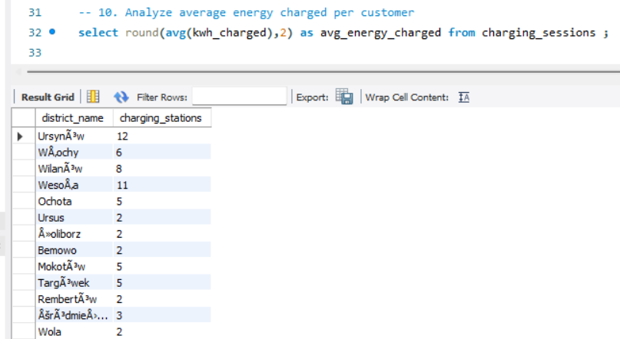
SQL · Q10 · INTERMEDIATE LEVEL
Average Energy Charged per Customer
Understanding how much energy each individual customer consumes across their lifetime on the network
Query 10 — Average kWh Charged per Customer
557.53 kWh
Average energy charged per customer across the dataset period — equivalent to roughly 9 full charge cycles for a standard 60 kWh battery.
What this means
This figure tells us customers are returning frequently. An avg of 557 kWh per customer, with 114K sessions and 8K customers = ~14 sessions per customer on average.
Retention signal
High average energy per customer is a strong indicator of loyal, repeat usage. These customers are good candidates for subscription or loyalty pricing programs.

Slide 8
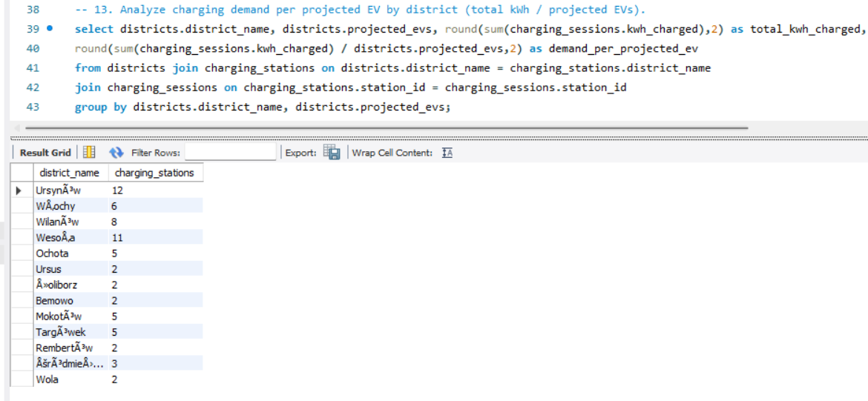
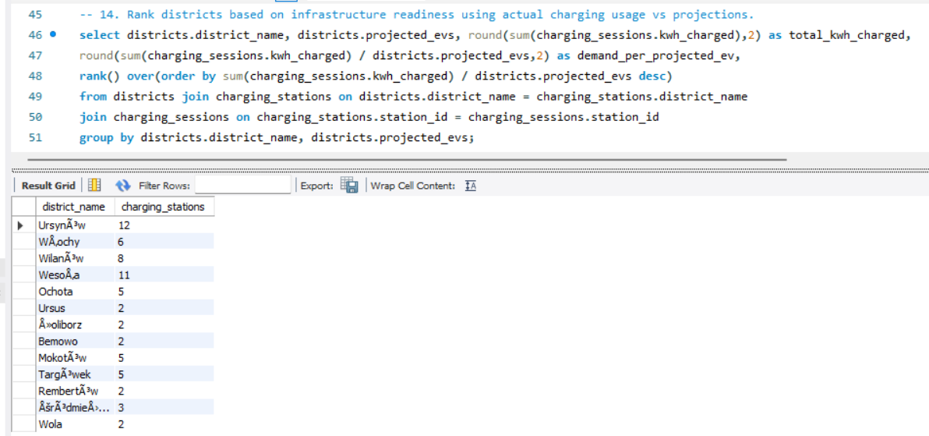
SQL · Q11 & Q12 · ADVANCED LEVEL
Projected EVs vs Available Plugs — The Gap Problem
Comparing what's planned against what exists: Warsaw's infrastructure readiness crisis in numbers
Q11 — Projected EVs vs Actual Plugs per District
Q12 — Districts Where Projected EVs Exceed Plugs
💡 37,100 EVs projected vs only 390 actual plugs. Every single district has far more EVs coming than plugs available — this is a city-wide infrastructure emergency.
💡 All 18 districts flagged. Worst: Mokotów (3,394 EV gap), Wola (3,200), Wilanów (3,006). 5 districts have zero plugs with thousands of EVs on the way.

Slide 9
SQL · Q13 & Q14 · ADVANCED LEVEL
Demand per Projected EV & Infrastructure Readiness Rank
Which districts are over-served? Which are in crisis? Ranking Warsaw's charging readiness district by district
Q13 — kWh Demand per Projected EV
Q14 — Infrastructure Readiness Ranking
💡 Wesoła has 1,096 kWh per projected EV — it's massively over-served. Most districts average well below 300 kWh/EV, showing just how thin coverage is across the city.
💡 Wesoła ranks #1 at 314% readiness — the only over-served district. Mokotów, Wola, and 5 zero-coverage districts sit at the very bottom of the readiness ladder.

Slide 10
SQL ANALYSIS · SUMMARY
6 Things the Queries Told Me
The data doesn't lie — here's what 14 SQL queries uncovered about Warsaw's EV network
5 Districts Have Zero Coverage
Ursynów Carries the Network
High-Income Pays 89% More
Bielany, Praga Południe, Białołęka, Praga Północ & Wawer have no stations despite projecting 9,300+ EVs combined.
12 stations, 72 plugs, zł2.10M revenue — one district contributing ~18% of total network output.
zł142.45 vs zł75.19 per session. But they have the fewest stations — that's the biggest missed revenue opportunity.
All 18 Districts Are Under-Plugged
Wesoła Is Over-Served at 314%
Mid-Range = Best ROI for Expansion
37,100 projected EVs, only 390 actual plugs. Total gap = 671 plugs. Every single district is flagged as deficit.
66 actual plugs vs 21 projected. Investment here is saturated — future capital should go elsewhere.
30 stations, 52,323 sessions, zł5.25M revenue (46% of total). Most consistent demand density in the city.

Slide 11
PART TWO
Power BI Dashboard
4 interactive pages — infrastructure, usage, customer behaviour, and revenue planning
Page 1
Page 2
Page 3
Page 4
Infrastructure Overview
Charging Usage & Demand
Customer Behaviour
Revenue & Planning

Slide 12
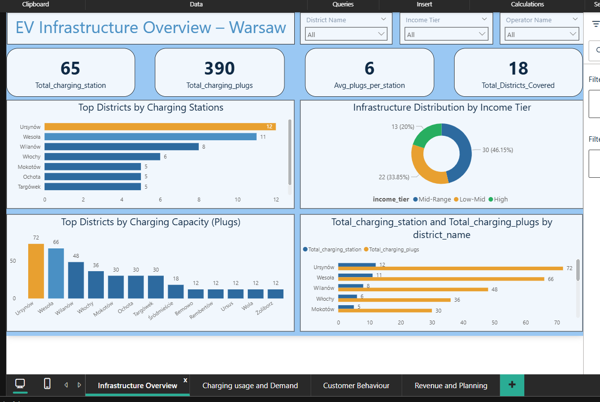
POWER BI · PAGE 1
Infrastructure Overview
Ursynów + Wesoła = 35% of all plugs
Mid-Range tier dominates at 46%
5 districts have zero infrastructure
These 2 districts hold 138 of 390 total plugs.
High-income districts have just 20% of stations despite paying 89% more per session.
Bielany, Praga Pd., Białołęka, Praga Pn., Wawer — completely unserved.

Slide 13
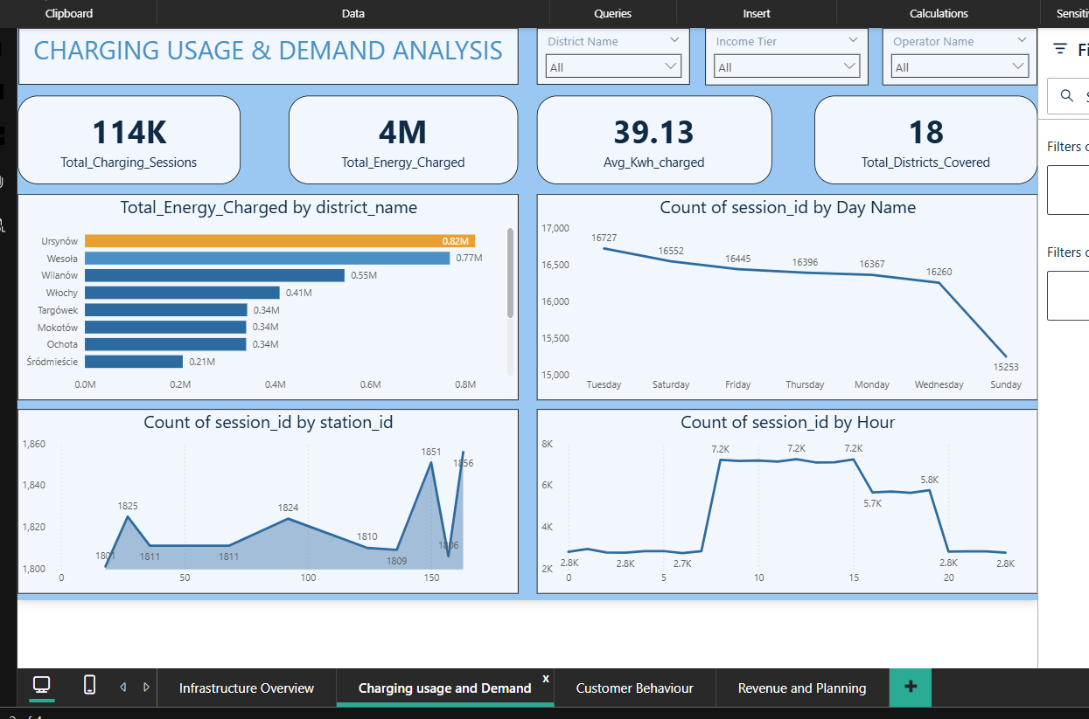
POWER BI · PAGE 2
Charging Usage & Demand Analysis
Midday is peak, not morning commute
Tuesday is the busiest day (16,727)
Ursynów leads energy output at 0.82M kWh
Sessions plateau from 8 AM–3 PM. Noon is the single busiest hour at 7,248 sessions.
Sunday is weakest at 15,253 — just 9% lower. EV charging is a daily habit across the week.
Wesoła is second at 0.77M. Both districts are heavily over-reliant on for network supply.

Slide 14
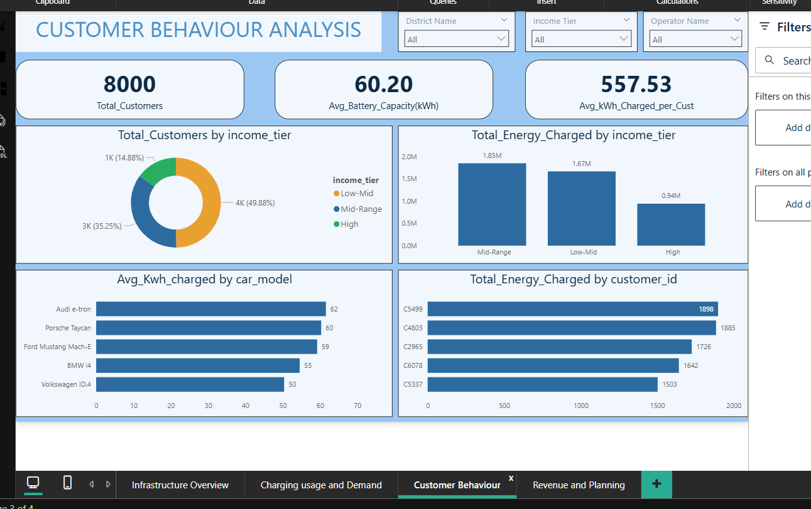
POWER BI · PAGE 3
Customer Behaviour Analysis
Mid-Range customers = biggest segment
Audi e-tron tops energy use at 62 kWh
Customer C5499 consumed 1,898 kWh total
4K customers (49.88%), 1.85M kWh consumed, zł5.25M revenue. The backbone of the network.
Premium EVs (Porsche 60, Mach-E 59) consistently charge more per session — more revenue per visit.
Top 5 customers all above 1,500 kWh. These are power users and prime loyalty program targets.

Slide 15
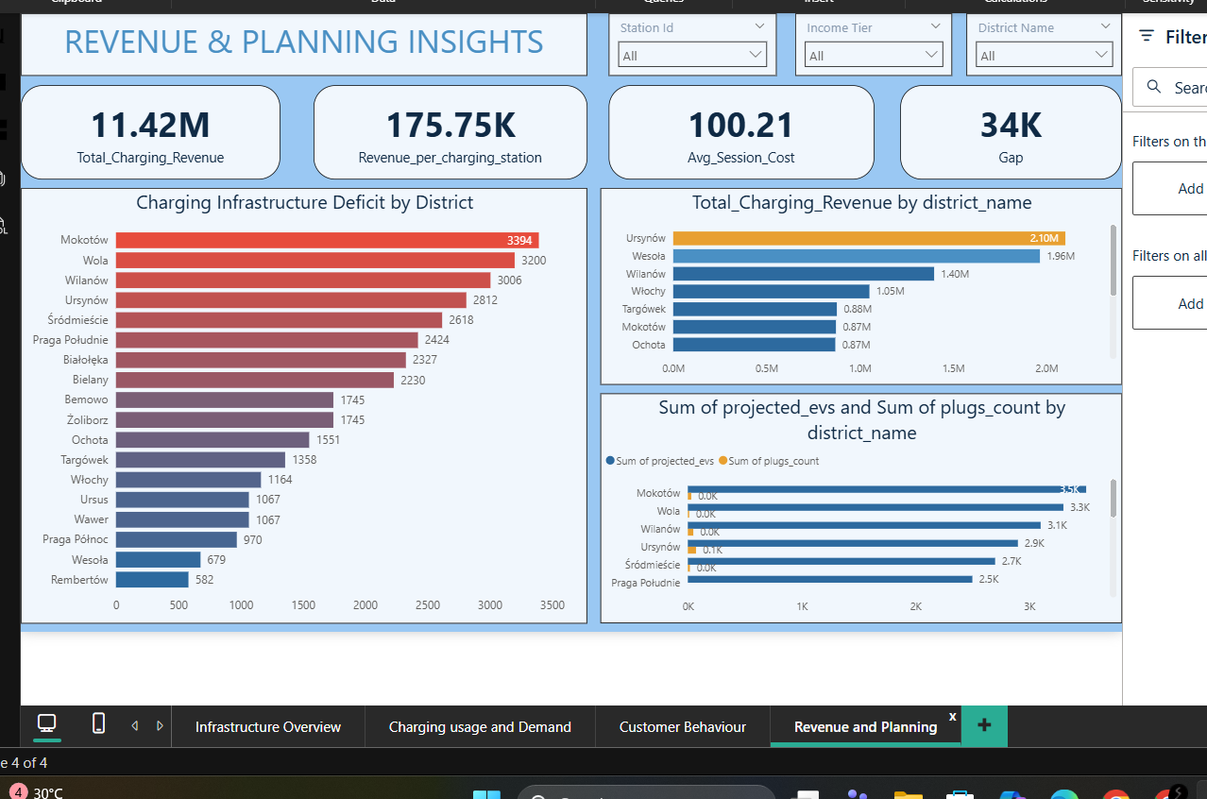
POWER BI · PAGE 4
Revenue & Planning Insights
Mokotów has the largest deficit: 3,394
Ursynów + Wesoła = 36% of revenue
Avg session cost is zł100.21
Wola at 3,200 and Wilanów at 3,006 follow closely. These need immediate infrastructure investment.
zł2.10M + zł1.96M = zł4.06M. The network depends heavily on just 2 districts for revenue.
Revenue per station is zł175.75K. Adding plugs in High-income zones would raise both metrics significantly.

Slide 16
CONCLUSIONS · RECOMMENDATIONS
What I'd Tell Warsaw's EV Infrastructure Team
Five priorities that follow directly from the SQL analysis, dashboard findings, and ML model outputs
01
Deploy stations in 5 zero-coverage districts
02
Expand High-income zones to capture lost revenue
Bielany, Praga Pd., Białołęka, Praga Pn. & Wawer project 9,300+ EVs with zero plugs. This is the single most urgent fix.
High-tier customers pay zł142/session — 89% more than Low-Mid. Adding 100 plugs in Śródmieście, Żoliborz & Wilanów could unlock zł3M+ annually.
03
Implement Dynamic pricing in peak window
04
Redirect Over-Investment Away from Wesoła
'Sessions by Hour' confirms 8 AM–3 PM plateau as peak demand window. Time-of-use pricing here would optimise grid load and increase revenue per session by an estimated 15–20%.
SQL Q14 confirms Wesoła at 314.3% readiness — massively over-served. Station ROI there is saturated. Future capital must flow to the 13 districts below 70% readiness.
05
Scale Mid-Range Districts as Growth Engine
Mid-Range delivers zł5.25M (46% of revenue) from 30 stations. SQL Q8 and PBI Page 4 both confirm this tier has the most consistent demand density and highest predictable ROI for scale.

Slide 17
Thank You
Presented by
Shivam Dhunotiya
Data Analyst · Warsaw EV Infrastructure Team
Warsaw EV Charging Network Analytics · SQL + Power BI · 2026
114K
65
zł11.42M
18
8K
Sessions
Stations
Revenue
Districts
Customers

