Slide 1
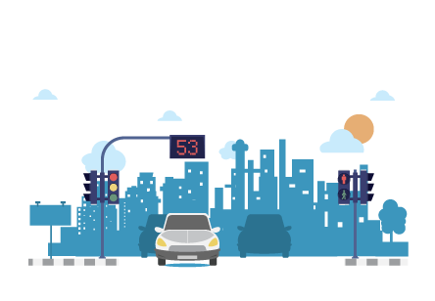
INTRODUCING
EDGE TRAFFIC

Slide 2

Problem Statement
Traffic Management: Develop an IoT and edge computing solution to optimize traffic flow, reduce congestion and enhance safety. Sensors and cameras collect real-time data, and machine learning predicts congestion hotspots. Edge computing provides drivers, traffic operators, and city officials actionable insights.

Slide 3
Solution
Developing an IoT device to control, and monitor traffic flow in a particular lane and also det accidents, informing near hospitals, police, and other related government bodies

Slide 4
GOALS:-
Real-time traffic monitoring
Dynamic traffic control
Predictive analytics
Accident detection
Safety features

Slide 5
Real time applications
Monitoring the traffic in a congested area
Controlling the traffic lights
Accident detection on roads
Viewing real-time traffic flow in an area
Road clearance

Slide 6
THANK YOU!!!

