Slide 1

CAPBOOK

Slide 2
TEAM 3
Srikhar Reddy. M
K. Avinash
A. Neeraj
K. Shiva Kumar
B. Sowjanya

Slide 3
List of modules
Logged in user profile page content
Add a friend
Approve/Reject request
Friends List
Online Friends

Slide 4
Logged in user profile page content
When a particular User signed in, the home page displays activity of his friends such as - wall post, status change , online friends , friend requests.
Integrating all the components (which were done by other modules) into the homepage.

Slide 5
Angular components
Homepage Component
Status Component
UserWall Component
OnlineFriends Component
FriendRequest Component

Slide 6
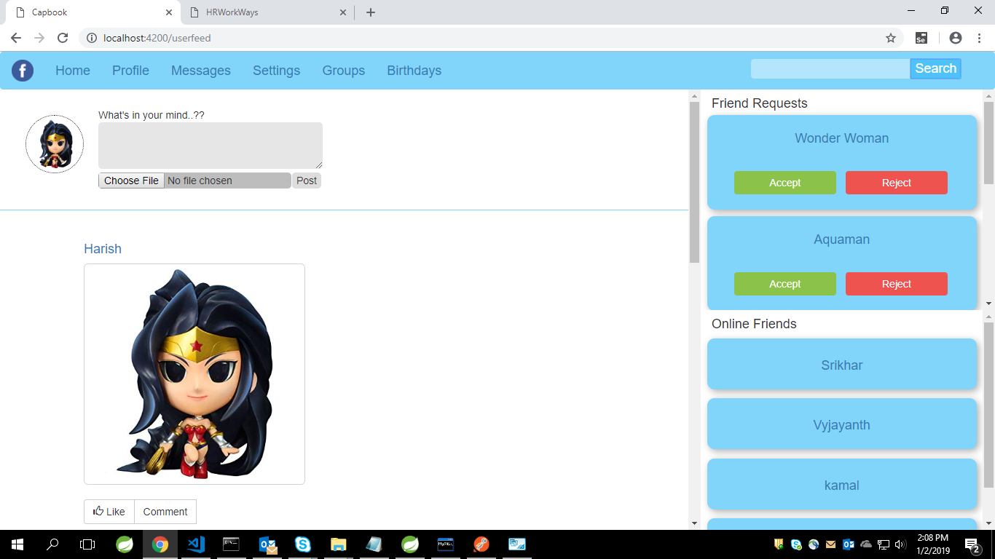

Slide 7
Thank you…!!

