Slide 1

CAPBOOK

Slide 2
TEAM 3
Srikhar Reddy. M
K. Avinash
A. Neeraj
K. Shiva Kumar
B. Sowjanya

Slide 3
List of modules
Logged in user profile page content
Add a friend
Approve/Reject request
Friends List
Online Friends

Slide 4
Logged in user profile page content
It displays the list of all the friends who are online at the moment of a particular user.
The list will change when a user friend logs-in or logs-out.
The list of online friends will also acts as a hyperlink which when clicked will open the chat box to chat which is implemented by the other module.

Slide 5
Tables used from the database
User_Profile
Login
Friend_Request

Slide 6
MVC layout
Controller:
OnlineController
Dao layers:
IOnlineDAO
IUserDAO
Service layers:
IOnlineService
OnlineService

Slide 7
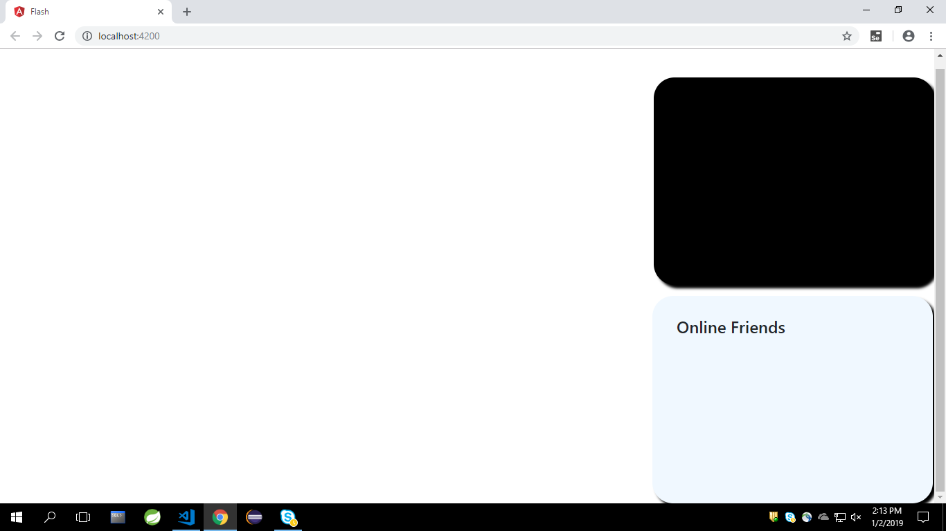

Slide 8
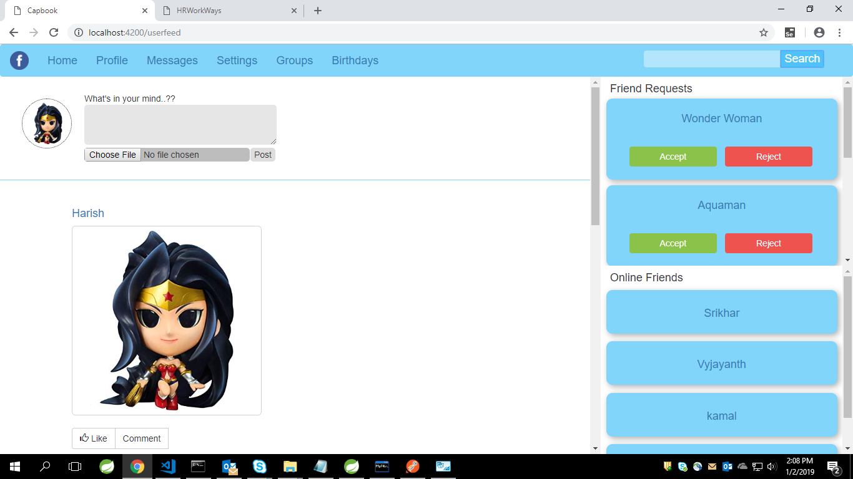

Slide 9
Thank you…!!

