Slide 1


Notes:
This will be a practical intro to understanding speech recognition focused on the interface of Sphinx

Slide 2
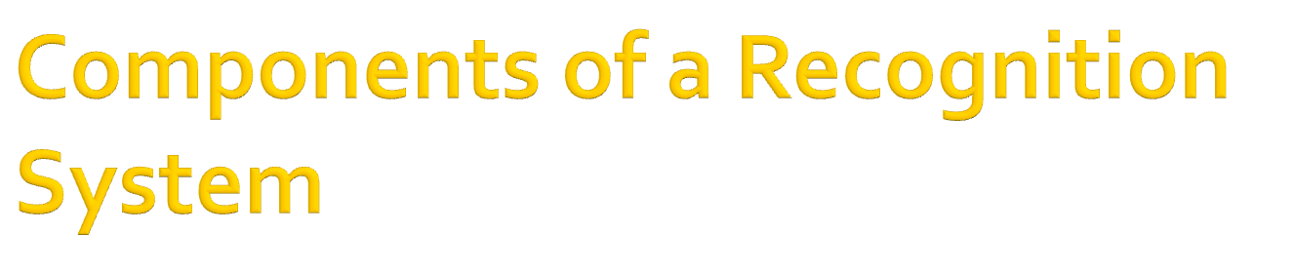
Notes:
Starting off with the components of a speech recognition system

Slide 3

Feature extractor
Notes:
Frontend is the first component of the system to see the data
It does signal processing to enhance the signal and extracts features

Slide 4

Feature extractor
Mel-Frequency Cepstral Coefficients (MFCCs)
Feature vectors
Notes:
-Different formats exist but MFCC common
The important point is that it is a way of transforming an analog signal into digital feature vectors of 39 numbers representing phonetic sounds
- Observations are taken every 10 ms -> 100 feature vectors a second
ch. 9.3 in Jurafsky&Martin has a nice description of the process

Slide 5

Acoustic Observations
Notes:
HMMs used for speech recog. Have 3 main components
We have observations the feature vectors,

Slide 6
Acoustic Observations
Hidden States
Notes:
Hidden states phones, partial phones and words, which we are trying to figure out

Slide 7
Acoustic Observations
Hidden States
Acoustic Observation likelihoods
Notes:
Observation likelihoods the probability of a feature vector being generated by a hidden state (phone, etc.)
P(features | phone)

Slide 8
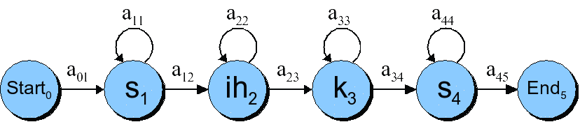
“Six”
Notes:
-HMMs are finite state machines and we can depict them graphically
-Consists of emitting states like S1 plus start and end states
-Transitions b/t states are weighted by their probability
-They flow Left to right, state can transition to self or forward (captures sequential nature of speech)
-Phones can vary in pronunciation length widely, self-loops allow accounting for this variable
(left -> right flowing HMM is called Bakis network)

Slide 9
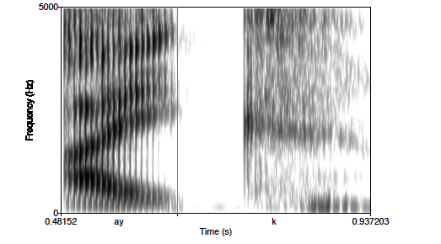
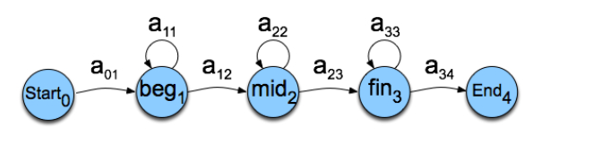
Notes:
Phones themselves contain a large amount of variation and in large vocab apps are often represented by multiple HMM states
In this diagram one phone (ay – pronounced “I”) is represented by 3 states, beginning, middle and final
See ch. 6 in Jurafsky&Martin for more info

Slide 10
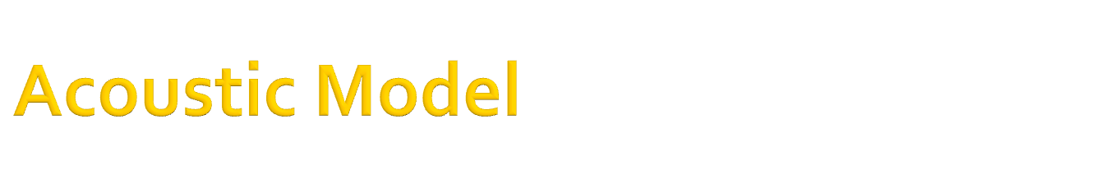
Constructs the HMMs of phones
Produces observation likelihoods
Notes:
Contains the acoustic info
Construct the HMMs for phones just described
Use Probability Density Functions and Gaussian Mixtures to create flexible models of phonetic sounds which are then used to compute
P(observation | phone) observation likelihoods
For more on PDfs and Gaussian methods see Jurafsky&Martin ch. 9.4.2

Slide 11
Constructs the HMMs for units of speech
Produces observation likelihoods
Sampling rate is critical!
WSJ vs. WSJ_8k
Notes:
All models are marked with a sampling rate
Sampling rate is very important! And must match what is in the application
Ie. You can’t train on 16k and use in the wild with 8k data. You will get horrible results

Slide 12
Constructs the HMMs for units of speech
Produces observation likelihoods
Sampling rate is critical!
WSJ vs. WSJ_8k
TIDIGITS, RM1, AN4, HUB4
Notes:
Creating acoustic models is a lot of work so usually we use ones that are available
Different models are available trained on different vocabularies, sampling rates, languages etc.
Can be found in sphinx4 in /models/acoustic read the readmes in their folders for details

Slide 13
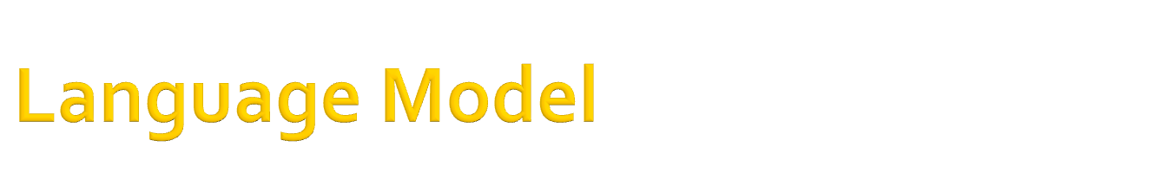
Word likelihoods
Notes:
contains information about how likely certain words are to occur

Slide 14
ARPA format Example:
1-grams:
-3.7839 board -0.1552
-2.5998 bottom -0.3207
-3.7839 bunch -0.2174
2-grams:
-0.7782 as the -0.2717
-0.4771 at all 0.0000
-0.7782 at the -0.2915
3-grams:
-2.4450 in the lowest
-0.5211 in the middle
-2.4450 in the on
Notes:
Common format is ARPA and can be produced using CMU-Cambridge Statistical Language Modeling Toolkit
Commonly contains tables of probabilities of 1,2 and 3 grams
Ngrams are listed 1 per line
preceded by log of conditional prob.
Followed by log of backoff weight ONLY for those N-grams that form a prefix of longer N-grams in the model.
#s are neg. because they are logarithms base 10 of the probabilities of very small #s
See Jurafsky&Martin p. 313

Slide 15

public <basicCmd> = <startPolite> <command> <endPolite>;
public <startPolite> = (please | kindly | could you ) *;
public <endPolite> = [ please | thanks | thank you ];
<command> = <action> <object>;
<action> = (open | close | delete | move);
<object> = [the | a] (window | file | menu);
Notes:
A away of specifying what words can be used and how
Java Speech API Grammar Format (JSGF)
Alternative to a statistical language model like ngrams
* = 0 or many, [] = optional () = grouping | = or
http://cmusphinx.sourceforge.net/sphinx4/javadoc/edu/cmu/sphinx/jsgf/JSGFGrammar.html

Slide 16

Maps words to phoneme sequences
Notes:
Defines what words will be available for recognition
Maps these words to phoneme sequences which are then used in creating HMMs

Slide 17
Example from cmudict.06d
POULTICE P OW L T AH S
POULTICES P OW L T AH S IH Z
POULTON P AW L T AH N
POULTRY P OW L T R IY
POUNCE P AW N S
POUNCED P AW N S T
POUNCEY P AW N S IY
POUNCING P AW N S IH NG
POUNCY P UW NG K IY
Notes:
Defines what words will be available for recognition
Cmu pronouncing dictionary is widely used
Contains over 100,000 words and their transcriptions.

Slide 18

Constructs the search graph of HMMs from:
  Acoustic model
  Statistical Language model ~or~
  Grammar
  Dictionary
Notes:
Language model or grammar must contain same words as dictionary
Acoustic model must contain same phone set as dictionary

Slide 19

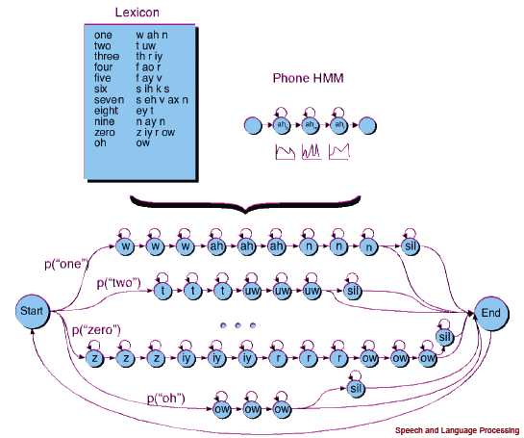
Notes:
We can represent a partial diagram of the digit recognition task like so

Slide 20
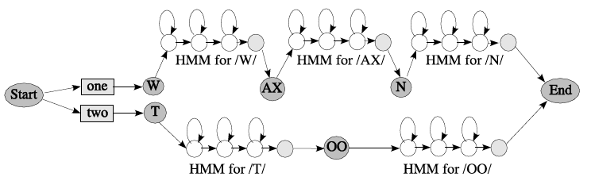
Notes:
Another representation of the same idea

Slide 21
Can be statically or dynamically constructed
Notes:
The entire search graph for the model can be computed ahead of time for small vocab tasks
For larger applications likely a partial search graph would be constructed ahead of time, dynamically expanded at runtime

Slide 22

FlatLinguist
Notes:
In sphinx4 there are 3 linguist types
Flat is for recognition tasks using a grammar or small ngram model, stores whole graph in memory

Slide 23
FlatLinguist
DynamicFlatLinguist
Notes:
Dynamic flat is similar but creates the search graph dynamically good for small complex grammars

Slide 24
FlatLinguist
DynamicFlatLinguist
LexTreeLinguist
Notes:
Large vocab Ngram models
Supports models created by the CMU Cambridge statistical language modeling toolkit

Slide 25

Maps feature vectors to search graph
Notes:
Job of the decoder is to use feature vectors from the frontend in conjunction with the search graph generated by the linguist to generate a result

Slide 26

Searches the graph for the “best fit”
Notes:
The decoder calls the search manager to search the graph for the best fit

Slide 27
Searches the graph for the “best fit”
P(sequence of feature vectors| word/phone)
aka. P(O|W)
-> “how likely is the input to have been generated by the word”
Notes:
For a given word or phone we want to determine the P(sequence of feature vectors | word or phone)

Slide 28
F ay ay ay ay v v v v v
F f ay ay ay ay v v v v
F f f ay ay ay ay v v v
F f f f ay ay ay ay v v
F f f f ay ay ay ay ay v
F f f f f ay ay ay ay v
F f f f f f ay ay ay v
…
Notes:
We could calculate every possible probability for a given word given a set of observations
but this would take exponential time to solve

Slide 29
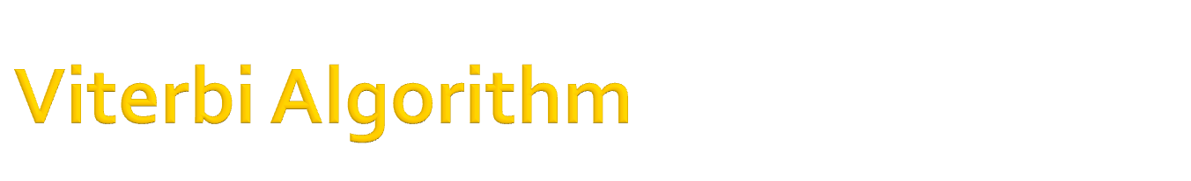
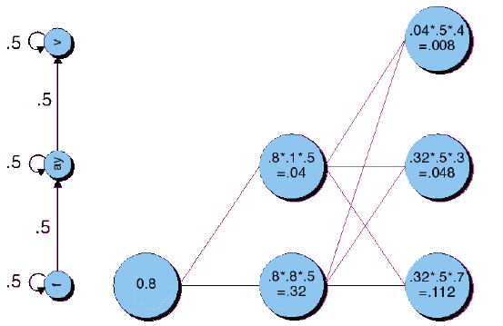
Time
O1
O2
O3
Notes:
-The search manager commonly uses the Viterbi algorithm,
-a form of Optimized graph search (heuristic) for finding the most likely sequence of hidden states (phones) in a HMM based on a sequence of observations over time
More in the appendix in these slides

Slide 30

Uses algorithms to weed out low scoring paths during decoding
Notes:
-Viterbi is more efficient than brute force but still can be slow on large search graphs
-the search manager often uses a pruner to narrow possible paths and speed up search
-Commonly prunes based on an absolute max # of paths or a threshold of probability relative to the currently most probable path

Slide 31

Words!
Notes:
Finally, the result is the words contained in the best fit path through the search graph

Slide 32

Most common metric
Measure the # of modifications to transform recognized sentence into reference sentence
Notes:
-Measure of recognition accuracy, more specifically
-the measure of the number of modification operations required to transform one sentence to the other in terms of number of insertions, deletions and substitutions.

Slide 33
Reference: “This is a reference sentence.”
Result: “This is neuroscience.”
Notes:
the measure of the number of modification operations required to transform one sentence to the other in terms of number of insertions, deletions and substitutions.

Slide 34
Reference: “This is a reference sentence.”
Result: “This is neuroscience.”
Requires 2 deletions, 1 substitution
Notes:
Errors:
1 deletion (a)
1 deletion (sentence)
1 substitution (reference for neuroscience)

Slide 35
Reference: “This is a reference sentence.”
Result: “This is neuroscience.”

Slide 36
Reference: “This is a reference sentence.”
Result: “This is neuroscience.”
D S D
Notes:
2 deletions + 1 sub / length of 5 = .6
* 100 = 60%

Slide 37
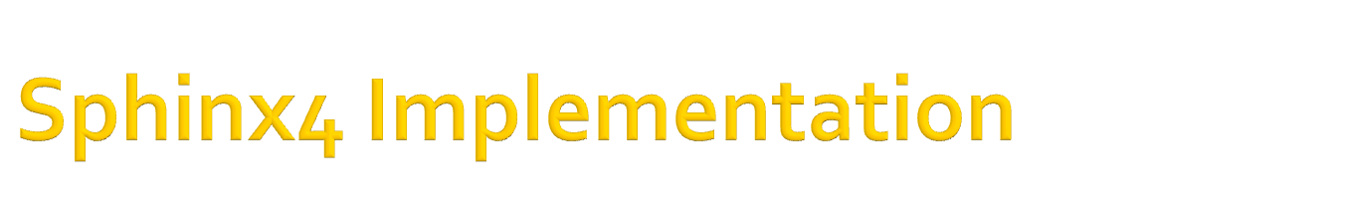
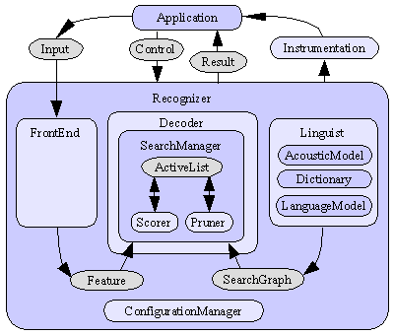
Notes:
Basic flow chart of how the components fit together

Slide 38
Notes:
We start out with audio input, live from a mic or recorded in an audio file

Slide 39
Notes:
The configuration file is used to set all variables. (Most of the components of the system are configurable Java interfaces.) These options are loaded by the configuration manager as the first step in any program. The config file is where most of work with sphinx4 takes place.

Slide 40
Notes:
the front end is constructed generating feature vectors from the input using the same process used during training

Slide 41
Notes:
the linguist generates search graph

Slide 42
Notes:
using the acoustic model, language model and dictionary specified in the config file.

Slide 43
Notes:
Then comes the decoder which constructs the search manager

Slide 44
Notes:
in turn initializing the scorer, pruner and active list

Slide 45
Notes:
The SearchManager uses the Features and the SearchGraph to find the best fit path

Slide 46
Notes:
In the final step this result is passed back to the application as a series of recognized words

Slide 47
Notes:
Once the initial configuration is complete the recognition process can repeat without re initializing everything

Slide 48

Limited Vocab Multi-Speaker
Notes:
The system can have a flexible model of a small set of words
Ex. Spoken dialog systems in telephony

Slide 49
Limited Vocab Multi-Speaker
Extensive Vocab Single Speaker
Notes:
Where the system can be trained on a single speaker’s voice, ie. Computer Dictation sw, command control of telephone or computer

Slide 50
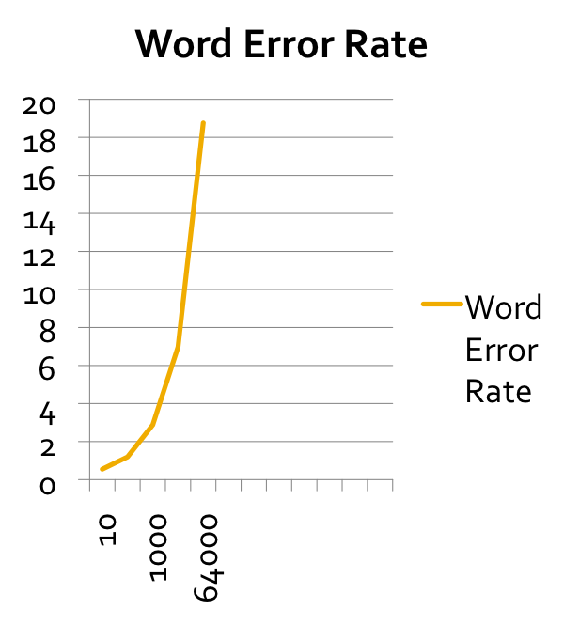
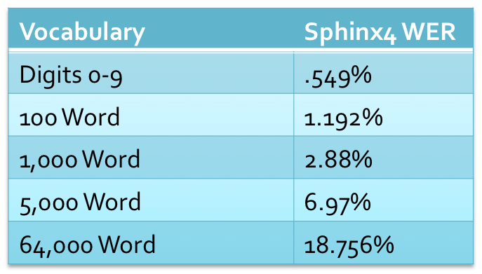
*If you have noisy audio input multiply expected error rate x 2
Notes:
For speaker independednt recognition the more words in the vocab the higher the WER
If the audio is noisy the WER will be at least twice as high
More info:
http://nshmyrev.blogspot.com/2009/08/how-to-improve-accuracy.html

Slide 51
Other variables:
-Continuous vs. Isolated
-Conversational vs. Read
-Dialect
Notes:
Other factors that impact performance include whether the speech is continuous, one word flowing into the next, or spoken in isolation
Whether the speech is directed at a human or person
Whether the dialect matches what the system was trained on

Slide 52
Questions?

Slide 53

Time
O1
O2
O3
Notes:
The search manager commonly uses the Viterbi algorithm, a form of Optimized graph search or heuristic
For each observation (O1…On) we map out a graph of each hidden state

Slide 54
P(ay | f) *
P(O2|ay)
P(f|f) *
P(O2 | f)
Time
O1
O2
O3
Notes:
Given that we know the probability of an observation given a phone
and we know the probability of phone given the previous phone
we can map out transition probabilities of the connections between states

Slide 55
P (O1) *
P(ay | f) *
P(O2|ay)
Time
O1
O2
O3
Notes:
And we can calculate the probability of a specific state given
the prob. Of the state it transitioned from * (.8 in the example)
the transition prob in the HMM * (.5 in the example) P( ay | f)
Prob. of the observation given the state ( .1 in the example – from a matrix defined in the acoustic model) P(O2 | ay)

Slide 56
Time
O1
O2
O3
Notes:
-For each state with more than one connection Viterbi scores the state with the probability of the most probable connection (MAX) and keeps a backpointer to which state it is connected to
-This is efficient in terms of memory usage and gives us a most likely state sequence for every final probability score
-In this example .3 is the P(O3 | ay) .5 is the P(ay| f) .32 is the max prev. state prob.
-Note: while a connection b/t f and v is shown its weight would be 0 b/c there is the HMM transition b/t f and v is 0
-Viterbi described in detail in Jurafsky&Martin ch. 6

Slide 57

Common Sphinx4 FAQs can be found online:
http://cmusphinx.sourceforge.net/sphinx4/doc/Sphinx4-faq.html
What followes are some less-FAQs

Slide 58
Q. Is a search graph created for every recognition result or one for the recognition app?
A. This depends on which Linguist is used. The flat linguist generates the entire search graph and holds it in memory. It is only useful for small vocab recognition tasks. The lexTreeLinguist dynamically generates search states allowing it to handle very large vocabularies

Slide 59
Q. How does the Viterbi algorithm save computation over exhaustive search?
A. The Viterbi algorithm saves memory and computation by reusing subproblems already solved within the larger solution. In this way probability calculations which repeat in different paths through the search graph do not get calculated multiple times
Viterbi cost = n² – n³
Exhaustive search cost = 2^{n} -3^{n}
Notes:
See Luger ch. 4.1.2 and Jurafsky&Martin ch. 6.4 for more detail

Slide 60
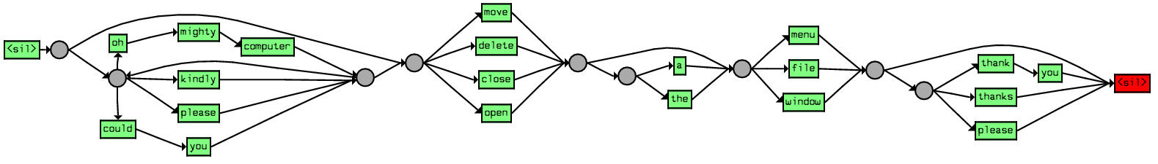
Q. Does the linguist use a grammar to construct the search graph if it is available?
A. Yes, a grammar graph is created

Slide 61
Q. What algorithm does the Pruner use?
A. Sphinx4 uses absolute and relative beam pruning

Slide 62
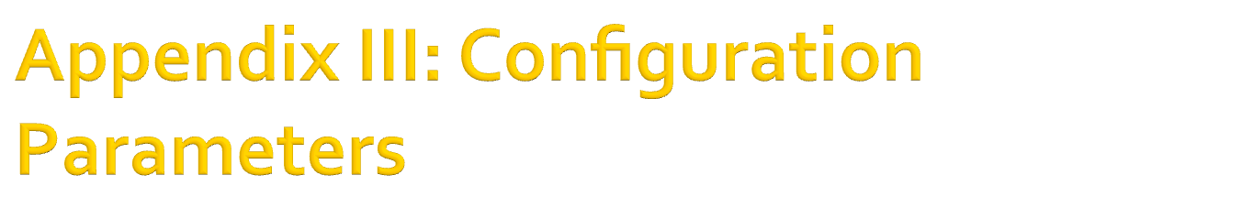
Absolute Beam Width - # active search paths
<property name="absoluteBeamWidth" value="5000"/>
Notes:
Absolute beam width controls the number of active search paths maintained during the pruning stage of speech decoding. A larger value for this beam width can sometimes yield higher recognition accuracy at the expense of longer decode times.
The absolute beam width specifies the maximum number of hypotheses to consider (i.e. the maximum size of the ArrayList used to hold the hypotheses). At each frame, if there are more hypotheses than the max, then only the best ones are kept and the rest are discarded. A value of -1 means an unbounded list, which is the norm because the relative beam width does a good job at pruning the list.

Slide 63
Absolute Beam Width - # active search paths
<property name="absoluteBeamWidth" value="5000"/>
Relative Beam Width – probability threshold
<property name="relativeBeamWidth" value="1E-120"/>
Notes:
Used to create a threshold for what tokens to keep based on their acoustic likelihood computation
Uses a negative exponent to represent very small fraction, the more negative the exponent the less hypotheses you discard and the more accurate your recognition but again with the tradeoff of increased search time
(sets the minimum score relative to the maximum score in the active list for pruning.)
the score of each hypothesis is compared to the score of the best hypothesis. The scores that are too far away relative to the best hypothesis are discarded.

Slide 64
Absolute Beam Width - # active search paths
<property name="absoluteBeamWidth" value="5000"/>
Relative Beam Width – probability threshold
<property name="relativeBeamWidth" value="1E-120"/>
Word Insertion Probability – Word break likelihood
<property name="wordInsertionProbability" value="0.7"/>
Notes:
Controls word breaks recognition. Near 1 is more likely to break into words
Ex. the sentences "A. D. 6" and "eighty six"
If the word insertion probability (a number b/t 0 and 1) is high, then the first sentence would be preferred, otherwise the second.
== word insertion penalty from Jurafsky&Martin pp. 315-316

Slide 65
Absolute Beam Width - # active search paths
<property name="absoluteBeamWidth" value="5000"/>
Relative Beam Width – probability threshold
<property name="relativeBeamWidth" value="1E-120"/>
Word Insertion Probability – Word break likelihood
<property name="wordInsertionProbability" value="0.7"/>
Language Weight – Boosts language model scores
<property name="languageWeight" value="10.5"/>
Notes:
Used to boost scores from the language model
Also called language model scaling factor
If lang weight higher language model importance is higher in balancing probability result
In other words if your recognition is not doing well raise this value
http://www.speech.cs.cmu.edu/sphinx/tutorial.html#app4
Jurafsky&Martin p. 315

Slide 66
Silence Insertion Probability – Likelihood of inserting silence
<property name="silenceInsertionProbability" value=".1"/>
Notes:
The silence insertion probability controls how aggressive Sphinx is at inserting silences. If you find that Sphinx isn't inserting silences where it should be, move this number closer to one. Note that addSilenceWords must be true for this to have effect.

Slide 67
Silence Insertion Probability – Likelihood of inserting silence
<property name="silenceInsertionProbability" value=".1"/>
Filler Insertion Probability – Likelihood of inserting filler words
<property name="fillerInsertionProbability" value="1E-10"/>
Notes:
If you are that Sphinx is not capturing filler words (extraneous noise such as coughing, phone rings etc. which vary from acoustic model to acoustic model), make this number closer to 1 so that Sphinx is more aggressive about inserting fillers.
addFillerWords parameter must be true

Slide 68

To call a Java example from Python:
import subprocess
subprocess.call(["java", "-mx1000m", "-jar",
"/Users/Username/sphinx4/bin/Transcriber.jar”)

Slide 69

Speech and Language Processing 2nd Ed.
Daniel Jurafsky and James Martin
Pearson, 2009
Artificial Intelligence 6th Ed.
George Luger
Addison Wesley, 2009
Sphinx Whitepaper
http://cmusphinx.sourceforge.net/sphinx4/#whitepaper
Sphinx Forum
https://sourceforge.net/projects/cmusphinx/forums

