Slide 1



Project Review
B Shiva Shankar
1602-21-737-050
Munagapati Lokesh
1602-21-737-030 Guide: T. Hitendra Sarma Associate Professor

Slide 2
Self Adaptive Evolutionary VAE Framework for Hyperspectral Unmixing with End Member Variability
Hyperspectral imaging (HSI) relies on accurate spectral unmixing (SU) to decompose mixed pixels into pure spectral components (endmembers) and their proportions. However, endmember variability—shifts due to environmental factors like lighting and atmospheric conditions—significantly challenges traditional unmixing methods, which lack adaptability to these dynamic spectral changes.
While variational autoencoders (VAEs) offer potential for capturing endmember variability, standard VAEs are limited by fixed hyperparameters, restricting their flexibility for complex real-world conditions. Recent advancements in self-adaptive evolutionary VAEs (SA-eInfoVAE) introduce dynamic hyperparameter optimization, enabling VAEs to better adjust to variability, but have yet to be applied for comprehensive SU tasks in HSI.
This study aims to develop a self-adaptive evolutionary VAE framework for hyperspectral unmixing that dynamically optimizes model parameters to manage endmember variability, enhancing unmixing accuracy across diverse HSI applications.

Slide 3
Abstract
Spectral unmixing (SU) in hyperspectral imaging (HSI) is crucial for applications like environmental monitoring and remote sensing, decomposing each pixel into its pure spectral components, or endmembers. However, endmember variability due to environmental factors (e.g., illumination and atmospheric changes) complicates accurate unmixing, limiting the effectiveness of traditional models like the linear mixing model (LMM) and standard variational autoencoders (VAEs).
This study introduces a self-adaptive evolutionary variational autoencoder (SA-eInfoVAE) framework to enhance SU by dynamically addressing endmember variability. By incorporating evolutionary techniques, including self-adaptive crossover and mutation strategies, SA-eInfoVAE optimizes VAE hyperparameters in real time, improving adaptability and unmixing performance across varied spectral conditions. Building on advancements in evolutionary autoencoder training, SA-eInfoVAE achieves lower computational costs and enhanced feature extraction.
Through evaluation on real-world datasets, SA-eInfoVAE demonstrates superior accuracy and adaptability over traditional methods, providing a robust solution for spectral data analysis in dynamic environments.

Slide 4
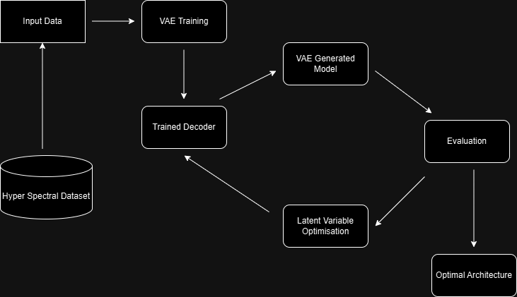
Proposed Methodology
Data Preprocessing: Hyperspectral data is normalized and prepared for input into the model.
Variational Autoencoder Initialization: VAE encodes spectral pixels into a compact latent space using neural layers.
Latent Representation Learning: The encoder learns mean and variance for latent variables using reparameterization.
Spectral Reconstruction: Decoder reconstructs original spectra from latent vectors, minimizing reconstruction loss.
Loss Computation: Combines reconstruction, KL divergence, SAD, and volume regularization losses.
Self-Adaptive SBX Optimization: Dynamically adjusts loss weights (λ_kl, λ_sad, λ_vol) using SBX strategy.
Abundance Estimation and Signature Extraction: Outputs material abundances and extracts refined endmember spectral signatures.

Slide 5
Literature Survey
1.Challenges in Hyperspectral Imaging:
Mixed Pixels: Real-world observed pixels are often mixtures of multiple spectral signatures.
Hyperspectral Unmixing (HU): Decomposes mixed pixels into endmembers and their corresponding abundances
2. Classical Unmixing Methods:
Linear Mixing Models (Keshava & Mustard, 2002): Assume spectral responses are weighted sums of endmembers.
Challenges: Struggles with nonlinearities and spectral variability.
3. Nonlinear Unmixing Methods:
Vertex Component Analysis (VCA) (Nascimento & Dias, 2005): A fast linear unmixing method assuming pure pixels.
Manifold Learning (Lu et al., 2008): Improved representation of data geometry for better unmixing

Slide 6
Literature Survey
4. Integration of Deep Learning in HU:
Convolutional Neural Networks (CNNs) (Zhang et al., 2018; Bhatt & Joshi, 2019): Leveraged for spatial-spectral feature extraction.
Self-Supervised Frameworks (Hong et al., 2020): EGU-Net regularizes learning using endmember priors.
5. Probabilistic Models:
Autoencoders (AEs): Used to encode abundances and reconstruct hyperspectral data nonlinearly (Palsson et al., 2017).
Variational Autoencoders (VAEs) (Shi et al., 2019): Captures endmember variability and models abundance distributions probabilistically.
6. Evolutionary Strategies:
Self-Adaptive VAE (Bojanowski et al., 2020): Enhances model expressiveness by balancing reconstruction and information preservation.
Evolutionary Crossover Strategies (Deb et al., 2021): Optimizes deep HU models by tuning neural architecture and parameters.

Slide 7
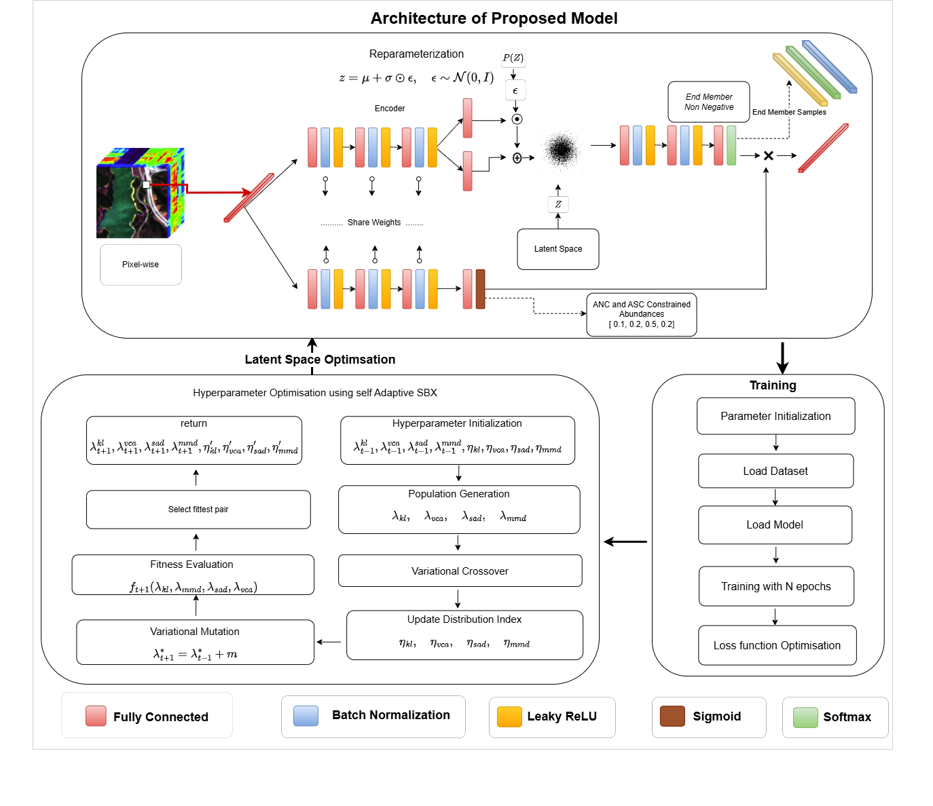
Architecture

Slide 8
Experimental Setup
Software Specifications
Operating System: Windows, Linux
Python Version: >=3.8
Frameworks and Libraries: NumPy, PyTorch, Matplotlib, Scikit-learn
MLOPs: wandb
Development Tools: Jupyter Notebook, VS Code, Git
Hardware Specifications
Processor (CPU): Intel Core i5
Graphics Card (GPU): NVIDIA RTX 3060 or higher with 12GB VRAM for deep learning tasks
RAM: Minimum 16GB (32GB recommended for large datasets)

Slide 9
Dataset Description
Jasper Ridge Dataset Characteristics:
Type: Hyperspectral dataset with high spectral resolution.
Components:
Mixed Pixels: Spectral signatures are mixtures of different endmembers (e.g., Tree, Water, Dirt and Road).
Endmembers: Pure spectral signatures of materials being unmixed.
Wavelength Range: 400 nm to 2500 nm (visible to shortwave infrared).
Spectral Bands: 224 bands (usable bands reduced due to noise and water absorption).
Spatial Dimensions: 100 x 100
Source: http://www.escience.cn/people/feiyunZHU/Dataset_GT.html

Slide 10
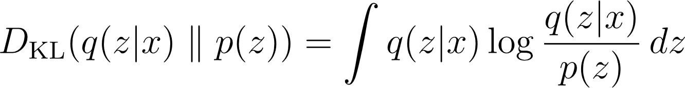
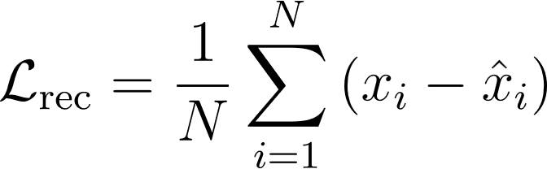
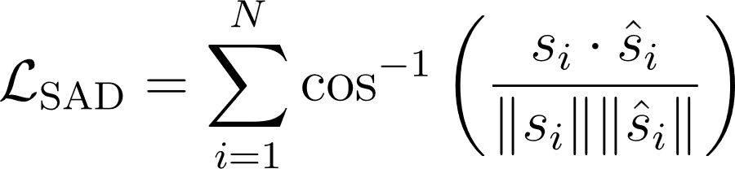
Evaluation Metrics
KL Divergence :
Reconstruction loss : SAD Loss : Loss Function : Fitness Function: 1/Loss Function

Slide 11
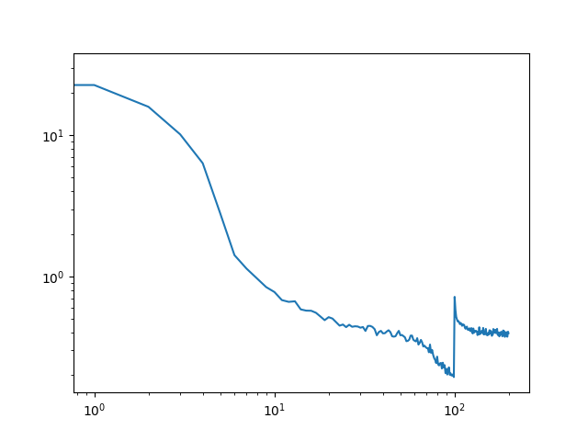
Results
Metric | Value
average_loss | 0.281
kl_div | 0.20504
lambda_kl | 0.4
lambda_sad | 6.24237
lambda_vol | 2.69809
loss | 0.32422
loss_minvol | 0.03859
loss_sad | 0.01265
loss_vca | 2.00633
recon_loss | 0.0591

Slide 12
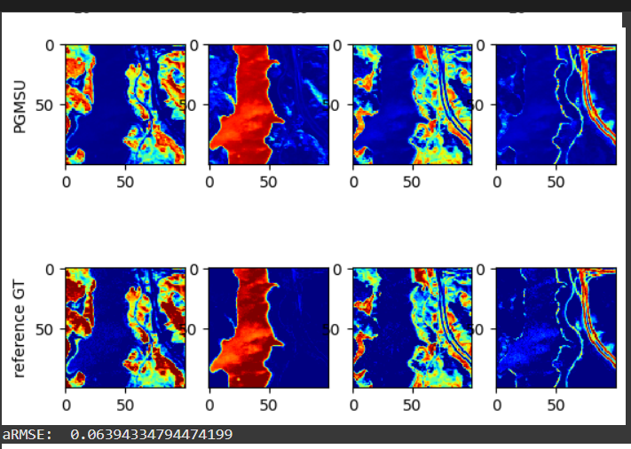
GT Vs Model
Tree Water Dirt Road

Slide 13
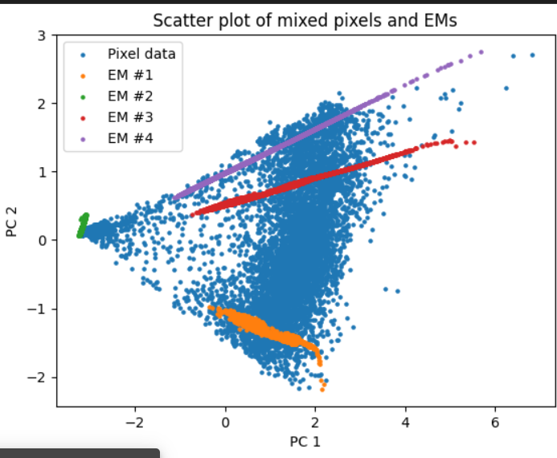
PCA
PCA Scatter Plot: Visualizes the relationship between mixed pixels and endmembers in reduced 2D space

Slide 14
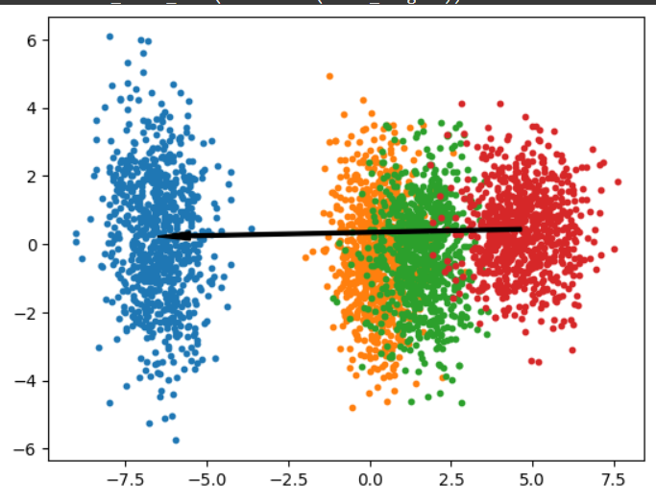
Proposed Model PCA for latent Dimensions
PCA Plot of Latent Variables: Shows the 2D projection of latent variables learned by the model. Better than Base Model

Slide 15
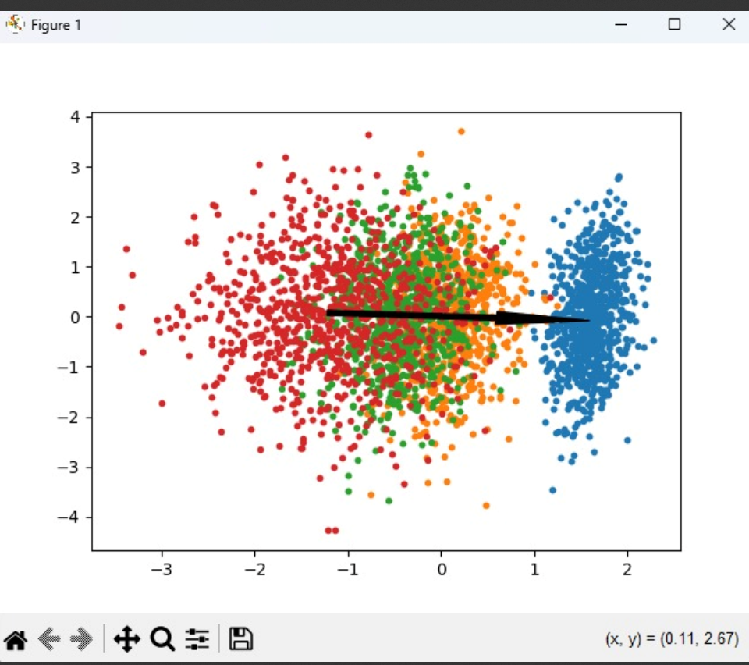
Base Model PCA for Latent Dimensions
Our model performed better here than base model as our model clearly distinguished end members

Slide 16
Analysis
Achieved state-of-the-art accuracy in hyperspectral unmixing tasks.
Clear spectral separation observed via PCA latent space visualization.
Achieved low aRMSE of 0.06394 in abundance estimation.
Maintained spectral coherence with SAD of 0.01265.
Reconstruction loss remained low at 0.0591.
Balanced KL divergence (0.20504) ensured stable latent structure.
Effectively handles mixed pixels and spectrally similar materials.
Self-adaptive SBX tuning enhanced model generalization.

Slide 17
Conclusion
In conclusion, the proposed self-adaptive evolutionary Variational AutoEncoder (VAE) framework demonstrates significant advancements in hyperspectral unmixing by effectively capturing endmember variability and ensuring robust spectral reconstruction. By leveraging a self-adaptive SBX mechanism, the model dynamically optimizes key loss weights to achieve a balanced and precise unmixing process. The integration of KL divergence, SAD, and minimum volume constraints enhances its capability to handle complex spectral data with high accuracy. The framework's scalability and adaptability make it a promising solution for real-world hyperspectral analysis, outperforming traditional models in both accuracy and generalization.

Slide 18
Future Scope
The future scope of the Self-Adaptive Evolutionary Info Variational Autoencoder (SA-eInfoVAE) lies in enhancing its applicability and performance across a broader range of hyperspectral unmixing challenges. Integrating spatial dependencies through Convolutional Neural Networks (CNNs) or Graph Neural Networks (GNNs) could improve the model's ability to preserve spatial coherence in high-resolution images. Additionally, extending the model to handle temporal variations would allow for dynamic monitoring applications, such as change detection and environmental monitoring. The incorporation of hybrid models, combining SA-eInfoVAE with GANs, could improve the generation of realistic endmembers and abundance maps, addressing challenges in spectral data generation. The model can also be expanded to multi-sensor fusion, making it more robust to variations in sensor characteristics, thereby increasing its versatility for real-world applications. Further optimization for real-time processing would enhance its practical use in operational systems like satellite or drone-based remote sensing. Finally, extensive benchmarking on diverse datasets will help assess the generalizability of the model, ensuring its robustness across different environments and spectral conditions.

Slide 19
References
[1] M. A. Moharram and D. M. Sundaram, “Land use and land cover classification with hyperspectral data: A comprehensive review of methods, challenges and future directions,” Neurocomputing, vol. 536, pp. 90–113,2023.
[2] E. Bedini, “The use of hyperspectral remote sensing for mineral exploration: A review,” Journal of Hyperspectral Remote Sensing, vol. 7,no. 4, pp. 189–211, 2017.
[3] B. Zhang, D. Wu, L. Zhang, Q. Jiao, and Q. Li, “Application of hyperspectral remote sensing for environment monitoring in mining areas,” Environmental Earth Sciences, vol. 65, pp. 649–658, 2012.
[4] G. Lu and B. Fei, “Medical hyperspectral imaging: a review,” Journal of biomedical optics, vol. 19, no. 1, pp. 010 901–010 901, 2014.
[5] P. W. Yuen and M. Richardson, “An introduction to hyperspectral imaging and its application for security, surveillance and target acquisition, “The Imaging Science Journal, vol. 58, no. 5, pp. 241–253, 2010.
[6] N. Keshava and J. F. Mustard, “Spectral unmixing,” IEEE signal processing magazine, vol. 19, no. 1, pp. 44–57, 2002.
[7] J. M. Nascimento and J. M. Dias, “Vertex component analysis: A fast algorithm to unmix hyperspectral data,” IEEE transactions on Geoscience and Remote Sensing, vol. 43, no. 4, pp. 898–910, 2005.
[8] X. Lu, H. Wu, Y. Yuan, P. Yan, and X. Li, “Manifold regularized sparse nmf for hyperspectral unmixing,” IEEE Transactions on Geoscience and Remote Sensing, vol. 51, no. 5, pp. 2815–2826, 2012.
[9] D. A. Roberts, M. Gardner, R. Church, S. Ustin, G. Scheer, and R. Green, “Mapping chaparral in the santa monica mountains using multiple endmember spectral mixture models,” Remote sensing of environment, vol. 65, no. 3, pp. 267 279, 1998.
[10] N. Dobigeon, J.-Y. Tourneret, C. Richard, J. C. M. Bermudez, S. McLaughlin, and A. O. Hero, “Nonlinear unmixing of hyperspectral images: Models and algorithms,” IEEE Signal processing magazine,vol. 31, no. 1, pp. 82–94, 2013.

Slide 20
References
[11] X. Zhang, Y. Sun, J. Zhang, P. Wu, and L. Jiao, “Hyperspectral unmixing via deep convolutional neural networks,” IEEE Geoscience and Remote Sensing Letters, vol. 15, no. 11, pp. 1755–1759, 2018.
[12] J. S. Bhatt and M. V. Joshi, “Deep learning in hyperspectral unmixing: A review,” in Igarss 2020-2020 IEEE international geoscience and remote sensing symposium. IEEE, 2020, pp. 2189–2192.
[13] V. S. Deshpande, J. S. Bhatt et al., “A practical approach for hyperspectral unmixing using deep learning,” IEEE Geoscience and Remote Sensing Letters, vol. 19, pp. 1–5, 2021.
[14] D. Hong, L. Gao, J. Yao, N. Yokoya, J. Chanussot, U. Heiden, and B. Zhang, “Endmember-guided unmixing network (egu-net): A general deep learning framework for self-supervised hyperspectral unmixing,” IEEE Transactions on Neural Networks and Learning Systems, vol. 33, no. 11, pp. 6518–6531, 2021.
[15] B. Palsson, J. Sigurdsson, J. R. Sveinsson, and M. O. Ulfarsson, “Hyperspectral unmixing using a neural network autoencoder,” IEEE Access, vol. 6, pp. 25 646–25 656, 2018.
[16] M. Wang, M. Zhao, J. Chen, and S. Rahardja, “Nonlinear unmixing of hyperspectral data via deep autoencoder networks,” IEEE Geoscience and Remote Sensing Letters, vol. 16, no. 9, pp. 1467–1471, 2019.
[17] S. Shi, M. Zhao, L. Zhang, and J. Chen, “Variational autoencoders for hyperspectral unmixing with endmember variability,” in ICASSP 2021-2021 IEEE International Conference on Acoustics, Speech and Signal Processing (ICASSP). IEEE, 2021, pp. 1875–1879
[18] P. Bojanowski, A. Joulin, D. Lopez-Paz, and A. Szlam, “Optimizing the latent space of generative networks,” arXiv preprint arXiv:1707.05776,2017.
[19] T. A. Emm and Y. Zhang, “Self-adaptive evolutionary info variational autoencoder,” Computers, vol. 13, no. 8, p. 214, 2024.
[20] K. Deb, K. Sindhya, and T. Okabe, “Self-adaptive simulated binary crossover for real-parameter optimization,” in Proceedings of the 9th annual conference on genetic and evolutionary computation, 2007, pp. 1187–1194

Slide 21
Thank You

