Slide 1
FSD2 LAB • EXPERIMENT 10
Experiment 10 — MongoDB Installation, Configuration and CRUD
Simple explanation • Clean code • Runtime pathway • Viva preparation
FSD2 Lab Materials

Slide 2
Syllabus tasks
Part 1
•
Select a database.
•
Insert student documents.
•
Find all documents.
•
Filter documents by branch.
•
Update a document.

Slide 3
Syllabus tasks
Part 2
•
Delete a document.
•
Display the final collection.
•
queries.js — readable, sectioned mongosh commands.

Slide 4
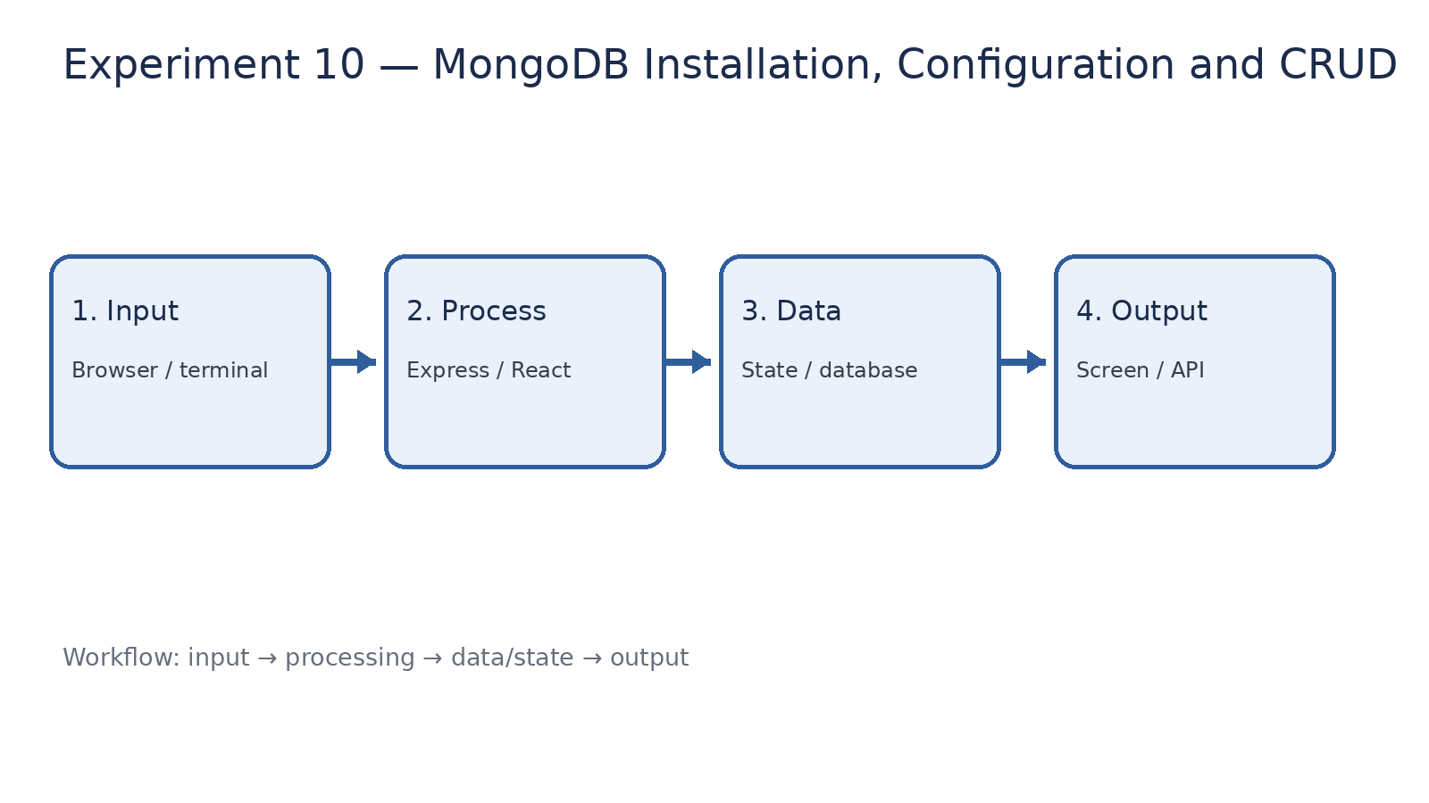
How it works
Input → processing → data/state → output

Slide 5
Code pathway 1
queries.js • lines 1–10
1 /**
2 * Experiment 10: MongoDB Installation, Configuration and CRUD
3 *
4 * Run this file inside mongosh.
5 *
6 * Demonstrates:
7 * - Database selection
8 * - Insert
9 * - Find
10 * - Update

Slide 6
Code pathway 2
queries.js • lines 11–20
11 * - Delete
12 */
13
14 // ------------------------------------------------------------
15 // Select database
16 // ------------------------------------------------------------
17
18 use fsd2lab;
19
20 // ------------------------------------------------------------

Slide 7
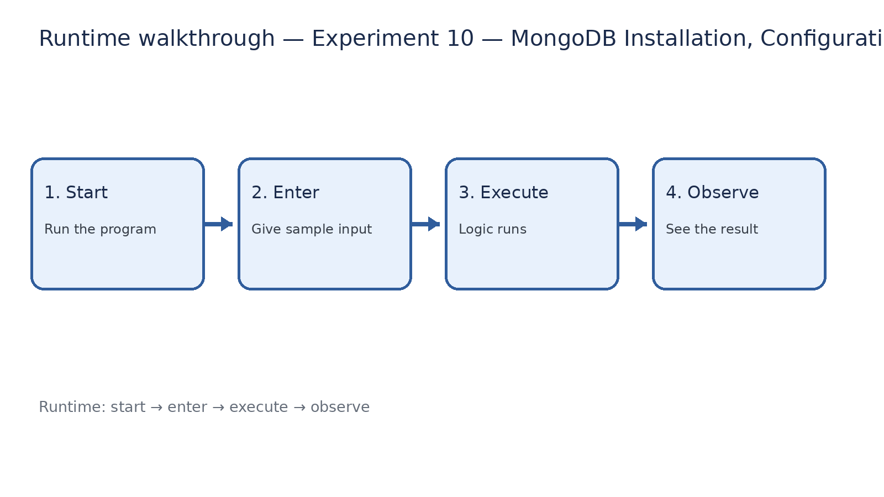
Runtime walkthrough
Start → enter input → execute → observe output

Slide 8
Expected result
Experiment 10 — MongoDB Installation, Configuration and CRUD
INPUT
PROCESS
OUTPUT
Enter the sample values or open the required page / route.
The Express route, React component, hook, or MongoDB command performs the task.
Check the browser, terminal, API response, or database result.
Verification checklist
•
No syntax errors appear in the terminal.
•
The requested feature responds to the input.
•
The displayed / returned value matches the operation.

Slide 9
Viva preparation
•
What is the purpose of this experiment?
•
Which input is required?
•
Which line or command performs the main operation?
•
What output should you observe?
•
What happens when the input changes?

