Slide 1
FSD2 LAB • EXPERIMENT 12
Augmented Programs — NodeJS Express To-do + React Quiz
Simple explanation • Clean code • Runtime pathway • Viva preparation
FSD2 Lab Materials

Slide 2
Syllabus tasks
•
Design a to-do list application using NodeJS and ExpressJS.
•
Design a Quiz app using ReactJS.
•
MongoDB University certification is included as a separate guide.

Slide 3
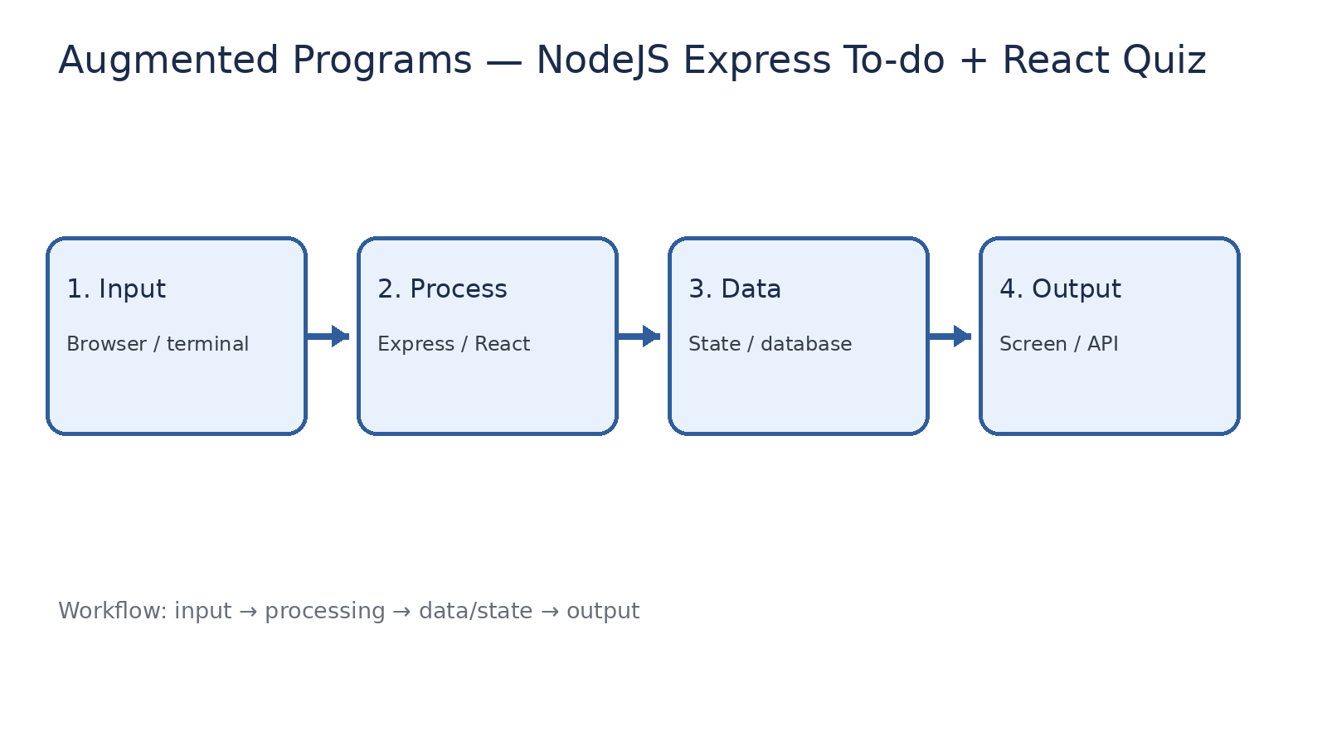
How it works
Input → processing → data/state → output

Slide 4
Code pathway 1
index.html • lines 1–1
1 <!doctype html><html><head><meta charset="UTF-8"><meta name="viewport"
content="width=device-width,initial-scale=1"><title>FSD2 React
Quiz</title></head><body><div id="root"></div><script type="module"
src="/src/main.jsx"></script></body></html>

Slide 5
Code pathway 2
main.jsx • lines 1–10
1 import React, { useState } from 'react';
2 import { createRoot } from 'react-dom/client';
3
4 const questions = [
5 { q: 'Which hook stores state?', options: ['useState', 'useRoute', 'useHTML'], answer:
'useState' },
6 { q: 'Which method is used to find MongoDB documents?', options: ['find()', 'show()',
'open()'], answer: 'find()' },
7 { q: 'Express is mainly used for?', options: ['Server-side web apps', 'Image editing',
'Operating systems'], answer: 'Server-side web apps' }
8 ];
9
10 function App() {

Slide 6
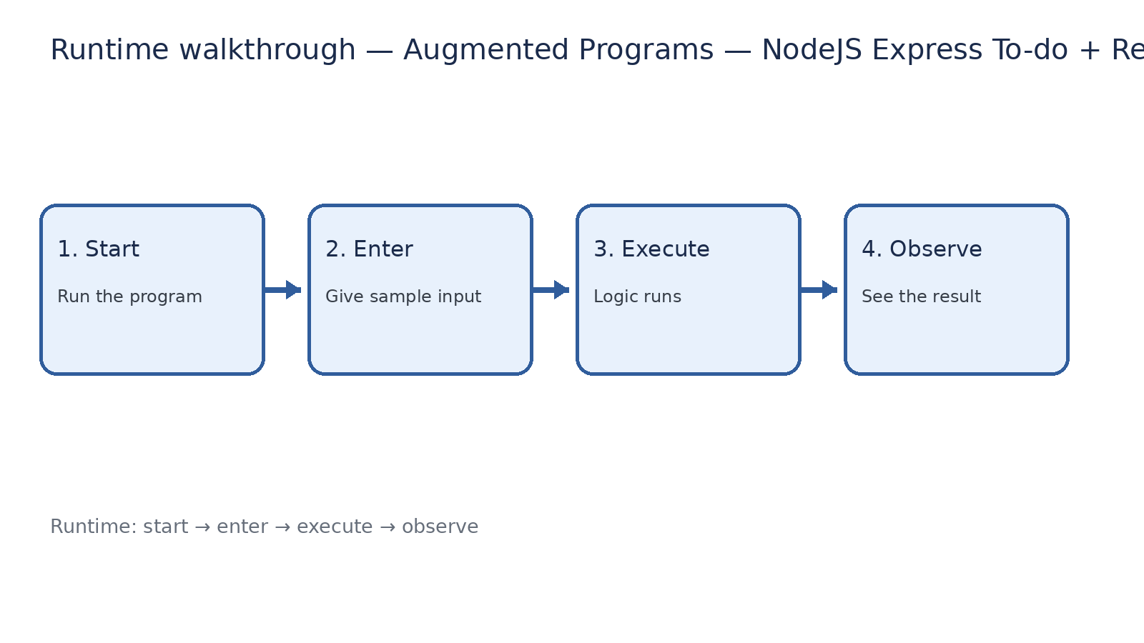
Runtime walkthrough
Start → enter input → execute → observe output

Slide 7
Expected result
Augmented Programs — NodeJS Express To-do + React Quiz
INPUT
PROCESS
OUTPUT
Enter the sample values or open the required page / route.
The Express route, React component, hook, or MongoDB command performs the task.
Check the browser, terminal, API response, or database result.
Verification checklist
•
No syntax errors appear in the terminal.
•
The requested feature responds to the input.
•
The displayed / returned value matches the operation.

Slide 8
Viva preparation
•
What is the purpose of this experiment?
•
Which input is required?
•
Which line or command performs the main operation?
•
What output should you observe?
•
What happens when the input changes?

