Slide 1
FSD2 LAB • EXPERIMENT 09
Experiment 09 — React Hooks and Sharing Data Between Components
Simple explanation • Clean code • Runtime pathway • Viva preparation
FSD2 Lab Materials

Slide 2
Syllabus tasks
•
`useState`: local state in a function component.
•
Lifting state up: place shared state in the closest common parent and
pass values/callbacks to children.
•
`createContext` / `useContext`: share a value across the component tree.
•
Class vs function component: two ways shown side-by-side to explain why
hooks are useful.

Slide 3
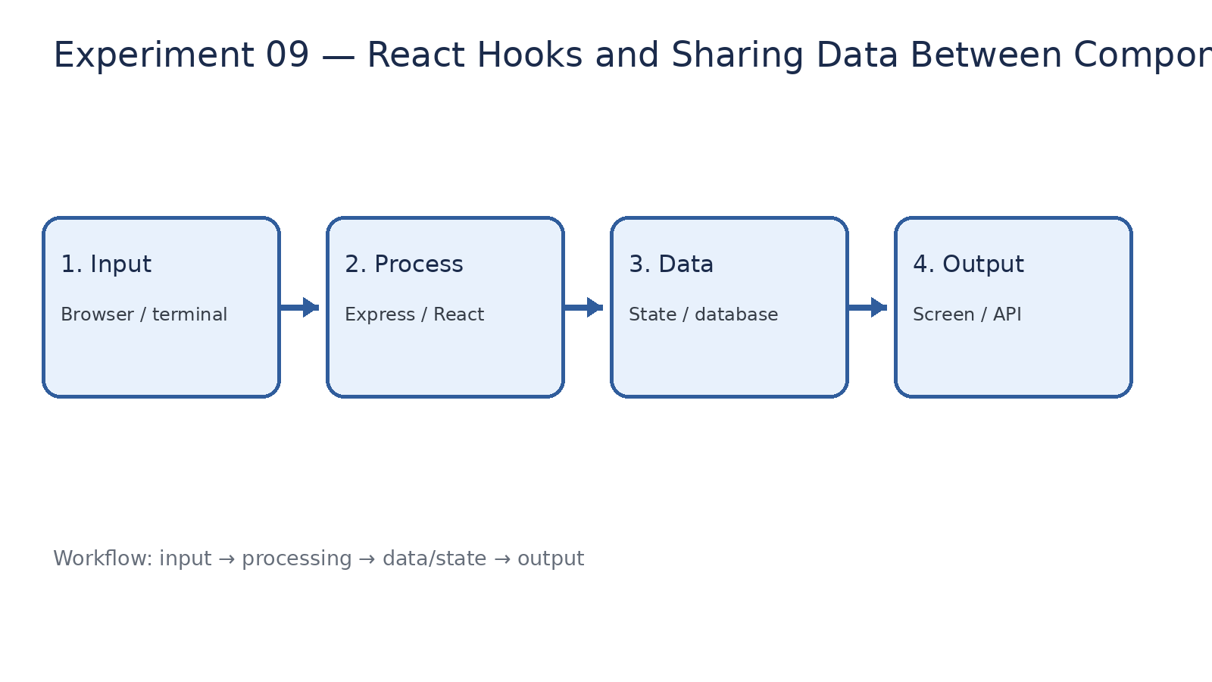
How it works
Input → processing → data/state → output

Slide 4
Code pathway 1
index.html • lines 1–10
1 <!DOCTYPE html>
2 <html lang="en">
3 <head>
4 <meta charset="UTF-8" />
5
6 <meta
7 name="viewport"
8 content="width=device-width, initial-scale=1.0"
9 />
10

Slide 5
Code pathway 2
index.html • lines 11–20
11 <title>
12 FSD2 React Experiment 09
13 </title>
14 </head>
15
16 <body>
17 <div id="root"></div>
18
19 <script
20 type="module"

Slide 6
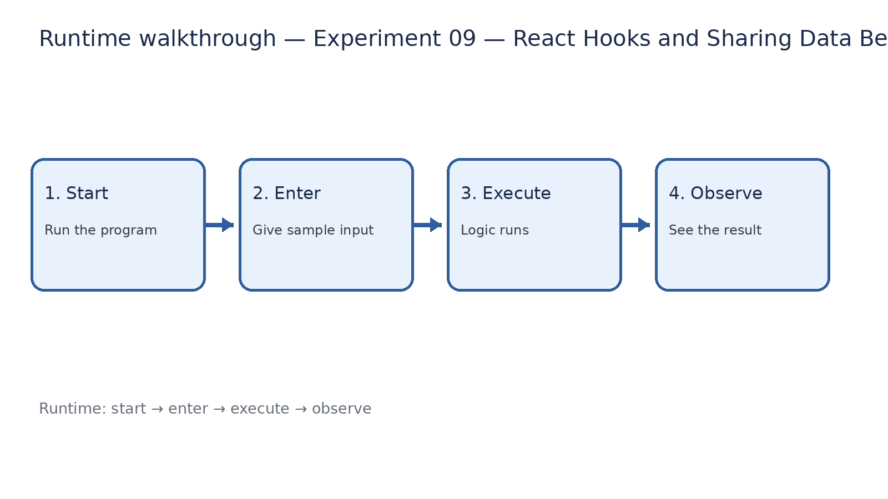
Runtime walkthrough
Start → enter input → execute → observe output

Slide 7
Expected result
Experiment 09 — React Hooks and Sharing Data Between Components
INPUT
PROCESS
OUTPUT
Enter the sample values or open the required page / route.
The Express route, React component, hook, or MongoDB command performs the task.
Check the browser, terminal, API response, or database result.
Verification checklist
•
No syntax errors appear in the terminal.
•
The requested feature responds to the input.
•
The displayed / returned value matches the operation.

Slide 8
Viva preparation
•
What is the purpose of this experiment?
•
Which input is required?
•
Which line or command performs the main operation?
•
What output should you observe?
•
What happens when the input changes?

