Slide 1
FSD2 LAB • EXPERIMENT 01
Experiment 01 — ExpressJS Routing, HTTP Methods and Middleware
Simple explanation • Clean code • Runtime pathway • Viva preparation
FSD2 Lab Materials

Slide 2
Syllabus tasks
Part 1
•
Start an Express server on port 3001.
•
Use custom middleware to log requests.
•
Read route parameters such as /students/1.
•
Read query parameters such as /search?name=Rama.
•
Build a URL dynamically.

Slide 3
Syllabus tasks
Part 2
•
Create, read and delete student records in memory.
•
app.js — complete ExpressJS example with comments and clear sections.

Slide 4
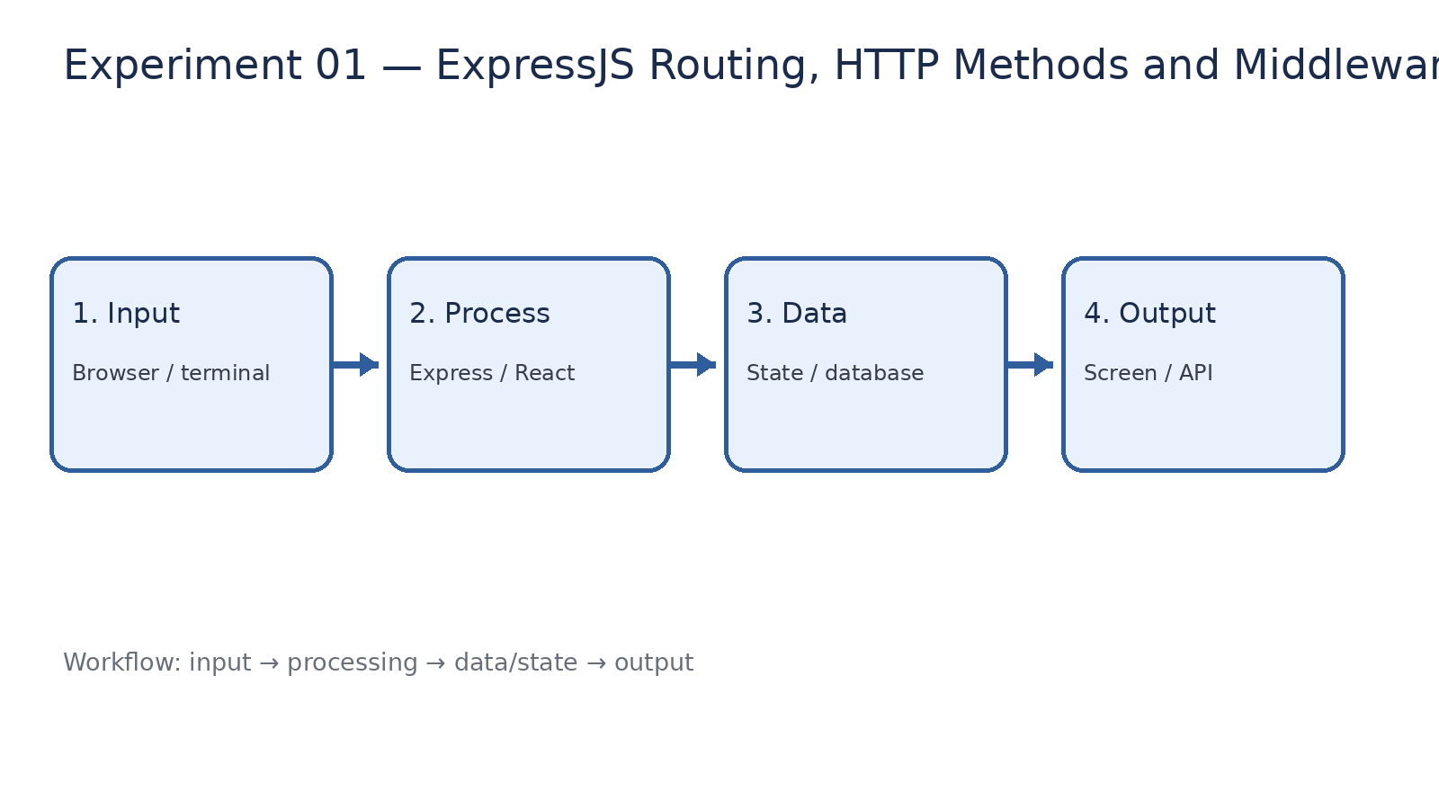
How it works
Input → processing → data/state → output

Slide 5
Code pathway 1
app.js • lines 1–10
1 /**
2 * Experiment 01: ExpressJS Routing, HTTP Methods and Middleware
3 *
4 * What it demonstrates:
5 * - Express server setup
6 * - Custom middleware
7 * - Route parameters and query parameters
8 * - URL building
9 * - GET, POST and DELETE methods
10 */

Slide 6
Code pathway 2
app.js • lines 11–20
11
12 const express = require('express');
13
14 const app = express();
15 const PORT = 3001;
16
17 // ------------------------------------------------------------
18 // Middleware
19 // ------------------------------------------------------------
20

Slide 7
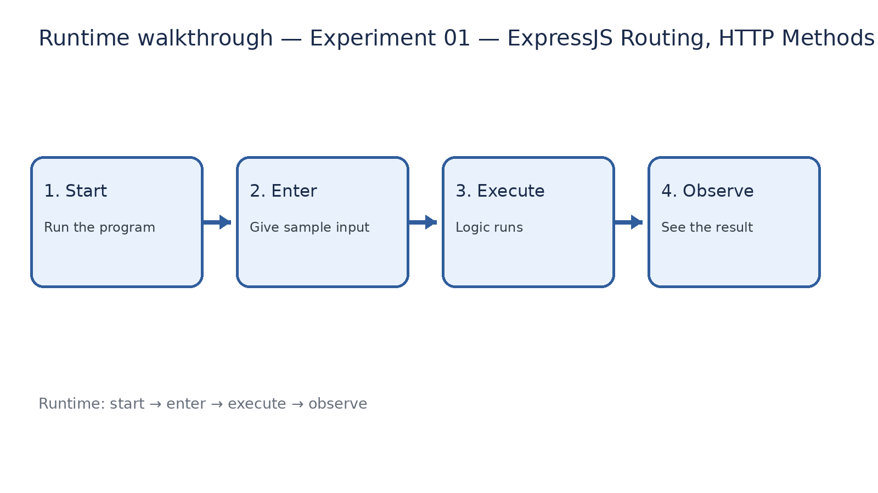
Runtime walkthrough
Start → enter input → execute → observe output

Slide 8
Expected result
Experiment 01 — ExpressJS Routing, HTTP Methods and Middleware
INPUT
PROCESS
OUTPUT
Enter the sample values or open the required page / route.
The Express route, React component, hook, or MongoDB command performs the task.
Check the browser, terminal, API response, or database result.
Verification checklist
•
No syntax errors appear in the terminal.
•
The requested feature responds to the input.
•
The displayed / returned value matches the operation.

Slide 9
Viva preparation
•
What is the purpose of this experiment?
•
Which input is required?
•
Which line or command performs the main operation?
•
What output should you observe?
•
What happens when the input changes?

