Slide 1
FSD2 LAB • EXPERIMENT 02
Experiment 02 — ExpressJS Templating and Form Data
Simple explanation • Clean code • Runtime pathway • Viva preparation
FSD2 Lab Materials

Slide 2
Syllabus tasks
Part 1
•
Display an HTML form.
•
Accept name and course values.
•
Read POST form data.
•
Send the submitted values back to the EJS template.
•
Display a dynamic result page.

Slide 3
Syllabus tasks
Part 2
•
app.js — Express configuration and routes.
•
views/index.ejs — readable EJS template.

Slide 4
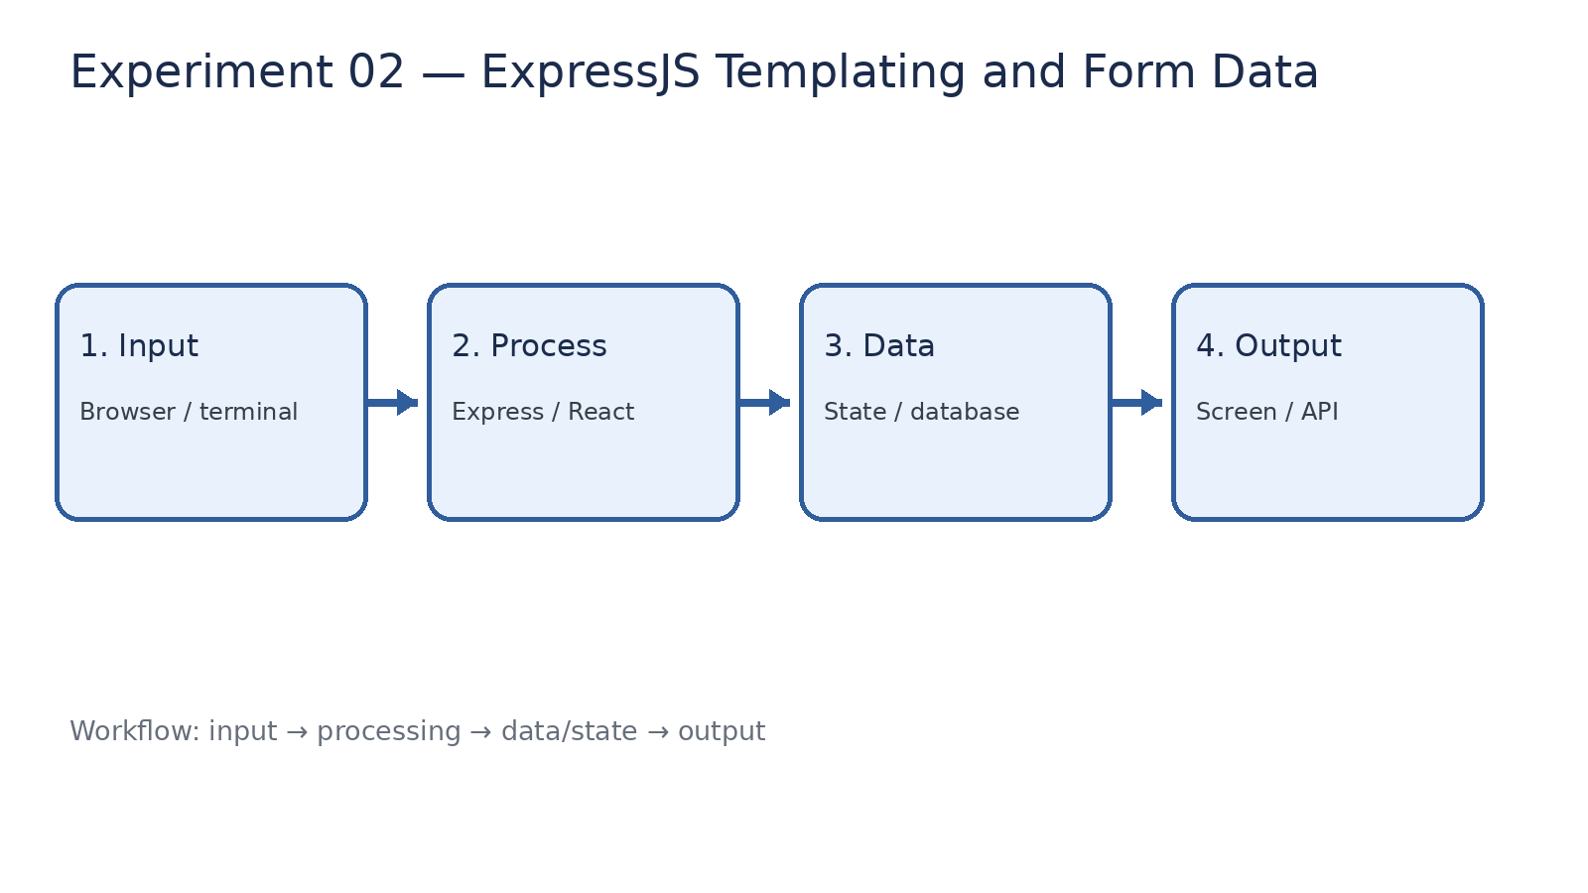
How it works
Input → processing → data/state → output

Slide 5
Code pathway 1
app.js • lines 1–10
1 /**
2 * Experiment 02: ExpressJS Templating and Form Data
3 *
4 * What it demonstrates:
5 * - EJS templating
6 * - HTML form handling
7 * - GET and POST routes
8 * - Passing data from Express to an EJS view
9 */
10

Slide 6
Code pathway 2
app.js • lines 11–20
11 const express = require('express');
12
13 const app = express();
14 const PORT = 3002;
15
16 // ------------------------------------------------------------
17 // Configuration and middleware
18 // ------------------------------------------------------------
19
20 app.set('view engine', 'ejs');

Slide 7
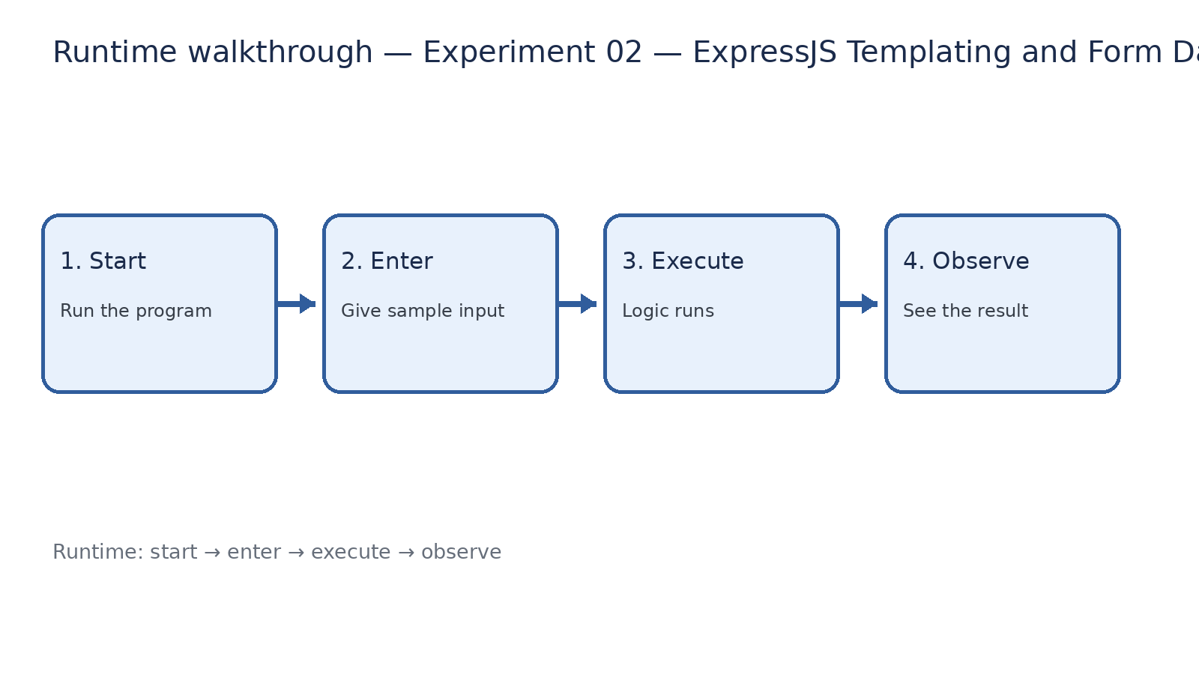
Runtime walkthrough
Start → enter input → execute → observe output

Slide 8
Expected result
Experiment 02 — ExpressJS Templating and Form Data
INPUT
PROCESS
OUTPUT
Enter the sample values or open the required page / route.
The Express route, React component, hook, or MongoDB command performs the task.
Check the browser, terminal, API response, or database result.
Verification checklist
•
No syntax errors appear in the terminal.
•
The requested feature responds to the input.
•
The displayed / returned value matches the operation.

Slide 9
Viva preparation
•
What is the purpose of this experiment?
•
Which input is required?
•
Which line or command performs the main operation?
•
What output should you observe?
•
What happens when the input changes?

