Slide 1
FSD2 LAB • EXPERIMENT 04
Experiment 04 — ExpressJS, Mongoose, CRUD and REST API
Simple explanation • Clean code • Runtime pathway • Viva preparation
FSD2 Lab Materials

Slide 2
Syllabus tasks
Part 1
•
Connect to MongoDB.
•
Define a Product schema.
•
Create products.
•
Read all products.
•
Update a product.

Slide 3
Syllabus tasks
Part 2
•
Delete a product.
•
Display the API data in a simple browser page using fetch().

Slide 4
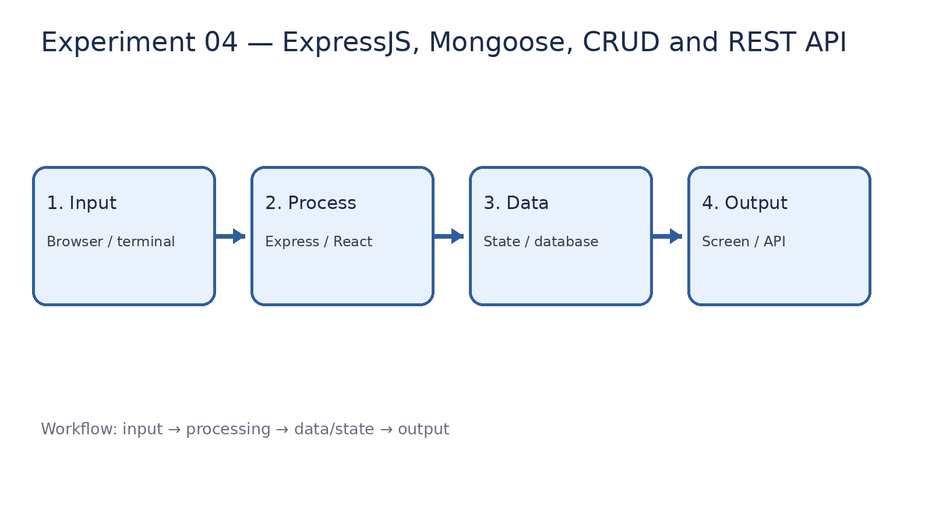
How it works
Input → processing → data/state → output

Slide 5
Code pathway 1
server.js • lines 1–10
1 /**
2 * Experiment 04: ExpressJS + Mongoose + CRUD + REST API
3 *
4 * What it demonstrates:
5 * - MongoDB connection using Mongoose
6 * - Mongoose schema and model
7 * - GET, POST, PUT and DELETE REST endpoints
8 * - A simple browser page that consumes the REST API
9 */
10

Slide 6
Code pathway 2
server.js • lines 11–20
11 const express = require('express');
12 const mongoose = require('mongoose');
13
14 const app = express();
15
16 const PORT = 3004;
17 const MONGO_URI =
18 process.env.MONGO_URI ||
19 'mongodb://127.0.0.1:27017/fsd2lab';
20

Slide 7
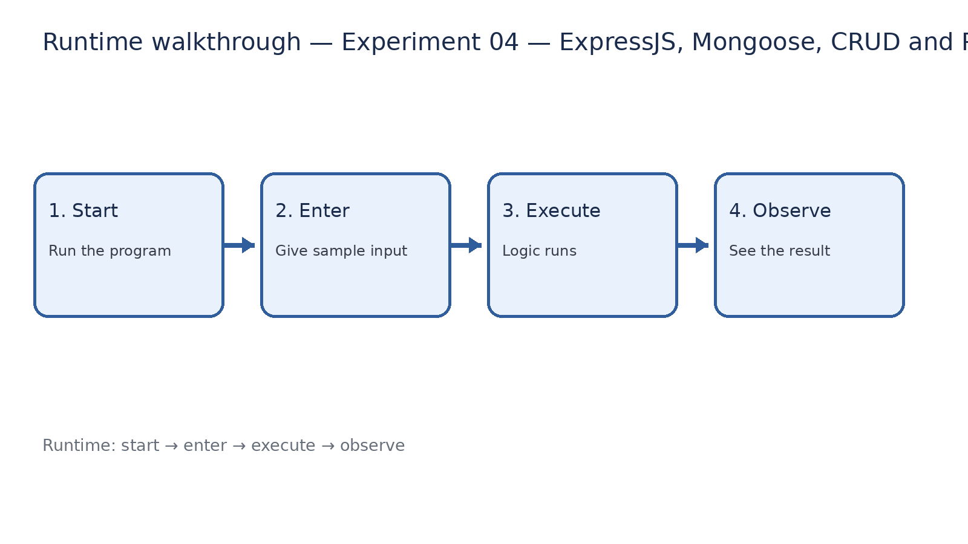
Runtime walkthrough
Start → enter input → execute → observe output

Slide 8
Expected result
Experiment 04 — ExpressJS, Mongoose, CRUD and REST API
INPUT
PROCESS
OUTPUT
Enter the sample values or open the required page / route.
The Express route, React component, hook, or MongoDB command performs the task.
Check the browser, terminal, API response, or database result.
Verification checklist
•
No syntax errors appear in the terminal.
•
The requested feature responds to the input.
•
The displayed / returned value matches the operation.

Slide 9
Viva preparation
•
What is the purpose of this experiment?
•
Which input is required?
•
Which line or command performs the main operation?
•
What output should you observe?
•
What happens when the input changes?

