Slide 1
ReactJS Render HTML, JSX, Function and Class Components
FSD2 Lab • Experiment 05

Slide 2
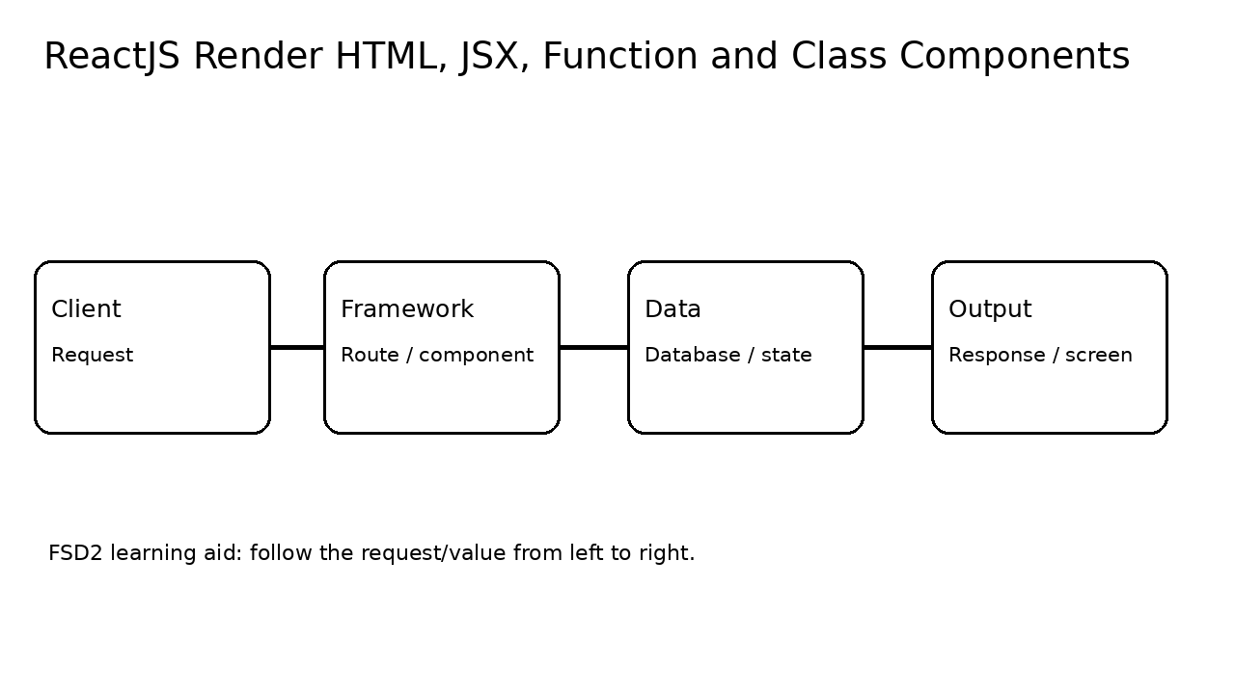
Syllabus tasks
Render HTML to a web page.
Write markup with JSX.
Create and nest function and class components.

Slide 3
How it works

Slide 4
Code pathway
index.html:1 <!doctype html><html><head><meta charset="UTF-8"><meta name="viewport" content="width=device-width,initial-scale=1"><title>FSD2 React Experiment 05</title></head><body><div id="root"></div><script type="module" src="/src/main.jsx"></script></body></html>

Slide 5
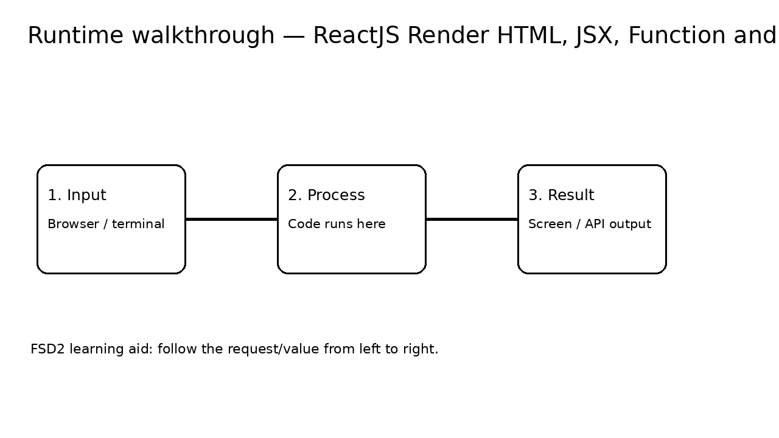
Runtime / expected output

Slide 6
Run it
From repository root: see 05-react-render-html-jsx-components/README.md
Keep the terminal open while testing the browser or API.
For MongoDB, use mongosh or Atlas as described in the README.

Slide 7
Viva points
What is the input?
Which line performs the main operation?
What is the output?
What changes if the input is changed?

