Slide 1
FSD2 LAB • EXPERIMENT 01
ExpressJS Routing, HTTP Methods, Middleware
Simple explanation • Clean code • Runtime pathway • Viva preparation
FSD2 Lab Materials

Slide 2
Syllabus tasks
•
Define a route, handle routes, route parameters, query parameters and
URL building.
•
Accept data, retrieve data and delete a specified resource using HTTP
methods.
•
Show the working of middleware.

Slide 3
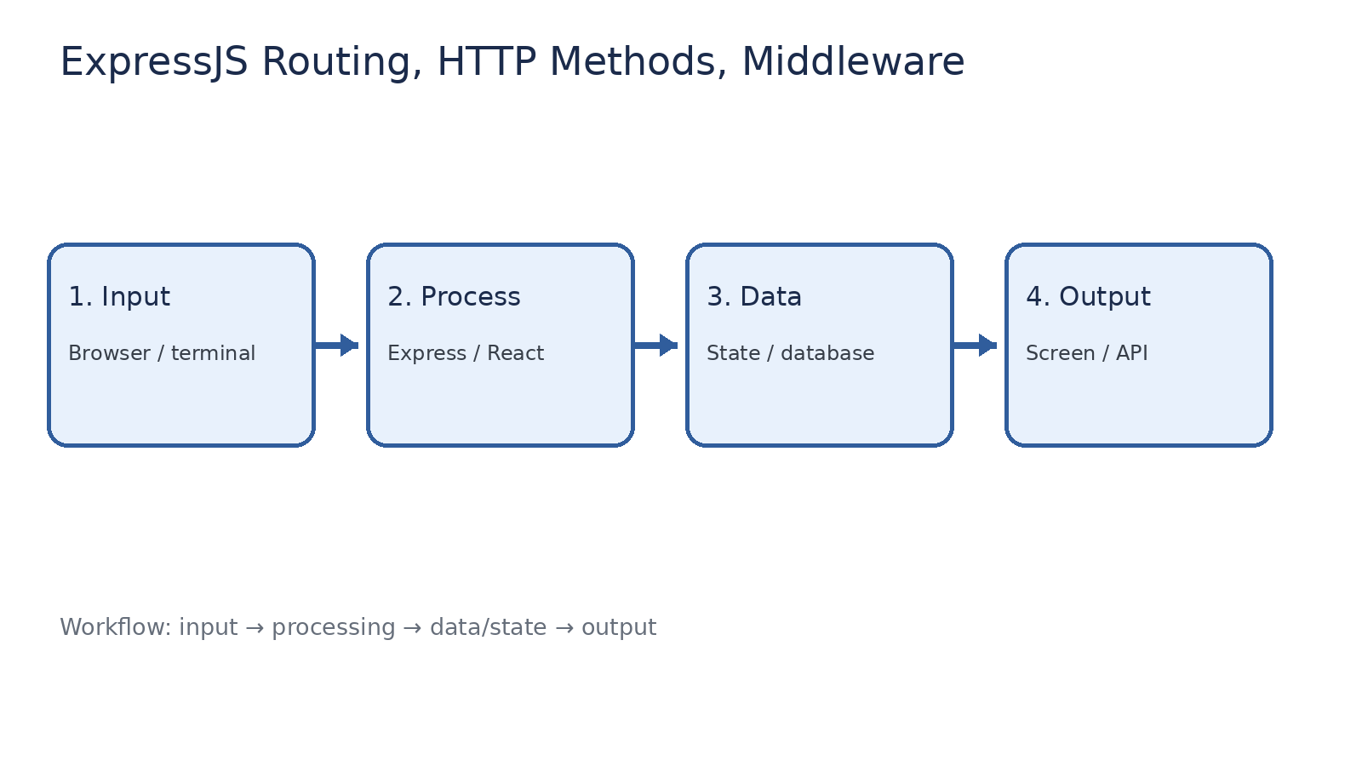
How it works
Input → processing → data/state → output

Slide 4
Code pathway 1
app.js • lines 1–10
1 const express = require('express');
2 const app = express();
3 const PORT = 3001;
4
5 app.use(express.json()); // Read JSON request bodies.
6
7 // Simple custom middleware: runs before the route handler.
8 app.use((req, res, next) => {
9 console.log(req.method, req.url); // Show method and URL in terminal.
10 next(); // Continue to the next middleware/route.

Slide 5
Code pathway 2
app.js • lines 11–20
11 });
12
13 let students = [{ id: 1, name: 'Rama' }];
14
15 app.get('/', (req, res) => {
16 res.send('FSD2 Express Lab is running');
17 });
18
19 // Route parameter: /students/1
20 app.get('/students/:id', (req, res) => {

Slide 6
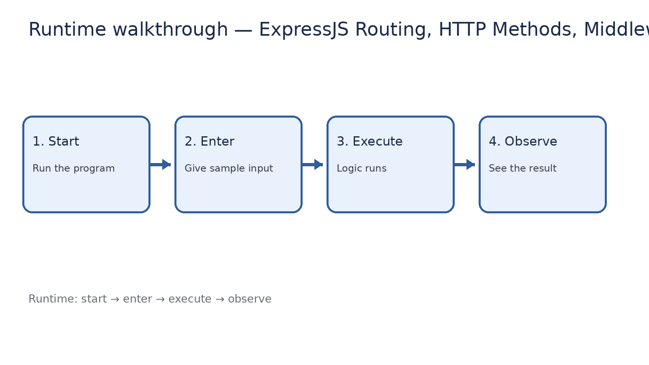
Runtime walkthrough
Start → enter input → execute → observe output

Slide 7
Expected result
ExpressJS Routing, HTTP Methods, Middleware
INPUT
PROCESS
OUTPUT
Enter the sample values or open the required page / route.
The Express route, React component, hook, or MongoDB command performs the task.
Check the browser, terminal, API response, or database result.
Verification checklist
•
No syntax errors appear in the terminal.
•
The requested feature responds to the input.
•
The displayed / returned value matches the operation.

Slide 8
Viva preparation
•
What is the purpose of this experiment?
•
Which input is required?
•
Which line or command performs the main operation?
•
What output should you observe?
•
What happens when the input changes?

