Slide 1
FSD2 LAB • EXPERIMENT 06
ReactJS Props, State, Styles and Events
Simple explanation • Clean code • Runtime pathway • Viva preparation
FSD2 Lab Materials

Slide 2
Syllabus tasks
•
Work with props and states.
•
Add CSS and Sass styling and display data.
•
Respond to events.

Slide 3
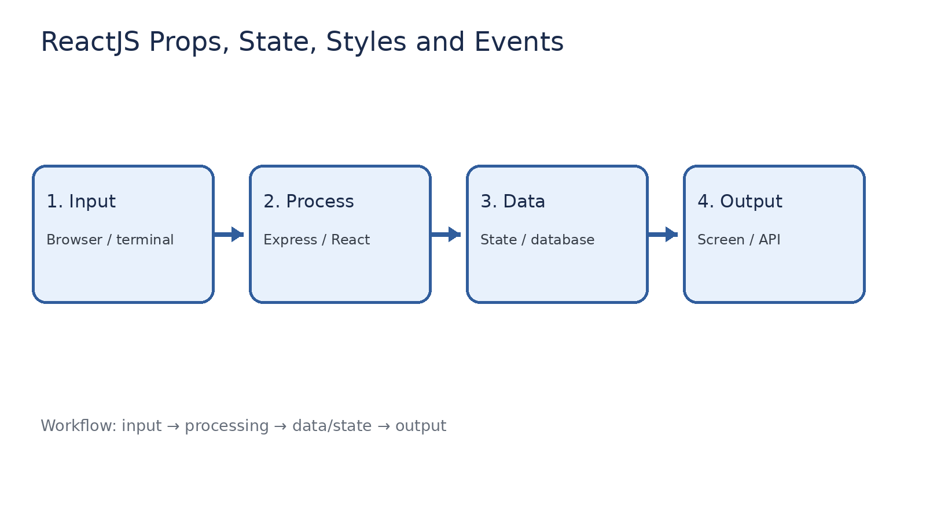
How it works
Input → processing → data/state → output

Slide 4
Code pathway 1
index.html • lines 1–1
1 <!doctype html><html><head><meta charset="UTF-8"><meta name="viewport"
content="width=device-width,initial-scale=1"><title>FSD2 React Experiment
06</title></head><body><div id="root"></div><script type="module"
src="/src/main.jsx"></script></body></html>

Slide 5
Code pathway 2
App.scss • lines 1–10
1 // Change this one variable to update the main theme color.
2 $primary-color: #6c5ce7;
3
4 :root {
5 --primary-color: #{$primary-color};
6 }
7
8 .app {
9 font-family: Arial, sans-serif;
10 max-width: 800px;

Slide 6
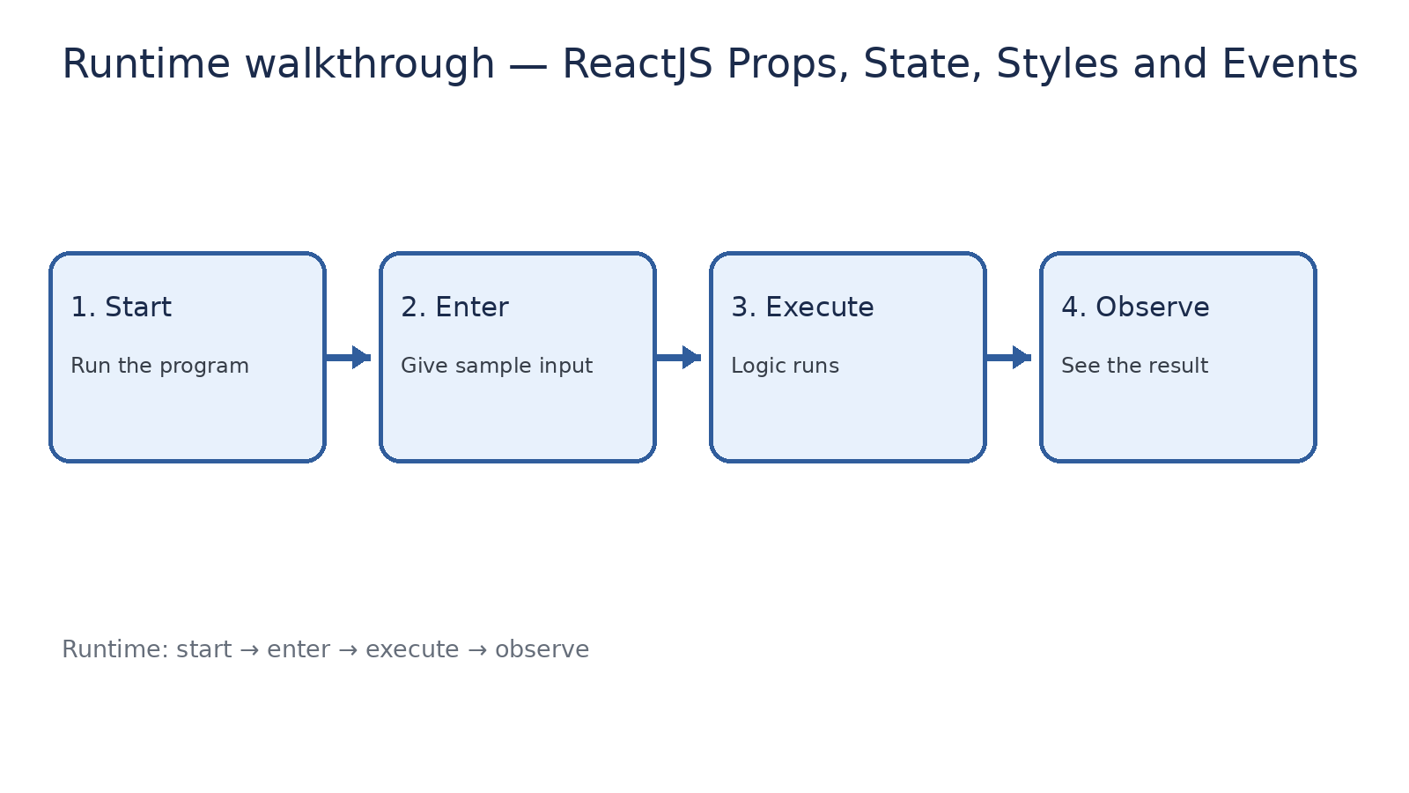
Runtime walkthrough
Start → enter input → execute → observe output

Slide 7
Expected result
ReactJS Props, State, Styles and Events
INPUT
PROCESS
OUTPUT
Enter the sample values or open the required page / route.
The Express route, React component, hook, or MongoDB command performs the task.
Check the browser, terminal, API response, or database result.
Verification checklist
•
No syntax errors appear in the terminal.
•
The requested feature responds to the input.
•
The displayed / returned value matches the operation.

Slide 8
Viva preparation
•
What is the purpose of this experiment?
•
Which input is required?
•
Which line or command performs the main operation?
•
What output should you observe?
•
What happens when the input changes?

