Slide 1
FSD2 LAB • EXPERIMENT 07
ReactJS Conditional Rendering, Lists and React Forms
Simple explanation • Clean code • Runtime pathway • Viva preparation
FSD2 Lab Materials

Slide 2
Syllabus tasks
Part 1
•
Implement conditional rendering.
•
Render lists.
•
Work with different form fields using React forms.
•
Added `EventDemo` with a `name` state starting as an empty string.
•
Added a controlled text input using `value` and `onChange`.

Slide 3
Syllabus tasks
Part 2
•
The page immediately displays `Hello, {name}!` while the user types,
with no submit button.

Slide 4
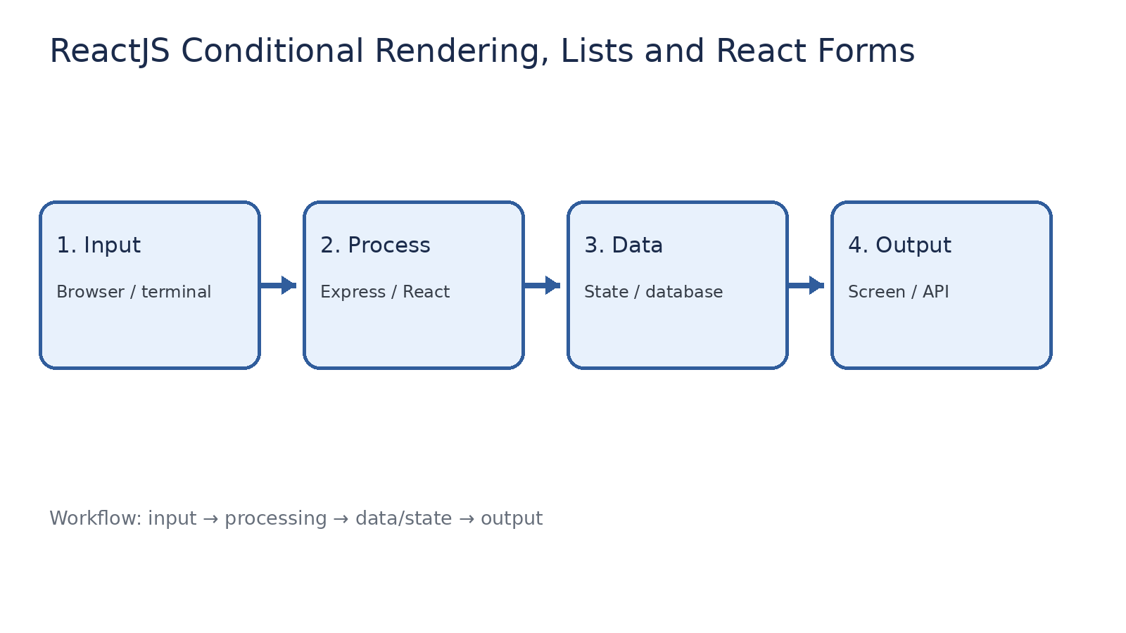
How it works
Input → processing → data/state → output

Slide 5
Code pathway 1
index.html • lines 1–1
1 <!doctype html><html><head><meta charset="UTF-8"><meta name="viewport"
content="width=device-width,initial-scale=1"><title>FSD2 React Experiment
07</title></head><body><div id="root"></div><script type="module"
src="/src/main.jsx"></script></body></html>

Slide 6
Code pathway 2
main.jsx • lines 1–10
1 import React, { useState } from 'react';
2 import { createRoot } from 'react-dom/client';
3
4 // Controlled input example: the input value is stored in React state.
5 function EventDemo() {
6 const [name, setName] = useState('');
7
8 return (
9 <section>
10 <h2>Live Name Greeting</h2>

Slide 7
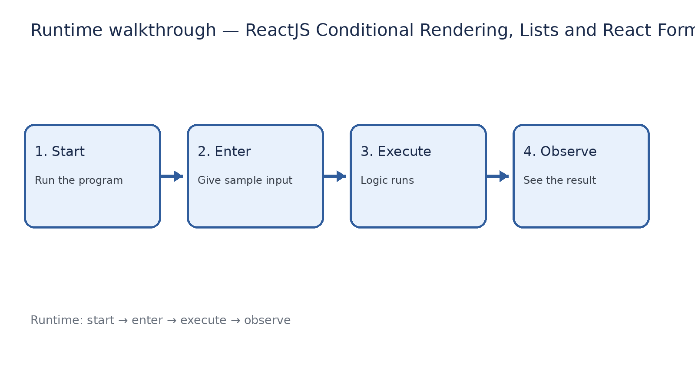
Runtime walkthrough
Start → enter input → execute → observe output

Slide 8
Expected result
ReactJS Conditional Rendering, Lists and React Forms
INPUT
PROCESS
OUTPUT
Enter the sample values or open the required page / route.
The Express route, React component, hook, or MongoDB command performs the task.
Check the browser, terminal, API response, or database result.
Verification checklist
•
No syntax errors appear in the terminal.
•
The requested feature responds to the input.
•
The displayed / returned value matches the operation.

Slide 9
Viva preparation
•
What is the purpose of this experiment?
•
Which input is required?
•
Which line or command performs the main operation?
•
What output should you observe?
•
What happens when the input changes?

