Slide 1
FSD2 LAB • EXPERIMENT 09
ReactJS Hooks and Sharing Data Between Components
Simple explanation • Clean code • Runtime pathway • Viva preparation
FSD2 Lab Materials

Slide 2
Syllabus tasks
•
Understand the importance of using hooks.
•
Share data between components.

Slide 3
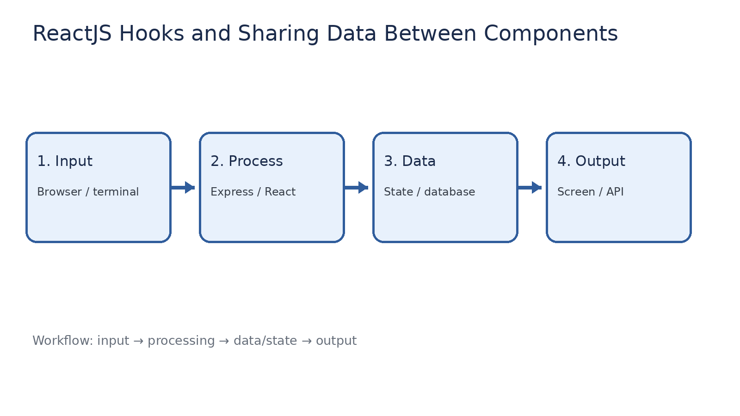
How it works
Input → processing → data/state → output

Slide 4
Code pathway 1
index.html • lines 1–1
1 <!doctype html><html><head><meta charset="UTF-8"><meta name="viewport"
content="width=device-width,initial-scale=1"><title>FSD2 React Experiment
09</title></head><body><div id="root"></div><script type="module"
src="/src/main.jsx"></script></body></html>

Slide 5
Code pathway 2
main.jsx • lines 1–10
1 import React, { createContext, useContext, useEffect, useState } from 'react';
2 import { createRoot } from 'react-dom/client';
3
4 const NameContext = createContext('Guest');
5
6 function Child() {
7 const name = useContext(NameContext); // Read shared data without prop drilling.
8 return <p>Child component received shared name: <b>{name}</b></p>;
9 }
10

Slide 6
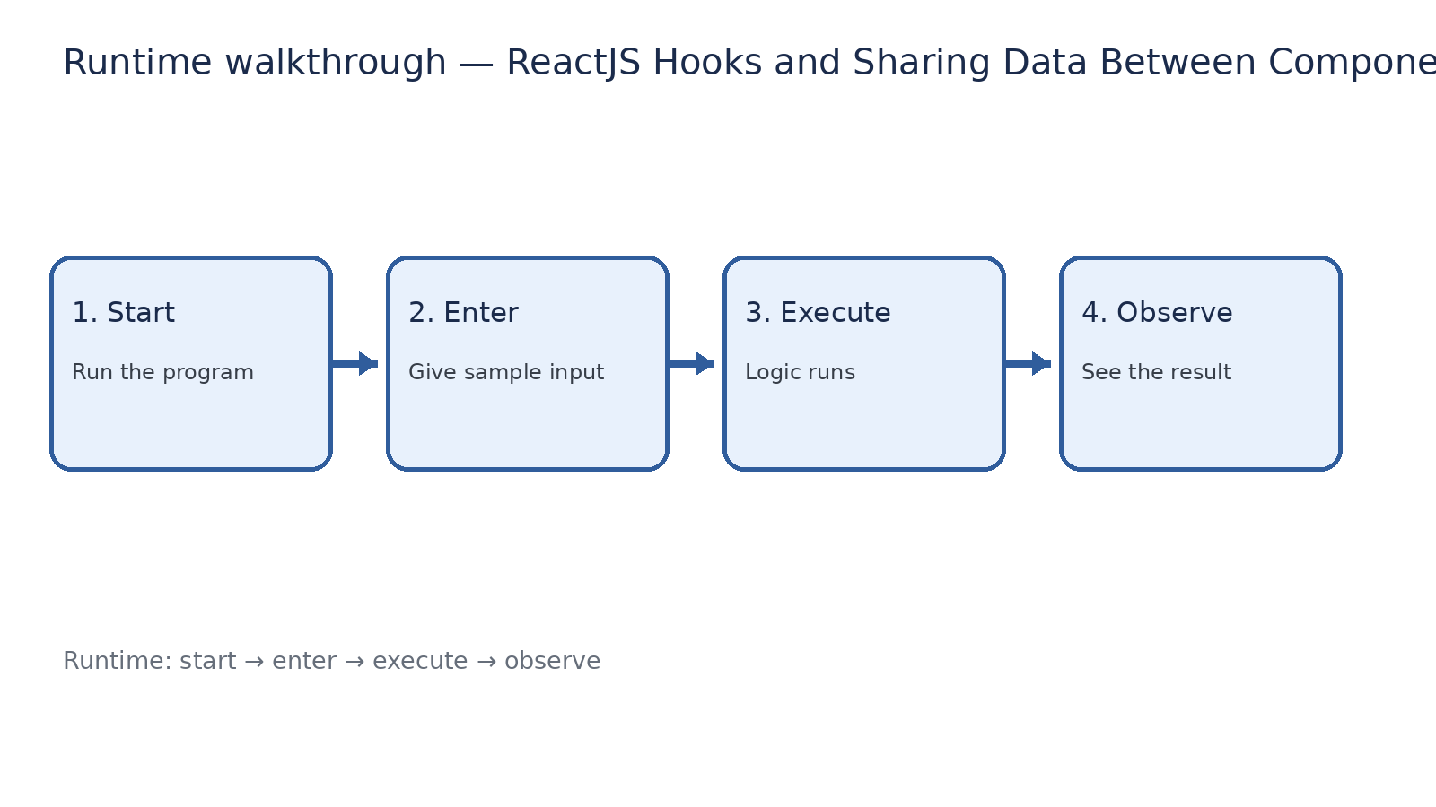
Runtime walkthrough
Start → enter input → execute → observe output

Slide 7
Expected result
ReactJS Hooks and Sharing Data Between Components
INPUT
PROCESS
OUTPUT
Enter the sample values or open the required page / route.
The Express route, React component, hook, or MongoDB command performs the task.
Check the browser, terminal, API response, or database result.
Verification checklist
•
No syntax errors appear in the terminal.
•
The requested feature responds to the input.
•
The displayed / returned value matches the operation.

Slide 8
Viva preparation
•
What is the purpose of this experiment?
•
Which input is required?
•
Which line or command performs the main operation?
•
What output should you observe?
•
What happens when the input changes?

