Slide 1
FSD2 LAB • EXPERIMENT 10
MongoDB Installation, Configuration and CRUD Operations
Simple explanation • Clean code • Runtime pathway • Viva preparation
FSD2 Lab Materials

Slide 2
Syllabus tasks
•
Install MongoDB and configure Atlas.
•
Perform CRUD operations using `insert()`, `find()`, `update()` and
`remove()`.

Slide 3
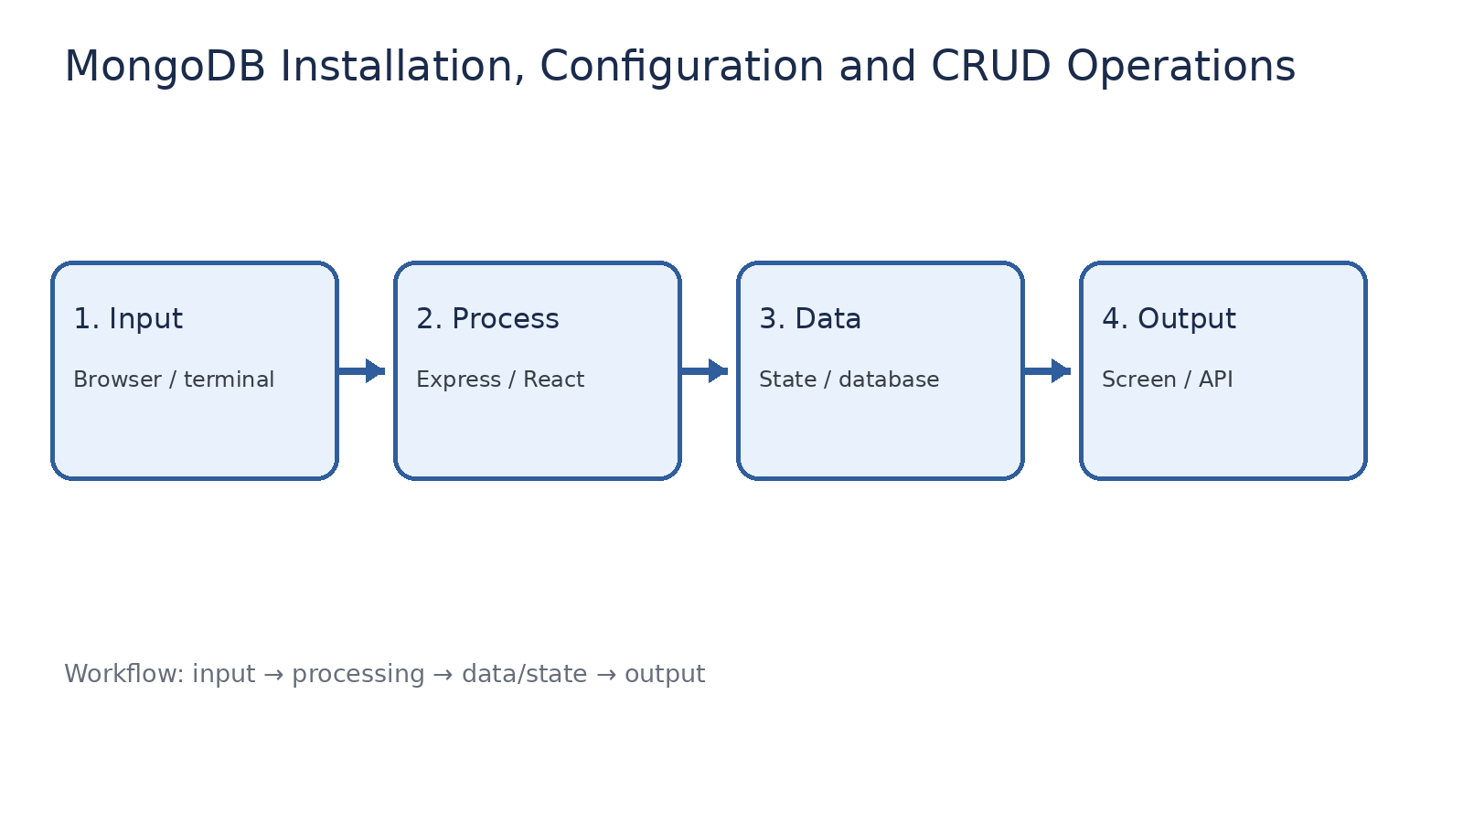
How it works
Input → processing → data/state → output

Slide 4
Code pathway 1
queries.js • lines 1–10
1 // FSD2 MongoDB CRUD lab. Run this file in mongosh.
2 use fsd2lab;
3
4 // INSERT: syllabus uses insert(); modern MongoDB also supports insertOne().
5 db.students.insertOne({ name: 'Rama', branch: 'CSE', year: 3 });
6 db.students.insertOne({ name: 'Gandhi', branch: 'CSE', year: 3 });
7
8 // FIND records.
9 db.students.find();
10 db.students.find({ branch: 'CSE' });

Slide 5
Code pathway 2
queries.js • lines 11–19
11
12 // UPDATE: syllabus says update(); modern form is updateOne().
13 db.students.updateOne({ name: 'Rama' }, { $set: { year: 4 } });
14
15 // REMOVE: syllabus says remove(); modern form is deleteOne().
16 db.students.deleteOne({ name: 'Gandhi' });
17
18 // Check the final data.
19 db.students.find();

Slide 6
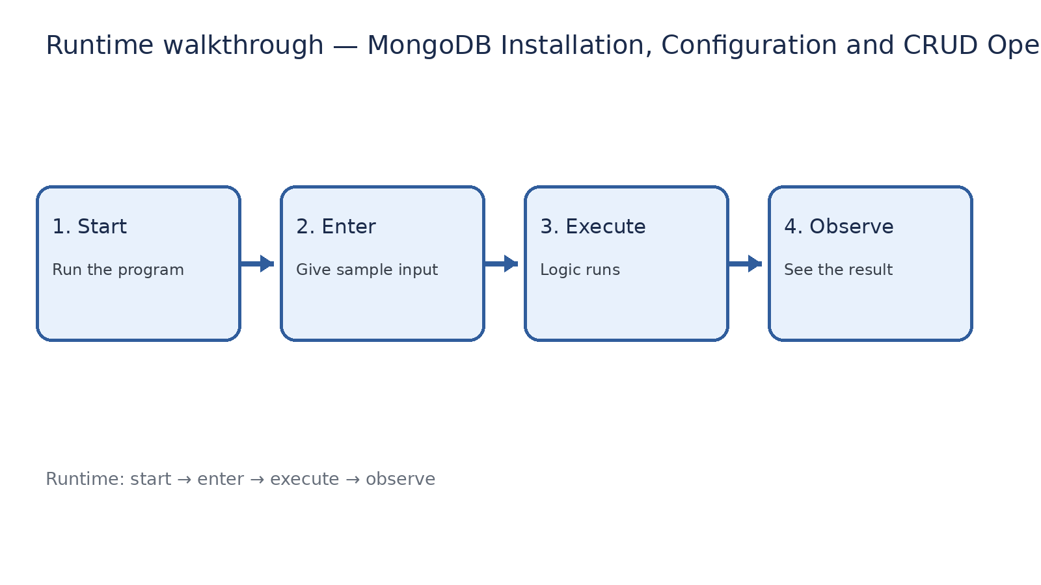
Runtime walkthrough
Start → enter input → execute → observe output

Slide 7
Expected result
MongoDB Installation, Configuration and CRUD Operations
INPUT
PROCESS
OUTPUT
Enter the sample values or open the required page / route.
The Express route, React component, hook, or MongoDB command performs the task.
Check the browser, terminal, API response, or database result.
Verification checklist
•
No syntax errors appear in the terminal.
•
The requested feature responds to the input.
•
The displayed / returned value matches the operation.

Slide 8
Viva preparation
•
What is the purpose of this experiment?
•
Which input is required?
•
Which line or command performs the main operation?
•
What output should you observe?
•
What happens when the input changes?

