Slide 1
FSD2 LAB • EXPERIMENT 11
MongoDB Databases, Collections and Records
Simple explanation • Clean code • Runtime pathway • Viva preparation
FSD2 Lab Materials

Slide 2
Syllabus tasks
•
Create and drop databases and collections.
•
Work with records using `find()`, `limit()`, `sort()`, `createIndex()`
and `aggregate()`.

Slide 3
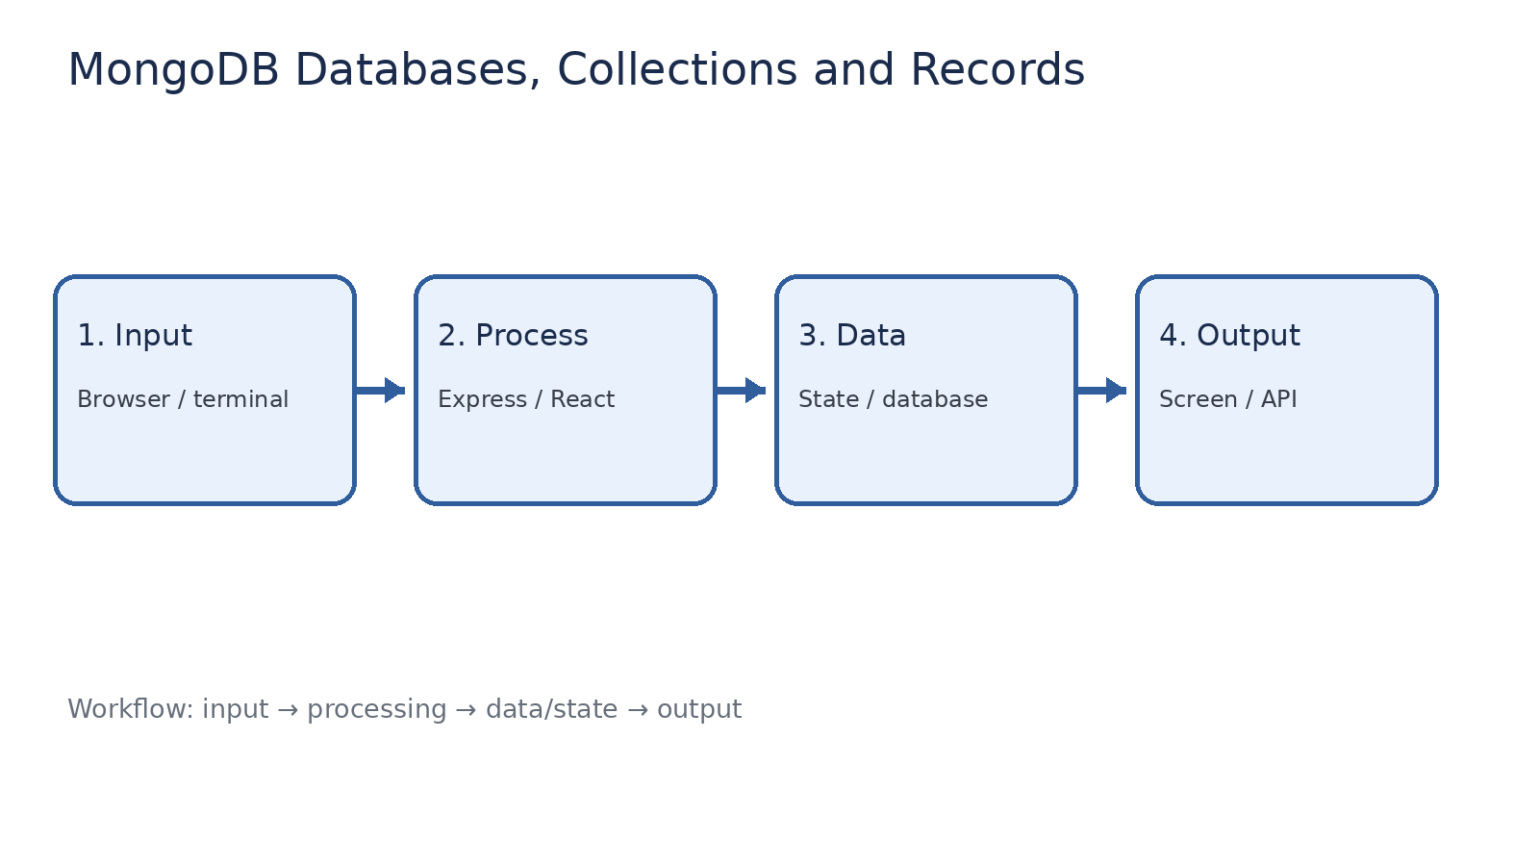
How it works
Input → processing → data/state → output

Slide 4
Code pathway 1
queries.js • lines 1–10
1 // Database and collection operations.
2 use fsd2records;
3 db.createCollection('students');
4
5 db.students.insertMany([
6 { name: 'Rama', marks: 88, branch: 'CSE' },
7 { name: 'Gandhi', marks: 76, branch: 'CSE' },
8 { name: 'Roshni', marks: 92, branch: 'ECE' },
9 { name: 'Kiran', marks: 81, branch: 'CSE' }
10 ]);

Slide 5
Code pathway 2
queries.js • lines 11–20
11
12 // FIND records.
13 db.students.find();
14
15 // LIMIT records.
16 db.students.find().limit(2);
17
18 // SORT by marks, descending.
19 db.students.find().sort({ marks: -1 });
20

Slide 6
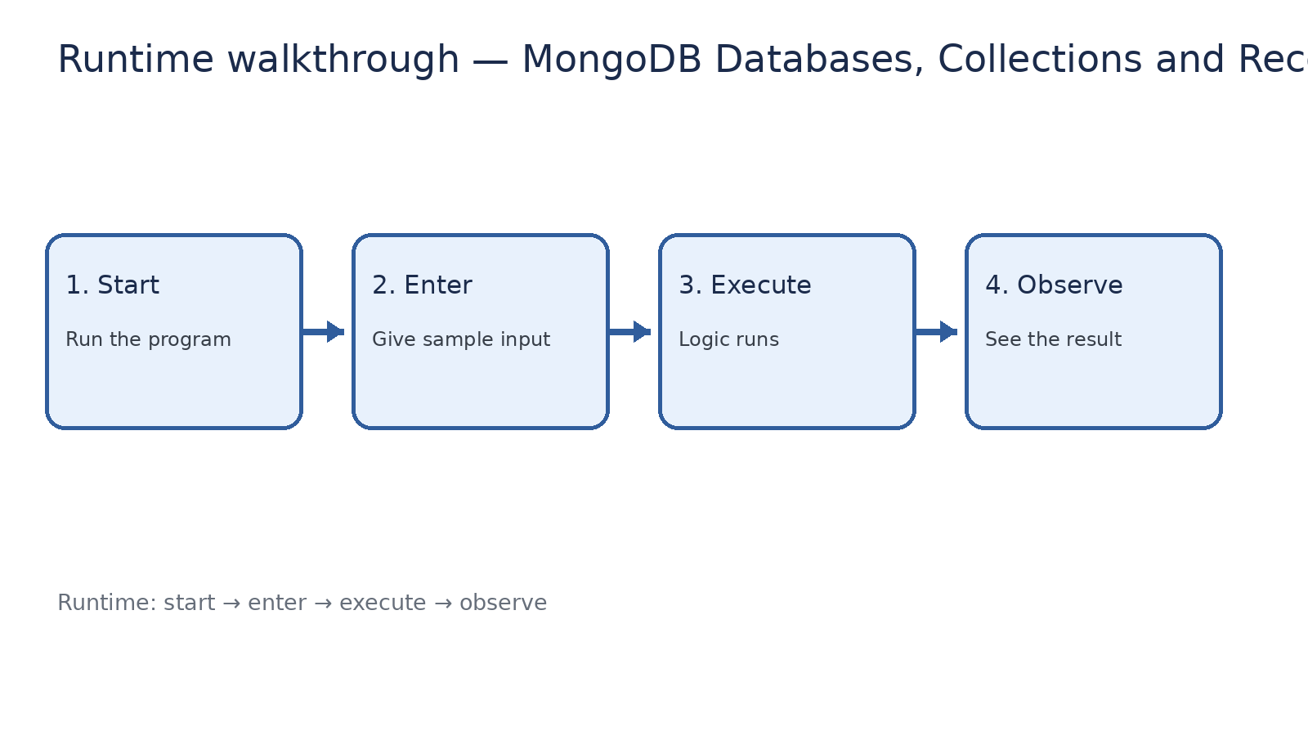
Runtime walkthrough
Start → enter input → execute → observe output

Slide 7
Expected result
MongoDB Databases, Collections and Records
INPUT
PROCESS
OUTPUT
Enter the sample values or open the required page / route.
The Express route, React component, hook, or MongoDB command performs the task.
Check the browser, terminal, API response, or database result.
Verification checklist
•
No syntax errors appear in the terminal.
•
The requested feature responds to the input.
•
The displayed / returned value matches the operation.

Slide 8
Viva preparation
•
What is the purpose of this experiment?
•
Which input is required?
•
Which line or command performs the main operation?
•
What output should you observe?
•
What happens when the input changes?

