Slide 1
FSD2 LAB • EXPERIMENT 03
ExpressJS Cookies, Sessions, Authentication
Simple explanation • Clean code • Runtime pathway • Viva preparation
FSD2 Lab Materials

Slide 2
Syllabus tasks
•
Write a program for session management using cookies and sessions.
•
Write a program for user authentication.

Slide 3
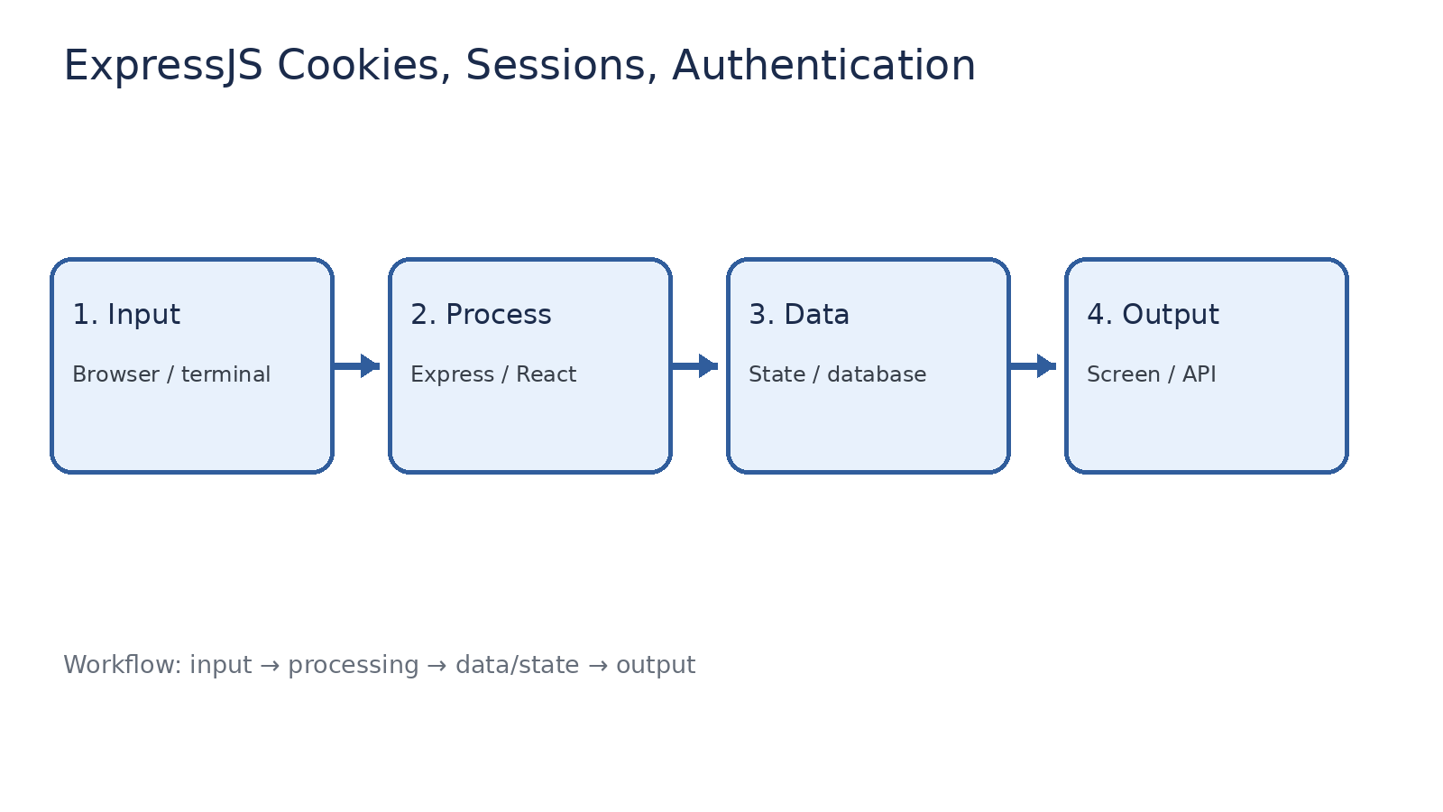
How it works
Input → processing → data/state → output

Slide 4
Code pathway 1
app.js • lines 1–10
1 const express = require('express');
2 const cookieParser = require('cookie-parser');
3 const session = require('express-session');
4 const app = express();
5 const PORT = 3003;
6
7 app.use(express.urlencoded({ extended: true }));
8 app.use(cookieParser()); // Reads cookies from the request.
9 app.use(session({
10 secret: 'fsd2-demo-secret',

Slide 5
Code pathway 2
app.js • lines 11–20
11 resave: false,
12 saveUninitialized: false,
13 }));
14
15 app.get('/', (req, res) => {
16 res.send(`<h2>FSD2 Authentication Demo</h2>
17 <form method="post" action="/login">
18 <input name="username" placeholder="username"><br>
19 <input name="password" type="password" placeholder="password"><br>
20 <button>Login</button>

Slide 6
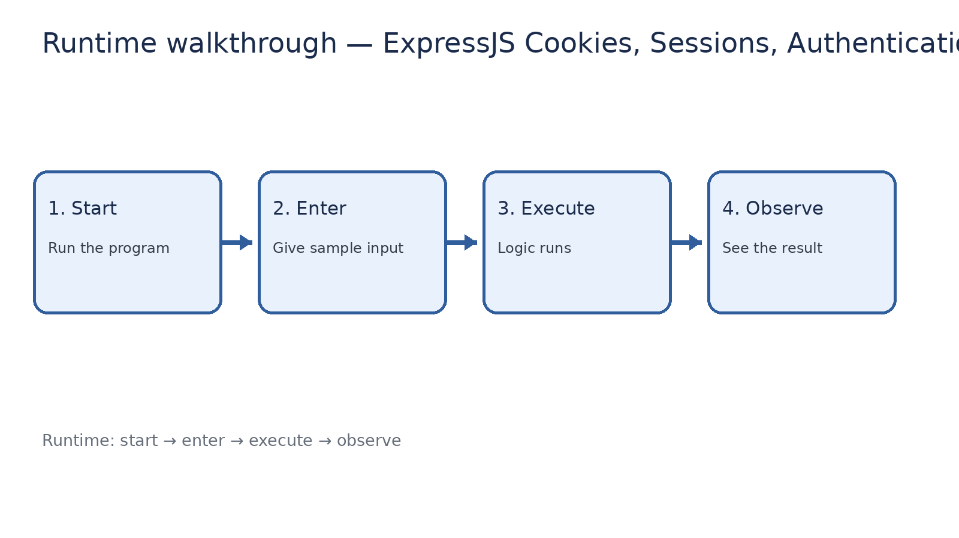
Runtime walkthrough
Start → enter input → execute → observe output

Slide 7
Expected result
ExpressJS Cookies, Sessions, Authentication
INPUT
PROCESS
OUTPUT
Enter the sample values or open the required page / route.
The Express route, React component, hook, or MongoDB command performs the task.
Check the browser, terminal, API response, or database result.
Verification checklist
•
No syntax errors appear in the terminal.
•
The requested feature responds to the input.
•
The displayed / returned value matches the operation.

Slide 8
Viva preparation
•
What is the purpose of this experiment?
•
Which input is required?
•
Which line or command performs the main operation?
•
What output should you observe?
•
What happens when the input changes?

