Slide 1
ExpressJS Database with Mongoose, CRUD, RESTful API
FSD2 Lab • Experiment 04

Slide 2
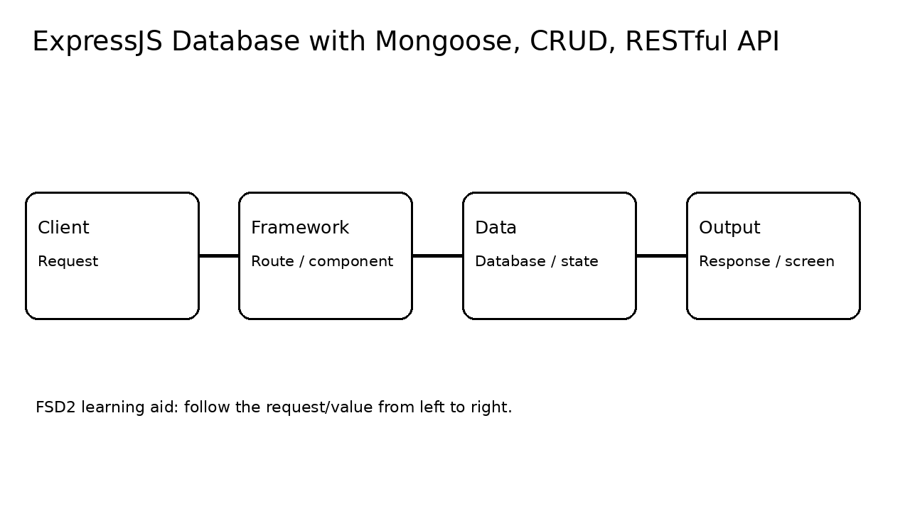
Syllabus tasks
Connect MongoDB using Mongoose and perform CRUD operations.
Develop a single page application using RESTful APIs.

Slide 3
How it works

Slide 4
Code pathway
server.js:1 const express = require('express');
server.js:2 const mongoose = require('mongoose');
server.js:3 const app = express();
server.js:4 const PORT = 3004;
server.js:5
server.js:6 app.use(express.json());
server.js:7
server.js:8 const productSchema = new mongoose.Schema({
server.js:9 name: String,
server.js:10 price: Number
server.js:11 });
server.js:12 const Product = mongoose.model('Product', productSchema);
server.js:13
server.js:14 // REST: GET all products.
server.js:15 app.get('/api/products', async (req, res) => {
server.js:16 res.json(await Product.find());
server.js:17 });
server.js:18
server.js:19 // REST: POST a product.
server.js:20 app.post('/api/products', async (req, res) => {
server.js:21 const product = await Product.create(req.body);
server.js:22 res.status(201).json(product);

Slide 5
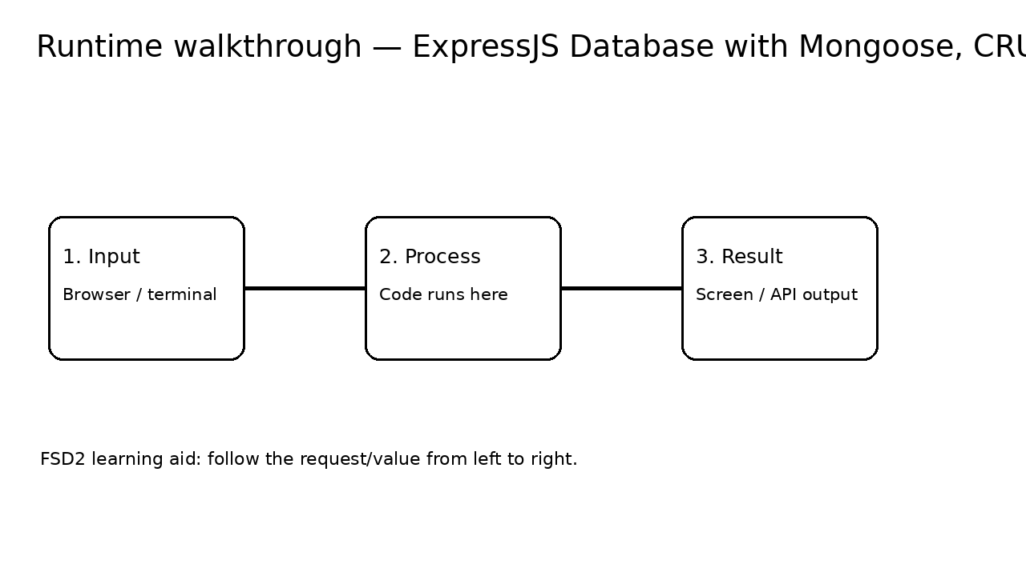
Runtime / expected output

Slide 6
Run it
From repository root: see 04-express-database-rest-api/README.md
Keep the terminal open while testing the browser or API.
For MongoDB, use mongosh or Atlas as described in the README.

Slide 7
Viva points
What is the input?
Which line performs the main operation?
What is the output?
What changes if the input is changed?

